Slide 1

A Project/Dissertation/Seminar Report
PRESENTATION
FAMEDD
SUBMITTED BY SUPERVISED BY
Mohd Hurmaan Siddiqui Mr. Syed Ali Mehdi
2021-310-152 Designation
BTECH CSE
SUBMITTED TO
Department of Computer Science & Engineering
School of Engineering Sciences & Technology
JAMIA HAMDARD

Slide 2

WELCOME
TO THE PROJECT

Slide 3

FAMEDD
GET YOUR SELF LIVE WITH THE HELP OF FAMEDD

Slide 4



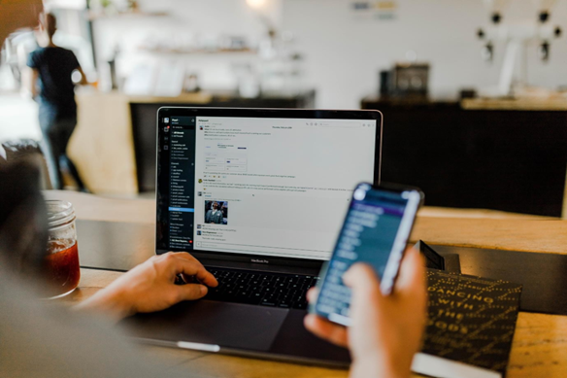




GETTING ONLINE
In today’s day and age doesn’t matter how big or small a business is, it
has become necessary for its owner to take it online.
Since by being on internet or so to say having your own website is the fastest and best way to be able to reach out to more people.
But how do you do that? How do you get yourself a cool looking website like the big multi million dollar companies without spending so much money?
If you also have all these question don’t worry we are here
to help you with all that all you need to do is
GET FAMEDD…

Slide 5

LIVE YOURSELF
idea behind the project title is to provide people a website which can help them to compete stay relevant by paying a price that they can afford.
GET FAMEDD…

Slide 6
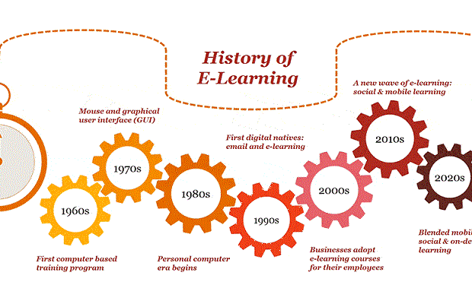
HISTORY
Where the Web was born. Tim Berners-Lee, a British scientist, invented the World Wide Web (WWW) in 1989, while working at CERN. The Web was originally conceived and developed to meet the demand for automated information-sharing between scientists in universities and institutes around the world.
Websites can be used in various fashions: a personal website, a corporate website for a company, a government website, an organization website, etc. Websites can be the work of an individual, a business or other organization, and are typically dedicated to a particular topic or purpose. Any website can contain a hyperlink to any other website, so the distinction between individual sites, as perceived by the user, can be blurred.

Slide 7
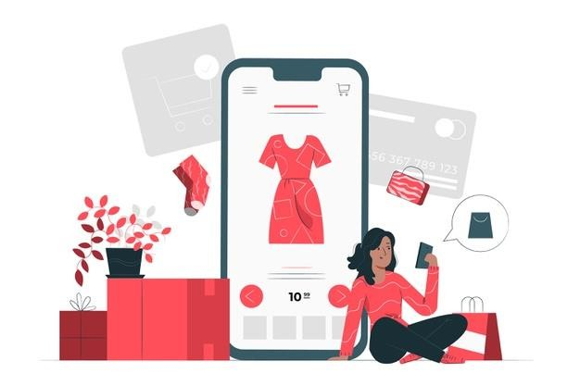
TECHNOLOGY PLATFORM
In this project, we are going to build a website for you by taking in your inputs on what you want.
By building website we mean we will be providing you firstly your UI based on the type of business you own
We will also provide you with your domain and domain security and will get your website online.
We will also provide you with a database which will help you to keep the data of the users that are accessing and coming to your website.
We will also provide you with your own QR code solutions.

Slide 8
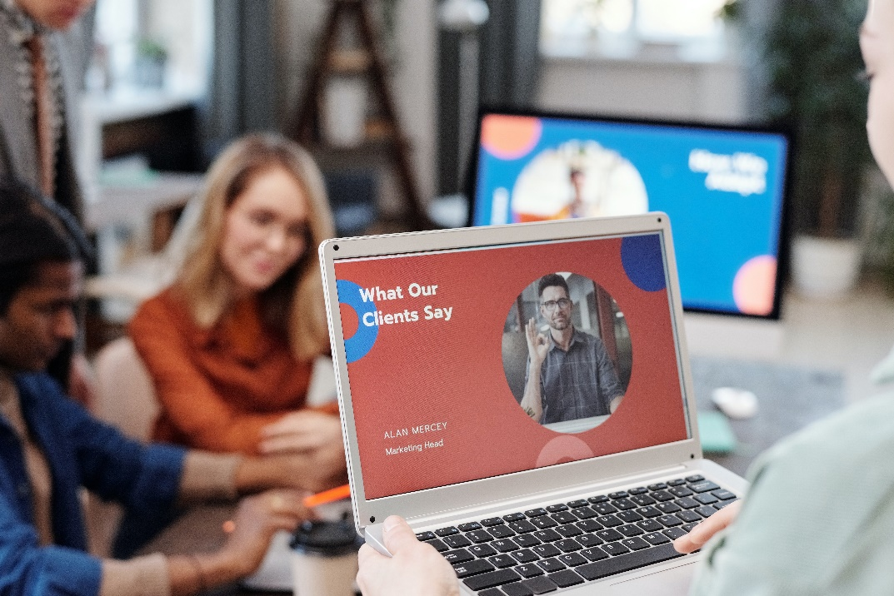
INTRODUCTION
“By 2025, India’s ecommerce
market is expected to cross
$200 billion, and there would be nearly 340 million ecommerce customers.” - Nikhil Vora, Sixth
Sense Ventures”
So with the amount of people coming online the potential for online businesses is increasing vastly and for businesses to still stay relevant and get more customers it has almost became a necessity for them to get
online.

Slide 9
IMPLEMENTATION
Hardware Interface:
1. Intel Processor
2. 60 MB of free hard-drive space
3. 128 MB of RAM
Software Interface:
1. Operating System: Windows (Vista/7 or above)
2. Web Browser: IE 10 or above, Mozilla FF 31 and above
or Google Chrome
3. Xampp platform

Slide 10
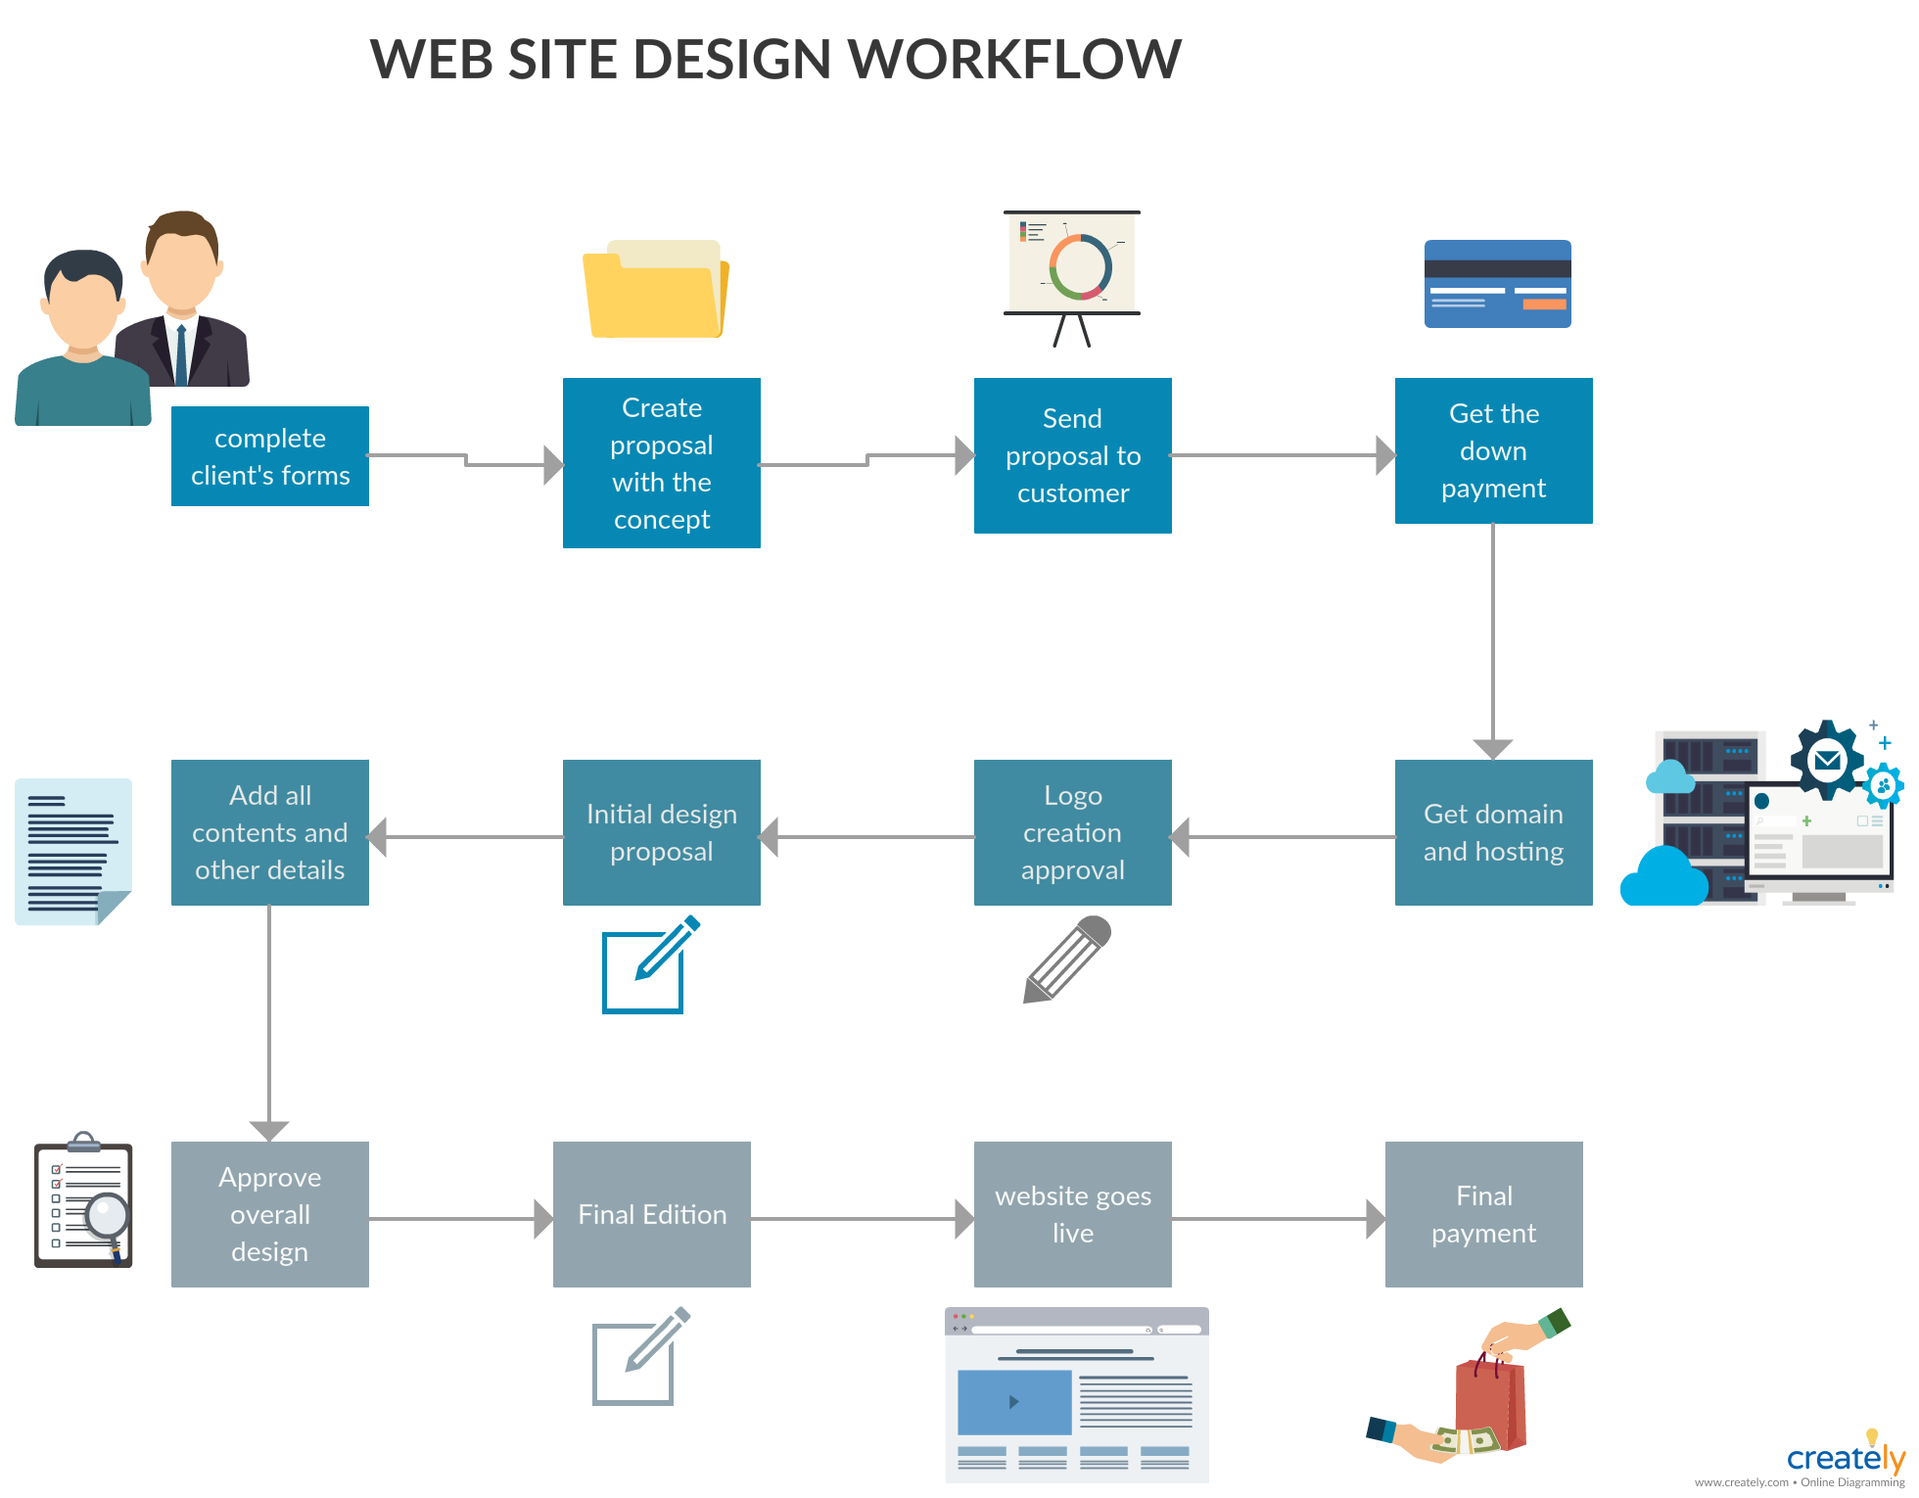
WORK FLOW

Slide 11

THANK YOU

