Slide 1

HELLO WORLD
FROM LONDONERS
Group 11
Bowen Zhang, Chia-Yin Lu, Fei Xu, Yunjing Hu
May 22th, 2019

Slide 2

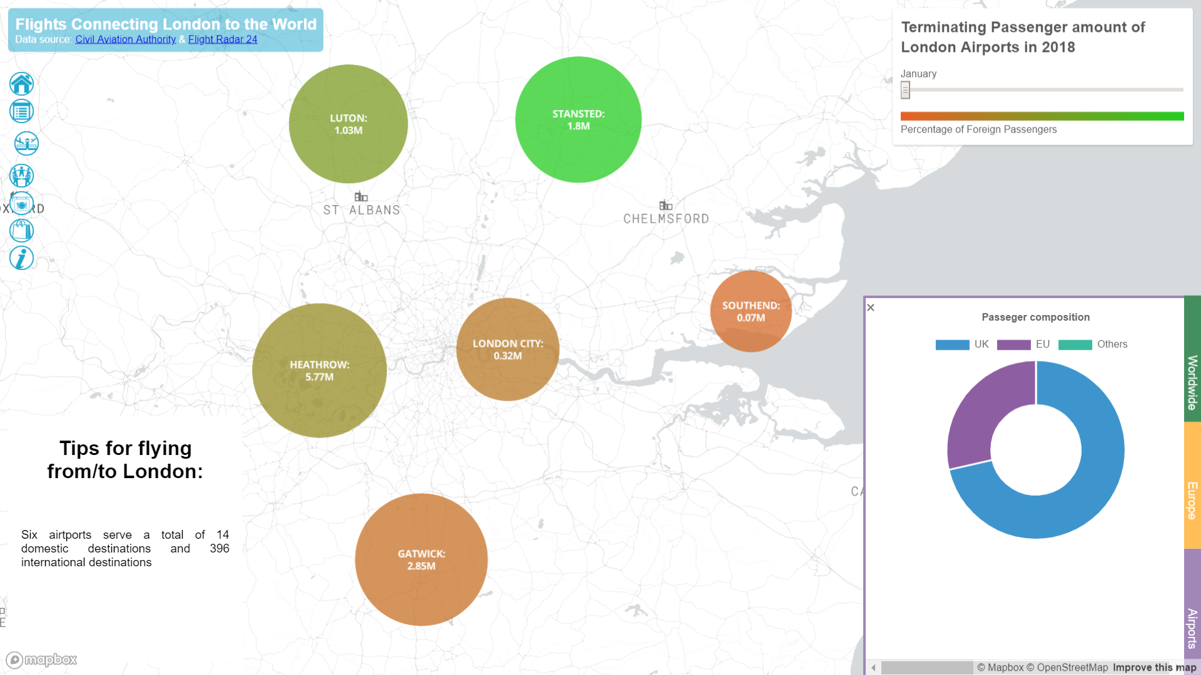
Worldwide Connection
Which airports in London is the most international one?
Which country in Europe/worldwide has the strongest connection with London by aviation.

Slide 3

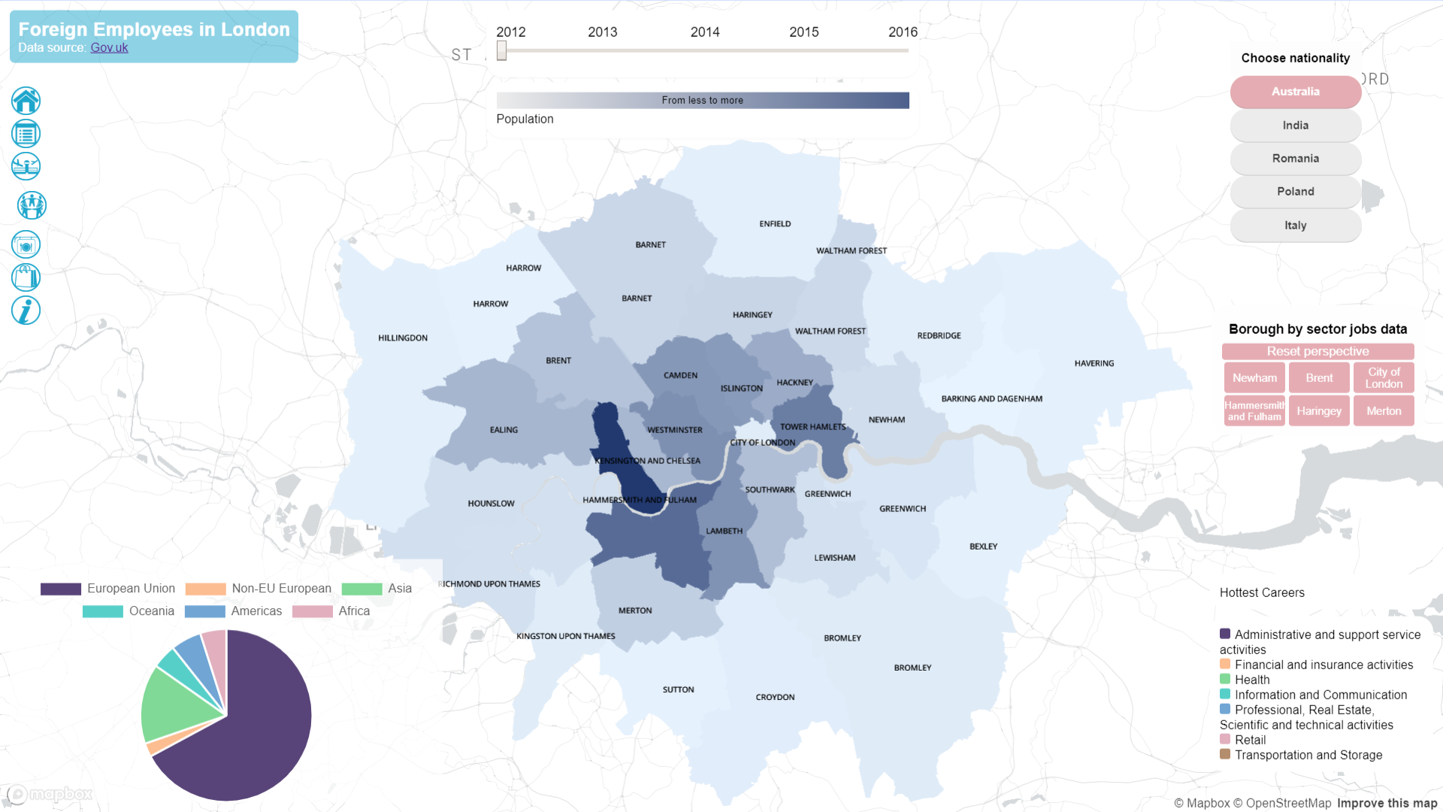
Cosmopolitan Community
How are people from the same country distributed in different boroughs in London?
Do people from the same country have a preference for a specified employee job?
How do the number of foreign employees change?

Slide 4

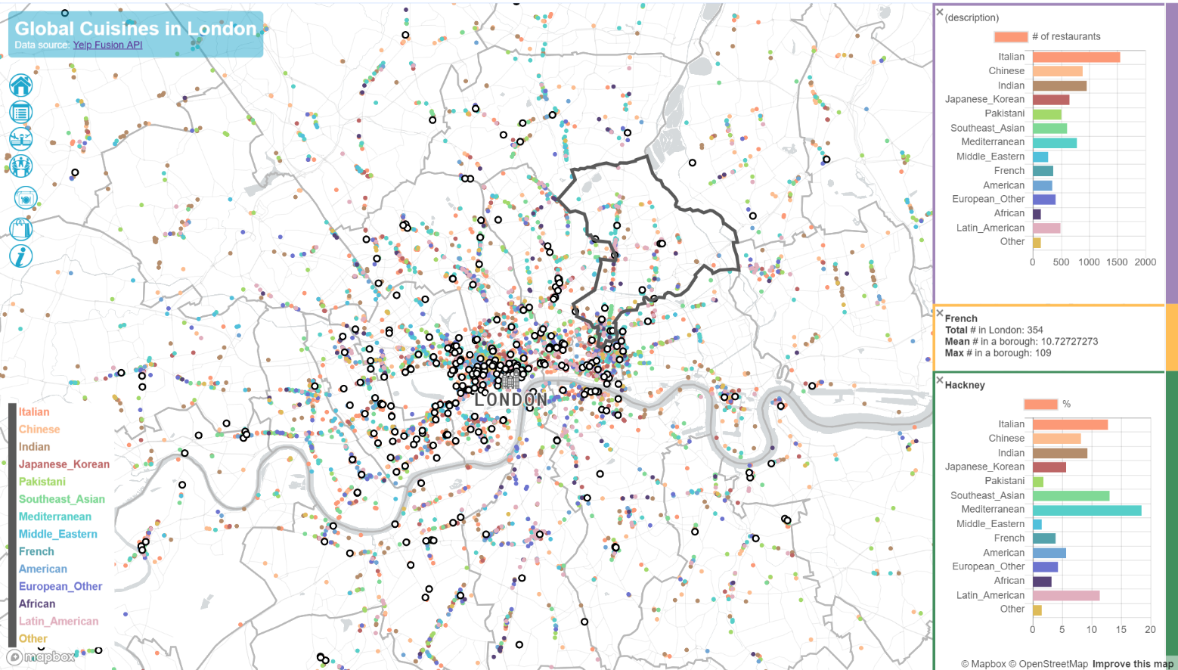
Global Foodcourt
What kinds of cuisines can you enjoy?
Where can you find them?
How are them distributed in different districts?

Slide 5

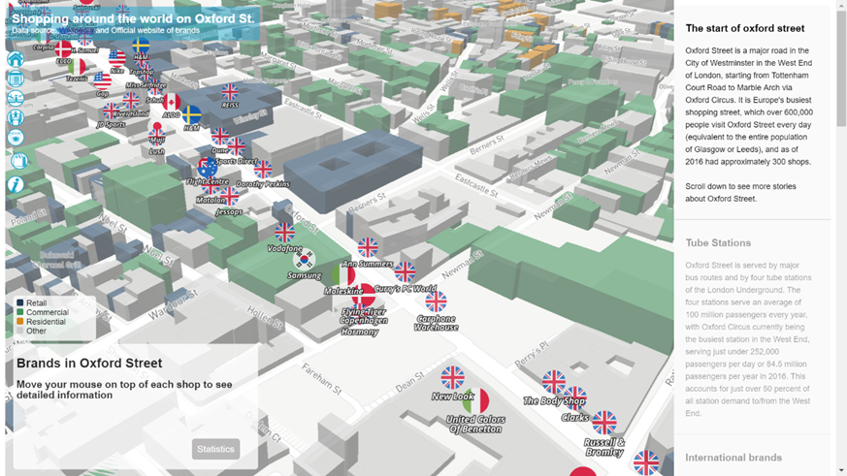
International Shopping Centre
Where are the shopping brands from?
When did they enter the UK market?
How many stores are there in the UK?

