Slide 1
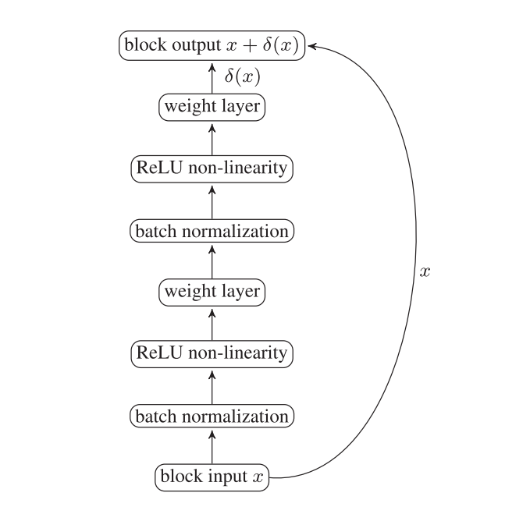


$$Loss=\sqrt{MMD^{2}(Φ\left(D_{1}\right), D_{2})}$$
$$MMD\left(F, p, q\right)=\sup_{\left\{f∈F\right\}}{{(E}_{\left\{x\sim p\right\}}f\left(x\right)−E_{\left\{y\sim q\right\}}f(y))}$$

