Slide 1
Morphological analysis of image processing
图像处理形态学分析
Fresh business general template
Applicable to enterprise introduction, summary report, sales marketing, chart data
组员：王昊飞 汪会 韩仲明 秦楷
汇报人：优品PPT

Slide 2
Basic morphology operation
01
基本形态学运算
目录
CONTENT
02
Morphological processing function in Matlab
Matlab中形态学处理函数
03
Application Analysis
应用分析

Slide 3
first part
Basic morphology operation

Slide 4
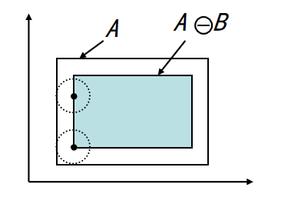
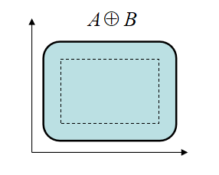
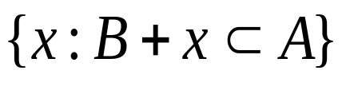
Corrosion and expansion
Corrosion
Represents the composition of all points x that translate(平移) B to x but still contained in A. If A is treated as an input image and B is treated as a structural element, in the process of translating the template, all the origins of the template that can be added to A are composed.
B
A B =
Expansion
It is a dual(对偶) operation of the corrosion operation, Translate(平移) b of structure element B to get B_{b}. If B_{b} hits A, write down this b point. A is expressed by B expansion as
A B={b| B_{b A} A }
十
A B

Slide 5





Open and close
Open
The result of A being first corroded and then expanded by B. It is recorded as:
A B A B
Close
The result of A being first expanded and then corroded by B. It is recorded as:
A

Slide 6
Second part
Morphological processing function in Matlab

Slide 7
Partial morphological processing function
Expansion
IM2=imdilate(IM,SE) % Inflate grayscale(灰度), binary(二值), and compressed binary images
IM2=imdilate(IM,NHOOD) %Inflating the structural elements specified by NHOOD
IM2=imdilate(IM,SE,PACKOPT,M)%Inflating the original uncompressed image with a line dimension of M
Corrosion
IM2=imerode(IM,SE) %corrosion
IM2=imerode(IM,NHOOD)
IM2=imerode(IM,SE,PACKOPT,M)
IM2=imclose(IM,SE)%close
IM2=imclose(IM,NHOOD)
IM2=imopen(IM,SE)%open
IM2=imopen(IM,NHOOD)
Structural element
SE=strel(shape, parameters)% Structure creation function shape is the shape of the created structural element. it includes ’ball’(球)、’disk’(盘)、’line’(线)、’diamod’(菱形) etc ,parameters is to specify the shape information.
……

Slide 8
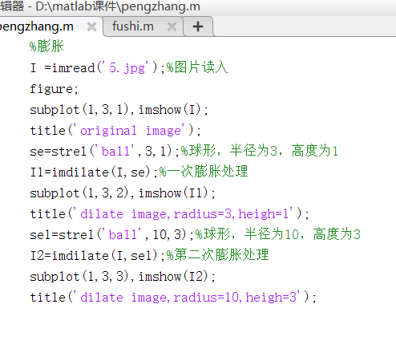
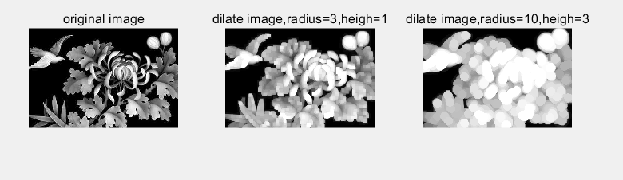
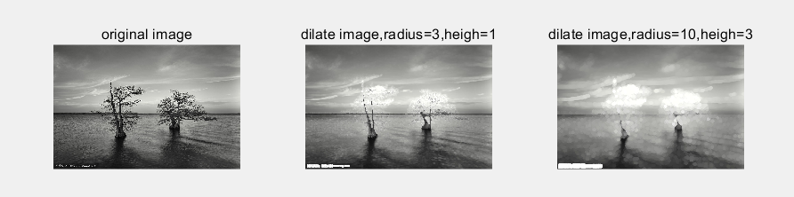

Slide 9
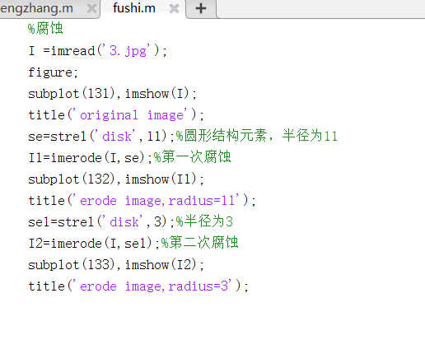
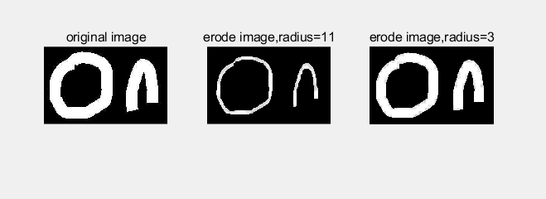
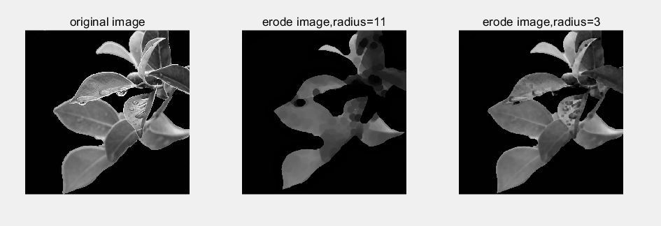

Slide 10
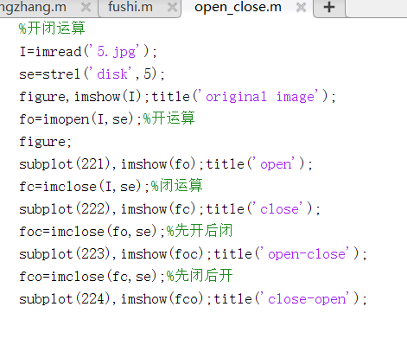
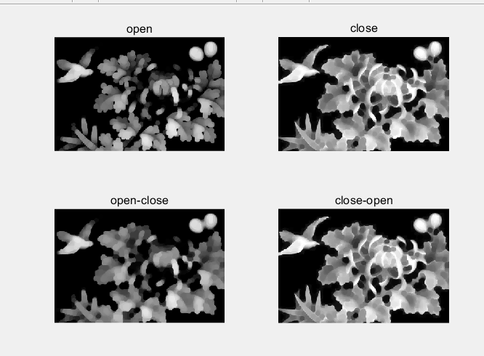
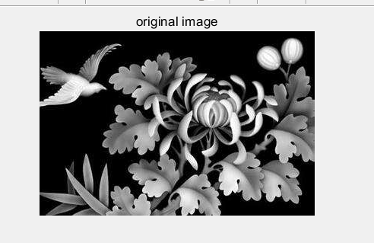

Slide 11
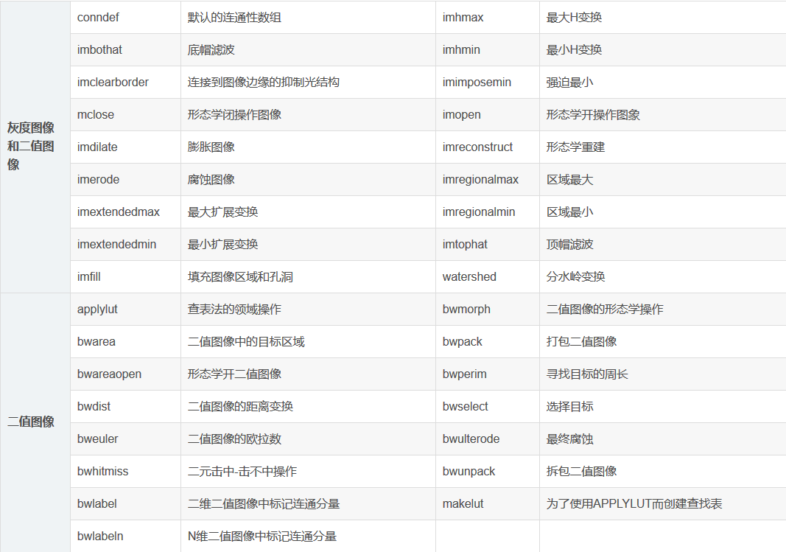
添加标题
请在此添加文字说明，编辑文字。
添加标题
请在此添加文字说明，编辑文字。

Slide 12
Third part
Application Analysis

Slide 13
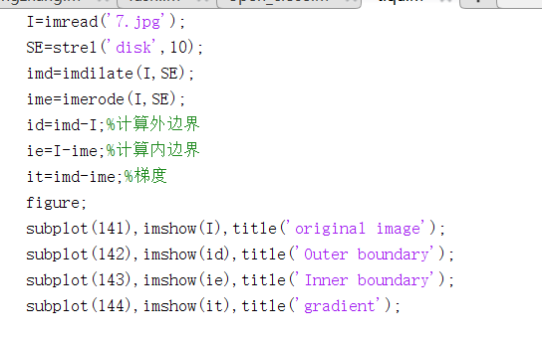
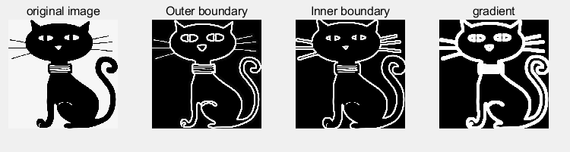

Expansion and corrosion
Boundary extraction and morphological gradient(梯度)
Etching or expanding the target image and comparing the difference between the resulting image and the original image.
Gradient: The difference between the expansion map and the corrosion map, retaining the edge contour of the object. (物体的边缘轮廓)

Slide 14
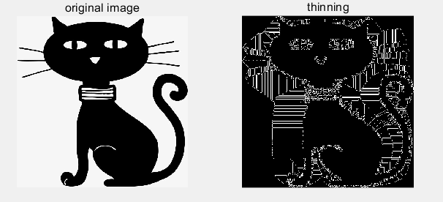
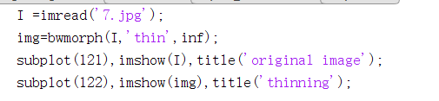
2. Image refinement(细化)
The refinement of the image is actually a gradual process of etching, one pixel(像素) at a time from the edge of the image until the corrosion position cannot continue.
bwmorph(image,p,n) % The first image input image (binary image), the second p represents the different operation mode, and the third n performs the operation.
Refinement must be: p=‘thin’, n=inf.

Slide 15
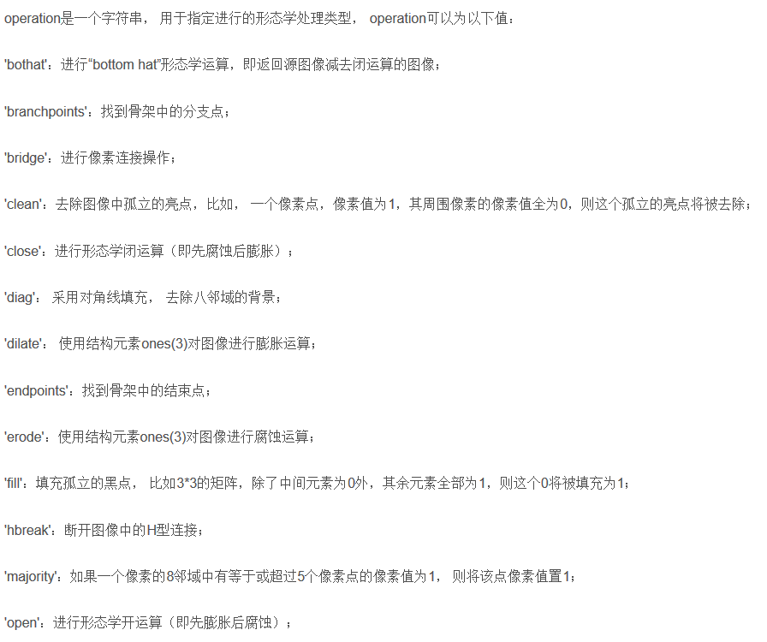
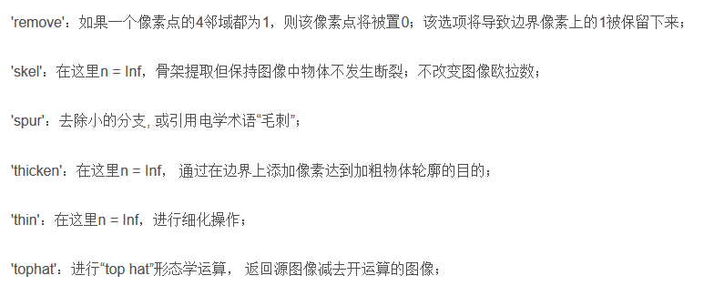
添加标题
请在此添加文字说明，编辑文字。
添加标题
请在此添加文字说明，编辑文字。

Slide 16
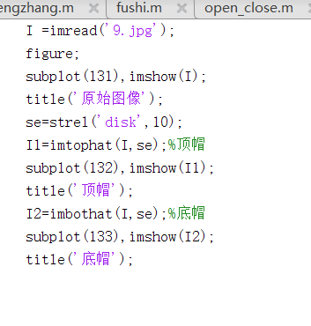
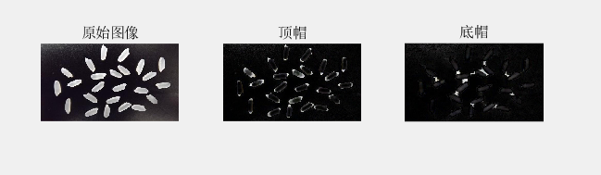
Image opening and closing operation
Change of top hat and bottom cap
Top hat: the difference between the original image and the result of the open operation IM2 = imtophat(IM,SE)
Bottom cap: the difference between the result image of the closed operation and the original image
IM2 = imbothat(IM,SE)

Slide 17
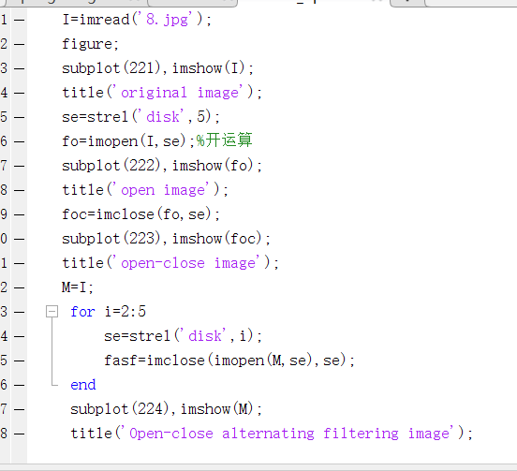
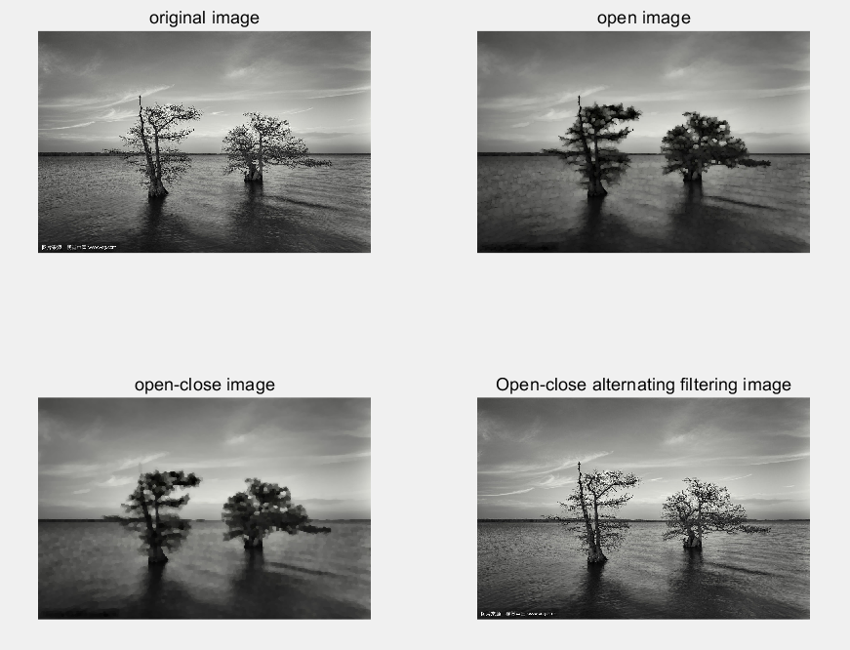
On: smoothes the outline of the object, breaks the narrow connection, and removes the small protruding parts.
Closed: Smoothes the outline, connects narrow places, and fills in small parts.

Slide 18
Thanks for watching

