Slide 1
Data Mining Final Project 2021
👱‍♂️Aleksander Wojnarowicz(AW77438)
👱‍♀️Yuqing Liu(YL110057)

Slide 2

1.1 Motivation
In the past few years, people have used intuition to distinguish fake job postings. For example, unusually high salaries may suggest false job postings. Nowadays, big data technology allows us to process these usage models to release job data more reliably and identify fake data. The goal of our project is to train a classifier to identify fake or real job postings using functions such as salary range, benefits, Required_experience, Required_education, etc.
1.2 Dataset Description
This dataset contains 18K job descriptions out of which about 800 are fake. The data consists of both textual information and meta-information about the jobs. The dataset can be used to create classification models which can learn the job descriptions which are fraudulent.
Link: https://www.kaggle.com/shivamb/real-or-fake-fake-jobposting-prediction
1.3 Description of Task
Our task is to bulid some models to predict whether the job is fake or not.
1.4 Descripe Target Variables
fraudulent - the job is fake or not? (binary: 'yes', 'no’)

Slide 3
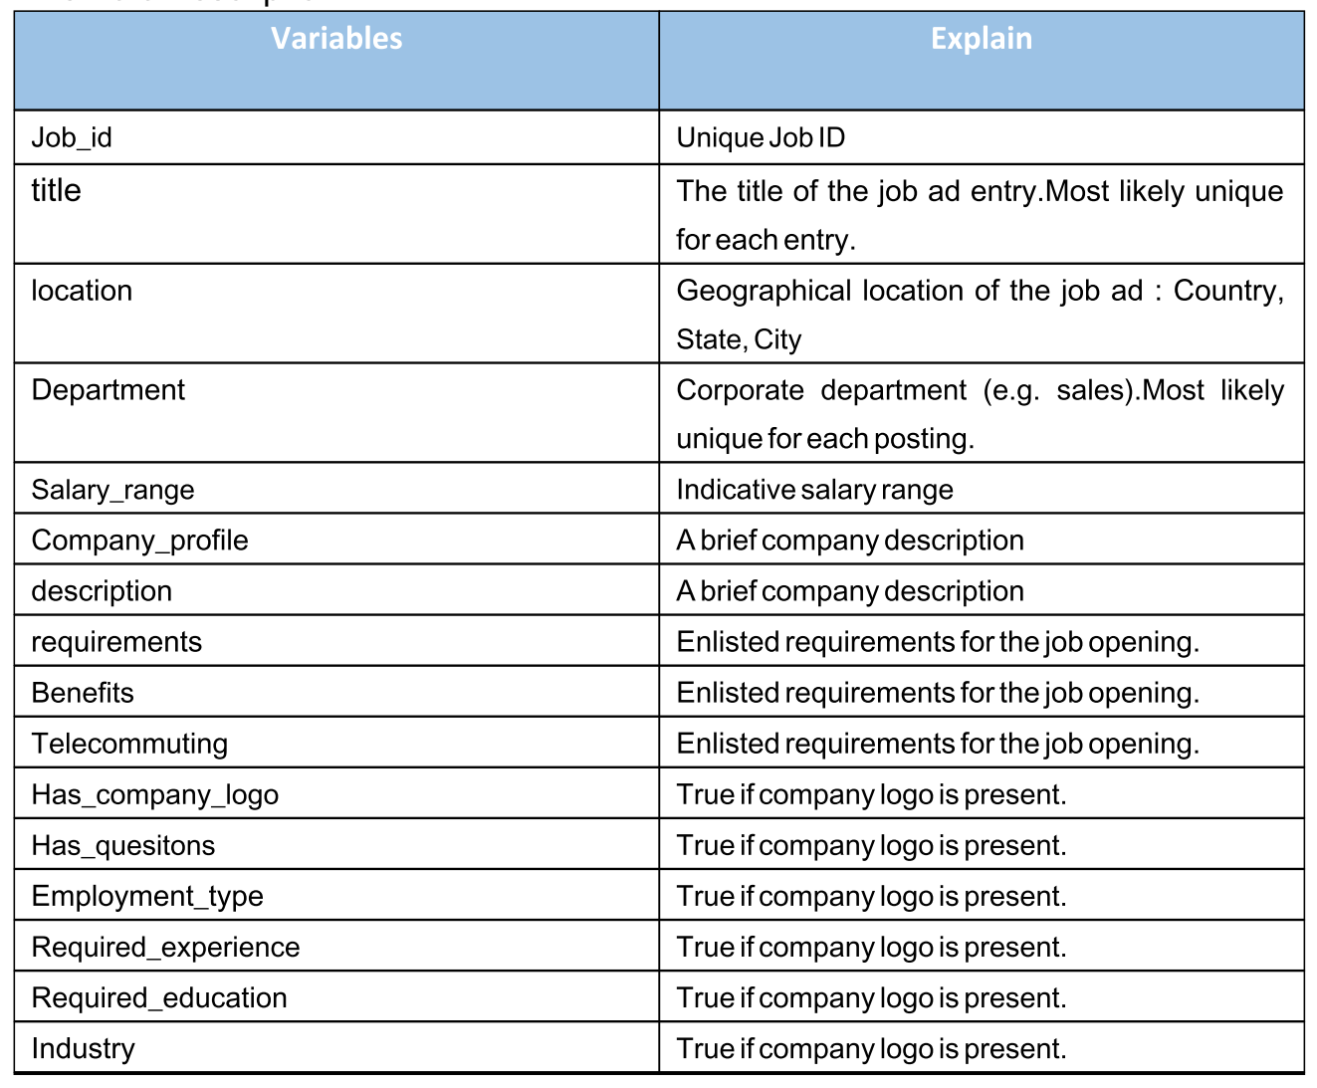
Features Explanation

Slide 4

>>STEPS
1. Cleaning Dataset
2. EDA
3. Data Processing
4. Build the Model
5. Summary

Slide 5
Cleaning Dataset
Dataset Report: https://github.com/AleksanderWWW/Data_mining-Fake_job/blob/master/DatasetReport.7z
Cleaning Dataset
1.1 Removing Missing
# Delete unnamed col
# Delete 'telecommuting、has_company_logo、has_questions、fraudulent' not 1 or 0
# Unbalanced Dataset
1.2 Imputing Missing
1.3 Handling Special Variable
# Salary>> Max & Min
# Convert numeric variable format from str to numeric

Slide 6
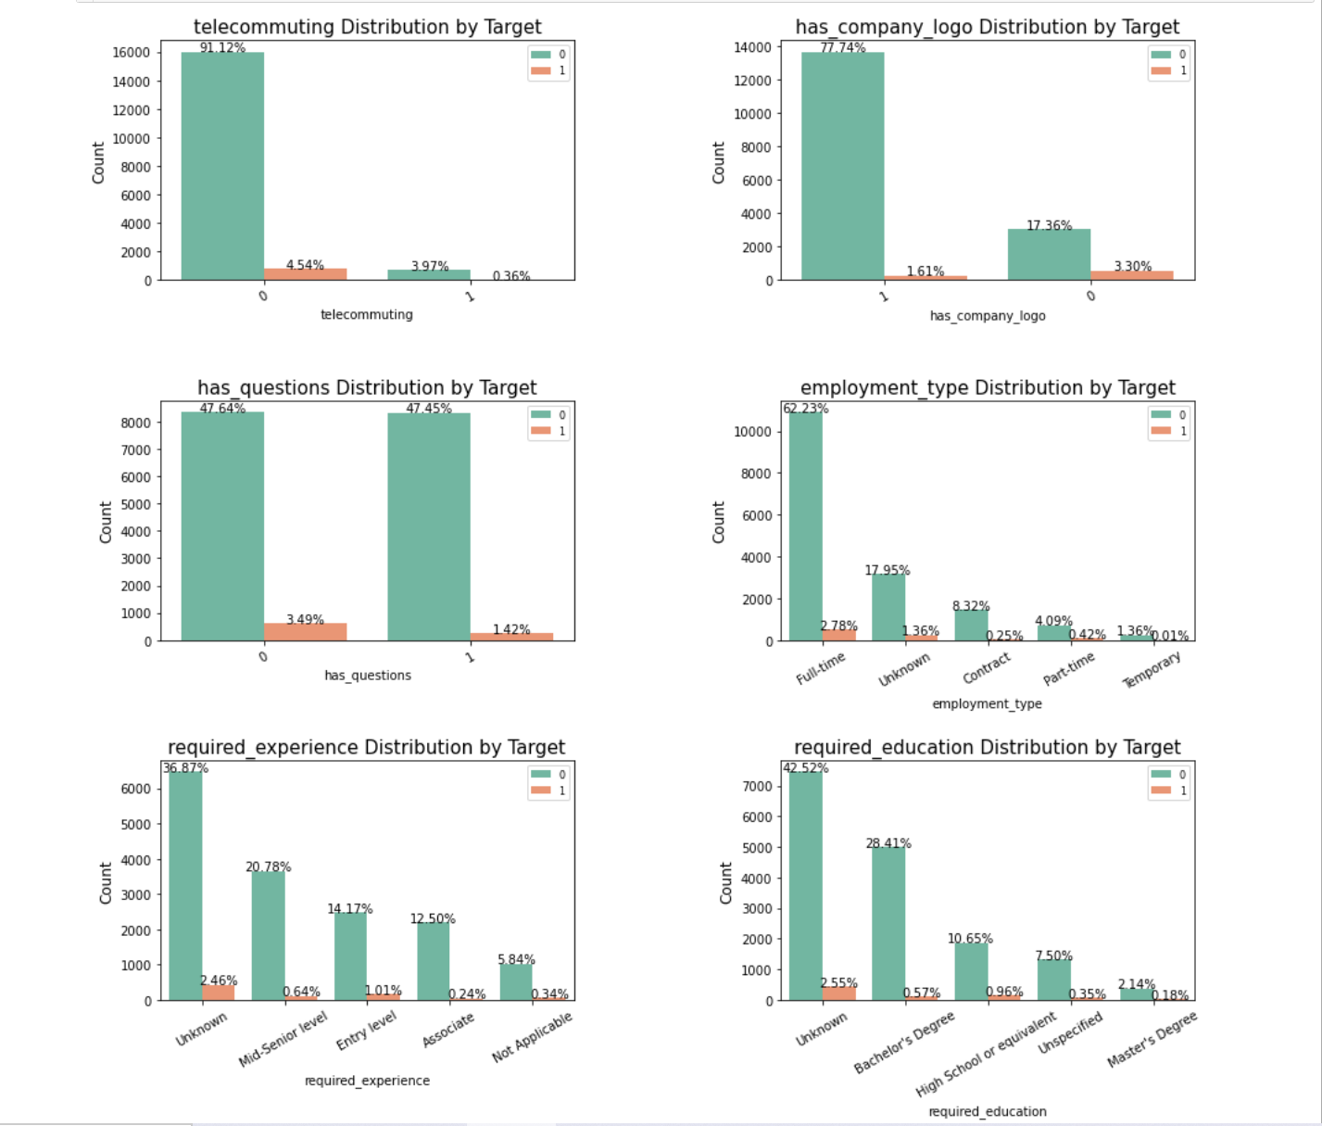
EDA
Education Related Variables

Slide 7

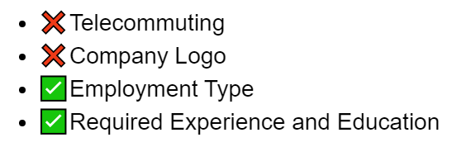
Real Posts
Fradulent Posts

Slide 8
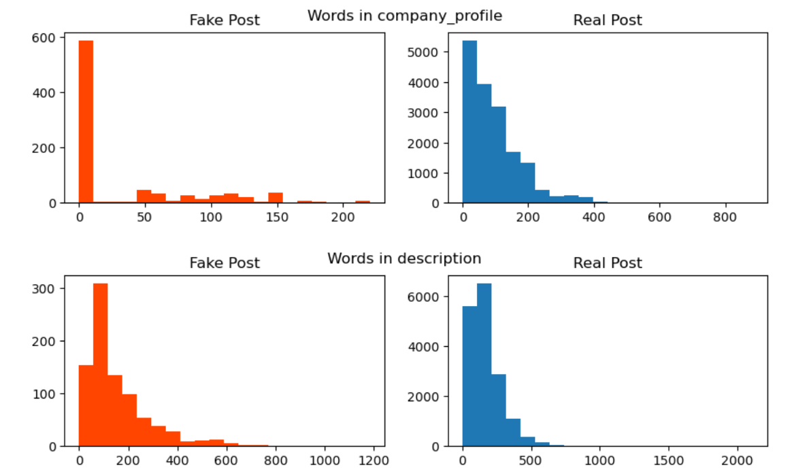
Text information variables

Slide 9
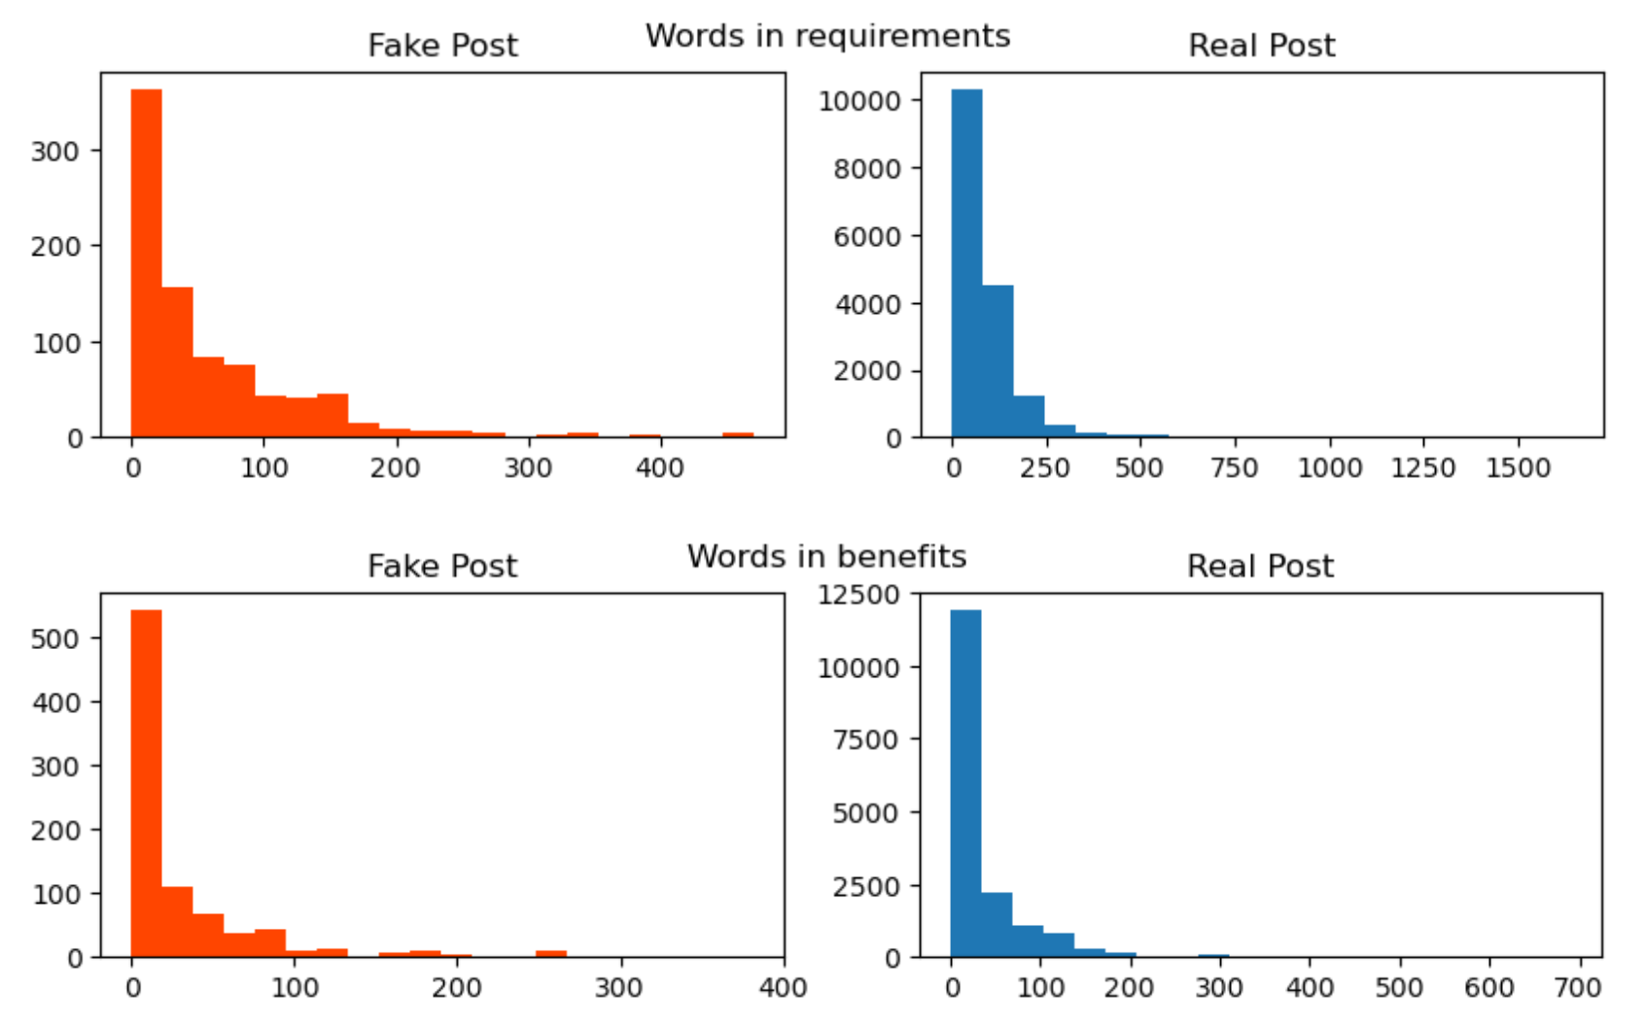

Slide 10
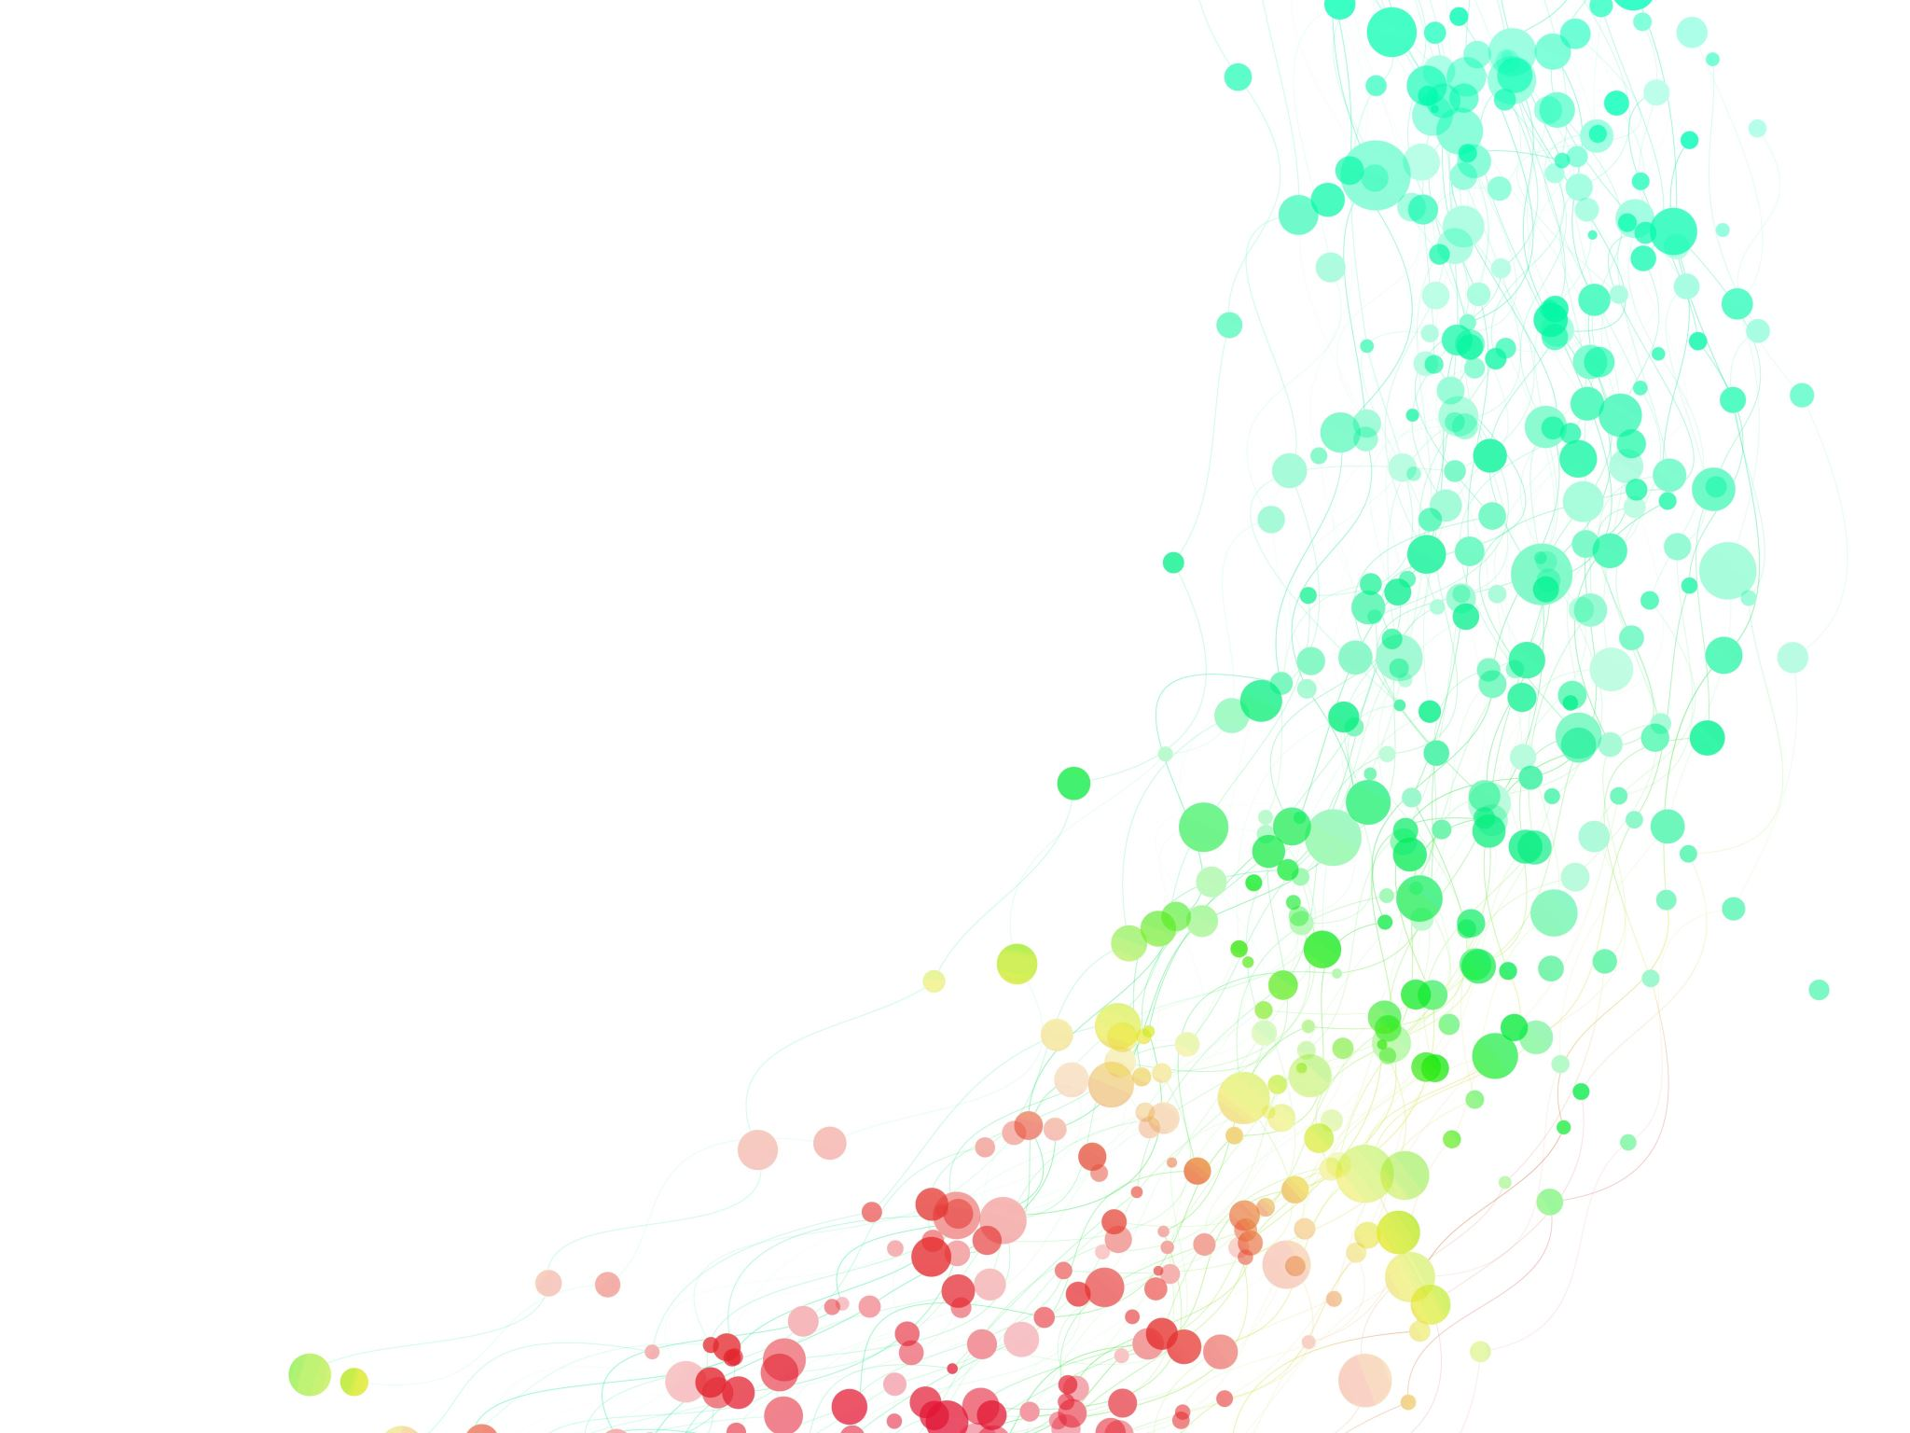
3. Data Processing
3.1 Key-Value
# # Descriptive related variables converted to length
3.2 One-hot encode
# Ordinal variables
# Discrete variable
3.3 PCA
3.4 Standard Scale
3.5 Upsampling
3.6 Clone
3.7 Feature Selection

Slide 11
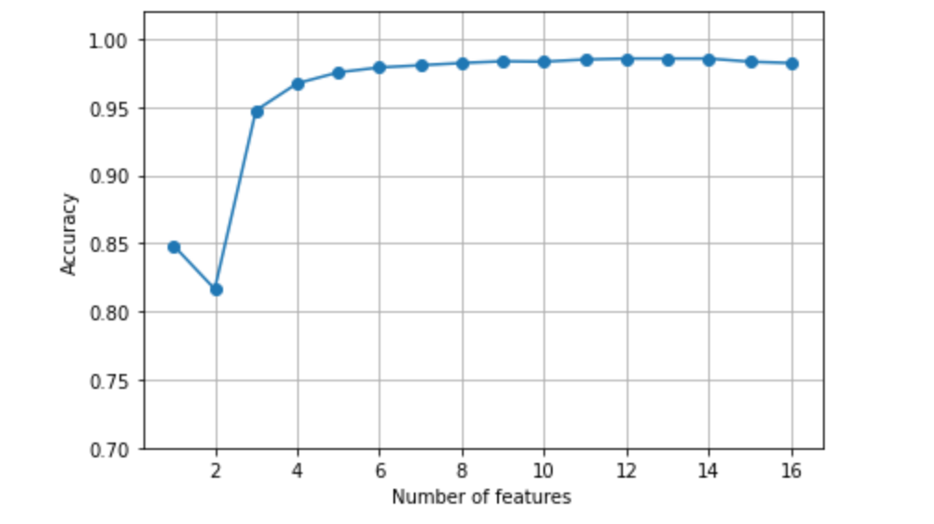

Slide 12

4. Build the Model

Slide 13
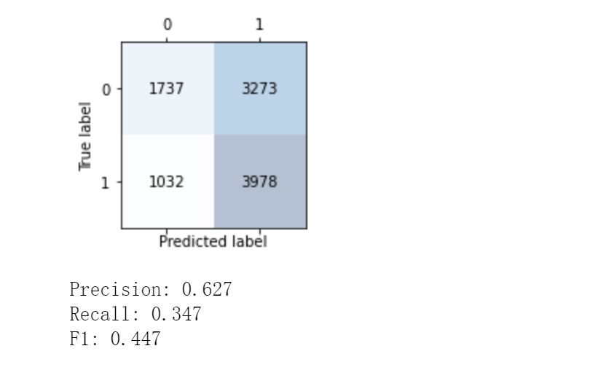
PCA_LR

Slide 14
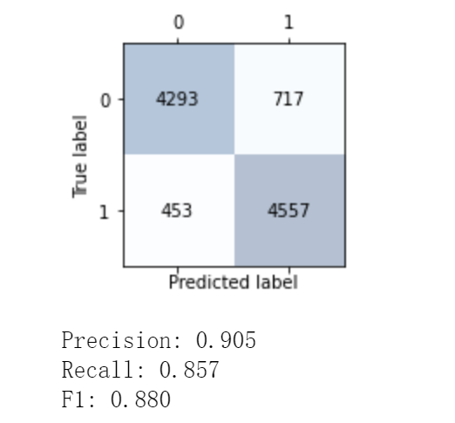
PCA_ Decision Tree

Slide 15
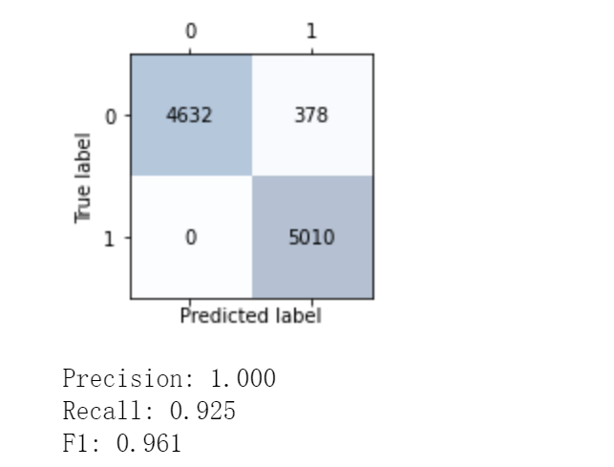
Bagging

Slide 16
Summary
LR | 0.447
DT | 0.879
BA | 0.961

Slide 17
Thank you for your attention!

