Slide 1
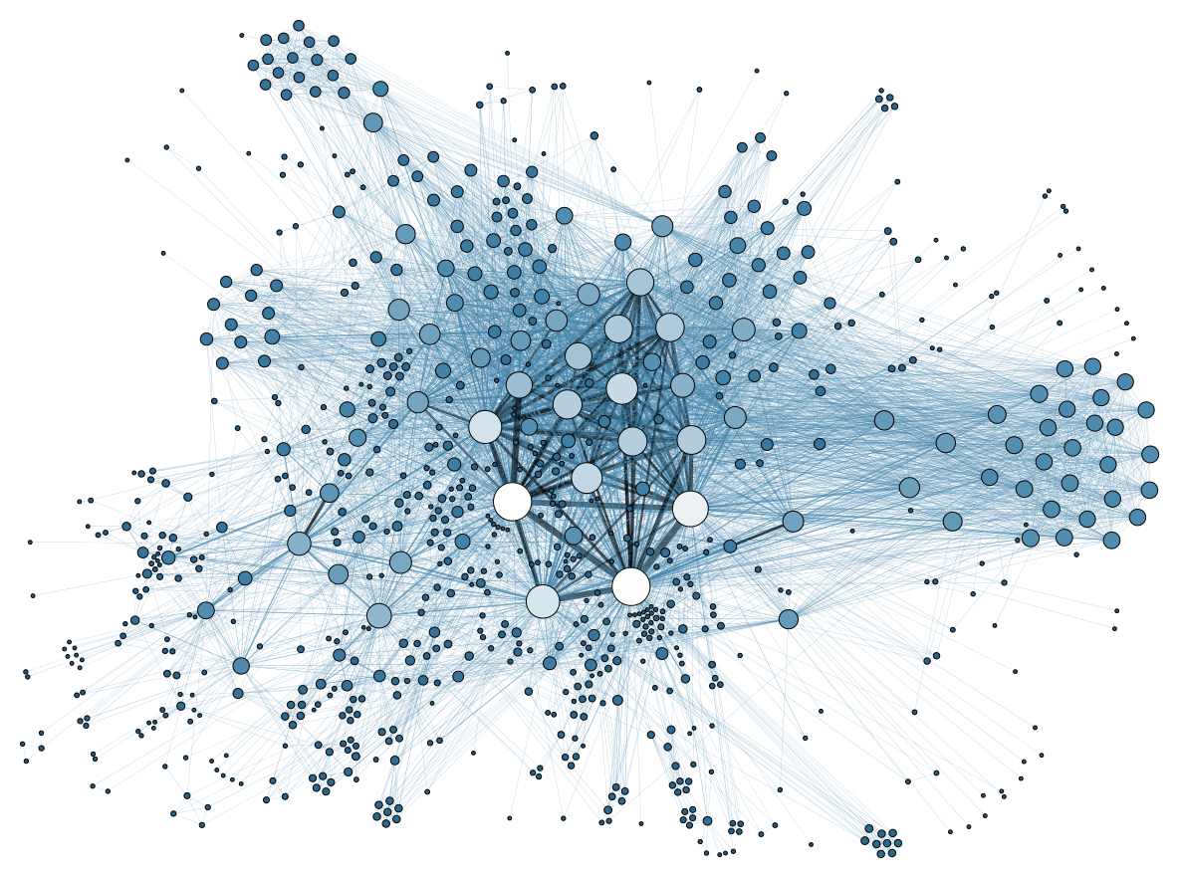
Semantic Network Analysis – An Overview
Shivam Sen
Faculty of Social Science
Charles University

Slide 2
No Coding Experience
Scared of Coding
Humanities and Social Science Background
Scared of Math
Desires to Learn
You

Slide 3
Walkthrough of initial barriers to coding •
Intuition of the idea of a graph/network •
An overview of how to put them together to analyze text •
Offer

Slide 4

Simple Path to Become a Coder
Pick a language to start
Recommendation: R
What is R?
R is a system for statistical computation and graphics
It is a language for data analysis and graphics
2
Set up coding environment
This involves downloading and installing the language on your computer
Follow this link to download R
It is also recommended that you use an Integrated Dev Environment (IDE)
Click here for RStudio
1

Slide 5
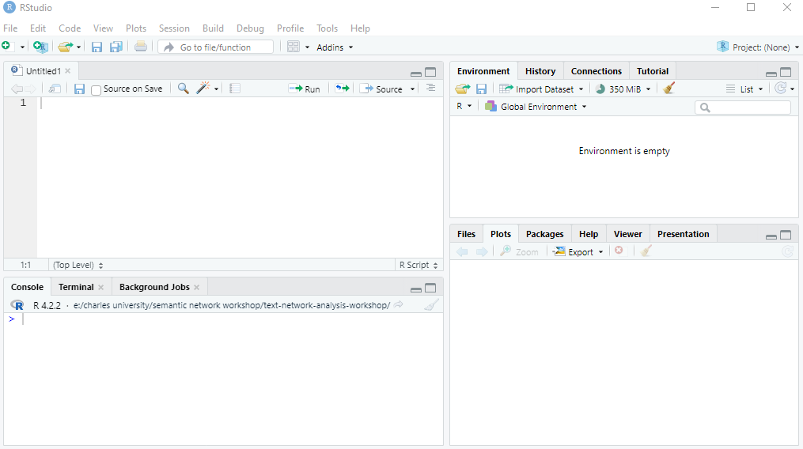
Simple Path to Become a Coder
3
Open Your New Environment

Slide 6
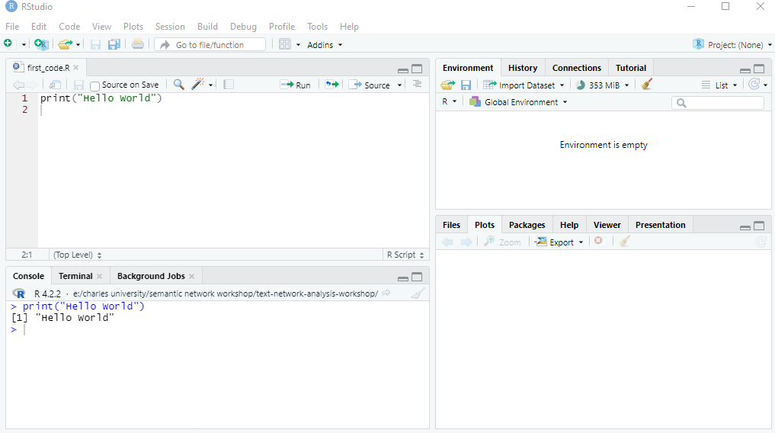
Simple Path to Become a Coder
4
Print “Hello World”

Slide 7
Simple Path to Become a Coder
Learn how to debug
Very low chance you are first with a problem or an error
The internet is your friend
Stack Overflow is an online community and question answer platform primarily focused on programming
ChatGPT
5
Find and Read Documentation and Manuals
For R, start here
6

Slide 8
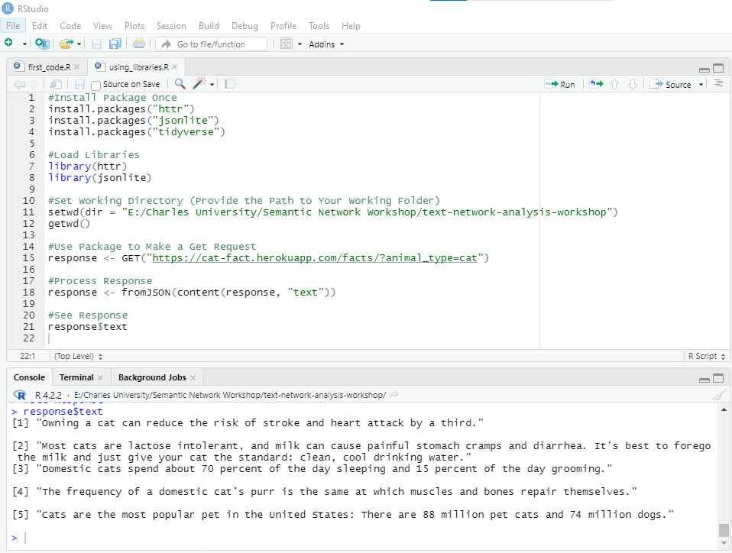
Simple Path to Become a Coder
7
Understand what is a Library/Package
In a sense, it is a set of words that once loaded, the computer will understand
e.g. httr, tidyverse, jsonlite in R

Slide 9
But, what is an API? And GET requests?
Application Programming Interface (REST)
Get
Post
Put
Delete
Your Program
Request
Server
Response
Graphical Interface

Slide 10










Applications
Automatically fetch data from all over the internet
Text from Publications of News Media Agencies
Text from Comments and Posts from Social Media Sites
, etc.
Online Libraries like Open Library and Project Gutenberg also has APIs associated with them
And, so does the major academic databases like Elsevier, Springer, Web of Science and Jstor.

Slide 11
How to Analyse All This Data?
Many ways
Depends on your research questions really
There exists:
Frequency Analysis
Colocation Analysis
Keyword Detection
Topic Modelling
Sentiment Analysis
Text Network/Semantic Network Analysis (Recommendation)
But for all these techniques, first you need to process the raw text extracted through APIs

Slide 12
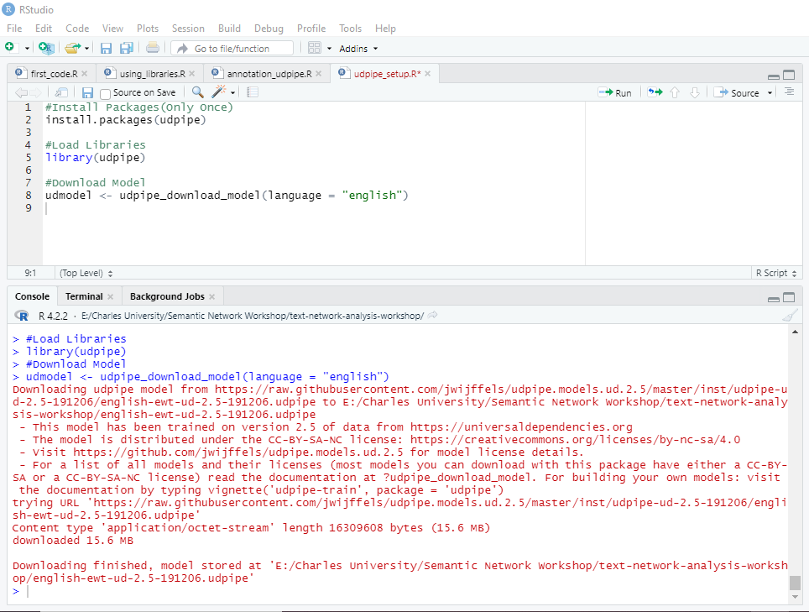
Text Processing with UDpipe
UDpipe is an easy to use and freely available natural language processing pipeline
With this R package you can tokenize, tag parts of speech and lemmatize text in more than 65 languages
To use it you first install the R package and then download the required model
The model gets saved in your folder
To illustrate how to use this model, we proceed with an example

Slide 13

Example
2015 book
Published by an American far right author, Ann Coulter
The text in the book is considered as a part of American far right discourse and analysed

Slide 14
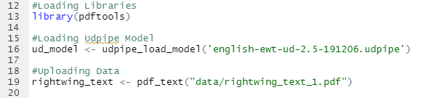
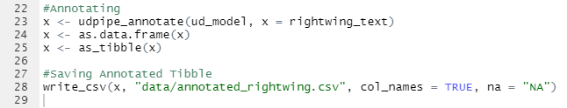
Text Annotation with Udpipe
Load Model and Text Data into Environment
Use model and the udpipe’s annotate ‘word’/function to annotate

Slide 15
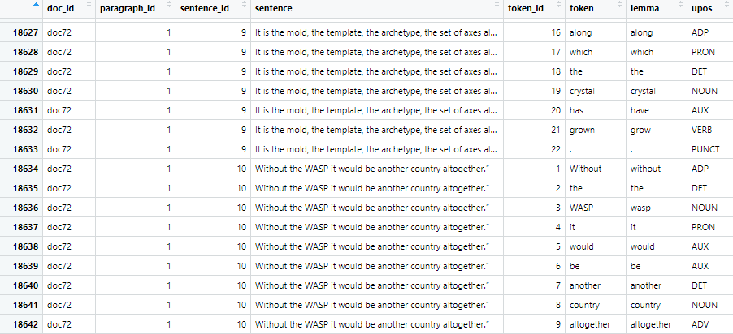
Text Annotation with Udpipe
This results in a data frame that looks like this -

Slide 16
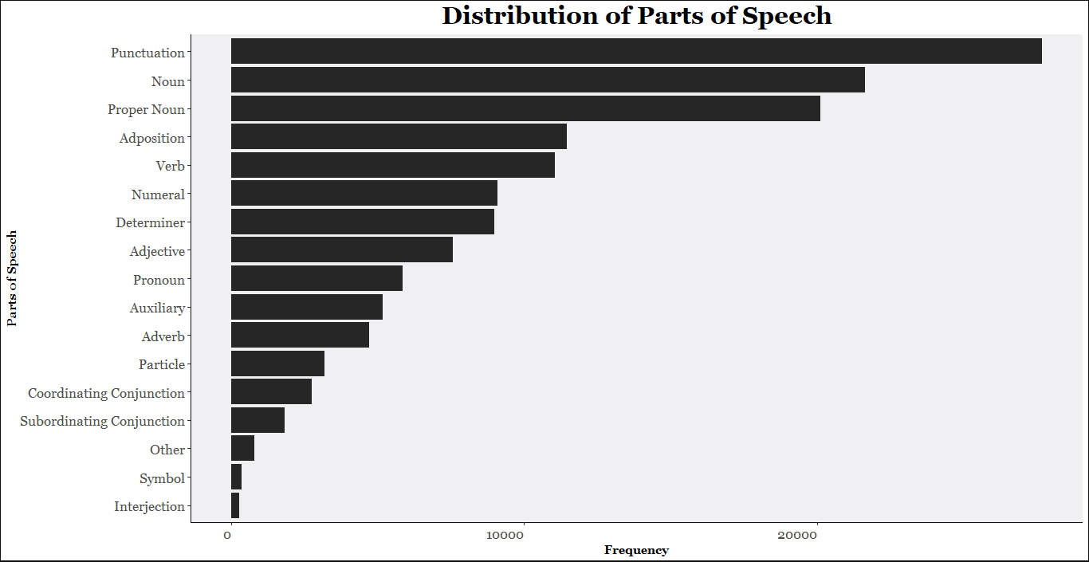
Text Annotation with Udpipe

Slide 17
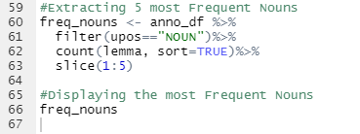
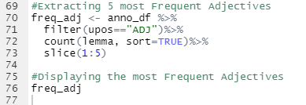
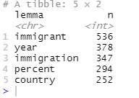
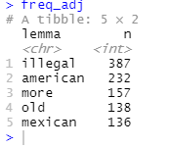
Frequency Analysis
Most Frequent Nouns
Most Frequent Adjectives

Slide 18
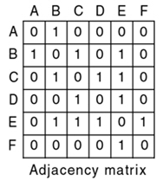
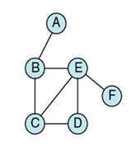
Semantic Network Analysis
What is a Network?
3 main representations
A Basic Network/Graph
Very useful for modelling relationships between multiple things
2 lists. E.g. A list of nodes, {A,B,C,D,E,F,}. And a list of connections between these nodes, {{A,B},{B,E},{E,C},{E,D},{B,C},{E,F}}

Slide 19
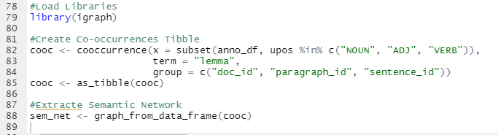
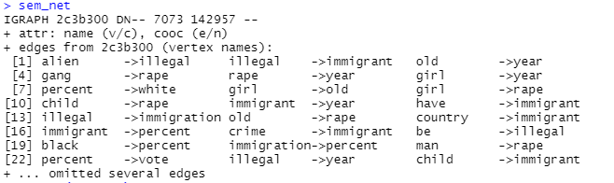
Extracting Semantic Network
Make a Data Frame of lemma co-occurrences using Udpipe and then turn that into a graph using igraph
The semantic network of our example looks like this -

Slide 20
Visualising Ego Graphs
So we saw that immigrants were a frequent noun in the text of our example
But, we want to see how the ‘immigrant’ is being portrayed in our text
What other objects are being associated with the immigrant in our text?
What is the strength of these associations?
The answers can be found in the ego graph of the ‘immigrant’
An ego graph of a node is a graph of only that node and other nodes that are directly connected to it
Let’s see how the ego graph of ‘immigrant’ looks like in our example…

Slide 21
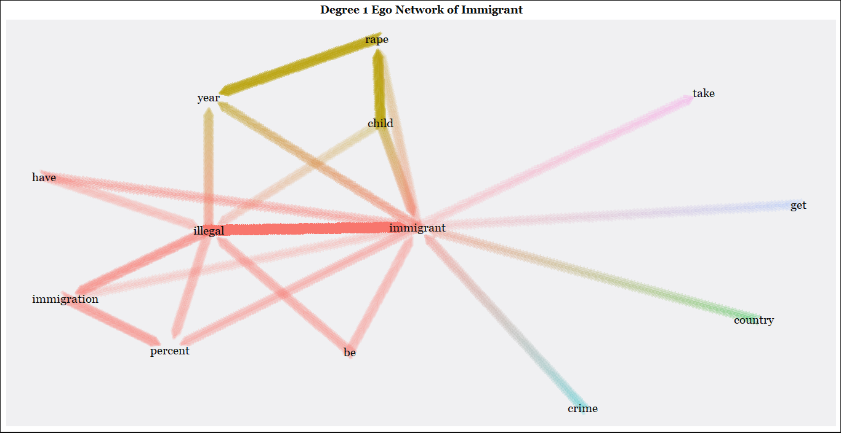

Slide 22
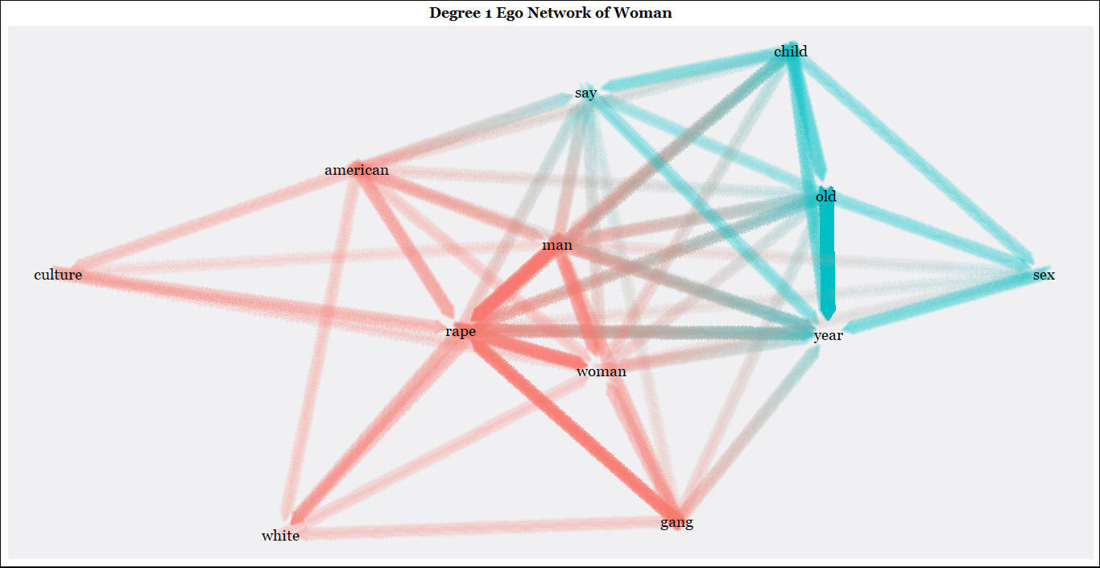

Slide 23
References
Hornik, K. (2022). R FAQ. Cran.r-Project.org. https://cran.r-project.org/doc/FAQ/R-FAQ.html
Ihaka, R., & Gentleman, R. (1996). R: A Language for Data Analysis and Graphics. Journal of Computational and Graphical Statistics, 5(3), 299–314. https://doi.org/10.1080/10618600.1996.10474713
UDPipe—Basic Analytics. (n.d.). Retrieved 14 June 2023, from https://cran.r-project.org/web/packages/udpipe/vignettes/udpipe-usecase-postagging-lemmatisation.html
Castelblanco, G., Guevara, J., Mesa, H., & Sanchez, A. (2021). Semantic Network Analysis of Literature on Public-Private Partnerships. Journal of Construction Engineering and Management, 147(5), 04021033. https://doi.org/10.1061/(ASCE)CO.1943-7862.0002041
Doerfel, M. L. (1998). What constitutes semantic network analysis? A comparison of research and methodologies. Connections, 21(2), 16–26.
Dorow, B. (2006). A graph model for words and their meanings.
Drieger, P. (2013). Semantic Network Analysis as a Method for Visual Text Analytics. Procedia - Social and Behavioral Sciences, 79, 4–17. https://doi.org/10.1016/j.sbspro.2013.05.053
Kharlamov, A., Gradoselskaya, G., & Dokuka, S. (2018). Dynamic Semantic Network Analysis of Unstructured Text Corpora. In W. M. P. van der Aalst, D. I. Ignatov, M. Khachay, S. O. Kuznetsov, V. Lempitsky, I. A. Lomazova, N. Loukachevitch, A. Napoli, A. Panchenko, P. M. Pardalos, A. V. Savchenko, & S. Wasserman (Eds.), Analysis of Images, Social Networks and Texts (pp. 392–403). Springer International Publishing. https://doi.org/10.1007/978-3-319-73013-4_36
Lahiri, S., Choudhury, S. R., & Caragea, C. (2014). Keyword and Keyphrase Extraction Using Centrality Measures on Collocation Networks (arXiv:1401.6571). arXiv. https://doi.org/10.48550/arXiv.1401.6571
Pons, P., & Latapy, M. (2005). Computing communities in large networks using random walks (long version) (arXiv:physics/0512106). arXiv. https://doi.org/10.48550/arXiv.physics/0512106
Segev, E. (2021). Semantic Network Analysis in Social Sciences. Routledge.
Universal POS tags. (n.d.). Retrieved 16 April 2023, from https://universaldependencies.org/u/pos/index.html
Beliga, S., Meštrović, A., & Martinčić-Ipšić, S. (2015). An Overview of Graph-Based Keyword Extraction Methods and Approaches. Journal of Information and Organizational Sciences, 39(1), 1–20.
Johnson-Laird, P. N. (1983). Mental models: Towards a cognitive science of language, inference, and consciousness (Issue 6). Harvard University Press.
Kang, G. J., Ewing-Nelson, S. R., Mackey, L., Schlitt, J. T., Marathe, A., Abbas, K. M., & Swarup, S. (2017). Semantic network analysis of vaccine sentiment in online social media. Vaccine, 35(29), 3621–3638. https://doi.org/10.1016/j.vaccine.2017.05.052
Nulty, P. (2017). Network visualisations for exploring political concepts. IWCS 2017—12th International Conference on Computational Semantics—Short papers.
Straka, M., Hajič, J., & Straková, J. (2016). UDPipe: Trainable Pipeline for Processing CoNLL-U Files Performing Tokenization, Morphological Analysis, POS Tagging and Parsing. Proceedings of the Tenth International Conference on Language Resources and Evaluation (LREC’16), 4290–4297. https://aclanthology.org/L16-1680
Straka, M., & Straková, J. (2017). Tokenizing, POS Tagging, Lemmatizing and Parsing UD 2.0 with UDPipe. Proceedings of the CoNLL 2017 Shared Task: Multilingual Parsing from Raw Text to Universal Dependencies, 88–99. https://doi.org/10.18653/v1/K17-3009
Universal POS tags. (n.d.). Retrieved 16 April 2023, from https://universaldependencies.org/u/pos/index.html

Slide 24
Link to Presentation - https://github.com/Helloworld910
Email – shivamsen910@gmail.com
Instagram - @senshivam910

Slide 25
Thank You
Questions?
Stay Healthy!

