Slide 1

Online Blogging System
Submitted To:
Department of Computer Application
Ratna Rajyalaxmi Campu
Submitted By:
BISHAM RAJ PANDEY (6-2-40-15-2021)
BISHAL REGMI (6-2-40-14-2021)

Slide 2
Introduction
The Online Blogging System is a platform that enables users to share posts and information on various topics.
It offers a user-friendly web-based platform for sharing thoughts, ideas, and information globally.
A valuable source of information and a platform for sharing ideas with a global audience.
Features
Access to a wide range of topics including Entertainment, National and International events.
Content moderation by designated Moderators.
Accessibility to users without specialized knowledge.

Slide 3

Problem of Statement
Difficulty in Creating and Reading Blog Posts
Users find it challenging to create and publish blog posts efficiently.
Readers may struggle with navigating and accessing blog content.
Prevalence of Fake News and Misinformation
The system faces issues with the spread of fake news and misinformation.
The system faces issues with the spread of fake news and misinformation.
Difficulty in Communication Between Users
Users encounter challenges in communicating effectively with each other within the platform.
Limited features for user interaction and engagement hinder community building.

Slide 4
Objectives
Provide a Platform for Blog Creation
1
Enable users to create and publish blog posts easily.
Offer tools and features for formatting, editing, and organizing content effectively.
Prevent Inappropriate Contents Using User Reports
2
Implement a system for users to report inappropriate content.
Utilize moderation tools to review reported content and take appropriate actions.
Provide an Easy Method for Communication with Users
3
Enhance user engagement by encouraging interaction and discussions.
Facilitate communication channels such as comments, messaging, and forums.

Slide 5

Requirement Analysis
Analyzed systems like Blogger, Medium, and Quora to gather requirements for the system.

Slide 6

Functional Requirement
Define fundamental actions that the system must perform.
Divided into categories: moderators and users, with detailed use cases.

Slide 7
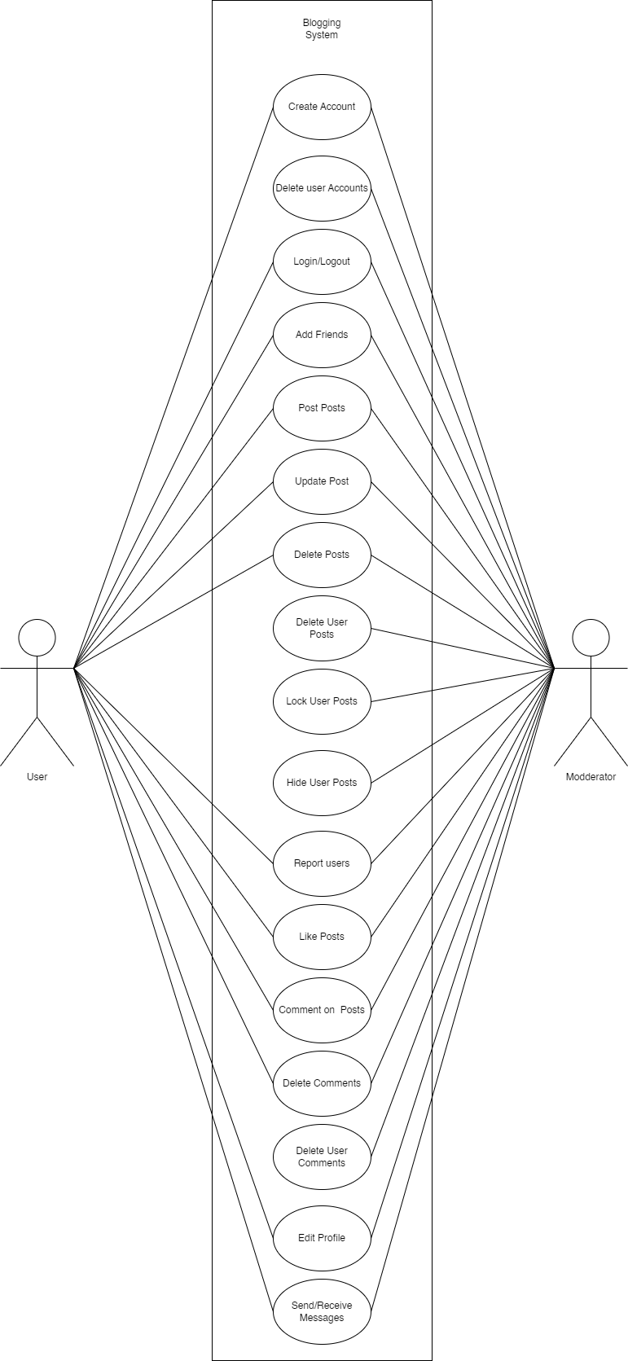
Use Case

Slide 8

Non Functional Requirement
Performance
Ensure responsiveness for a large number of concurrent users.
Fast loading times, quick user interactions, and efficient database queries.
Security
Robust security measures to protect user data and prevent unauthorized access.
Implementation of encryption protocols, secure authentication, and regular security audits.
Scalability
Design for growth in user base and content volume.
Horizontal scaling, optimization of code and database structures for increased load.

Slide 9
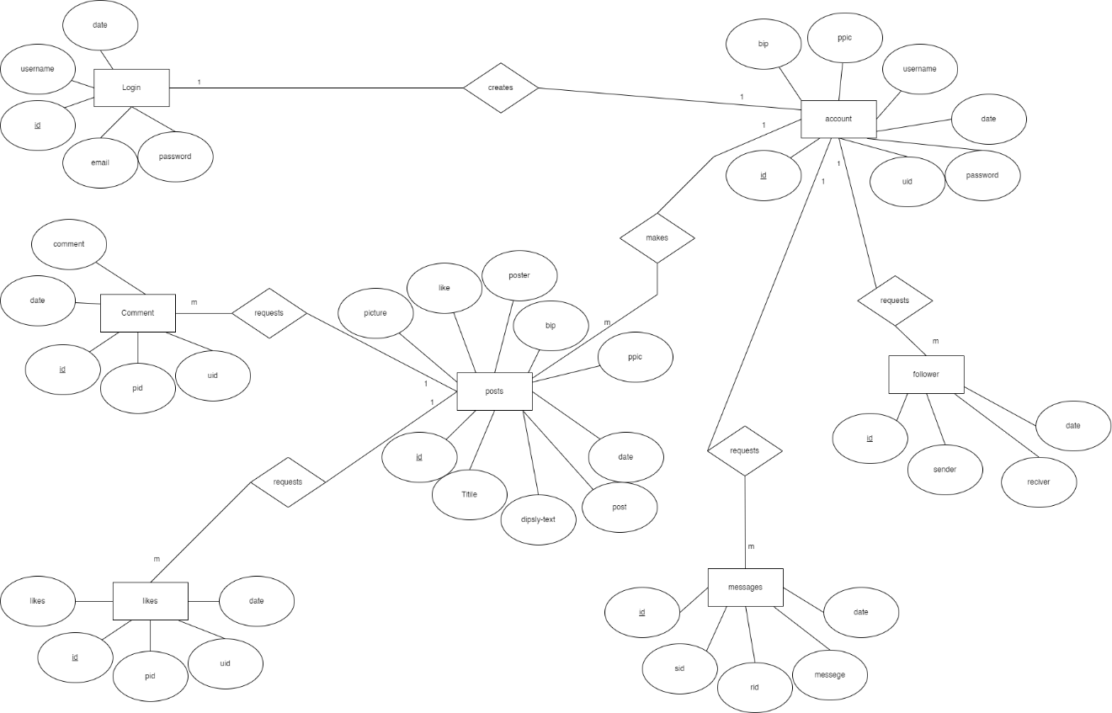
Data Modeling: ER Diagram

Slide 10
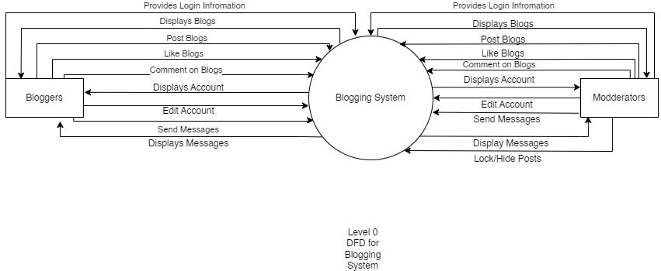
Process Modeling

Slide 11
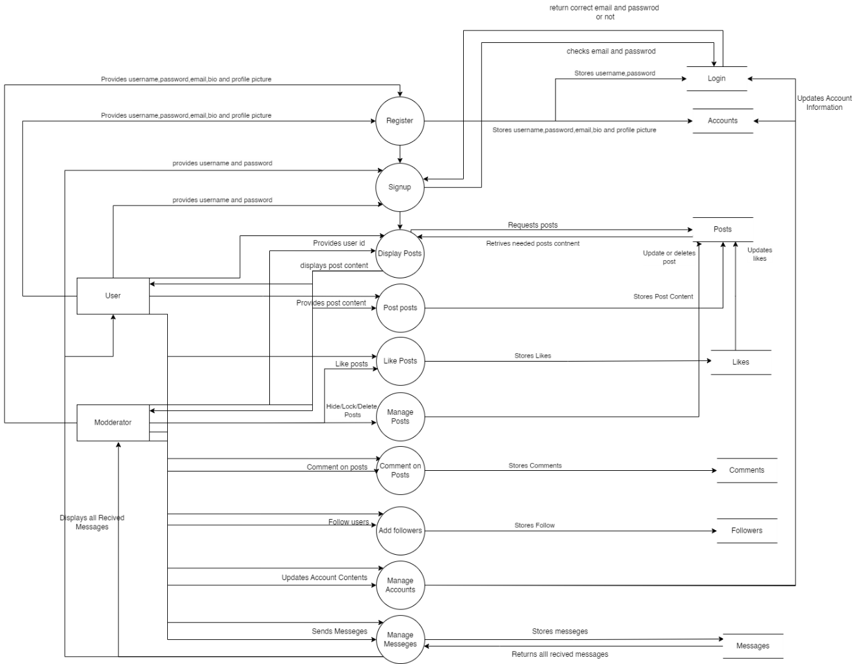
Level 1 DFD

Slide 12

Implementing Tools
Development Tools
HTML
Used for developing the basic structure of the site.
CSS
Used for designing and styling the HTML pages.
JavaScript
Used for making the site more responsive and adding additional functions.
Backend Tools
PHP
Used for interacting with the database and server-side scripting.
MySQL
Used for database storage and management.

Slide 13
Implementation Module Details
Login Module
Facilitates the login process for registered users.
User provides username and password to access the system.
Register Module
Facilitates the registration process for new users.
User provides information like username, email, profile picture, etc.
Post Module
Allows users to create and post content.
User provides title, text, image, etc., which is then stored and displayed to others.

Slide 14
Implementation Module Details
Display Module
Enables users to view posts created by other users.
Users can read and interact with other people's blogs.
Account Module
Provides users with access to their account settings.
Users can modify their username, password, profile picture, etc.

Slide 15

Thank you
ANY QUESTIONS

