Slide 1
Online Blogging System
Submitted To:
Department of Computer Application
Ratna Rajya Laxmi Campus
Submitted By:
BISHAM RAJ PANDEY (6-2-40-15-2021)
BISHAL REGMI (6-2-40-14-2021)

Slide 2
Introduction
The Online Blogging System is a platform that enables users to share posts and information on various topics.
It offers a user-friendly web-based platform for sharing thoughts, ideas, and information globally.
A valuable source of information and a platform for sharing ideas with a global audience.
Features
Access to a wide range of topics including Entertainment, National and International events.
Content moderation by designated Moderators.
Accessibility to users without specialized knowledge.

Slide 3
Problem Statement
Difficulty in Creating and Reading Blog Posts
Users find it challenging to create and publish blog posts efficiently.
Readers may struggle with navigating and accessing blog content.
Prevalence of Fake News and Misinformation
The system faces issues with the spread of fake news and misinformation.
The system faces issues with the spread of fake news and misinformation.
Difficulty in Communication Between Users
Users encounter challenges in communicating effectively with each other within the platform.
Limited features for user interaction and engagement hinder community building.

Slide 4
Objectives
Provide a Platform for Blog Creation
Enable users to create and publish blog posts easily.
Offer tools and features for formatting, editing, and organizing content effectively.
Prevent Inappropriate Contents Using User Reports
Implement a system for users to report inappropriate content.
Utilize moderation tools to review reported content and take appropriate actions.
Provide an Easy Method for Communication with Users
Enhance user engagement by encouraging interaction and discussions.
Facilitate communication channels such as comments, messaging, and forums.

Slide 5
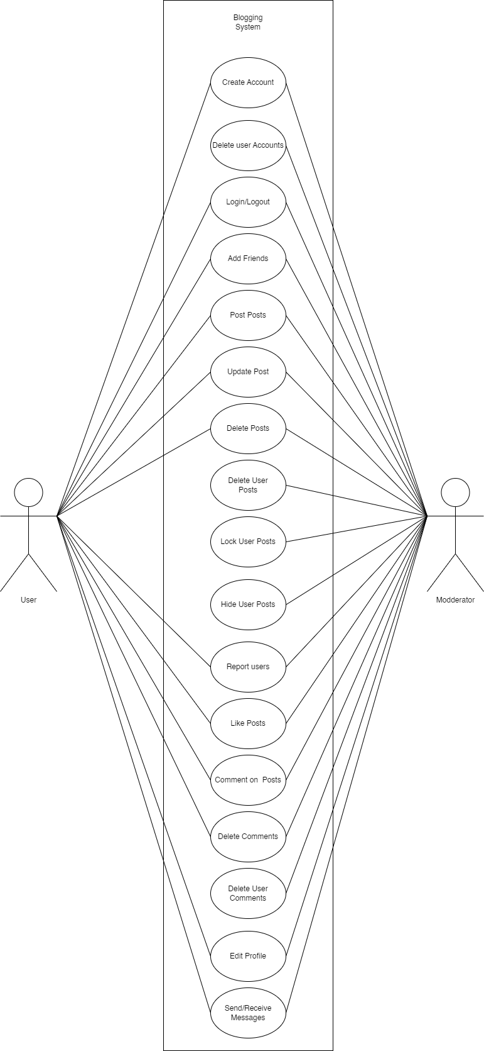
Use Case Diagram

Slide 6
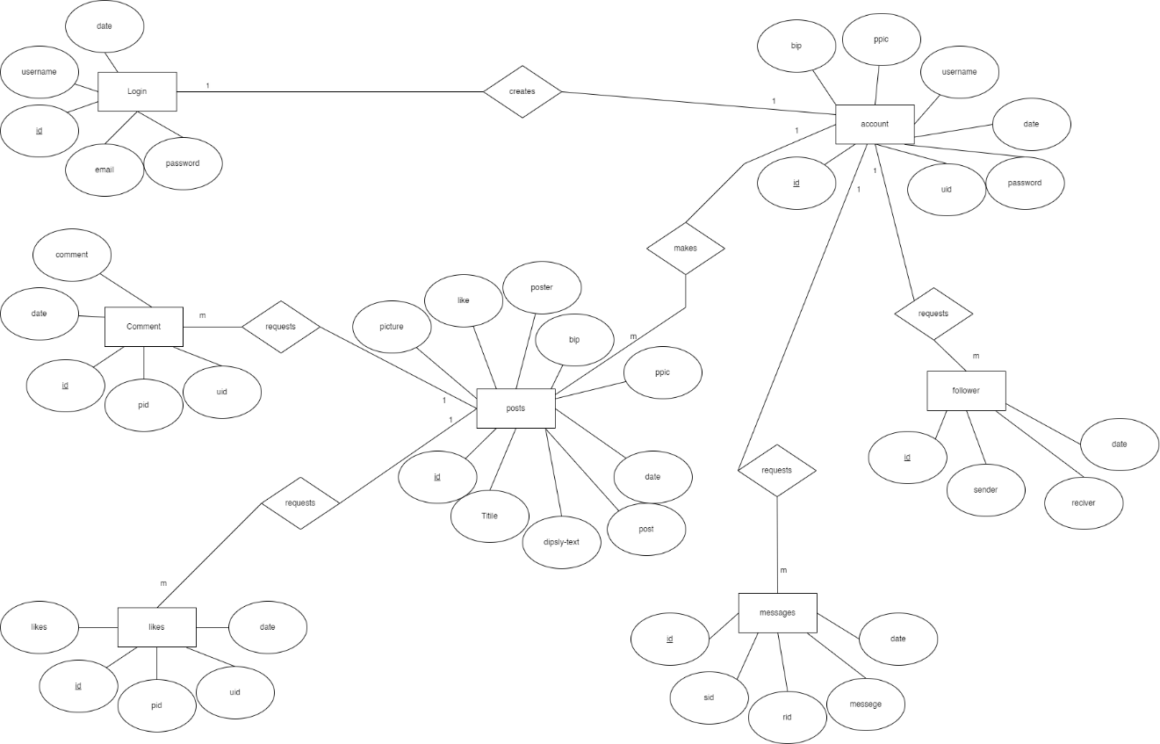
Data Modeling: ER Diagram

Slide 7
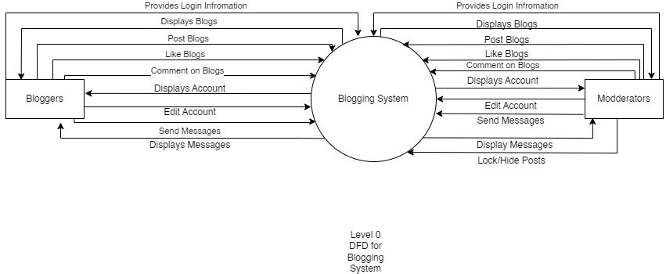
Process Modeling

Slide 8
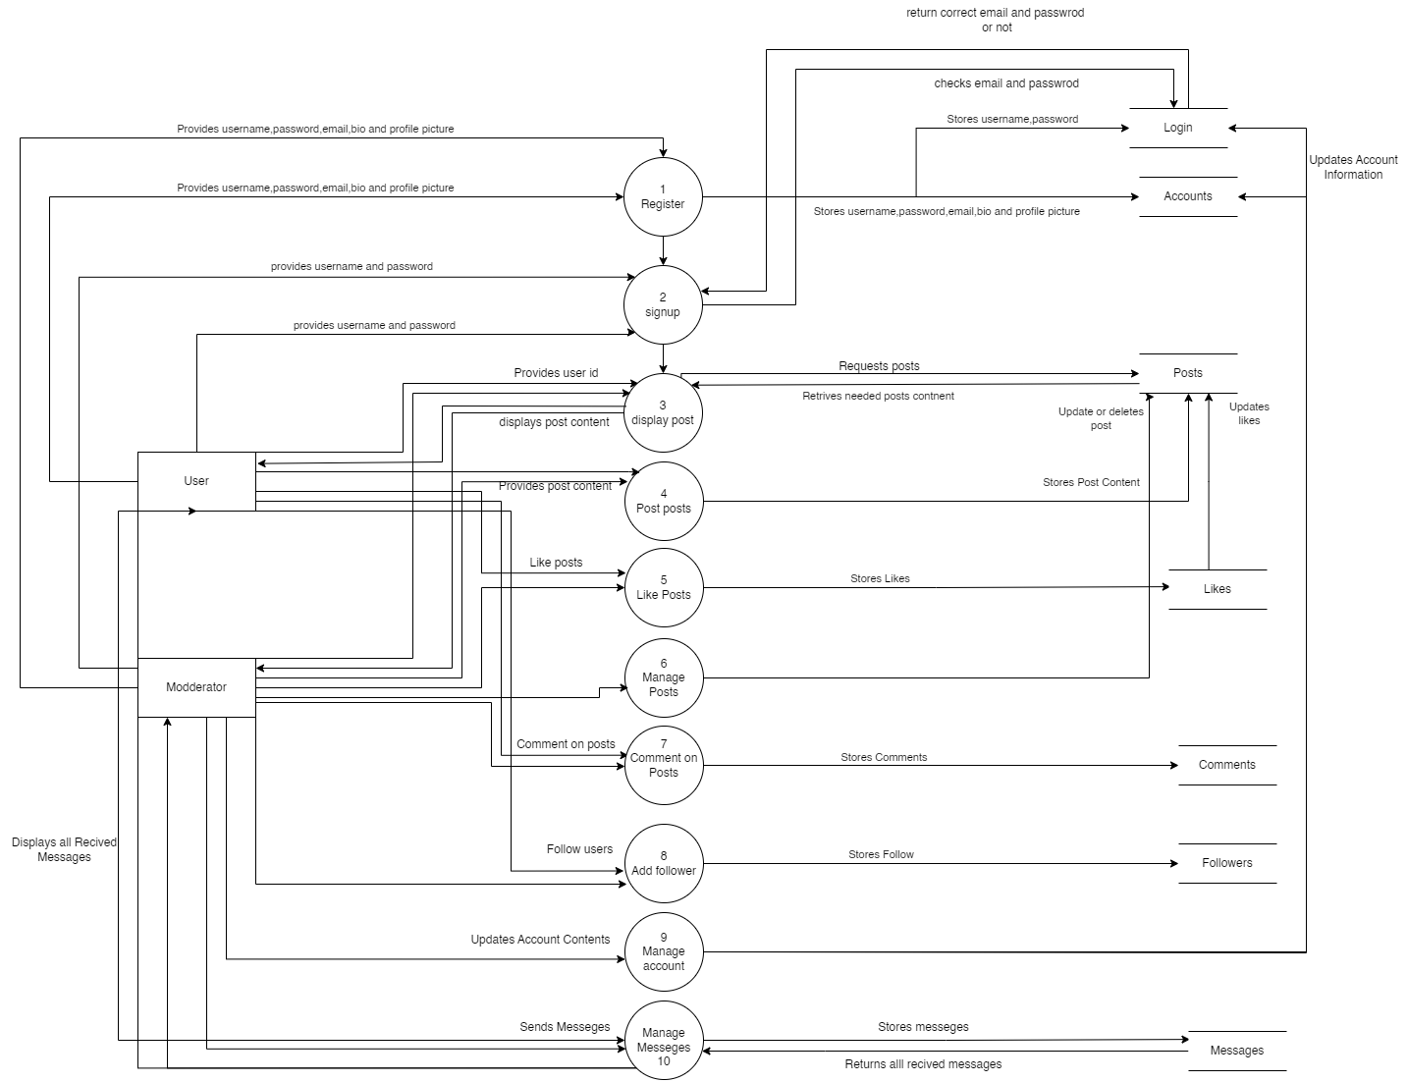
Level 1 DFD

Slide 9
Implementing Tools
Development Tools
HTML
Used for developing the basic structure of the site.
CSS
Used for designing and styling the HTML pages.
JavaScript
Used for making the site more responsive and adding additional functions.
Backend Tools
PHP
Used for interacting with the database and server-side scripting.
MySQL
Used for database storage and management.

Slide 10
Implementation Module Details
Login Module
The Login module facilitates the login process for registered users. The user provides their username and password which will lead them to the system.
Register Module
The Register module facilitates the registration process for new users. The user provides information such as username, email, profile picture etc.
Post Module
This module allows the user to post posts. The user provides information such as title, text image which is then stored and displayed to other users.
Display Module
This module allows the user to see the post other users have posted. This allows users to read other people's blogs

Slide 11
Thank
You

