Slide 1

SHIVI X100+
Research-Grade · Production-Grade · AI-Native Enterprise Operating Platform
A unified ecosystem combining a shared kernel and platform fabrics with 100 production and research systems — purpose-built for the autonomous enterprise. Not 100 disconnected applications. One operating platform.
TARGET ARCHITECTURE
EXECUTIVE & TECHNICAL BRIEFING
FOUNDERS · ENGINEERS · INVESTORS

Slide 2

The Problem: The Enterprise is Drowning in Disconnected Intelligence
The Status Quo Is Broken
Identity Fragmentation
Policy Blindness
Modern enterprises run on a patchwork of SaaS tools, point solutions, and bespoke integrations — each generating data, each requiring separate identity models, each with its own authorization logic, observability story, and operational overhead. The result is an AI deployment landscape that is fragmented by design.
AI copilots are bolted onto existing applications without shared memory, shared context, or shared policy. Agents cannot trust one another. Tools cannot be governed at runtime. Models propose actions with no platform-level authorization layer to verify intent, validate outputs, or capture evidence.
No unified identity primitive across agents, users, tools, and tenants
No runtime authorization layer; agents act with unconstrained delegation
Context Amnesia
Evidence Vacuum
No shared context, memory, or knowledge plane across systems
No provenance, audit trail, or outcome traceability across AI actions
The enterprise AI gap is not a model quality problem. It is a platform problem. ShiVi is the platform.

Slide 3



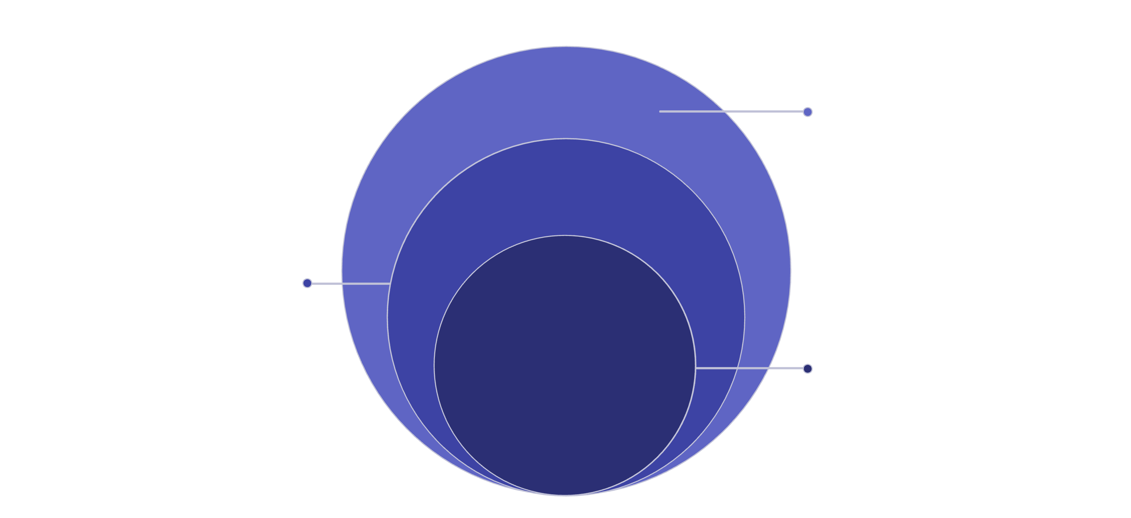
The ShiVi Thesis: One Kernel. One Platform. 100 Systems.
ShiVi is not a suite of AI features added to enterprise software. It is a ground-up re-architecture of how enterprise operating platforms are built — with AI, agents, and autonomous workflows as first-class kernel primitives from day one.
Shared Kernel
Platform Fabrics
100-System Portfolio
17 contract-driven primitives: Identity, Tenant, Capability, Policy, Context, Memory, Tool, Agent, Task, Workflow, Event, Artifact, Evidence, Environment, Experiment, Evaluation, Outcome
12 cross-cutting platform layers: Identity/Tenancy, Authorization, API Gateway, AI Gateway, Agent Runtime, MCP/A2A, Workflows/Events, Data/Knowledge, Security/Trust, Observability, Infrastructure, Research
Production and research systems across GTM, RevOps, Operations, Agents, AI/ML, Security, Observability, Platform Engineering, and Research — all sharing the same kernel and fabrics
The principle is architectural unification: every system in the portfolio inherits identity, policy, context, observability, and security from the shared platform rather than re-implementing them. Model proposes. ShiVi authorizes. This single constraint reshapes the entire risk posture of enterprise AI deployment.
Product & Research
100 systems delivering applications and experiments
Platform Fabrics
12 fabrics enabling platform services
Shared Kernel
17 core primitives driving capabilities

Slide 4
The 100-System Ecosystem
ShiVi's portfolio spans six major domains. Every system is built on the shared kernel — none re-implements identity, policy, context, or observability from scratch.
🎯 GTM & Revenue
⚙️ Operations & Enterprise
AI GTM Operating System
Autonomous RevOps Engine
AI Revenue Intelligence
AI CRM Copilot
AI Sales & SE Copilot
AI Marketing Intelligence
AI Personalization Engine
AI Lead Intelligence
AI Pricing & Forecasting
AI Territory & Commission
AI Customer Success
AI Support & Contact Center
AI Proposal / RFP
AI Organization Digital Twin
AI Process Mining
AI Workflow Automation
AI Enterprise Search
Enterprise Knowledge Cloud
AI Meeting Intelligence
AI Task Orchestration
AI Enterprise Planning
AI Resource Optimization
AI Internal Operations
AI Policy Assistant
AI Contract Intelligence
AI Vendor & Procurement
AI Asset Intelligence
AI Risk & Compliance
AI Executive Intelligence
AI Business Continuity
AI Enterprise Simulation
🤖 Agent Platform
🧠 AI / ML Fabric
Agent Control Plane
Agent Runtime & Fleet
Agent Marketplace
Skill Registry
Agent Memory & Identity
Capability Broker
Agent Governor
Agent Reputation
Multi-Agent Orchestrator
Agent Arbitration
A2A Collaboration
Tool Registry & MCP Gateway
Agent Sandbox
Browser Agent
Agent Contract Engine
Agent Constitution
AI Gateway & Model Router
Model Registry & LLMOps
Enterprise RAG
Context Compiler
Context Firewall
Knowledge Graph
Entity Resolution
Data Governance & Quality
Synthetic Enterprise
AI Experiment Platform
AI Cost / FinOps
Distributed AI Compute
🔒 Security & Trust
🔬 Platform & Research
ShiVi Guardian
Intent Firewall
Capability Firewall
Evidence Ledger
Agent Security Lab
Agent Cyber Range
Red-Team Platform
Threat Hunting
Policy-as-Code
Authorization Graph
DLP, Secrets, Supply-Chain
AI-BOM, Crypto Agility/PQC
Observability & GenAI Obs.
Trajectory Evaluation
Benchmark Integrity
Simulation Engine
SRE Platform
Platform Engineering Portal
Environment Platform
Developer Platform
Research OS

Slide 5
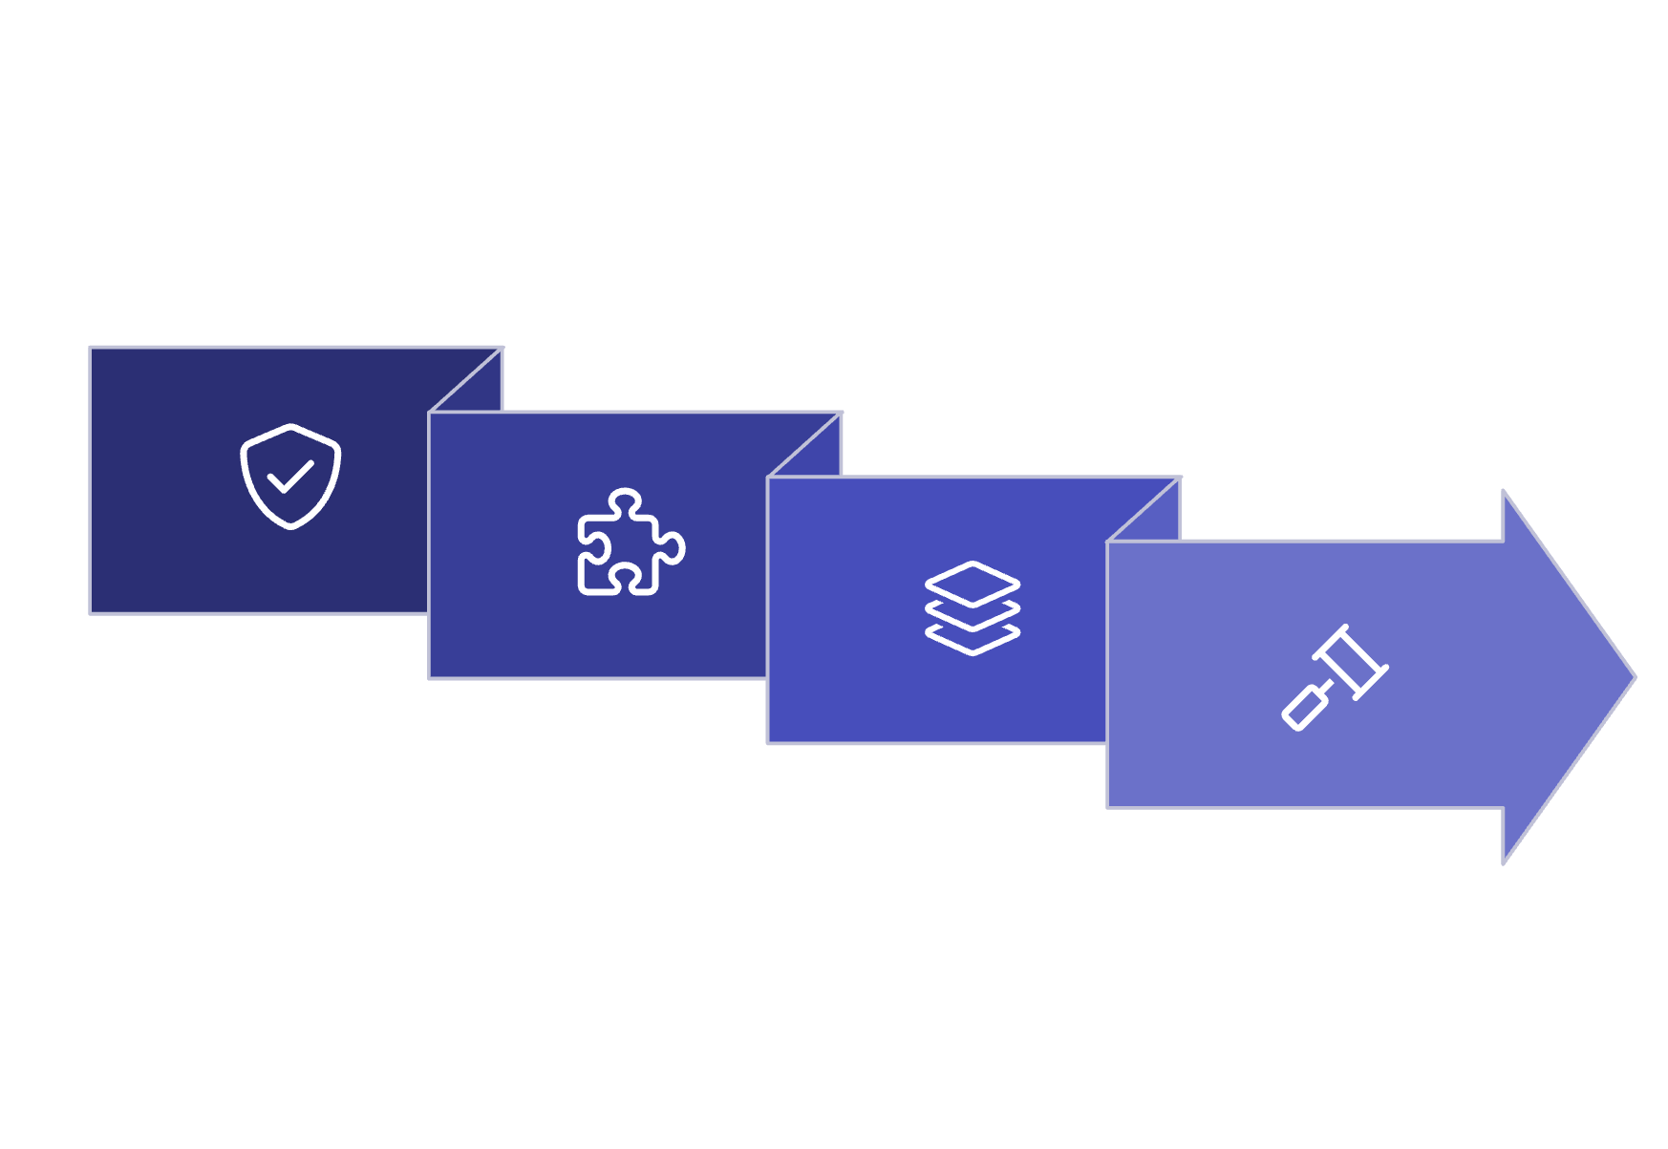

Kernel Primitives & Agent Execution Contract
17 Kernel Primitives
Agent Execution Flow
Every ShiVi system operates on a shared set of contract-driven, versioned primitives. These are not abstractions — they are enforced runtime types with schemas, lifecycle state machines, and policy hooks.
Every agent action traverses a mandatory authorization and verification pipeline. No agent bypasses this flow — it is enforced at the kernel level, not by convention.
Identity
Tenant
Capability-bound, SPIFFE/SPIRE-attested identities for users, agents, tools, and services
Full multi-tenant isolation across API, DB, cache, vector, graph, events, storage, agents, and billing
Resolve Capabilities
Authorize Policy
Policy
Context
Verify Identity
OPA/OpenFGA/Kyverno enforced at runtime; desired-state reconciliation with audit evidence
Versioned, provenance-tracked context packets with quality scoring and firewall enforcement
Assemble Context
Memory
Evidence
Core constraint: Model proposes. ShiVi authorizes. Risk-tiered autonomy gates high-impact actions behind human approval workflows with full evidence capture.
Governed agent memory with poisoning defenses, epoch management, and selective retention
Immutable provenance ledger: UNKNOWN → DISCOVERED → PLANNED → IMPLEMENTED → TESTED → VERIFIED → PRODUCTION_READY

Slide 6




Security, Trust & Zero-Trust Agent Governance
ShiVi's security model is not perimeter-based. It is a zero-trust, policy-enforced, evidence-producing mesh that governs every agent action, every tool invocation, and every model output at runtime.
Identity & Access
Tri-Layer Agent Firewall
OIDC/OAuth, SPIFFE/SPIRE workload identity, OpenFGA authorization graph, OPA policy engine, Kyverno admission control. Capability-bound identities prevent privilege escalation and cross-tenant access at the cryptographic layer.
Intent Firewall detects prompt injection and unsafe delegations before execution. Capability Firewall enforces least-privilege tool access at runtime. Context Firewall prevents memory/context poisoning and untrusted content injection.
Supply-Chain & Provenance
Evidence Ledger & Auditability
Sigstore/Cosign artifact signing, Trivy vulnerability scanning, SBOM and AI-BOM generation, Cilium/Hubble network policy, Secrets management, DLP enforcement, and crypto agility with Post-Quantum Cryptography readiness.
Every agent action, policy decision, tool invocation, and model output produces an immutable evidence record. The Evidence Ledger supports compliance audits, incident reconstruction, and regulatory reporting with full provenance chains.
Threat surface addressed: Prompt injection, indirect injection, tool abuse, memory poisoning, context poisoning, privilege escalation, cross-tenant access, malicious MCP/A2A servers, unsafe delegation, data exfiltration, and supply-chain compromise. High-assurance mode and confidential execution profiles available for regulated workloads.

Slide 7

Context Loop MAX & AI / RAG Architecture
Context Loop MAX
Enterprise RAG & AI Gateway
Context engineering is the core differentiator of ShiVi's AI fabric. The platform does not blindly append conversation history or retrieved documents. It runs a 12-phase context lifecycle that produces a scored, verified, budget-constrained Context Packet before any model receives input.
The AI Gateway and Model Router sit in front of all model invocations, providing unified routing, cost attribution, rate limiting, fallback, and observability. The Enterprise RAG pipeline layers context engineering on top of vector, graph, and full-text retrieval.
Discover & Index
Understand & Model
01
Query Understanding
Intent classification, entity extraction, query decomposition and sub-question generation
02
Verify, Measure & Update
Multi-Source Retrieval
Plan & Execute
Vector DB, Knowledge Graph (Neo4j), OpenSearch full-text, ClickHouse analytics, and structured DB retrieval in parallel
Each Context Packet carries: source provenance, freshness scores, trust tier classification, compression metadata, epoch markers, and a Context Quality Score. External and retrieved content is treated as untrusted by default and passes through the Context Firewall before assembly.
03
Context Assembly
Collect → Classify → Filter → Rank → Deduplicate → Compress → Verify → Budget → Assemble with Context Firewall enforcement
04
Model Invocation
AI Gateway routes to optimal model; ShiVi authorizes the plan; model executes within capability bounds
05
Evaluation & Evidence
Trajectory evaluation, hallucination detection, RAG quality scoring, and evidence capture before outcome is committed

Slide 8


Platform Fabrics: Data, Workflows, Events & Observability
Data Architecture
Workflow, Event & Observability Plane
ShiVi's data plane is polyglot by design — each storage tier is selected for its access pattern, not for uniformity. All tiers enforce multi-tenant isolation at the query, schema, and network layer.
All durable workflows run on Temporal with full tenant, actor, correlation, causation, and trace ID propagation. Events are versioned, idempotent, and schema-validated at publish time.
Tier
Technology
Purpose
Temporal Workflows
Event Bus
Transactional
PostgreSQL (RLS)
Canonical entities, contracts, policies, approvals
Long-running, durable, retryable workflows with saga compensation, human approval gates, and full event replay
NATS/Kafka events carry tenant, actor, correlation, causation, and trace IDs. Schema registry enforces backward-compatible versioning
Cache / State
Redis / Valkey
Session, rate limit, feature flags, hot context
Vector / Semantic
pgvector / Qdrant
Embeddings, RAG retrieval, semantic search
OpenTelemetry Traces
SLO & Error Budgets
Graph
Neo4j
Knowledge graph, authorization graph, entity resolution
End-to-end traces: User → API → Agent → Context → RAG → Model → Tool → Workflow → Policy → Data → Outcome
Per-service SLO definitions, error budget burn alerts, dependency graphs, change intelligence, and chaos engineering integration
Search
OpenSearch
Enterprise search, log aggregation, full-text
Canonical entities — Tenant, User, Organization, Account, Lead, Opportunity, Contract, Invoice, Agent, Tool, Model, Memory, Policy, Incident, Experiment — are versioned across all storage tiers.
Analytics
ClickHouse
Observability metrics, cost/FinOps, evaluation data
Lakehouse
dbt + object storage
Data warehouse, ML training, compliance archival
Streaming
NATS / Kafka / Redpanda
Versioned, idempotent events with full correlation IDs

Slide 9

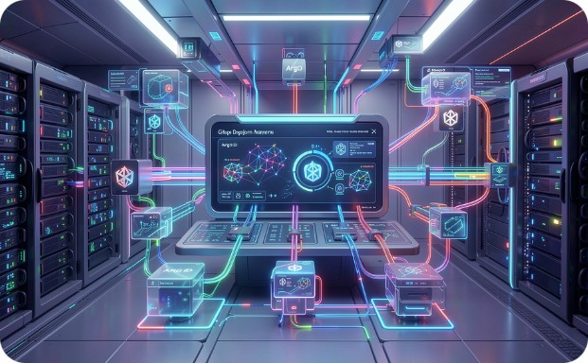

Platform Engineering, Developer Experience & Research OS
ShiVi treats the developer platform as a first-class product. Golden paths eliminate toil and enforce standards without restricting autonomy. Every service bootstrapped through the platform portal is production-ready by default.
Golden Paths
Infrastructure & GitOps
Research OS & Innovation Pipeline
Automated scaffold generation: repo structure, Dockerfile, test harnesses, OpenTelemetry instrumentation, SBOM generation, security scanning, CI/CD pipeline, policy definitions, SLO configuration, Grafana dashboards, runbooks, and rollback procedures — in one command.
Backstage developer portal with software catalog and TechDocs. Crossplane for infrastructure-as-code. Argo CD for GitOps reconciliation. Argo Rollouts for progressive delivery with canary analysis. OpenFeature for feature flag management. Environments span: local → dev → test → integration → staging → preview → canary → production → research → high-assurance.
Trajectory evaluation, benchmark integrity, adversarial probes, synthetic enterprise generator, cyber range, simulation engine, counterfactual decision engine, and digital twin. Research-to-production promotion follows: Experiment → Evaluation → Security Review → Canary → Approval → Production. No uncontrolled self-modification. All model, agent, prompt, tool, and data versions are pinned and reproducible.

Slide 10
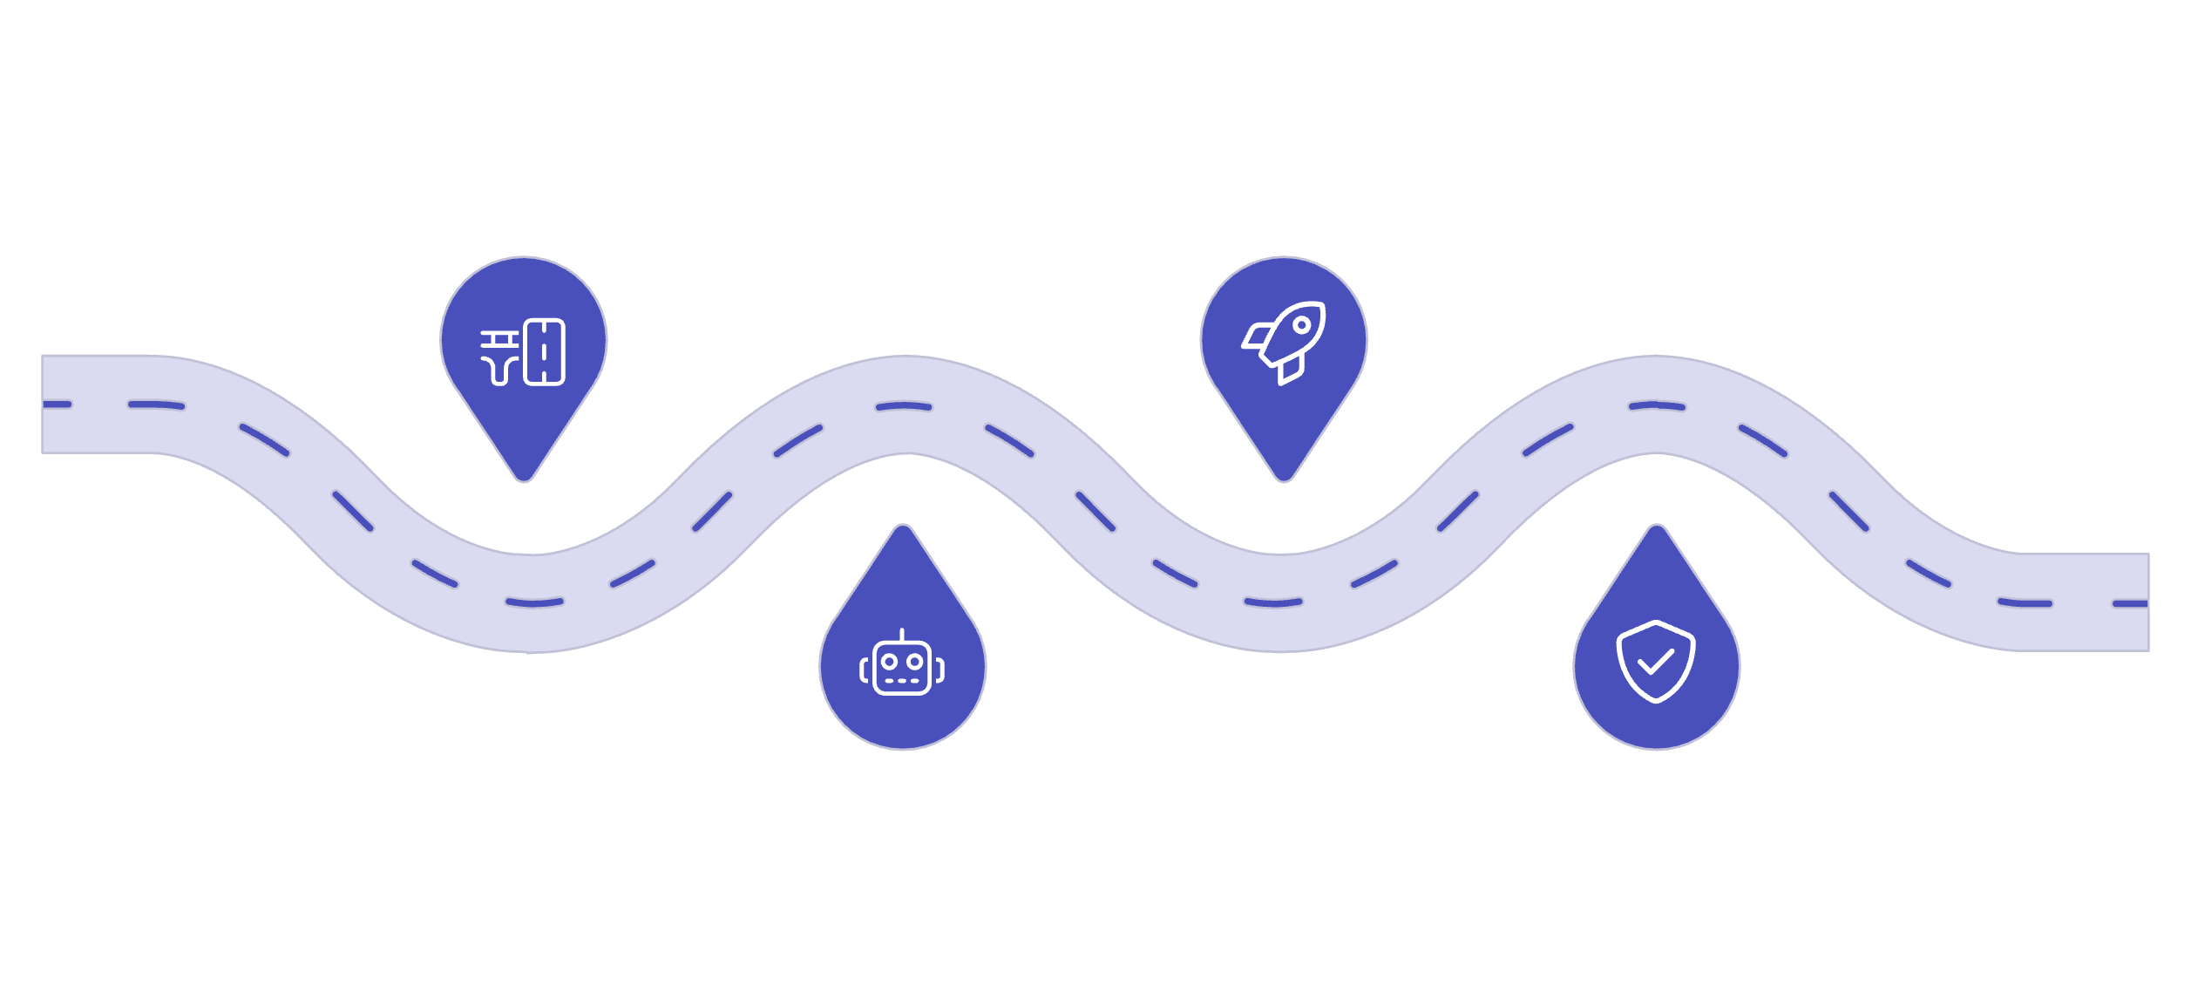

Technology Stack, Delivery Roadmap & KPIs
Core Technology Ecosystem
Delivery Phases & Readiness KPIs
Frontend
Backend
Phase 1
Phase 3
Next.js · React · TypeScript · Design tokens · AI-native UX · Streaming · Command palette · Accessibility · Visual regression
Node.js 24 LTS · Python · Fastify / NestJS · Zod / JSON Schema · Temporal · NATS / Kafka / Redpanda · MCP · A2A
Kernel & platform fabrics: identity, policy, gateway, observability
100-system portfolio rollout: GTM and Operations
AI / ML
Security
ShiVi AI Gateway · vLLM · KServe · MLflow · Ray · LLMOps · RAG · Context Compiler · Knowledge Graph
OpenFGA · OPA · Kyverno · OIDC/OAuth · SPIFFE/SPIRE · Cilium/Hubble · Sigstore/Cosign · Trivy · PQC
Observability
Platform
OpenTelemetry · Prometheus · Grafana · Loki · Tempo / Jaeger · Trajectory Evaluation · Benchmark Integrity
Kubernetes · Gateway API · Backstage · Crossplane · Argo CD · Argo Rollouts · OpenFeature · Terraform / OpenTofu
Phase 2
Phase 4
Core agent runtime and Context Loop MAX
Research OS and high-assurance production
17
Kernel Primitives
Contract-driven, versioned, enforced at runtime
12
Platform Fabrics
Shared cross-cutting layers across all systems
100
Systems Portfolio
Production and research systems on one kernel
10
Environments
From local dev to high-assurance production
Evidence states govern all delivery claims: UNKNOWN → DISCOVERED → PLANNED → IMPLEMENTED → TESTED → VERIFIED → PRODUCTION_READY. Target architecture is clearly distinguished from verified implementation at all times.

Slide 11




The Transformative Vision of ShiVi
ShiVi is more than a platform; it's a paradigm shift designed to unlock the full potential of enterprise intelligence. It redefines innovation, operational excellence, and strategic agility for the modern business landscape.
Unified Intelligence
Pioneering Architecture
Bridging disconnected data and AI silos with a single, intelligent operating kernel that orchestrates complex workflows across the enterprise.
A novel kernel-based approach enabling a 100-system ecosystem, setting new standards for AI deployment, security, and governance.
Operational Excellence
Future-Proof Security
Automating complex processes, enhancing decision-making, and ensuring reproducibility and auditability from research to production.
Integrating zero-trust principles and robust governance to protect sensitive data and AI assets against evolving threats.

Slide 12




Elastic Scalability & Resilience
ShiVi is engineered from the ground up for massive scale and unparalleled resilience, ensuring enterprise-grade performance and continuous availability even under extreme loads.
Horizontal Scaling
Fault Tolerance
Leveraging cloud-native microservices architecture, ShiVi scales horizontally across compute, data, and agent layers to meet fluctuating demand.
Built-in redundancy and self-healing mechanisms ensure that individual component failures do not disrupt overall system operation or data integrity.
Global Distribution
Performance Optimization
Designed for multi-region and multi-cloud deployments, providing low-latency access and compliance across diverse geographical requirements.
Continuous profiling, load testing, and intelligent resource allocation maintain peak performance and cost efficiency at scale.

Slide 13



Performance Evaluation & Assurance
ShiVi's comprehensive evaluation framework ensures continuous optimization, transparent impact measurement, and reliable performance across the entire enterprise intelligence ecosystem.
Metric-Driven Optimization
Reproducibility & Auditability
Real-time dashboards and custom alerts track key performance indicators (KPIs) and service level objectives (SLOs) to identify bottlenecks and opportunities for improvement.
Every agent, model, prompt, and data version is pinned, allowing for full traceability and recreation of any experiment or operational outcome.
Continuous Validation
Impact Measurement
Automated testing, A/B experimentation, and adversarial probes continuously validate system integrity, model accuracy, and policy effectiveness in dynamic environments.
Quantifiable business value is measured through defined metrics, demonstrating the tangible return on investment and strategic impact of ShiVi's capabilities.

Slide 14

The Problem: Disconnected Intelligence
Modern enterprises are grappling with a rapidly expanding landscape of data, applications, and AI models, leading to critical challenges that ShiVi is uniquely designed to solve.
Data Silos & Fragmentation
AI Disconnect & Governance Gap
Information is scattered across disparate systems, preventing a unified view and hindering intelligent decision-making at scale.
AI/ML models often operate in isolation, lacking consistent governance, lifecycle management, and integration into core business processes.
Security Vulnerabilities & Trust Deficit
Slow Innovation & Operational Friction
Fragmented security policies and opaque AI processes create exploitable loopholes and erode trust in automated systems.
Manual processes, complex deployment pipelines, and a lack of reproducibility stifle rapid experimentation and efficient operations.

Slide 15




ShiVi Across Industries & Business Functions
ShiVi's intelligent kernel and unified platform empower enterprises to transform operations and unlock new opportunities across diverse sectors and critical business functions.
Financial Services
Healthcare & Life Sciences
Enhance fraud detection, optimize algorithmic trading, and personalize customer experiences while ensuring regulatory compliance.
Accelerate drug discovery, improve diagnostic accuracy, and manage patient data securely for personalized treatment plans.
Manufacturing & Supply Chain
Retail & E-commerce
Enable predictive maintenance, optimize inventory, and create resilient supply chains through intelligent automation and forecasting.
Drive hyper-personalization, manage dynamic pricing, and streamline omnichannel operations for superior customer engagement.

Slide 16

Uncompromising Security: Zero-Trust AI Governance
ShiVi embeds security at its core, creating a resilient defense against evolving threats and ensuring trustworthy AI operations across the enterprise.
Zero-Trust Architecture
AI & Data Governance
Default deny, least privilege, and continuous verification enforce granular access to all resources and agents.
Robust policies, model integrity checks, and data privacy controls ensure responsible and compliant AI deployments.
Threat Intelligence & Response
Secure by Design
Proactive monitoring, anomaly detection, and automated incident response minimize exposure and mitigate risks in real-time.
Security is integrated throughout the entire development lifecycle, from kernel primitives to agent deployment.

Slide 17

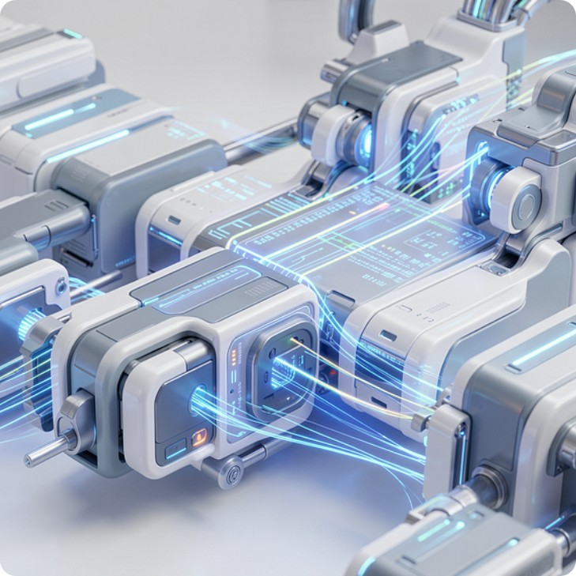

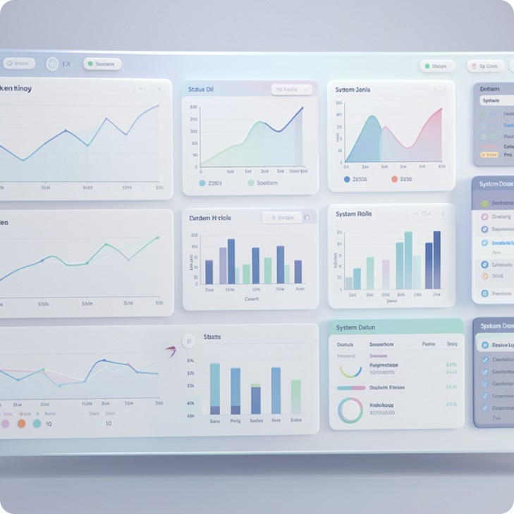
Seamless AI Pipelines & Data Flow
ShiVi unifies and automates the entire data and AI pipeline, ensuring fluid information exchange and efficient model lifecycle management from ingestion to deployment across the enterprise.
Unified Data Integration
Automated Workflow Orchestration
Connects and harmonizes disparate data sources across the enterprise, creating a single, trustworthy data foundation for AI.
Orchestrates complex AI/ML pipelines, automating training, validation, and deployment with robust versioning and reproducibility.
Real-time Processing & Delivery
End-to-End Observability
Enables high-throughput, low-latency processing for immediate insights, feeding intelligence directly into operational systems.
Provides comprehensive monitoring and logging across all pipeline stages for transparency, debugging, and continuous optimization.

Slide 18

Optimizing the AI Workflow
ShiVi integrates every phase of AI development and deployment, turning complex processes into a seamless, intelligent continuum.
From Data to Decision
ShiVi's unified platform streamlines the entire AI workflow, ensuring data integrity, efficient model training, and rapid, governed deployment. This accelerates the journey from raw insights to actionable intelligence, reducing friction and maximizing impact.
Automated data preparation and feature engineering
Scalable model training and validation
One-click deployment with built-in governance
Continuous monitoring and performance feedback

Slide 19




High-Performance AI Infrastructure
ShiVi is built upon a robust, scalable infrastructure, leveraging cutting-edge hardware and network capabilities to deliver unparalleled performance and reliability for enterprise AI.
Distributed Data Centers
Globally dispersed, secure data centers provide the foundation for massive data processing and low-latency access.
Accelerated GPU Compute
Dedicated GPU clusters power complex AI/ML models, enabling rapid training, inference, and real-time analytics.
High-Speed Interconnects
Ultra-fast network fabrics ensure seamless data flow and communication between all components of the ShiVi ecosystem.

Slide 20
Cost Optimization & Value Realization
ShiVi is engineered to deliver significant cost efficiencies and accelerate time-to-value, transforming AI from a capital expenditure into a strategic investment with measurable returns.
30%
50%
Operational Cost Reduction
Faster Time-to-Value
Streamlined processes and automated governance lead to a substantial decrease in AI operational expenses.
Rapid development, deployment, and integration capabilities enable quicker realization of AI benefits and ROI.
25%
—
Resource Utilization Efficiency
Predictable Spending
Intelligent resource allocation and optimized infrastructure maximize computational efficiency and minimize waste.
Transparent cost models and granular control provide clear visibility and predictability for AI investments.

Slide 21





Intuitive UI/UX & Intelligent Interaction
ShiVi is designed for seamless human-AI collaboration, transforming complex AI functionalities into intuitive, user-centric experiences for both developers and end-users.
Natural Language Interfaces
Visualizing AI Insights
Empower users to interact with AI through conversational UIs, making advanced capabilities accessible and user-friendly.
Translate complex AI outputs into clear, interactive dashboards that provide actionable intelligence at a glance.
Streamlined Developer Experience
Adaptive & Contextual UX
Offer intuitive tools and APIs that simplify the building, integration, and deployment of AI-powered applications.
Deliver interfaces that learn user preferences and adapt dynamically to provide relevant, personalized interactions.

