Slide 1

Heal Yourself With The Power Of Ayurveda

Slide 2
Stages
Understanding the problem
Proposed project Definition
Data Extraction
Data Cleaning
Data Transformation & Feature Selection
Incorporating Machine Learning Algorithms
Model Building
Testing & Deploying
Now, We will understand each stage of our project development one by one…

Slide 3
Problem Statement
In the 21st century Fast-paced life is the style of life. And also prices for everything is going up.
starting from the first breath we take in, food we consume, the polluted atmosphere in which we rome around, working stress ,depression everything is affecting precious body and mind health but living this fast life we really don’t have time to go to the doctor regularly and also we don’t want to spend money in the doctor’s high consultancy fees for every small problem.
So, The Solution for this problem is to involve a machine and Nature in the picture. So, this the main idea and purpose of the proposed project.

Slide 4
Project Definition
This project is based on diseases prediction and suggesting solution (i.e Home remedies) for the predicted diseases or symptoms added by user.
Existing Projects v/s Purposed Project
There are few diseases prediction projects in the market already in the market which will may predict the diseases acc. to provided symptoms and may get appointment of the doctor but main difference of this project is ,this project not only predict the diseases but also it will suggest the Home Remedies for those symptoms or predicted diseases.

Slide 5
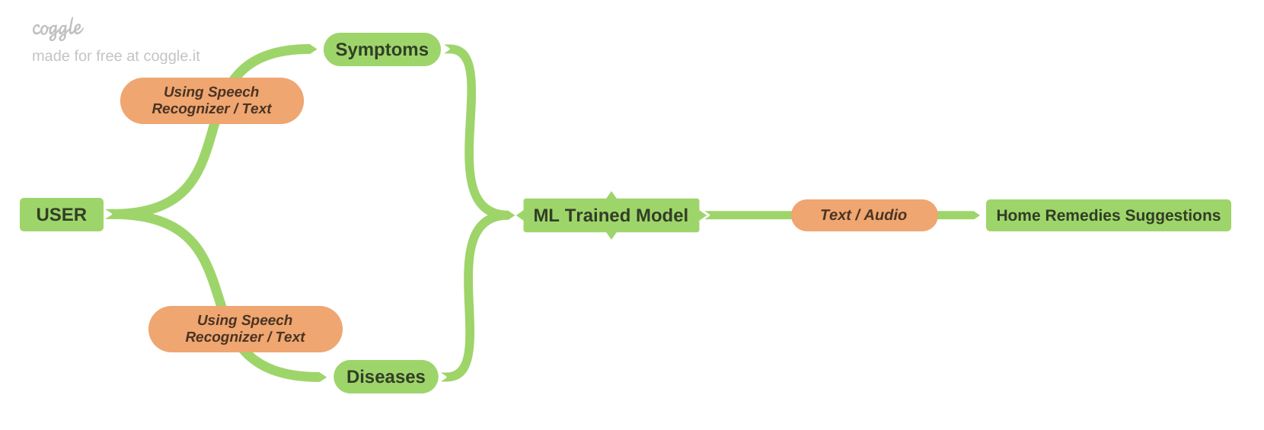

Slide 6
Functionalities Explained
First of all user will enter symptoms that he/she is facing via audio or directly text.
If input is given using audio then python speech recognizer will convert it into text else the direct text will be given input as ML trained model with the dataset.
Now, Using different algorithms of ML (like K-Means Clustering) it will suggest the user some home remedies according to entered symptoms.

Slide 7
Continue…
If user already knows the diseases name then that can also be entered directly.
Now, Using different algorithms of ML (like K-Means Clustering) it will suggest the user some home remedies according to entered diseases name.

Slide 8
Functionalities Can be added Later on…
more than one language recognition and converting to text
User friendly chat bot
Sending suggestion to the Contact number/email

Slide 9
Data Extraction
2nd Presentation
The Data Extraction means collecting data to analyse and build models for the proposed project.
Data Extraction can be done from various sources online, surveys, and existing Databases.
Here , For this project dataset is taken from the online source and from the local public survey in the form of diseases and it’s symptoms which they have suffered from.
So after the Data collection we have Dataset of around 5000 rows with Diseases and Symptoms.

Slide 10
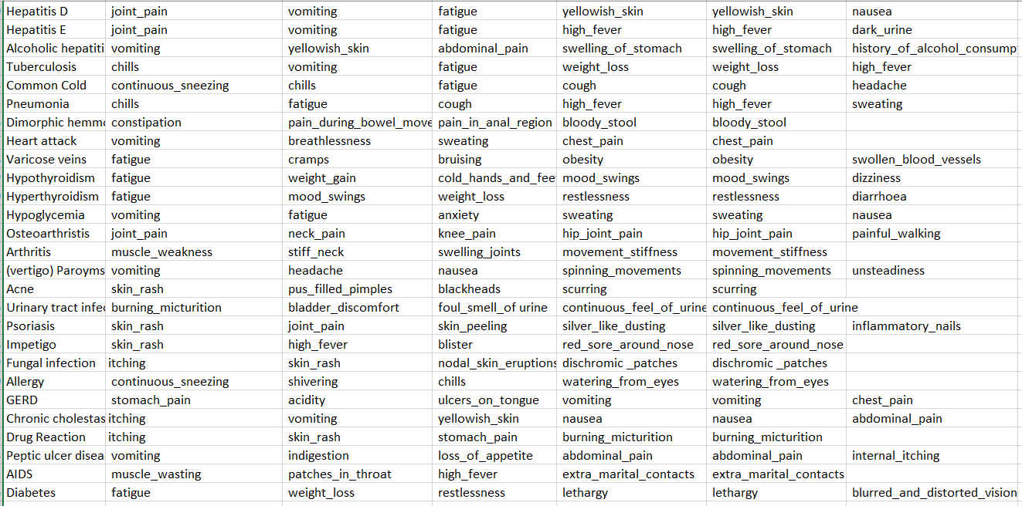
Snapshot of Dataset

Slide 11
Data Cleaning
Duplicate items are reduced from a variety of Databases.
Some of the missing values are filled with the past experience or may be set to ‘unknown’(i.e. 0)
The error with the input Data in terms of Precision.
Changes, Updates, and Deletions are made to the Data entries.
Variables with missing values across multiple Databases.
In Our Dataset, Some entries collected from local people were having data was not given properly may be due to lack of knowledge , any technical error , etc. all those things were handled here in this phase.

Slide 12
Data Transformation & Feature Selection
The Dataset that we have created previously is somewhat difficult for implementing different ML algos on that.
So, From that Format we have transformed our dataset into 0/1 format for the simplicity and better understanding.
Previously we were having only those symptoms which are related to that particular diseases , But In the new dataset we have 134 symptoms column for each 42 diseases samples taken (approx. 5000 ).Symptoms which are related to that diseases having value ‘1’, else ‘0’.
So Finally with this we are ready to implement ML algos on Dataset.

Slide 13
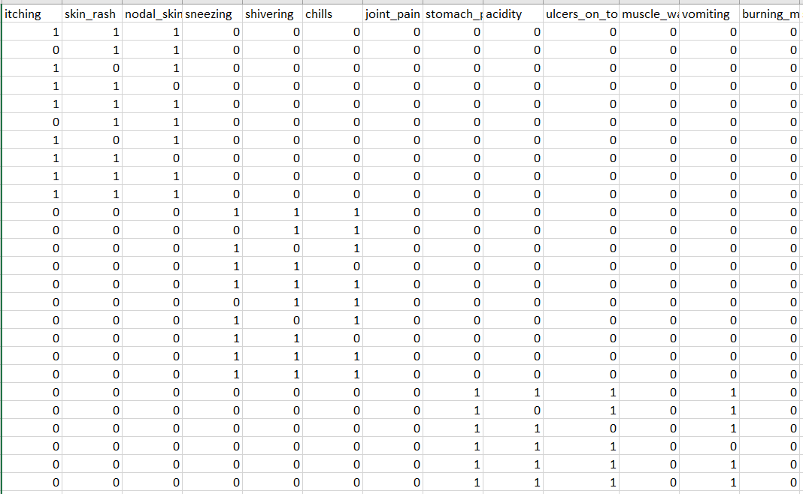
Snapshot of new dataset

Slide 14
Incorporating Machine Learning Algorithms
This is one of the most crucial processes in Data Science Modelling as the Machine Learning Algorithm aids in creating a usable Data Model. There are a lot of algorithms to pick from, the Model is selected based on the problem.
As we are going to use classification we can implement,
KNN
Naïve bayes
Random Forest
SVM

Slide 15
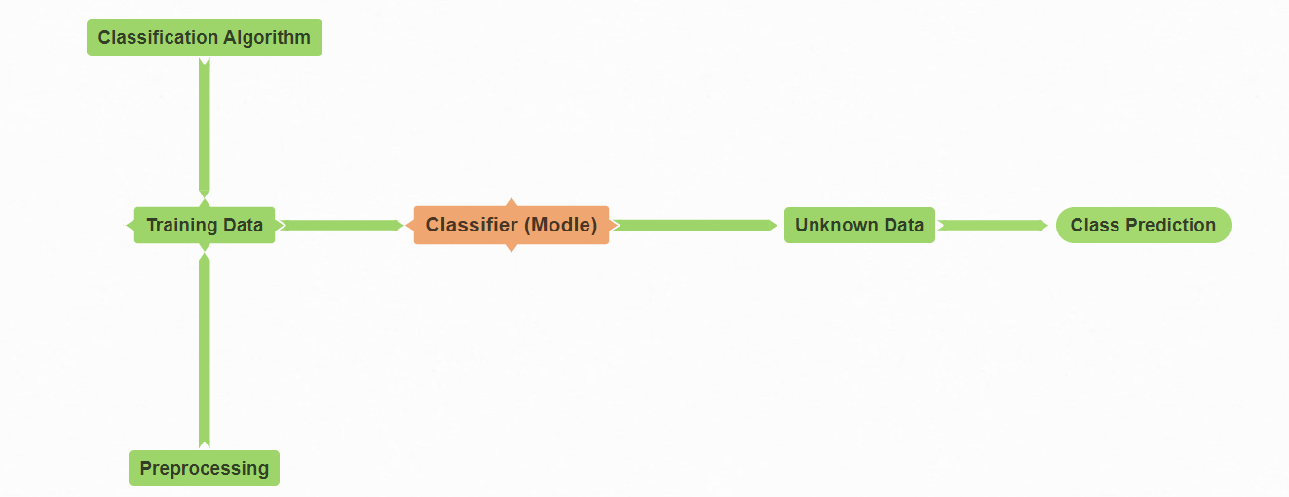

Slide 16
Model Building
Here We have Diseases as our class , so our ML model will be multiclass predictive model.
For that we need to follow 2 steps.
1.Traning Data
2.Testing Data
Training Data: It has pre-defined labels. Collected data it is divided into two parts – training and testing or validating data. Model created on training data and tested against the validating data whose labels are temporarily removed. 4. Confusion matrix is created to find the predicted labels and their validity. 5. Different measures available to find efficiency of model / classifier.
Testing Data: It has no labels .Our model predicts the labels.

Slide 17
Technical Feasibility System Specification
Software Specification
Hardware Specification
OS: windows 7 or higher
Python
Anaconda Distribution OR
Pycharm
Python Modules: e.g SpeechRecognition,
Pyaudio, NLTK , spacy, Sklearn etc…
Processor : intel® Core TM i3 cpu
RAM : 2 GB or higher
Disk Space : 5 GB or higher

Slide 18


UML Diagram – Use Case
Provide Symptoms
ML Model
User
Developer
Get Home Remedies

