Slide 1
BLUESTOCK
Mutual Fund Analytics
Capstone Project Presentation
40 Fund Schemes · Jan 2022 – Dec 2025 · ₹81 Lakh Crore Industry AUM
Bluestock Fintech Internship · June 2026
₹81L Cr
₹31K Cr
26.12 Cr
17% YoY
Total AUM
Peak SIP
Folios
SIP Growth

Slide 2
Problem & Objective
Why mutual fund analytics? What does this project solve?
📊 Problem
Retail investors lack quantitative tools to compare 1,900+ MF schemes on risk-adjusted metrics beyond simple returns.
🎯 Objective
Build an end-to-end platform: data ingestion → ETL → performance analytics → interactive Power BI dashboard → CLI fund recommender.
📈 Scope
40 SEBI-regulated schemes (Large/Mid/Small Cap, Debt, Hybrid), 2022–2025, covering NAV history, transactions, AUM, SIP flows.
Bluestock MF Analytics · Capstone Project 2026

Slide 3
Data Sources
10 structured datasets + live AMFI API (mfapi.in)
• Fund Master (40 funds)
• NAV History (~60K rows)
AMFI codes, risk grade, expense ratio
Daily NAV, 2022–2025, ffilled
• AUM by AMC (~300 rows)
• Monthly SIP Inflows (48)
Quarterly AUM per fund house
Inflows, accounts, YoY growth
• Investor Transactions (~50K)
• Benchmark Indices (~3.8K rows)
SIP/Lumpsum/Redemption + demographics
Daily NIFTY50, NIFTY100
• Live NAV — mfapi.in REST API
6 key funds fetched live
Bluestock MF Analytics · Capstone Project 2026

Slide 4
ETL Architecture
Four-stage pipeline — run_pipeline.py orchestrates all stages
1 Fetch
2 Clean
3 Analyse
4 Visualise
live_nav_fetch.py mfapi.in API
data_ingestion.py Validate & ffill
performance_analytics.py advanced_analytics.py
run_eda.py Power BI Dashboard
→
→
→
Database: SQLite star schema · dim_fund, dim_date, fact_nav, fact_transactions, fact_performance, fact_aum
Bluestock MF Analytics · Capstone Project 2026

Slide 5
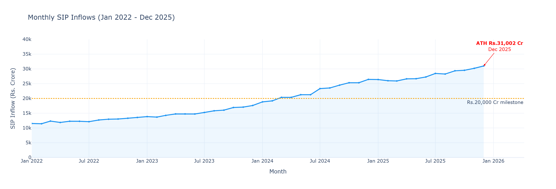
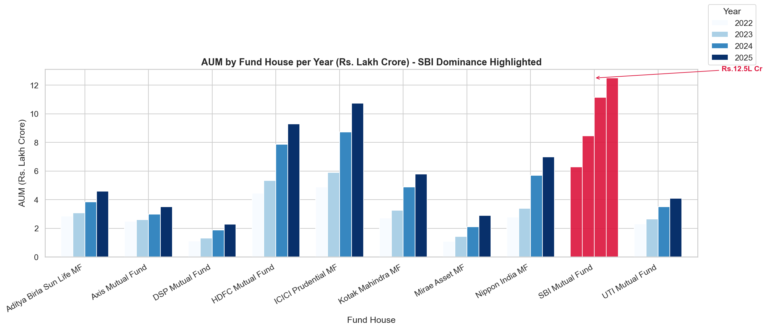
EDA Highlights — Industry Growth
SIP momentum & AUM dominance (2022–2025)
SIP: ₹11K Cr → ₹31K Cr ATH (Dec 2025)
SBI leads AUM at ₹12.5 Lakh Crore
Bluestock MF Analytics · Capstone Project 2026

Slide 6
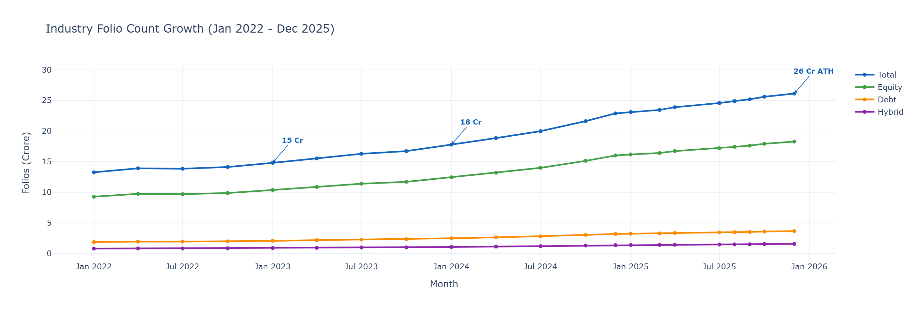
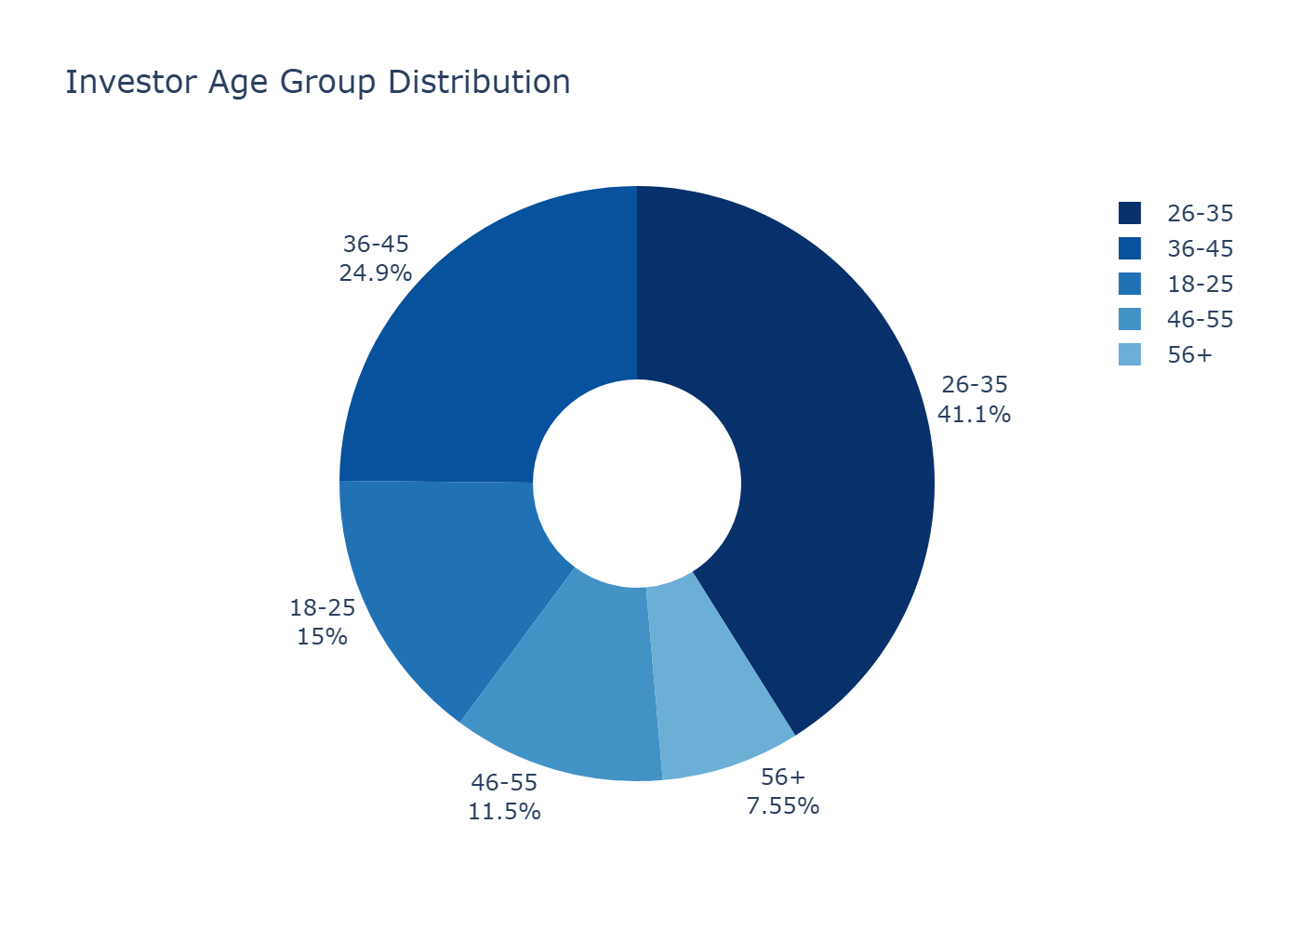
EDA Highlights — Investors & Folios
Demographics, geography, folio growth
Folios: 12 Cr (2022) → 26.12 Cr ATH (2025)
26–45 age group dominates SIP investing
Bluestock MF Analytics · Capstone Project 2026

Slide 7
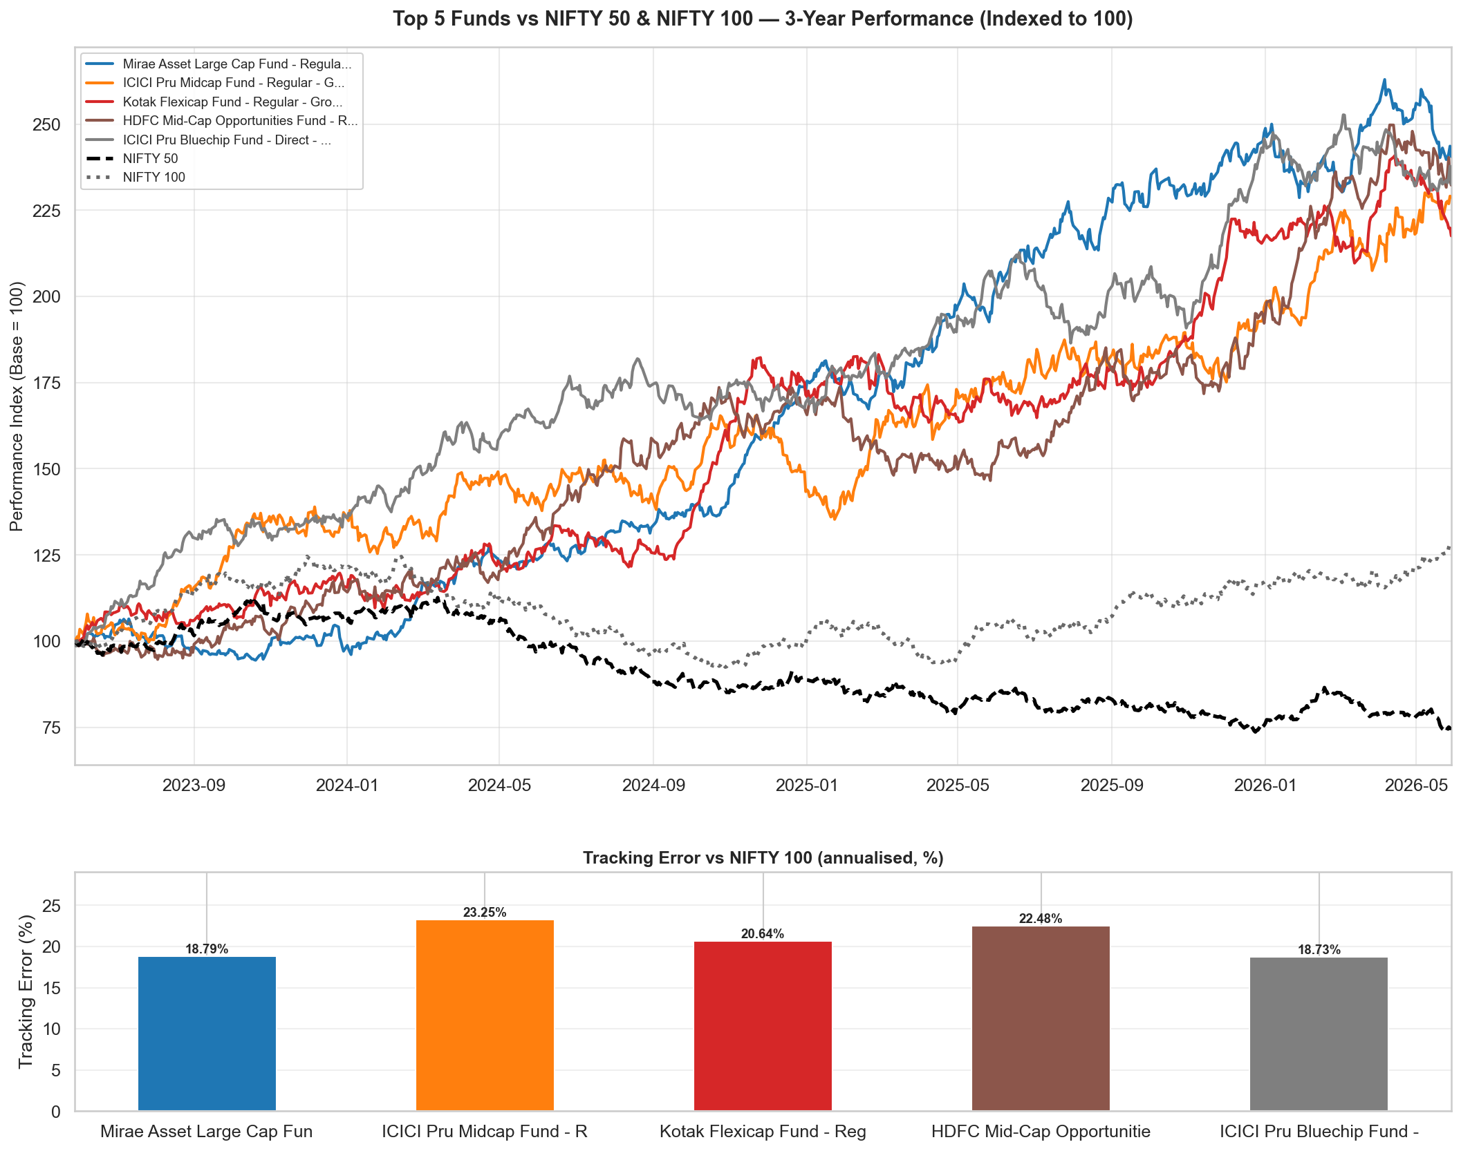
Performance — Benchmark Comparison
Top 5 funds vs NIFTY 50 & NIFTY 100 · 3-year indexed to 100
Top 5 funds: 15–18% CAGR vs NIFTY 100 ~13–14% · Direct plans beat Regular by 50–100 bps annually
Bluestock MF Analytics · Capstone Project 2026

Slide 8
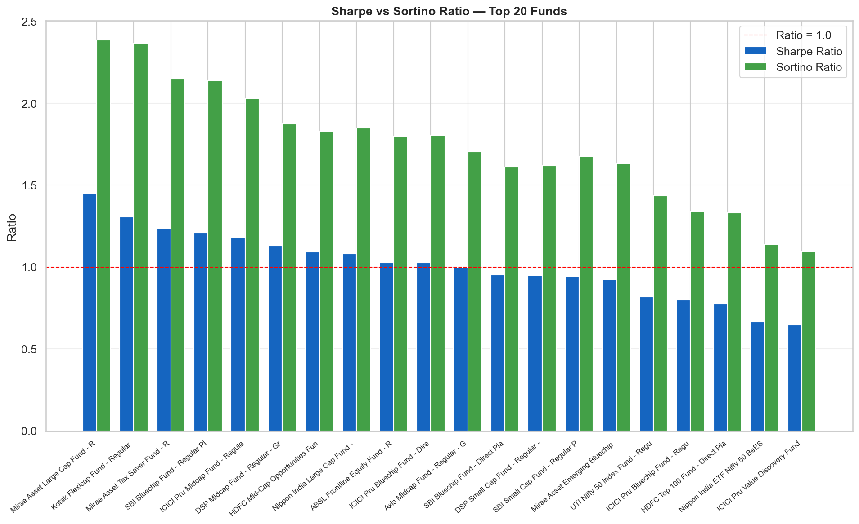
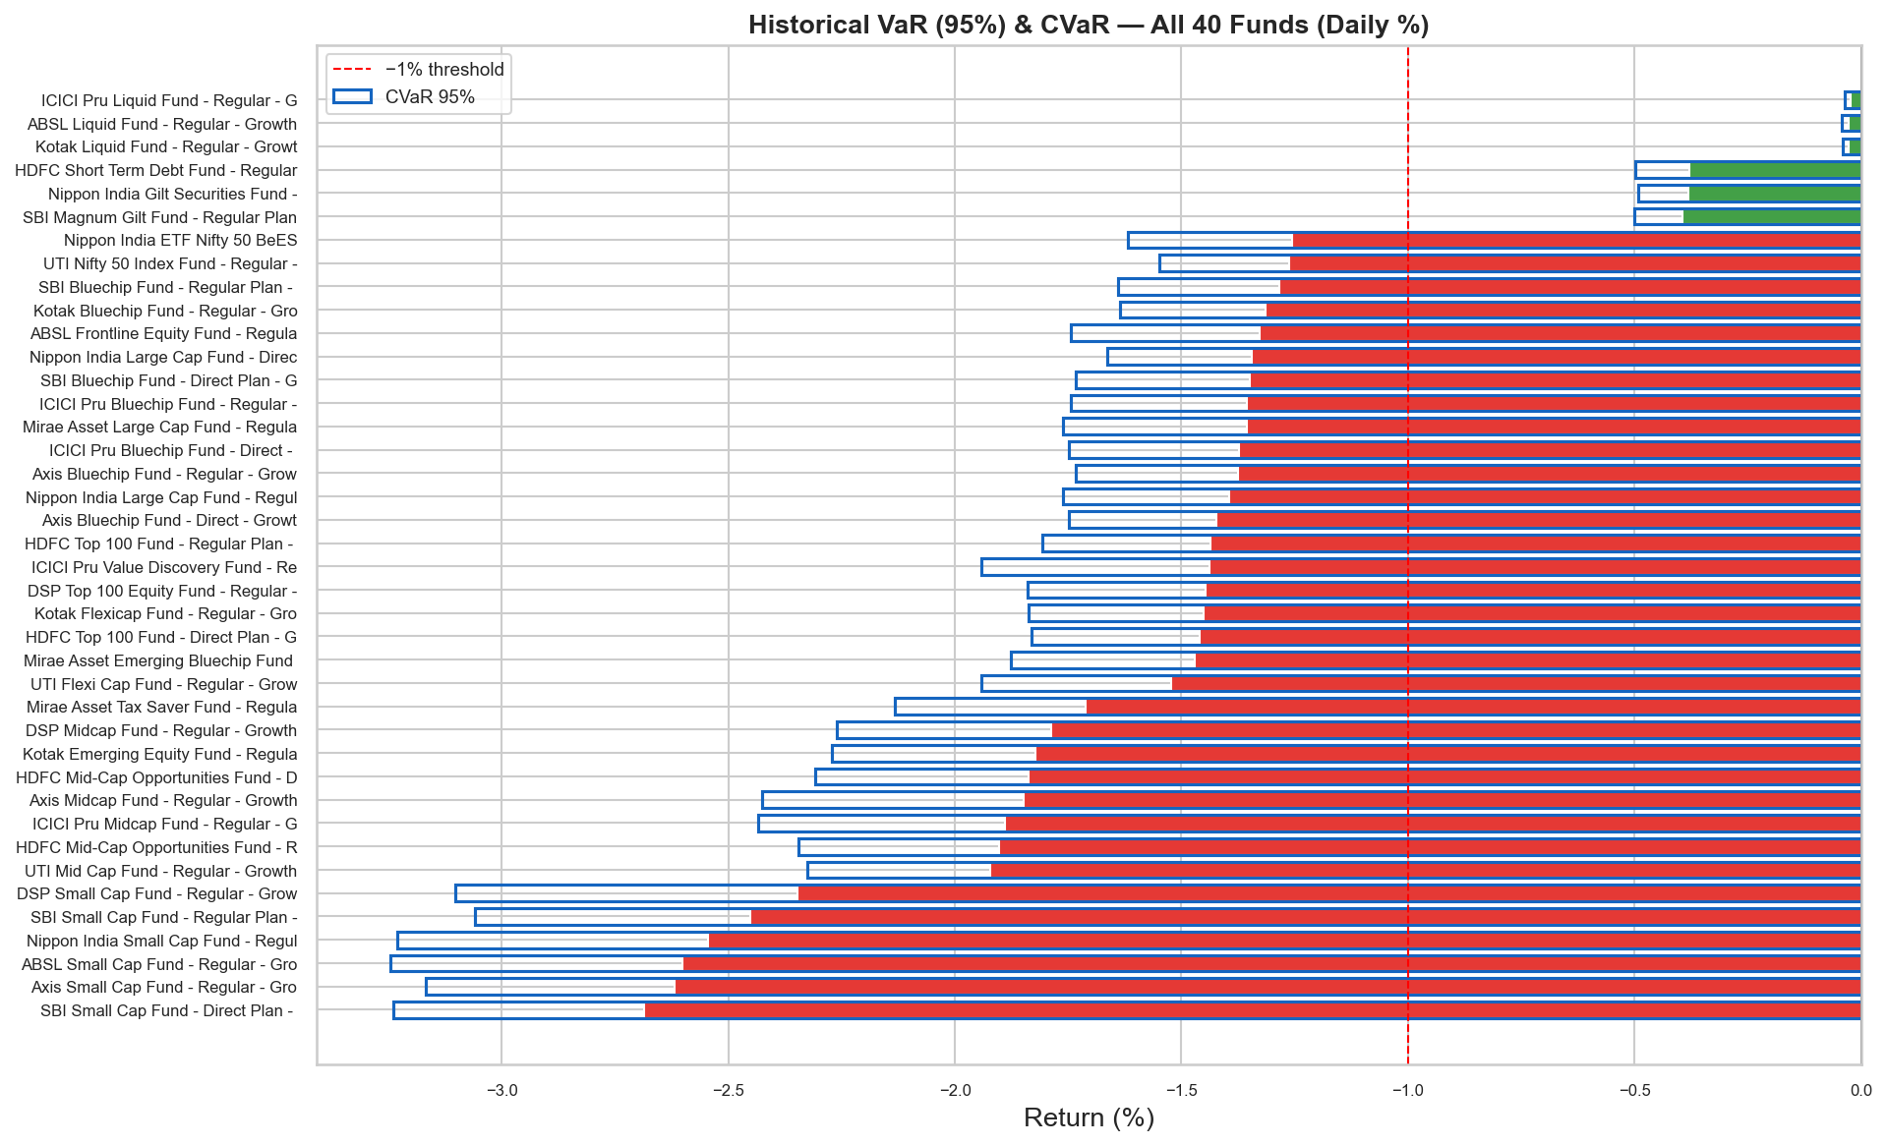
Performance — Risk-Adjusted Returns
Sharpe, Sortino, Alpha/Beta, VaR/CVaR
Sharpe: 1.05–1.48 for top equity funds
Daily VaR 95%: equity –0.9% to –1.4%
Bluestock MF Analytics · Capstone Project 2026

Slide 9
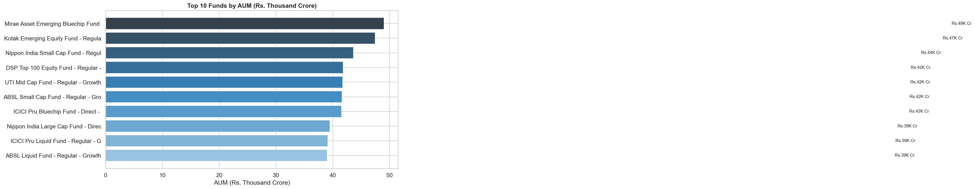
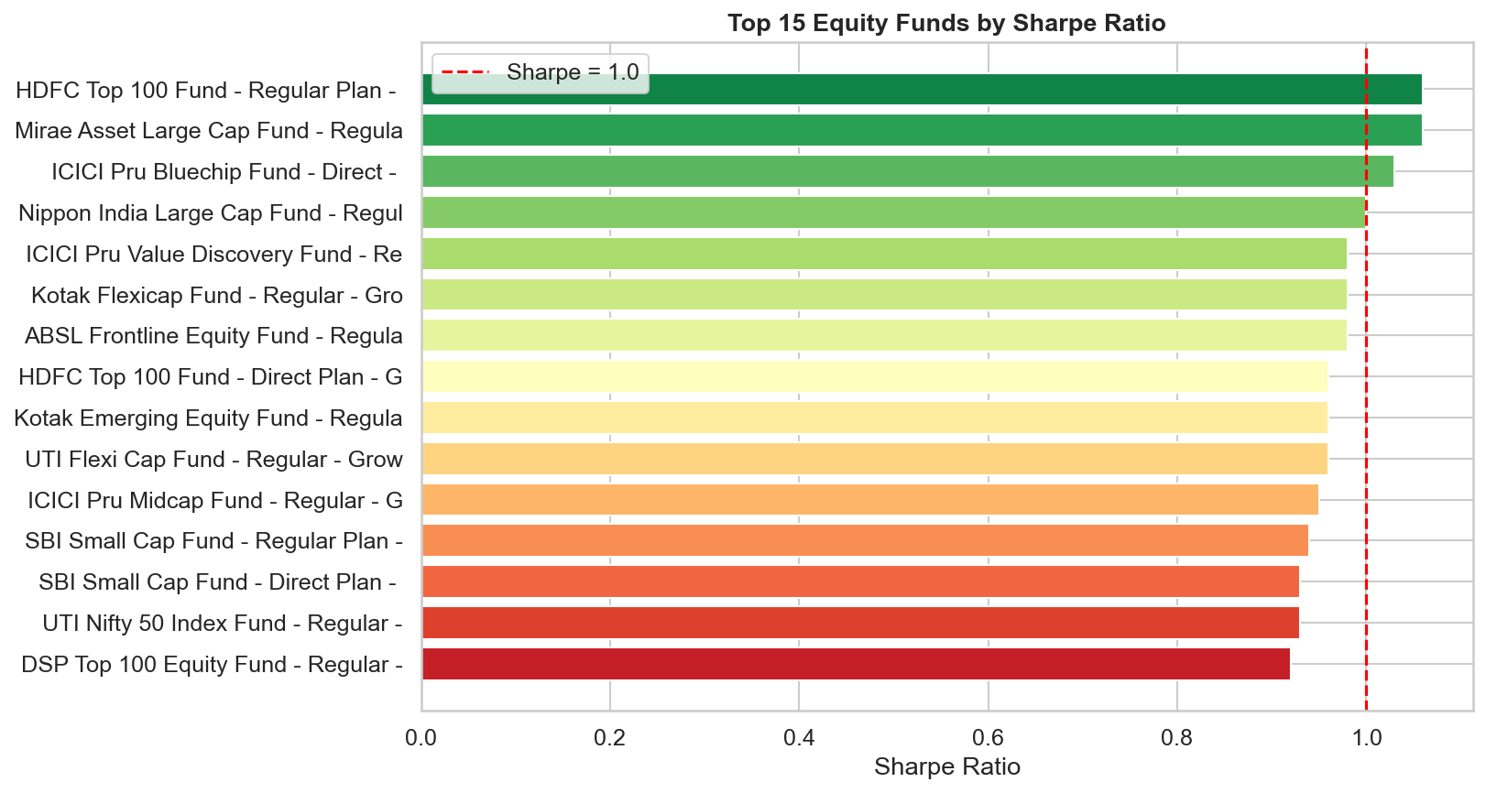
Dashboard — Industry Overview & Fund Performance
Power BI · Page 1 and Page 2
Page 1: KPIs (AUM, SIP, Folios) + AUM trend by AMC
Page 2: Risk-return scatter + Fund Scorecard table + drill-through
Bluestock MF Analytics · Capstone Project 2026

Slide 10
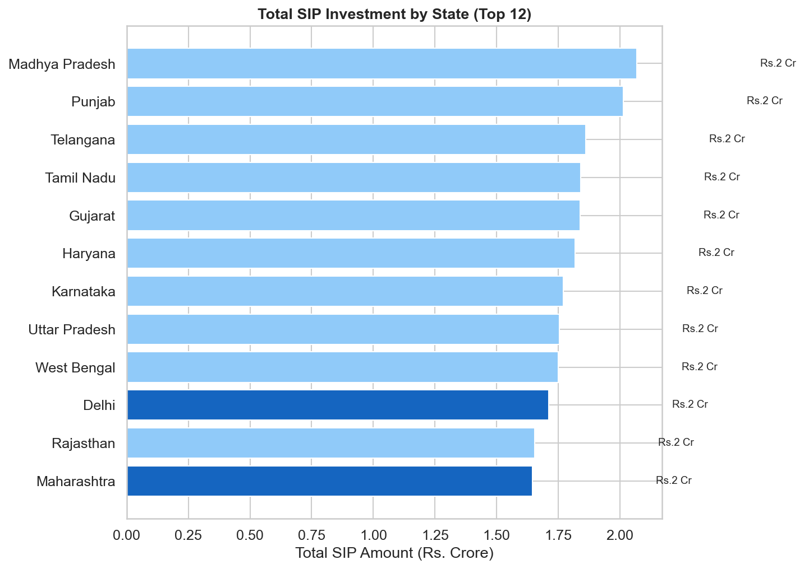
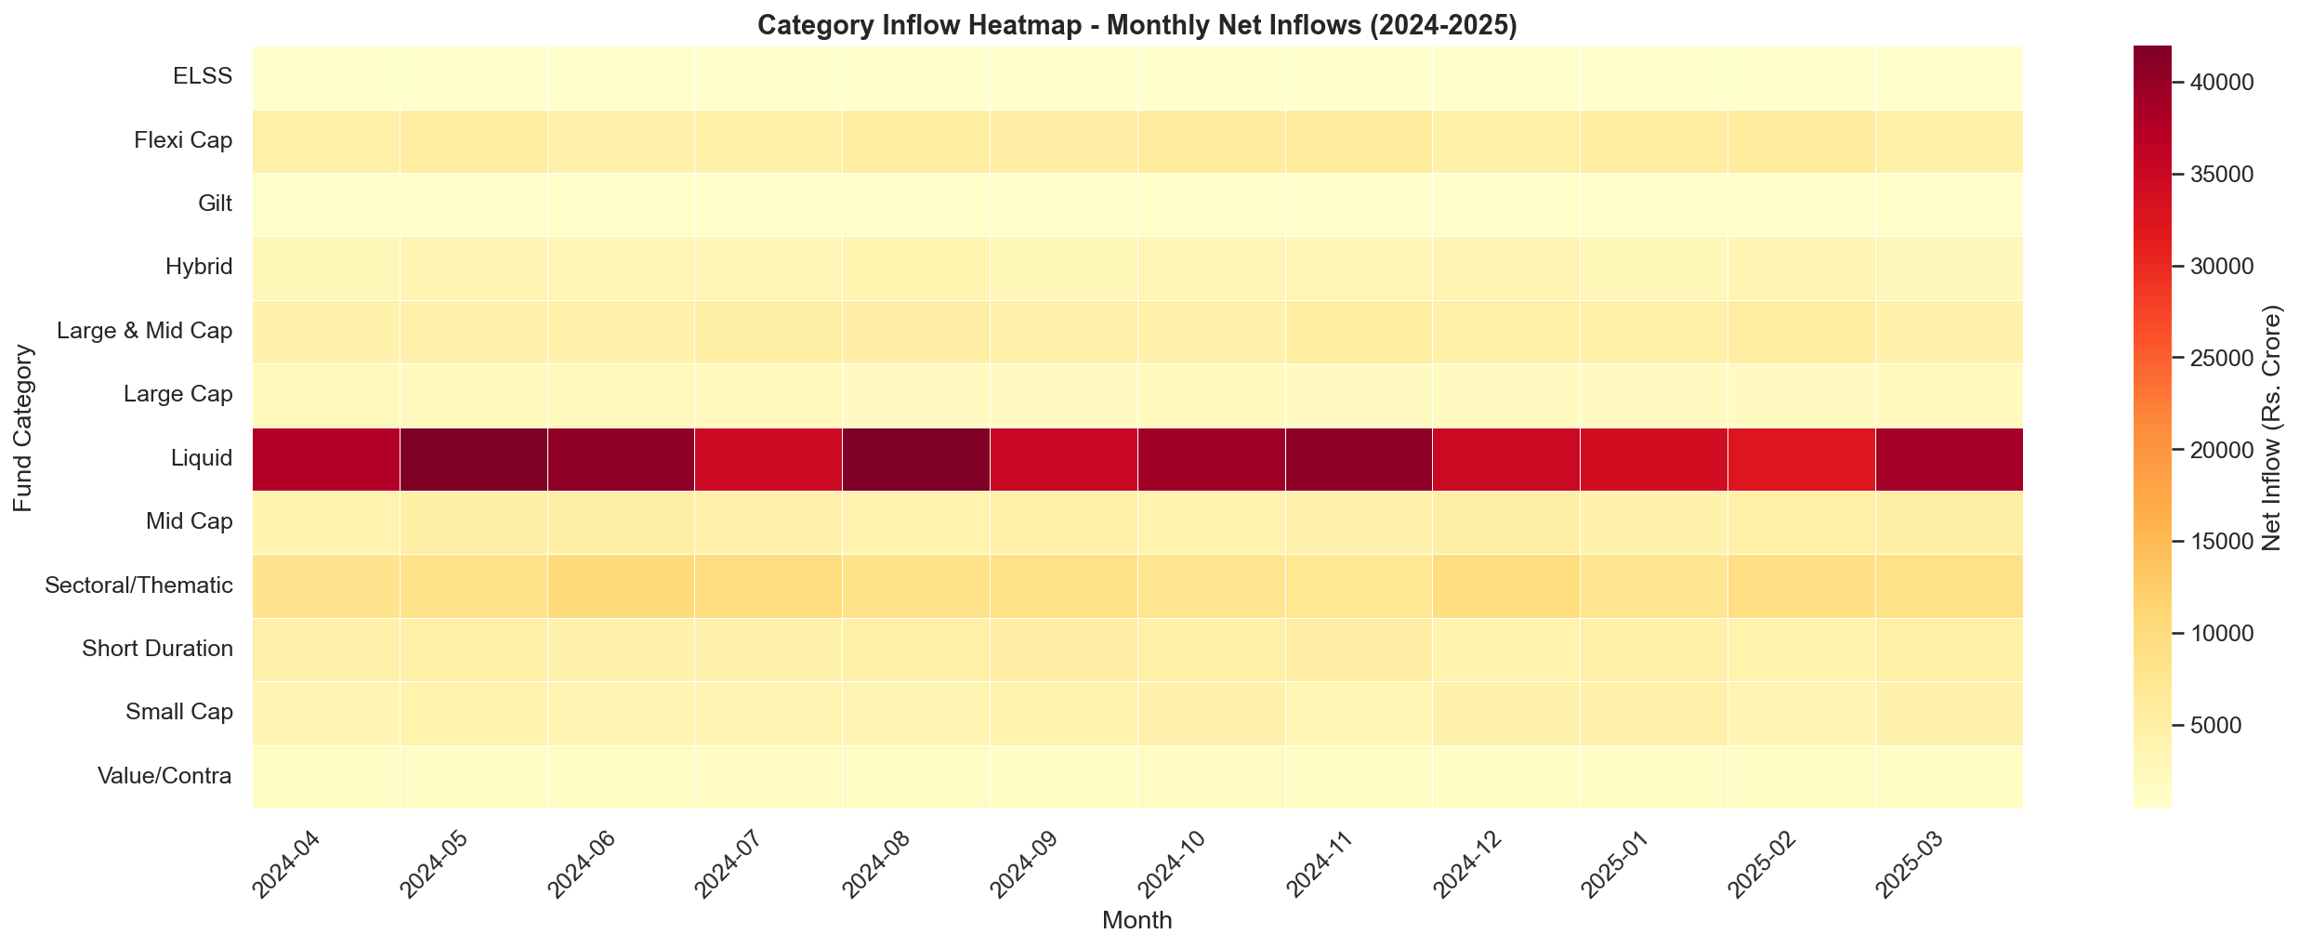
Dashboard — Investor Analytics & SIP Trends
Power BI · Page 3 and Page 4
Page 3: SIP by state, age analysis, monthly volume
Page 4: SIP vs Nifty 50 dual-axis + category heatmap
Bluestock MF Analytics · Capstone Project 2026

Slide 11
Key Findings
Eight evidence-backed insights from the analysis
• SIP ATH:
₹31,002 Cr in Dec 2025 — 17% YoY growth, 30% CAGR over 4 years
• AUM Leadership:
SBI MF ₹12.5L Cr; industry total ₹81L Cr — all AMCs grew 45–120%
• Quality Funds:
Alpha>1% AND Sharpe>1 — high-conviction invest. universe (SQL Q10)
• Direct Plans:
Direct beat Regular by 50–100 bps p.a. due to lower TER
• 2023/2024 Cycles:
2023 bull: Sharpe >1.5; 2024 correction: Sharpe compressed to 0.3–0.7
• T30 Dominance:
Maharashtra + Delhi drive >40% of SIP value; B30 growing faster
• SIP Continuity:
82% investors maintain regular cadence; 18% at-risk (gap>35 days)
• HHI / Sectors:
Most equity funds diversified (HHI<0.15); Fin. Services top sector ~28%
Bluestock MF Analytics · Capstone Project 2026

Slide 12
Thank You
Bluestock MF Analytics — Capstone Project v1.0
Source Code & Documentation
github.com/<your-username>/MutualFundAnalytics
📂
📊
🤖
📋
Datasets
Charts
Recommender
Dashboard
10 CSVs + 6 analytics outputs
30 publication-quality PNGs
python recommender.py --risk Moderate
4-page Power BI + 25 DAX measures

