Slide 1
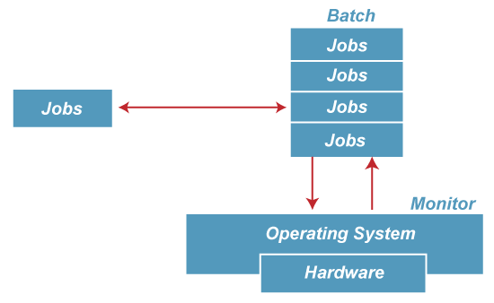
Types of Operating Systems (OS)
Batch operating system
In Batch operating system, access is given to more than one person; they submit their respective jobs to the system for the execution. The system put all of the jobs in a queue on the basis of first come first serve and then executes the jobs one by one. The users collect their respective output when all the jobs get executed.
Advantages of Batch OS
The use of a resident monitor improves computer efficiency as it eliminates CPU time between two jobs.
Resident Monitor: The purpose of this operating system was mainly to transfer control from one job to another as soon as the job was completed. It contained a small set of programs called the resident monitor that always resided in one part of the main memory.
Disadvantages of Batch OS
1. Starvation
Batch processing suffers from starvation.
There are five jobs J1, J2, J3, J4, and J5, present in the batch. If the execution time of J1 is very high, then the other four jobs will never be executed, or they will have to wait for a very long time. Hence the other processes get starved.
2. Not Interactive
Batch Processing is not suitable for jobs that are dependent on the user's input. If a job requires the input of two numbers from the console, then it will never get it in the batch processing scenario since the user is not present at the time of execution.

Slide 2
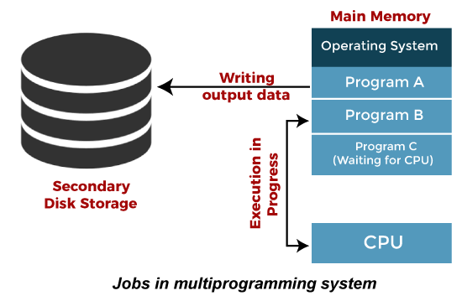
Multiprogramming Operating System
Multiprogramming is an extension to batch processing where the CPU is always kept busy. Each process needs two types of system time: CPU time and I/O time.
In a multiprogramming environment, when a process does its I/O, The CPU can start the execution of other processes. Therefore, multiprogramming improves the efficiency of the system.
Advantages of Multiprogramming OS
Throughout the system, it increased as the CPU always had one program to execute.
Response time can also be reduced.
Disadvantages of Multiprogramming OS
Multiprogramming systems provide an environment in which various systems resources are used efficiently, but they do not provide any user interaction with the computer system.

Slide 3
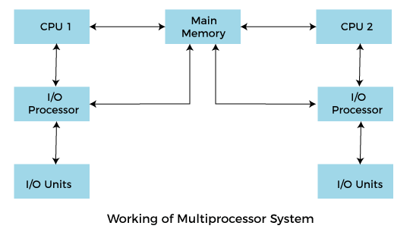
Multiprocessing Operating System
In Multiprocessing, Parallel computing is achieved. There are more than one processors present in the system which can execute more than one process at the same time. This will increase the throughput of the system.
Advantages of Multiprocessing operating system:
Increased reliability: Due to the multiprocessing system, processing tasks can be distributed among several processors. This increases reliability as if one processor fails, the task can be given to another processor for completion.
Increased throughout: As several processors increase, more work can be done in less.
Disadvantages of Multiprocessing operating System
Multiprocessing operating system is more complex and sophisticated as it takes care of multiple CPUs simultaneously.
Symmetric multiprocessing (SMP)
Each processor runs and identical copy of the operating system.
Asymmetric multiprocessing
Each processor is assigned a specific task; master processor schedules and allocated work to slave processors.
More common in extremely large systems

Slide 4
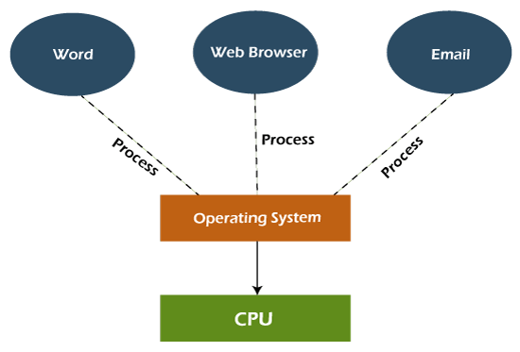
Multitasking Operating System
The multitasking operating system is a logical extension of a multiprogramming system that enables multiple programs simultaneously. It allows a user to perform more than one computer task at the same time.
Advantages of Multitasking operating system
This operating system is more suited to supporting multiple users simultaneously.
The multitasking operating systems have well-defined memory management.
Disadvantages of Multitasking operating system
The multiple processors are busier at the same time to complete any task in a multitasking environment, so the CPU generates more heat.

Slide 5
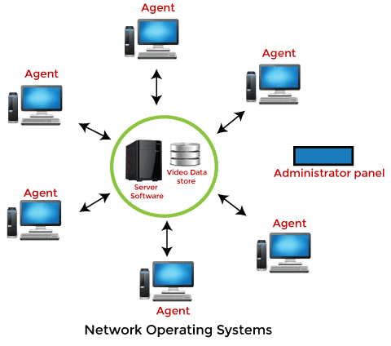
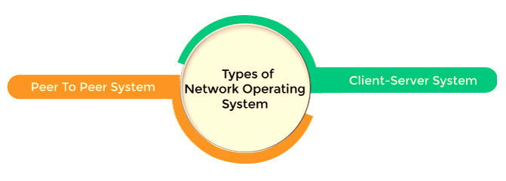
Network Operating System
An Operating system, which includes software and associated protocols to communicate with other computers via a network conveniently and cost-effectively, is called Network Operating System.
Advantages of Network Operating System
In this type of operating system, network traffic reduces due to the division between clients and the server.
This type of system is less expensive to set up and maintain.
Disadvantages of Network Operating System
In this type of operating system, the failure of any node in a system affects the whole system.
Security and performance are important issues. So trained network administrators are required for network administration.

Slide 6
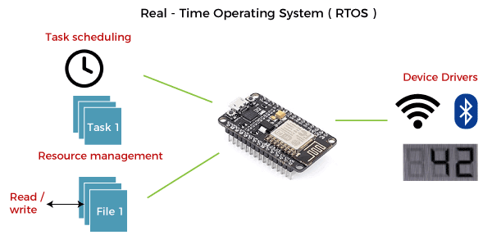
Real Time Operating System
In Real-Time Systems, each job carries a certain deadline within which the job is supposed to be completed, otherwise, the huge loss will be there, or even if the result is produced, it will be completely useless.
Advantages of Real-time operating system:
Easy to layout, develop and execute real-time applications under the real-time operating system.
In a Real-time operating system, the maximum utilization of devices and systems.
Disadvantages of Real-time operating system:
Real-time operating systems are very costly to develop.
Real-time operating systems are very complex and can consume critical CPU cycles.
Hard real-time:
Secondary storage limited or absent, data stored in short term memory, or read-only memory (ROM)
Conflicts with time-sharing systems, not supported by general-purpose operating systems.
Soft real-time
Limited utility in industrial control of robotics
Useful in applications (multimedia, virtual reality) requiring advanced operating-system features.

Slide 7
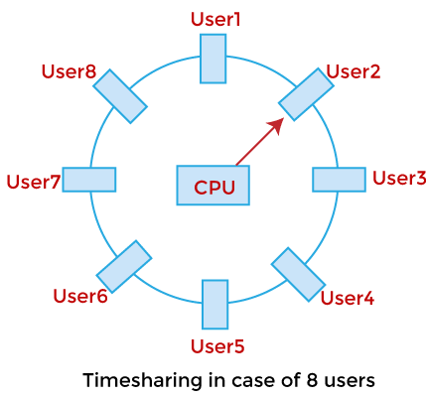
Time-Sharing Operating System
In the Time Sharing operating system, computer resources are allocated in a time-dependent fashion to several programs simultaneously. Thus it helps to provide a large number of user's direct access to the main computer. It is a logical extension of multiprogramming. In time-sharing, the CPU is switched among multiple programs given by different users on a scheduled basis.
Advantages of Time Sharing Operating System
The time-sharing operating system provides effective utilization and sharing of resources.
This system reduces CPU idle and response time.
Disadvantages of Time Sharing Operating System
Data transmission rates are very high in comparison to other methods.
Security and integrity of user programs loaded in memory and data need to be maintained as many users access the system at the same time.

Slide 8
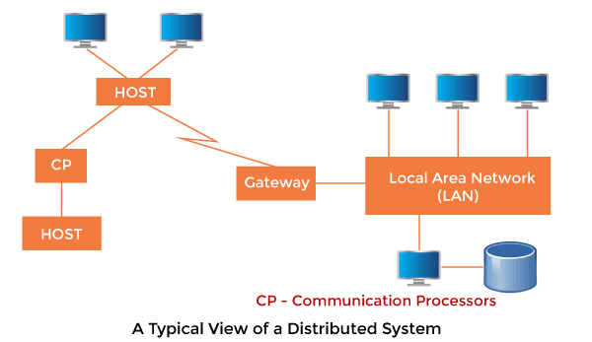
Distributed Operating System
The Distributed Operating system is not installed on a single machine, it is divided into parts, and these parts are loaded on different machines. A part of the distributed Operating system is installed on each machine to make their communication possible.
Distributed Operating systems are much more complex, large, and sophisticated than Network operating systems because they also have to take care of varying networking protocols.
Advantages of Distributed Operating System
The distributed operating system provides sharing of resources.
This type of system is fault-tolerant.
Disadvantages of Distributed Operating System
Protocol overhead can dominate computation cost.

Slide 9
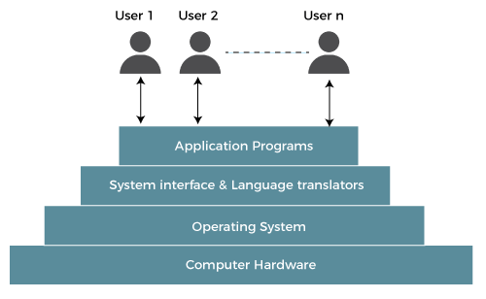
The operating system operates either in kernel mode or user mode. Compilers and editors run in user mode, whereas operating system code runs in kernel mode.
Operating system services:
The operating system gives several services to utility programmers and users.
Following are the services provided by an operating system -
Program execution
Control Input/output devices
Program creation
Error Detection and Response
Accounting
Security and Protection
File Management
Communication

Slide 10
Program execution
To execute a program, several tasks need to be performed. Both the instructions and data must be loaded into the main memory. In addition, input-output devices and files should be initialized, and other resources must be prepared. The Operating structures handle these kinds of multi-tasks.
Control Input/output devices
As there are numerous types of I/O devices within the computer system, and each I/O device calls for its own precise set of instructions for the operation. The Operating System hides that info with the aid of presenting a uniform interface. Thus, it is convenient for programmers to access such devices easily.
Program Creation
The Operating system offers the structures and tools, including editors and debuggers, to help the programmer create, modify, and debugging programs.
Error Detection and Response
An Error in a device may also cause malfunctioning of the entire device. These include hardware and software. To avoid error, the operating system monitors the system for detecting errors and takes suitable action with at least impact on running applications.
While working with computers, errors may occur quite often. Errors may occur in the:
Input/ Output devices: For example, connection failure in the network, lack of paper in the printer, etc.
User program: For example: attempt to access illegal memory locations, divide by zero, use too much CPU time, etc.
Memory hardware: For example, Memory error, the memory becomes full, etc.

Slide 11
Accounting
An Operating device collects utilization records for numerous assets and tracks the overall performance parameters and responsive time to enhance overall performance. These personal records are beneficial for additional upgrades and tuning the device to enhance overall performance.
Security and Protection
Operating device affords safety to the statistics and packages of a person and protects any interference from unauthorized users. The safety feature counters threats, which are published via way of individuals out of doors the manage of the running device.
For Example:
When a user downloads something from the internet, that program may contain malicious code that may harm the already existing programs. The operating system ensures that proper checks are applied while downloading such programs.
If one computer system is shared amongst a couple of users, then the various processes must be protected from another intrusion. The Operating System include providing unique users ids and passwords to each user.
File management
Computers keep data and information on secondary storage devices like magnetic tape, magnetic disk, optical disk, etc. Each storage media has its capabilities like speed, capacity, data transfer rate, and data access methods.
Communication
The operating system manages the exchange of data and programs among different computers connected over a network.

