Slide 1
Agentic coding
Or rather everything BUT the coding

Slide 2
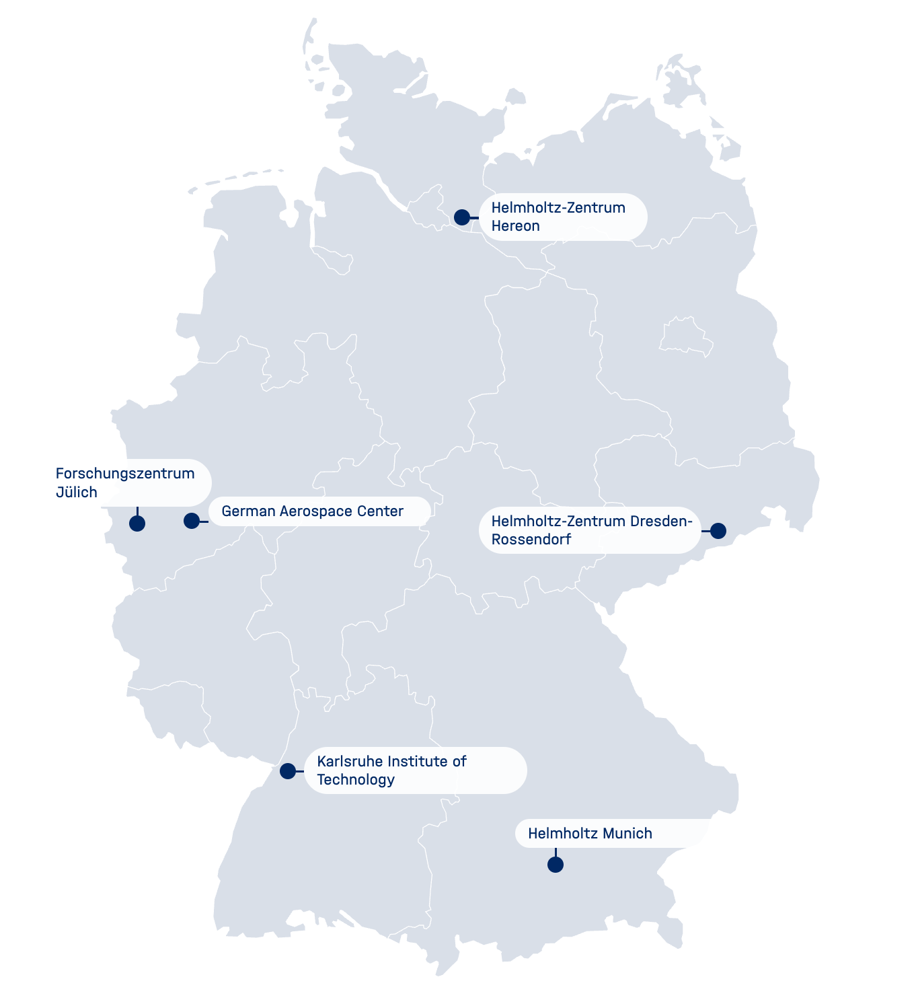





Who are we?
What is our mission?
Maximise research impact by democratizing access to AI
How do we do it?
Short- to mid-term scientific collaboration
Free of charge
Easy application
https://voucher-system.helmholtz.ai/
Till
Korten
Donatella
Cea
Karol Szustakowski
Serena Sritharan

Slide 3
Agenda
Intro to agentic coding
Software engineering practices with Agentic coding
Setup (OpenCode + Blablador API key)
Hands-on implementation (+ presentations at the end)

Slide 4
Software engineering done right
Phase | Key activities | Deliverables
1. Planning | Identify project scope, goals and requirements | Initial project plan
2. Analysis | Gather and review data on project requirements | Fully detailed requirement documentation
3. Design | Define project architecture | Software design document (SDD)
4. Coding | Write initial code | Functional software prototype
5. Testing | Review code and eliminate bugs | Refined, optimized software
6. Deployment | Deploy code to production environment | Software available to end users
7. Maintenance | Continual fixes and improvements | Updated and optimized code
Source: www.ibm.com/think/topics/sdlc/jcr%3Acontent

Slide 5
Software engineering done right
Phase | Key activities | Deliverables
1. Planning | Identify project scope, goals and requirements | Initial project plan
2. Analysis | Gather and review data on project requirements | Fully detailed requirement documentation
3. Design | Define project architecture | Software design document (SDD)
4. Coding | Write initial code | Functional software prototype
5. Testing | Review code and eliminate bugs | Refined, optimized software
6. Deployment | Deploy code to production environment | Software available to end users
7. Maintenance | Continual fixes and improvements | Updated and optimized code
Human input required
Agentic coding figures this out*
Human input required
Source: www.ibm.com/think/topics/sdlc/jcr%3Acontent
*for the most part

Slide 6
planning
Problem / project description : What problem are we solving?
Goals & outcomes : What do we want to achieve?
Stakeholders & users : Who is involved or affected?
User needs / use cases : What do users need to do?
Scope : What is included and excluded?
Requirements & constraints : What must we consider from the start?
Feasibility : Can we realistically build it?
Technical approach : What is the initial technical direction?
Risks & assumptions : What could go wrong, and what are we assuming?
Resources & responsibilities : Who does what?
Milestones & timeline : What are the key dates and deliverables?
Development approach : How will we organize the work?
Quality, security & compliance : What standards must we meet?
Success criteria : How will we know we succeeded?
Create your SPEC.md now!
Tip: do not use an LLM to generate it, use it to help you ideate. A brief spec is better than a huge generated one. Make it a source of hard truths!
Check out https://notes.desy.de/

Slide 7
planning
Problem / project description : What problem are we solving?
Goals & outcomes : What do we want to achieve?
Stakeholders & users : Who is involved or affected?
User needs / use cases : What do users need to do?
Scope : What is included and excluded?
Requirements & constraints : What must we consider from the start?
Feasibility : Can we realistically build it?
Technical approach : What is the initial technical direction?
Risks & assumptions : What could go wrong, and what are we assuming?
Resources & responsibilities : Who does what?
Milestones & timeline : What are the key dates and deliverables?
Development approach : How will we organize the work?
Quality, security & compliance : What standards must we meet?
Success criteria : How will we know we succeeded?
Create your SPEC.md now!
Tip: do not use an LLM to generate it, use it to help you ideate. A brief spec is better than a huge generated one. Make it a source of hard truths!

Slide 8
PLANNING
Problem / project description : What problem are we solving?
Goals & outcomes : What do we want to achieve?
Stakeholders & users : Who is involved or affected?
User needs / use cases : What do users need to do?
Scope : What is included and excluded?
Requirements & constraints : What must we consider from the start?
Technical approach : What is the initial technical direction?
Development approach : How will we organize the work?
Quality, security & compliance : What standards must we meet?
Success criteria : How will we know we succeeded?
Create your SPEC.md now!
Tip: do not use an LLM to generate it, use it to help you ideate. A brief spec is better than a huge generated one. Make it a source of hard truths!

Slide 9
ANALYSIS
We will shorten the analysis stage today, let’s focus just on the user stories.
Let’s write them one person at a time. Keep them detailed:
Good example: I click the “render” button at the bottom of the interface, and the image is rendered on top of the button in color with a brightness slider to the right”.
Bad example: I click render and can see the image and adjust the brightness.
If you want to include more details here:
What performance, reliability, security, etc. are required? → known as non-functional requirements
What data is needed, produced, and stored?
What other systems or components are involved?
What technical, organizational, or regulatory limits apply?
What functions and behaviors are needed? → known as functional requirements

Slide 10
Design – tech stack
Drop your SPEC.md into an agent, and ask it:
Which coding frameworks can be used to achieve this (frontend, backend)?
What are the considerations for each of the frameworks. What are the limitations?
What is the best pipeline for testing and creating this software with you if my coding expertise is [your coding expertise]?
Which framework would you recommend, and why?
Do not let the agent implement JavaScript or Python or [your language of choice] from scratch! Use a framework!

Slide 11
Design
Give it a read and decide on:
your frontend and backend frameworks (if they apply),
your UI/UX frameworks (if they apply),
your testing setup,
your build and deployment setup.

Slide 12
Design (part of spec.md)
## Technical Stack
### Frontend
Next.js
### Backend
FastAPI
### UI/UX
Tailwind CSS + component library – material tailwind
### Testing
Pytest– no end-to-end tests here
### Build
Local – no docker or other containers for this prototype
### Deployment
Local

Slide 13
Design (part of spec.md)
## Development framework
Use the waterfall model for this software and implement everything end-to-end.
OR
## Development framework
Use an agile for this software and include me in feedback loops often. Implement one feature at a time.
OR
## Development framework
Use the RAD model, deliver the first working prototype as soon as possible.

Slide 14
How to split your work if the agent does the coding?
Team Collaboration
Create a GitHub repository and upload your SPEC.md (and other relevant files) there.
Keep a TODO.md in the repository.
Continuously test the app while the agent is developing it.
Add bugs, requests, and observations to TODO.md.
For larger teams, use one TODO file per person, e.g. TODO_Matthias.md, TODO_Mike.md → No git? No problem! Just send your files to the person running the agent.
Tell the agent (in SPEC.md):
“Team members will add requests and bugs to the TODO files in this repository. Check them after each major change. When you find new items, address them where appropriate. Do not modify the TODO files, keep your own DONE.md to mark finished tasks.”

Slide 15
Before you start building
Take your finished SPEC.md to your agent, ask it to read it and ask it to ask you any questions which would clarify anything about the project which is yet unclear.

Slide 16
OUR TIP
Whenever possible, use Test-Driven-Development (TDD). Ask the agent to write tests first, and only then proceed with writing the software. Without end-to-end tests, this might be difficult for web apps, but the core functions can still usually be tested with unit tests.
An idea for this workshop:
“Start with a TDD setup, write tests which do not require a long time to run but will verify the core logic. Run the tests and verify that they fail. Do not use end-to-end tests which require long runtimes. Aim for a high test coverage”.

Slide 17
Time to press play!
Take your finished SPEC.md to your agent, ask it to read it and ask it to ask you any questions which would clarify anything about the project which is yet unclear.
After the questions are answered, ask the agent to start working. You can put some relevant answers in a FAQ section of your SPEC.md, too.
You just learned spec-driven-development!

Slide 18
Questionnaire
Please take a couple of minutes to provide feedback

Slide 19
Thank you
Notes:
Maybe a short example with hugginface?

Slide 20
Resources
Introductory slides : https://github.com/Helmholtz-AI-Matter/coding-assistants
Slides on hands-on session : https://github.com/HelmholtzAI-Consultants-Munich/agentic-coding-hands-on
Workshop page (shared with participants) : https://notes.desy.de/OZCosgehTVeEJWbqQ3quwg?view

