Slide 1
HMKSocialHub
Web Application for Virtual Interaction

Slide 2


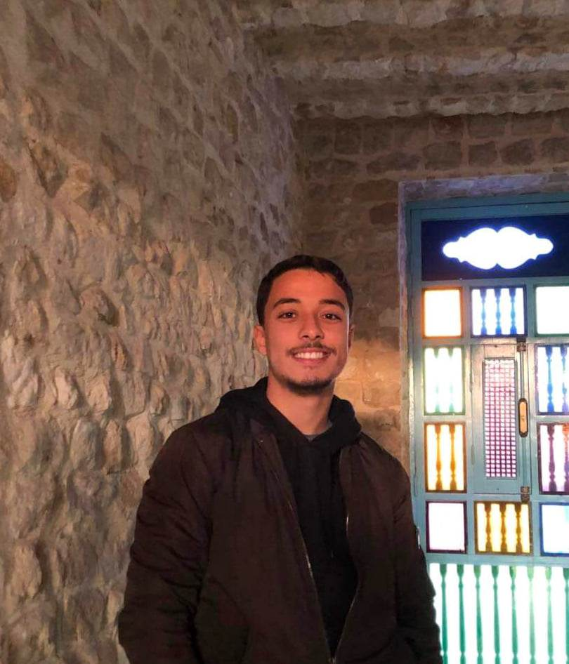
About US
Mahdi Mzoughi
Mern Stack Web Dev
Helmi Lakhder
AI Enthusiast
Khalil Ben Makhlouf
Machine Learning Dev

Slide 3
Why ?

Slide 4
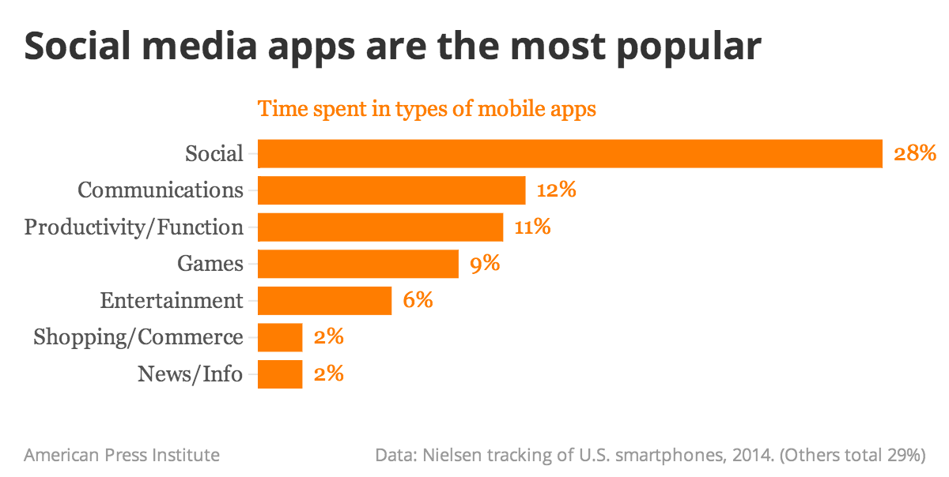
Social Media App are the most popular

Slide 5
HMKSocialHub

Slide 6
Easy to use Application
Gives indication about time use
Supports and Encourages the User
Aim

Slide 7




Tech Stack
Django
PostgreSQL
HTML-CSS-JS

Slide 8
Features

Slide 9









Slide 10

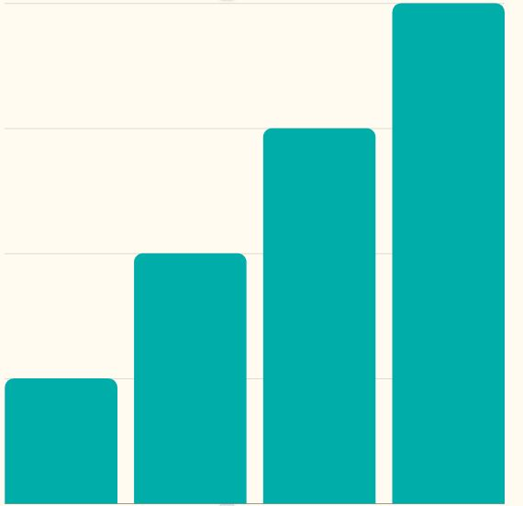
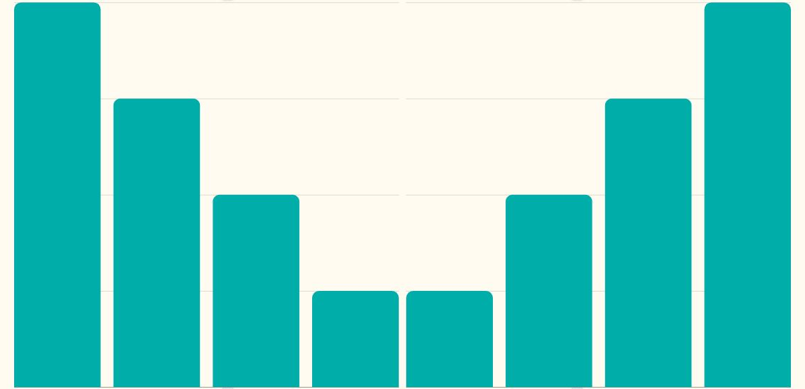
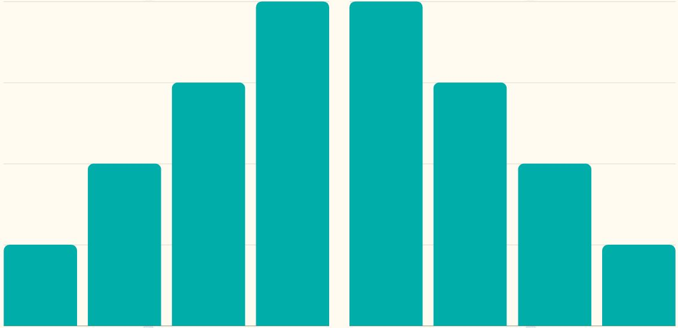
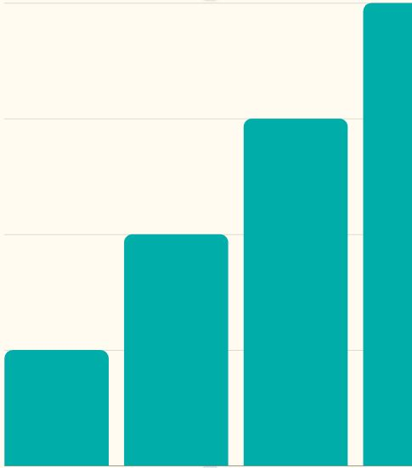
Proﬁle Section
Contains information about user
Gives analysis of all following/followers/posts
Gives detailed uploaded pictures with a smooth slide

Slide 11

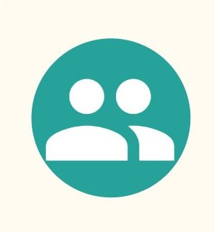
Informative Design
User - Friendly

Slide 12
UML Diagrams

Slide 13
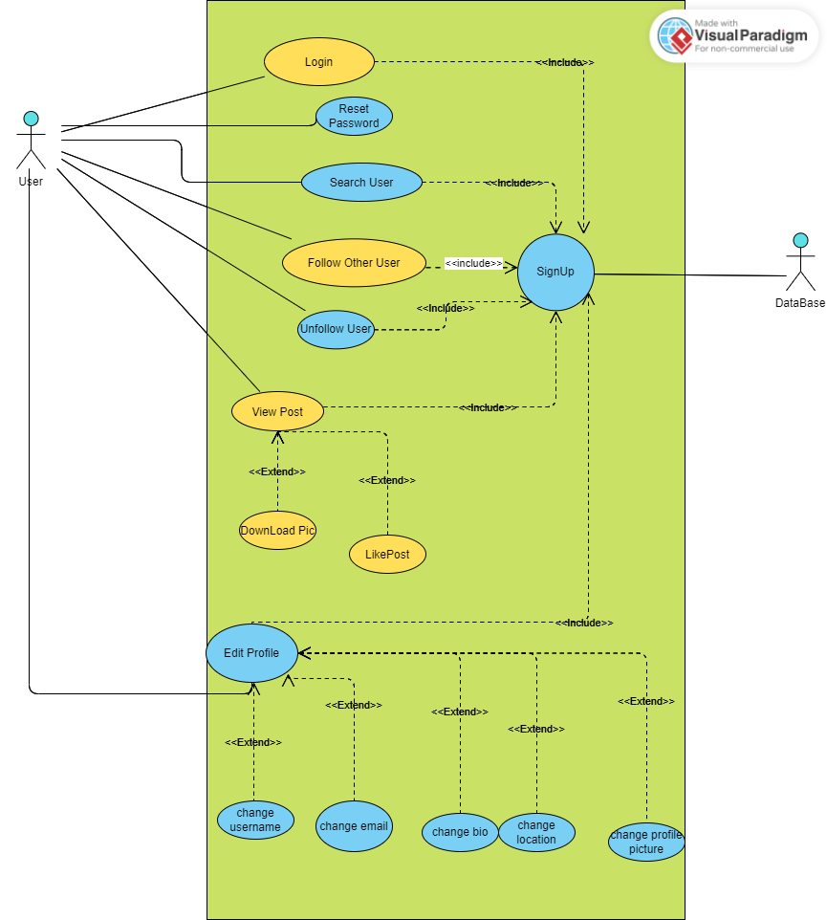

Slide 14
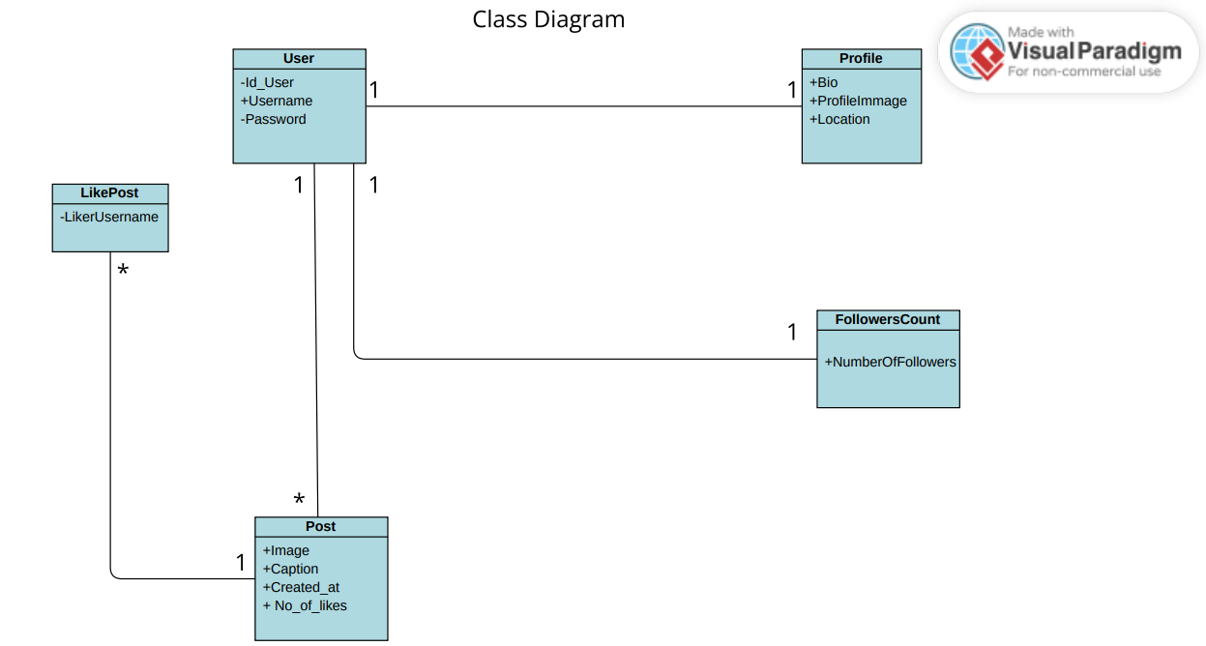

Slide 15
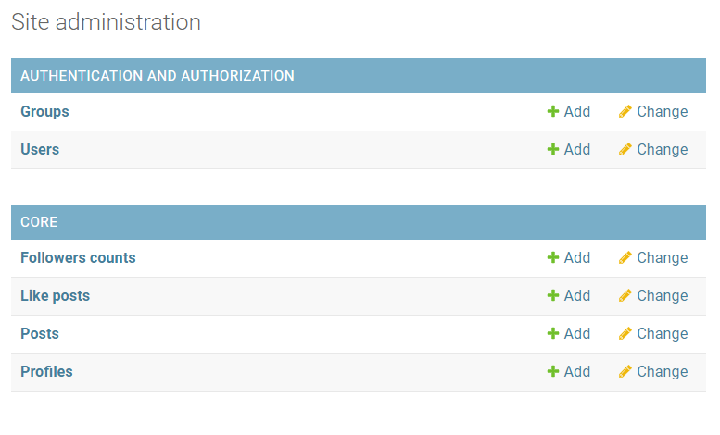
Class Diagram into DataBase Model

Slide 16
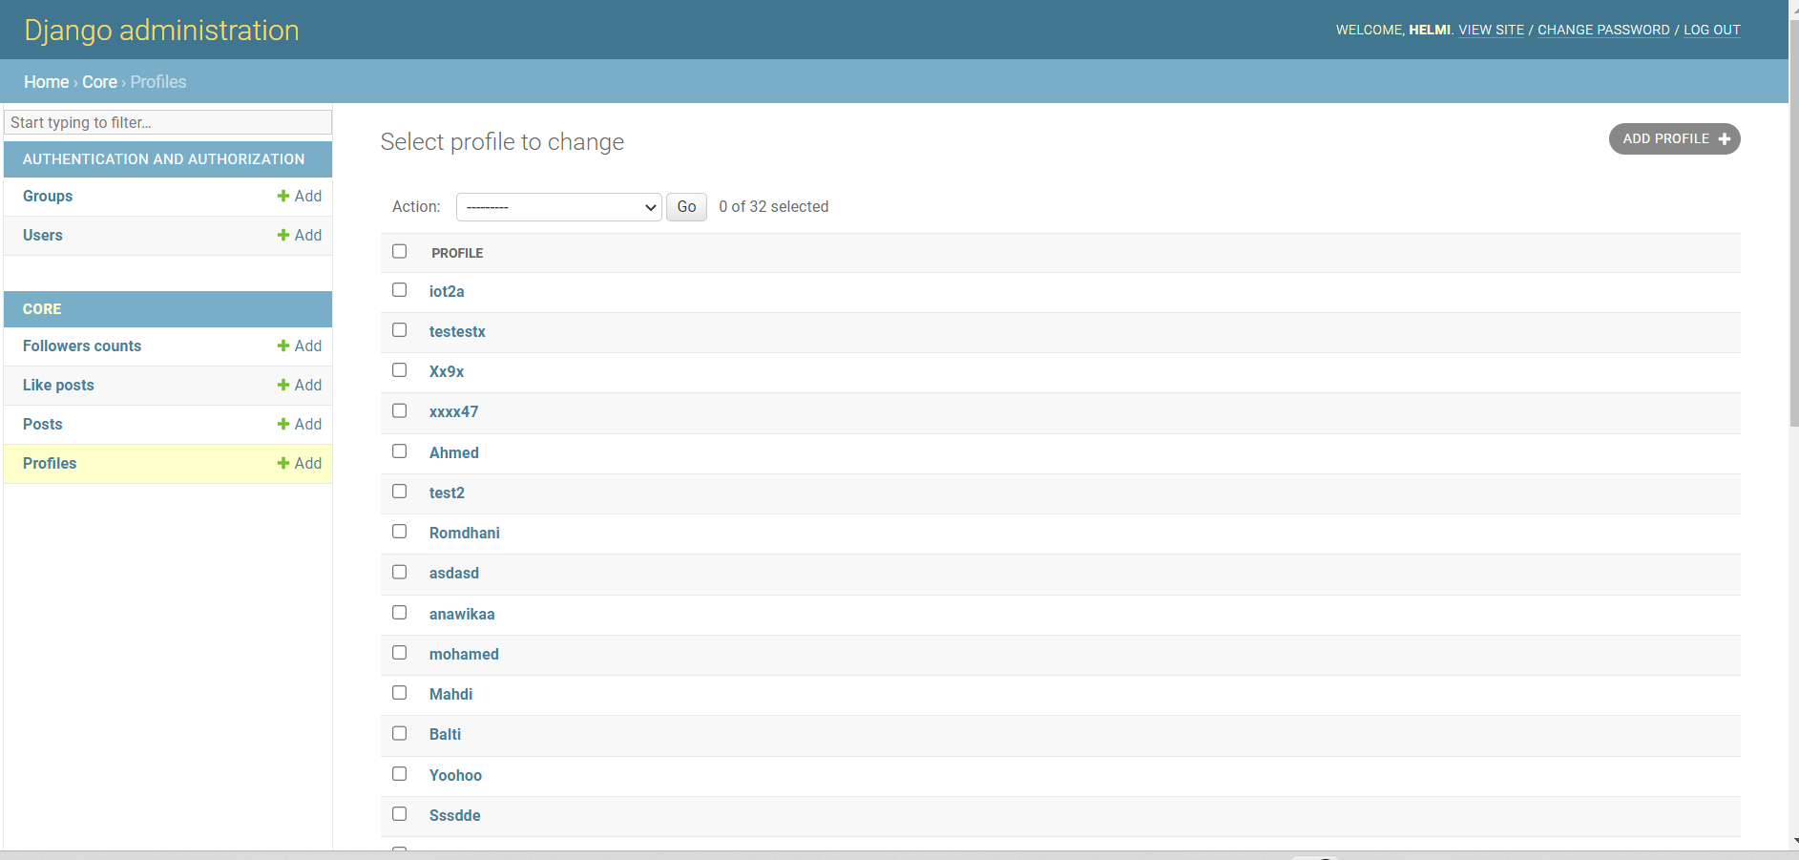

Slide 17
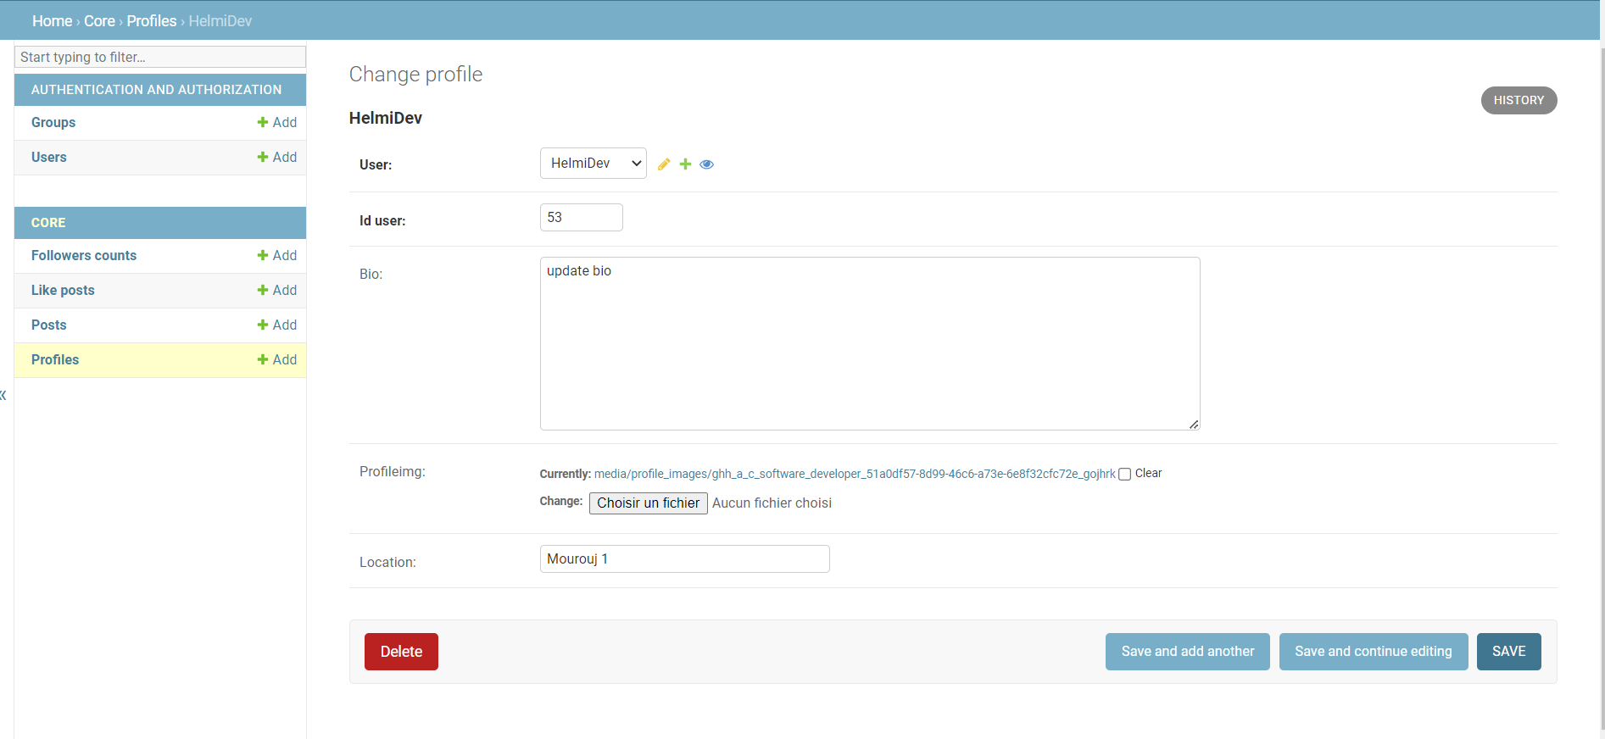

Slide 18
Demo

Slide 19
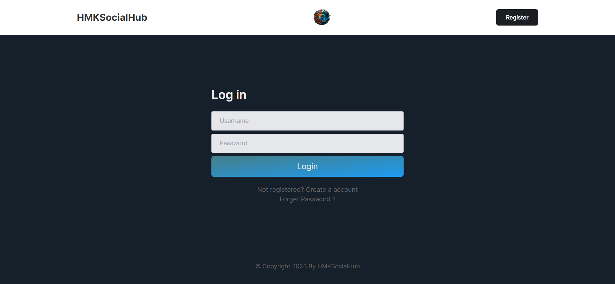

Slide 20
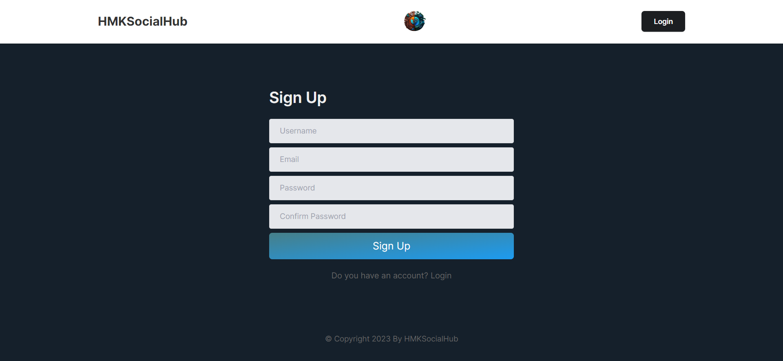

Slide 21
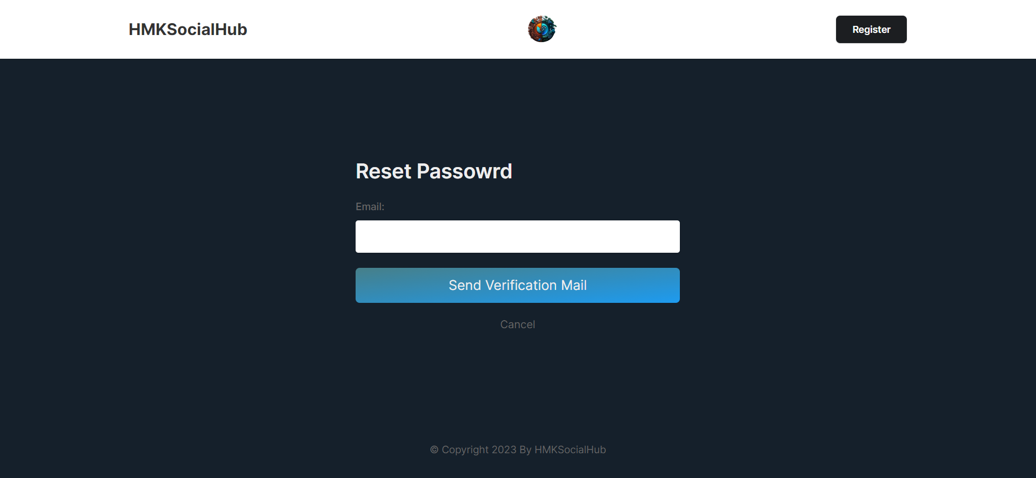

Slide 22
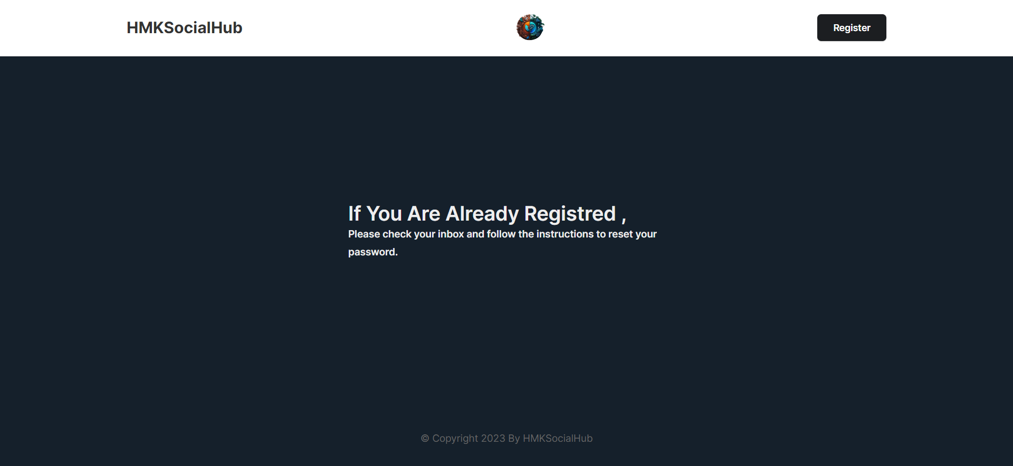

Slide 23
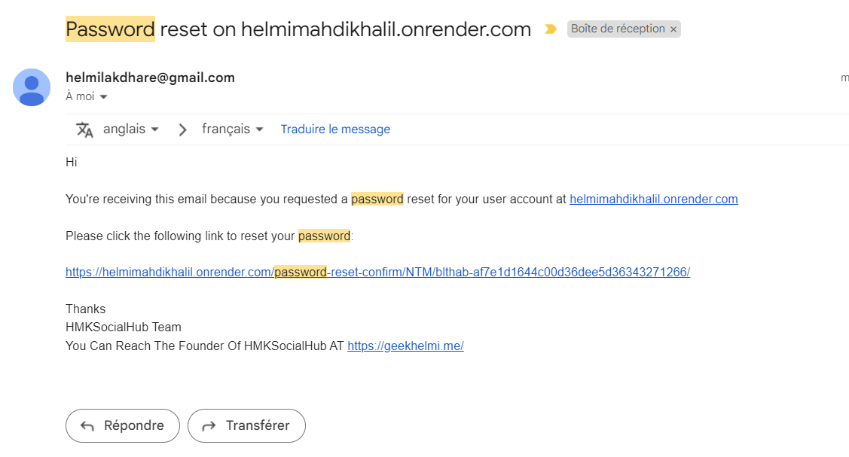

Slide 24
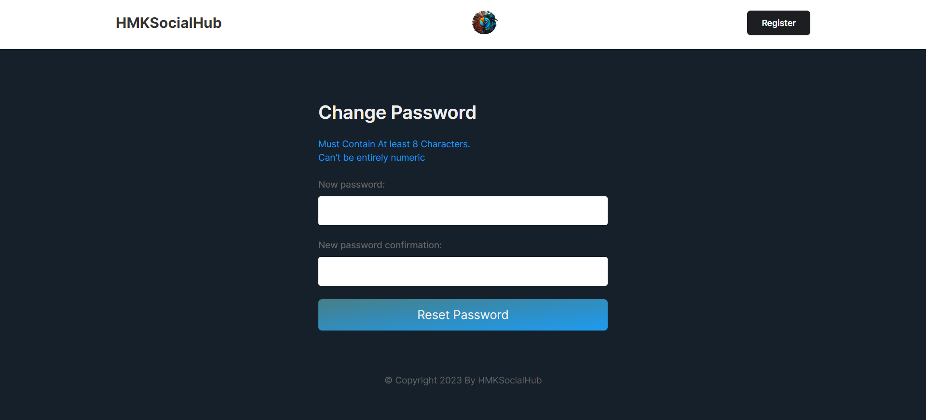

Slide 25
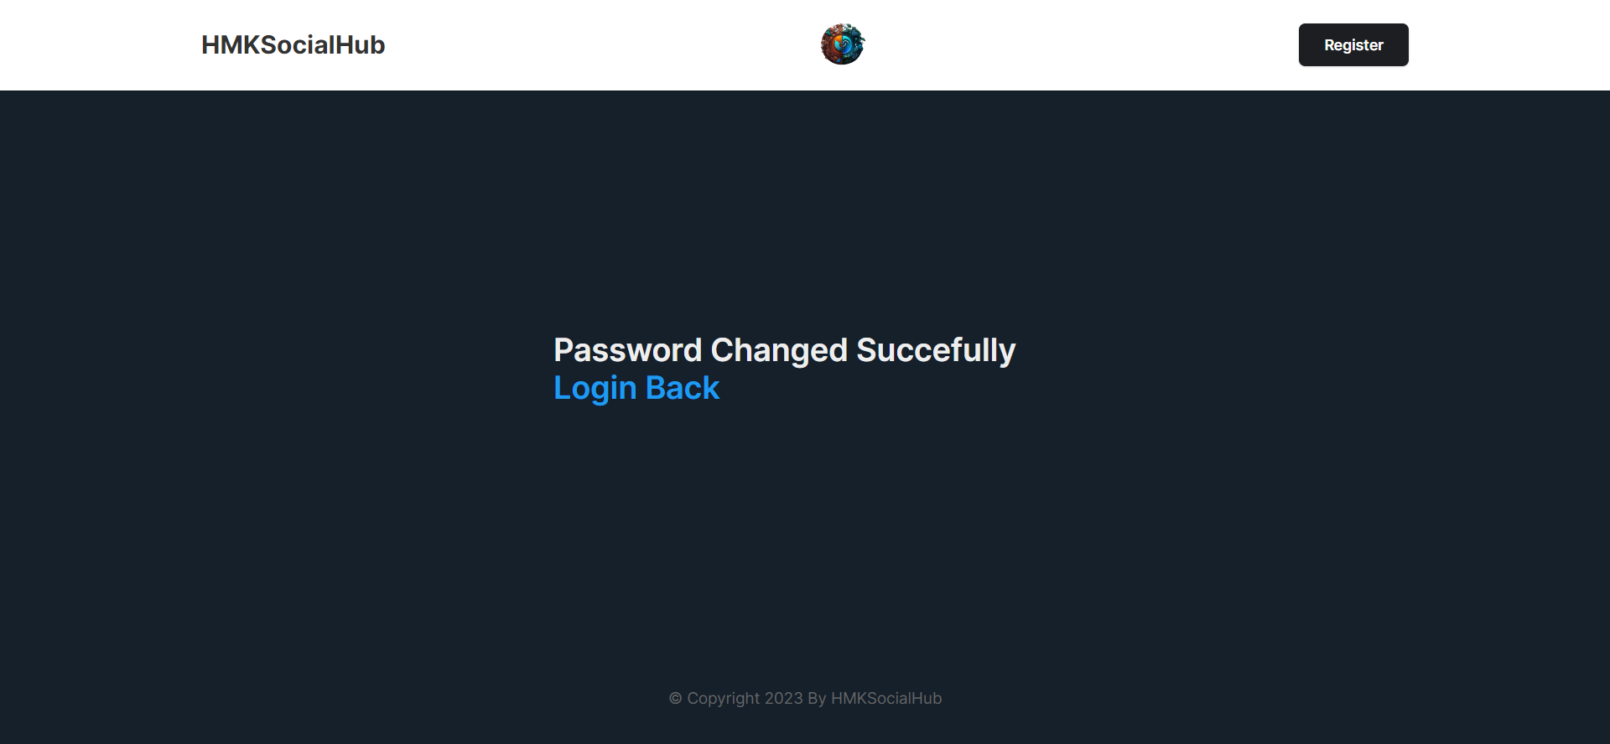

Slide 26
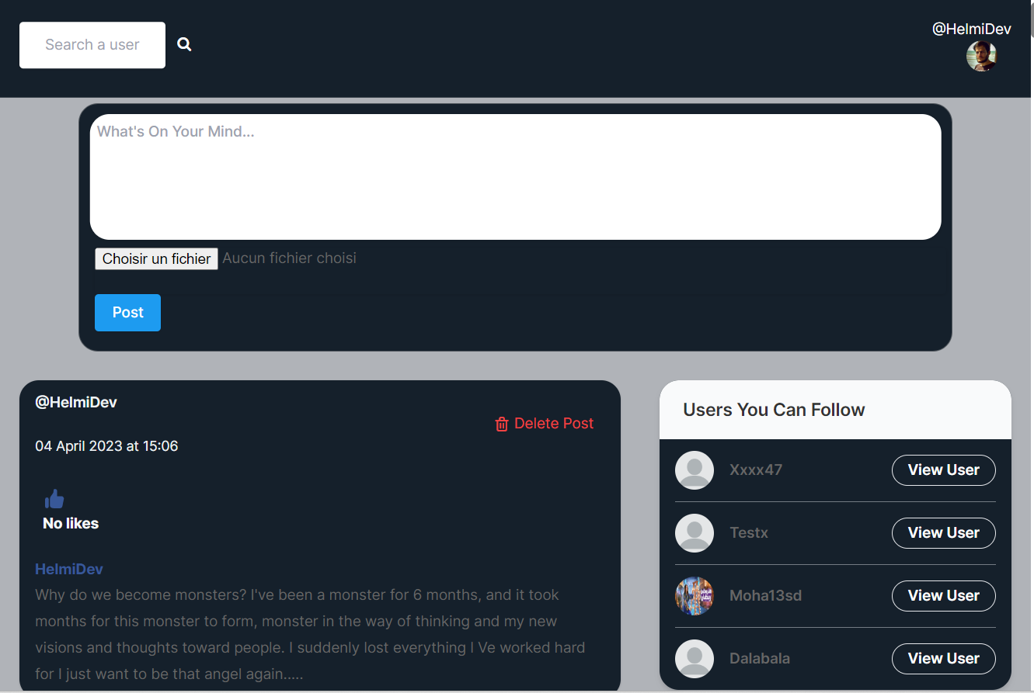

Slide 27
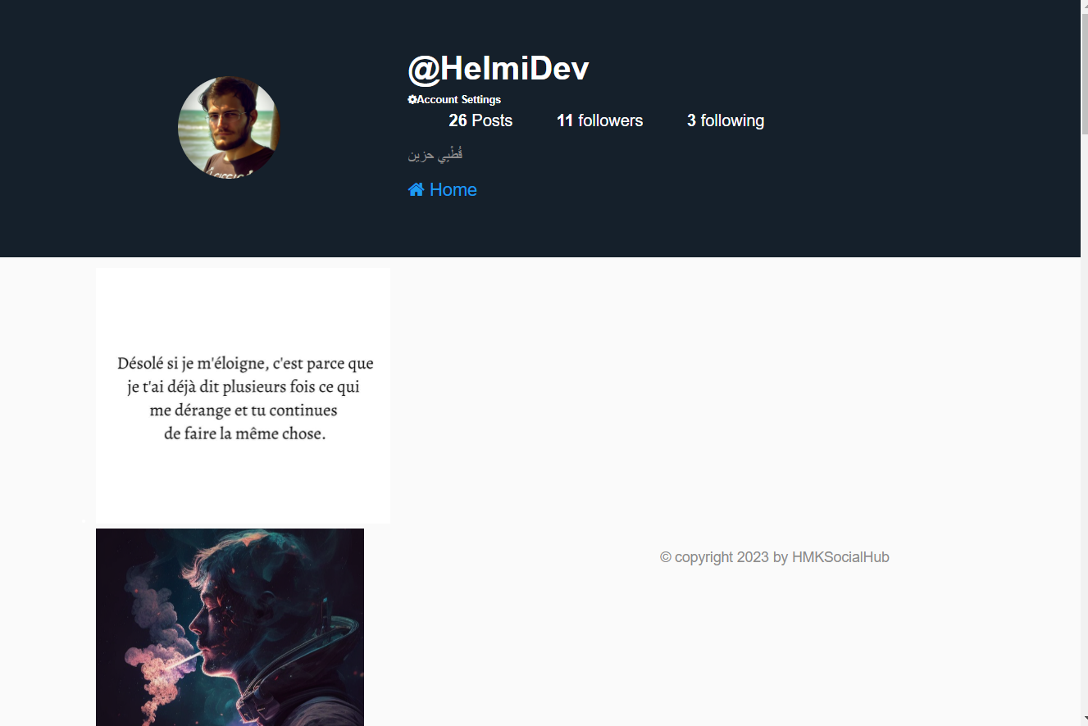

Slide 28
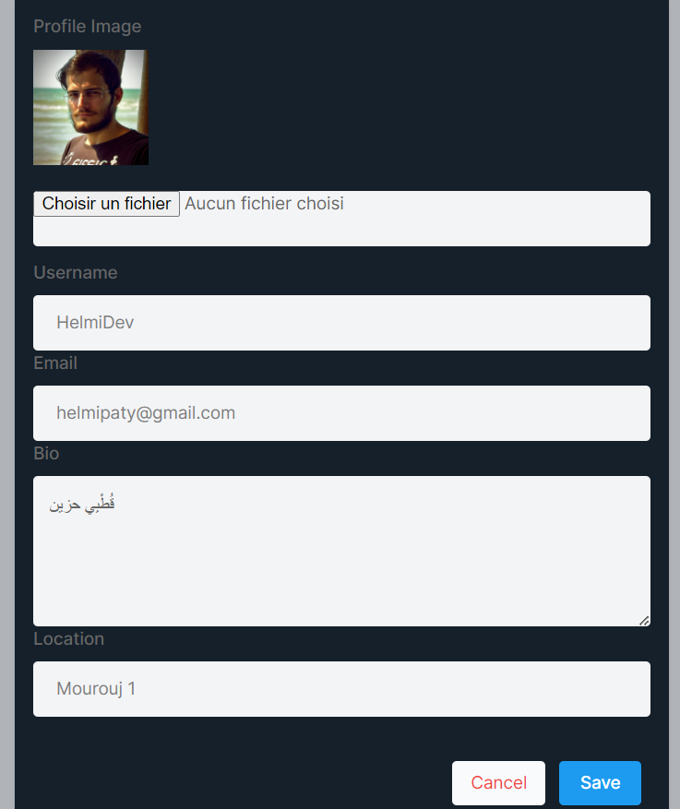

Slide 29
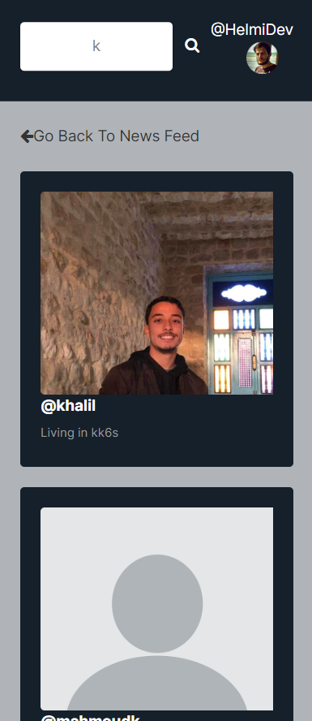

Slide 30
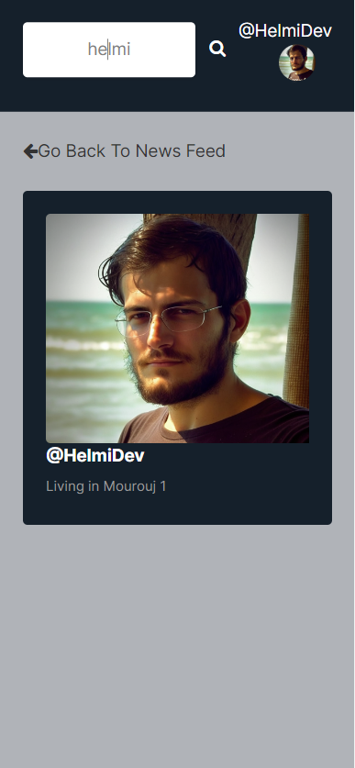

Slide 31

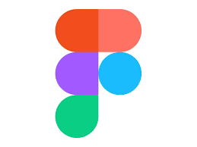

Links
https://github.com/HelmiDev03/Social-Media-Web-App
https://www.figma.com/file/DyegsicRH5NXG7nIipTAx0/HMKSOCIALHUB
helmimahdikhalil.onrender.com

Slide 32
Thank You

