Slide 1
HMKSocialHub
Web Application for Virtual Enteraction

Slide 2


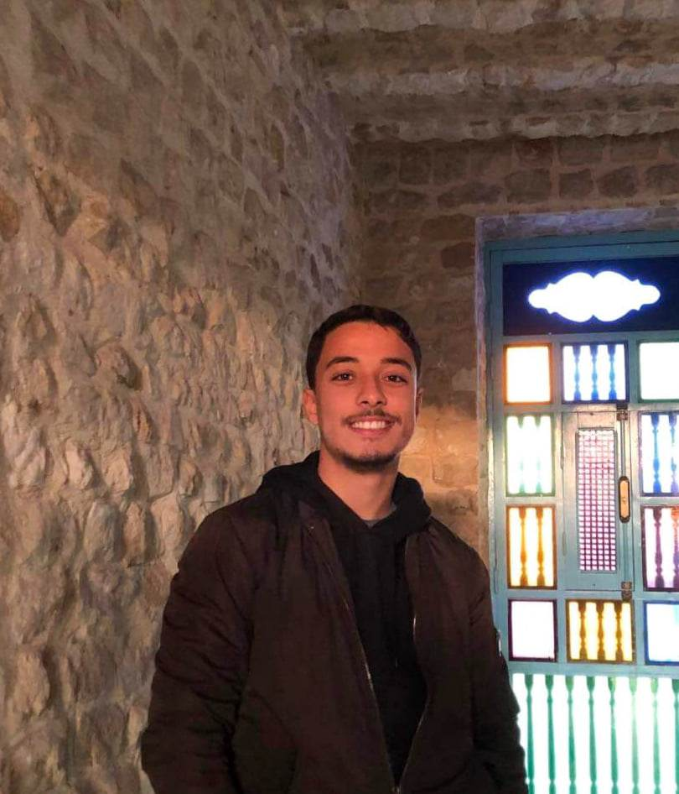
About US
Mahdi Mzoughi
Helmi Lakhder
Khalil Ben Makhlouf

Slide 3
Why ?

Slide 4
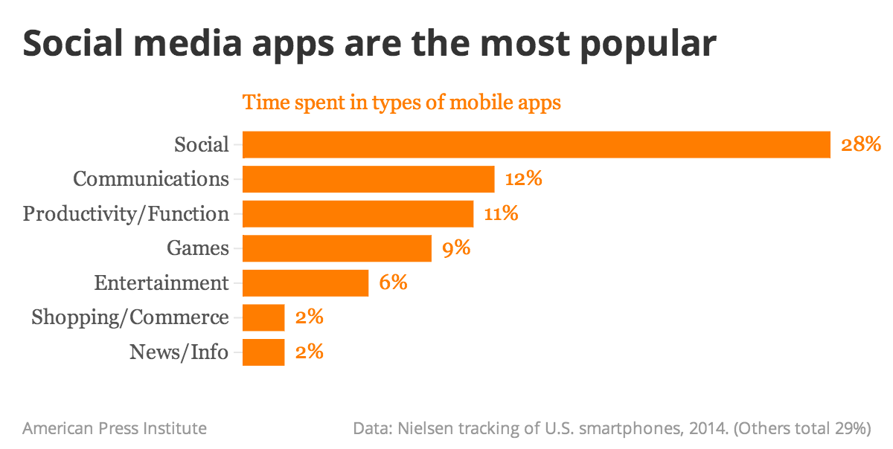
Social Media App are the most popular

Slide 5
HMKSocialHub

Slide 6
Easy to use Application
Gives indication about time use
Supports and Encourages the User
Aim

Slide 7





Tech Stack
Django
Python
PostgreSQL
HTML-CSS-JS

Slide 8
Features

Slide 9



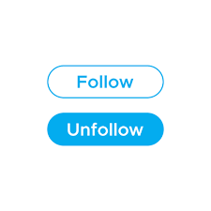





Slide 10

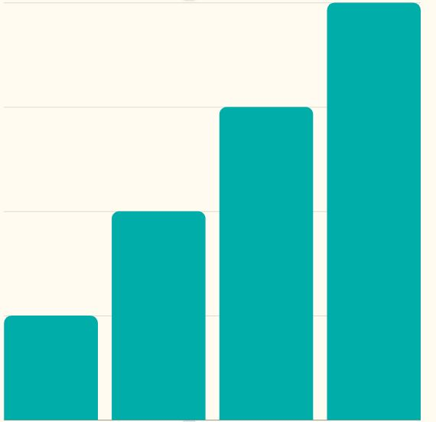
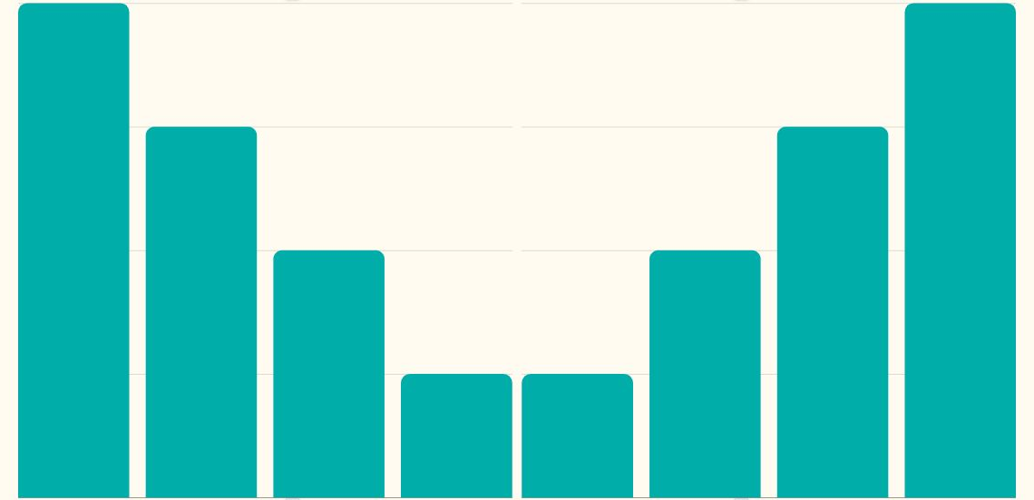
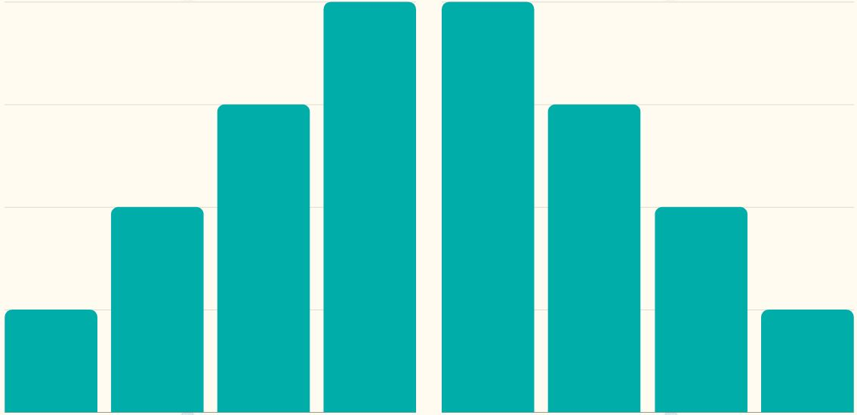
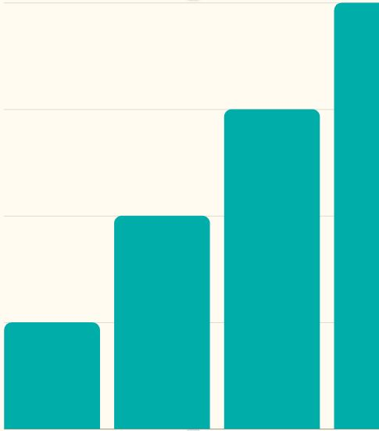
Proﬁle Section
Contains information about user
Gives analysis of all following/followers/posts
Gives detailed uploaded pictures with a smooth slide

Slide 11


Informative Design
User - Friendly

Slide 12
UML Diagrams

Slide 13
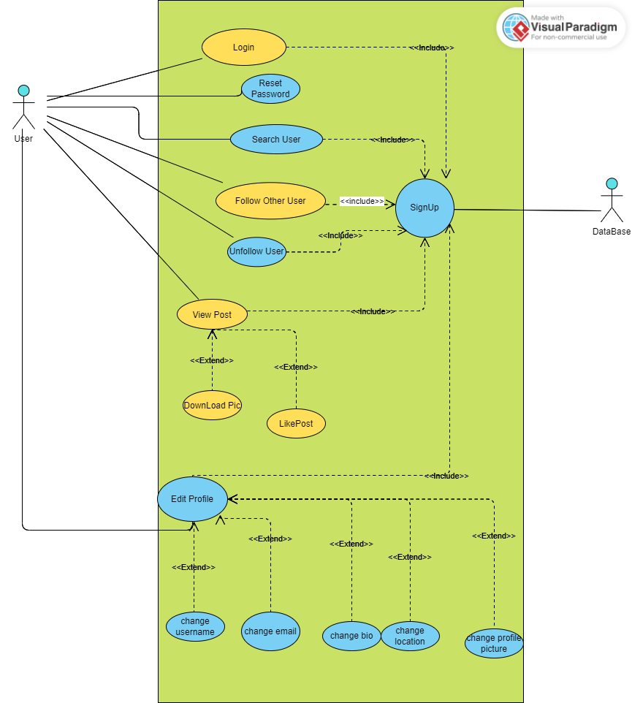
Use Case

Slide 14
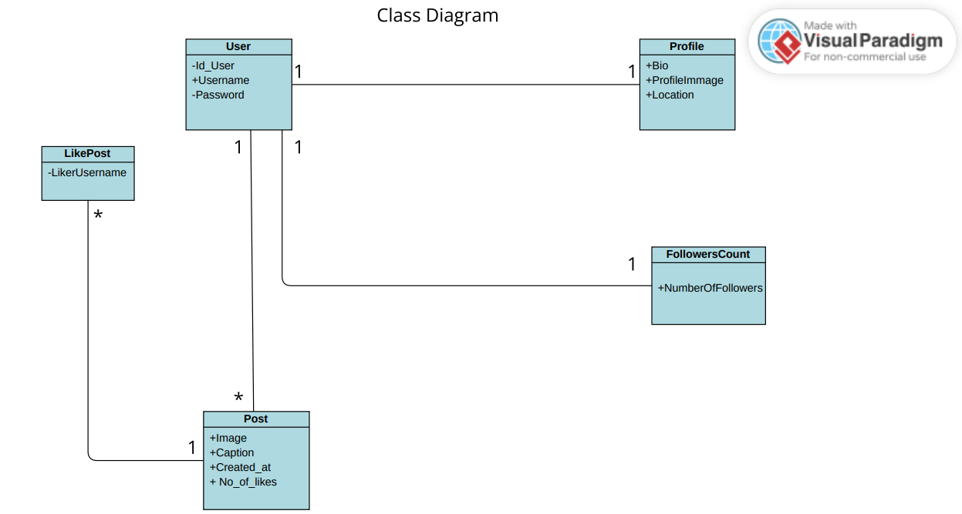

Slide 15
Demos

Slide 16
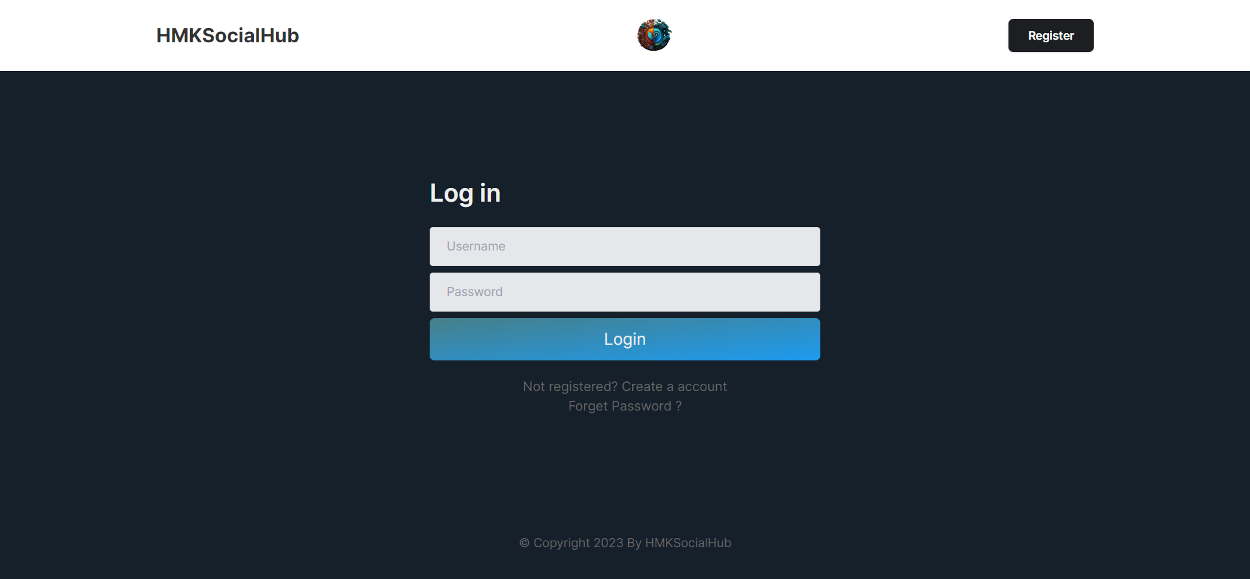

Slide 17
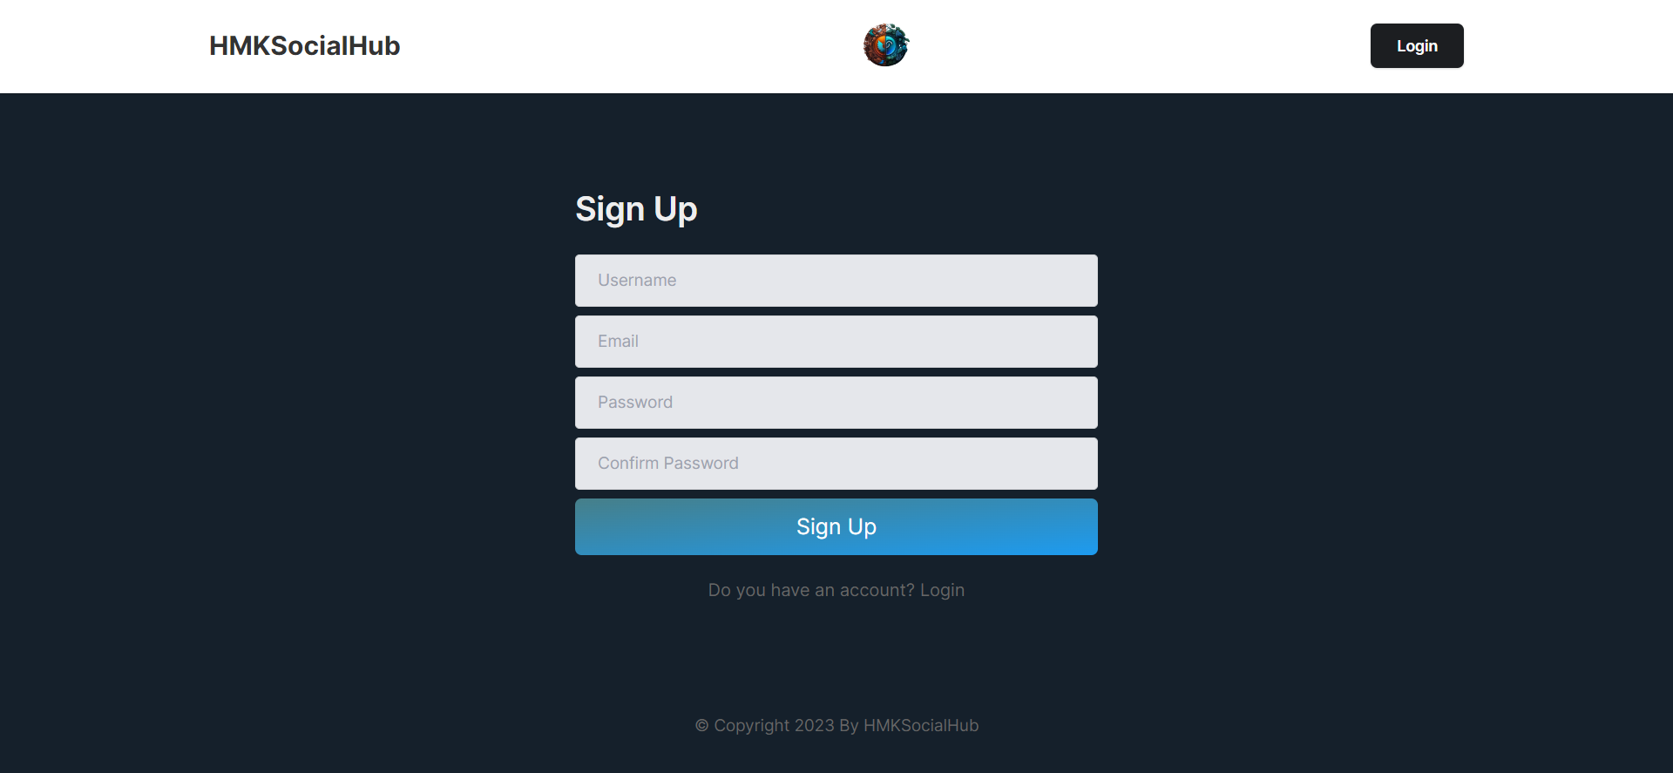

Slide 18
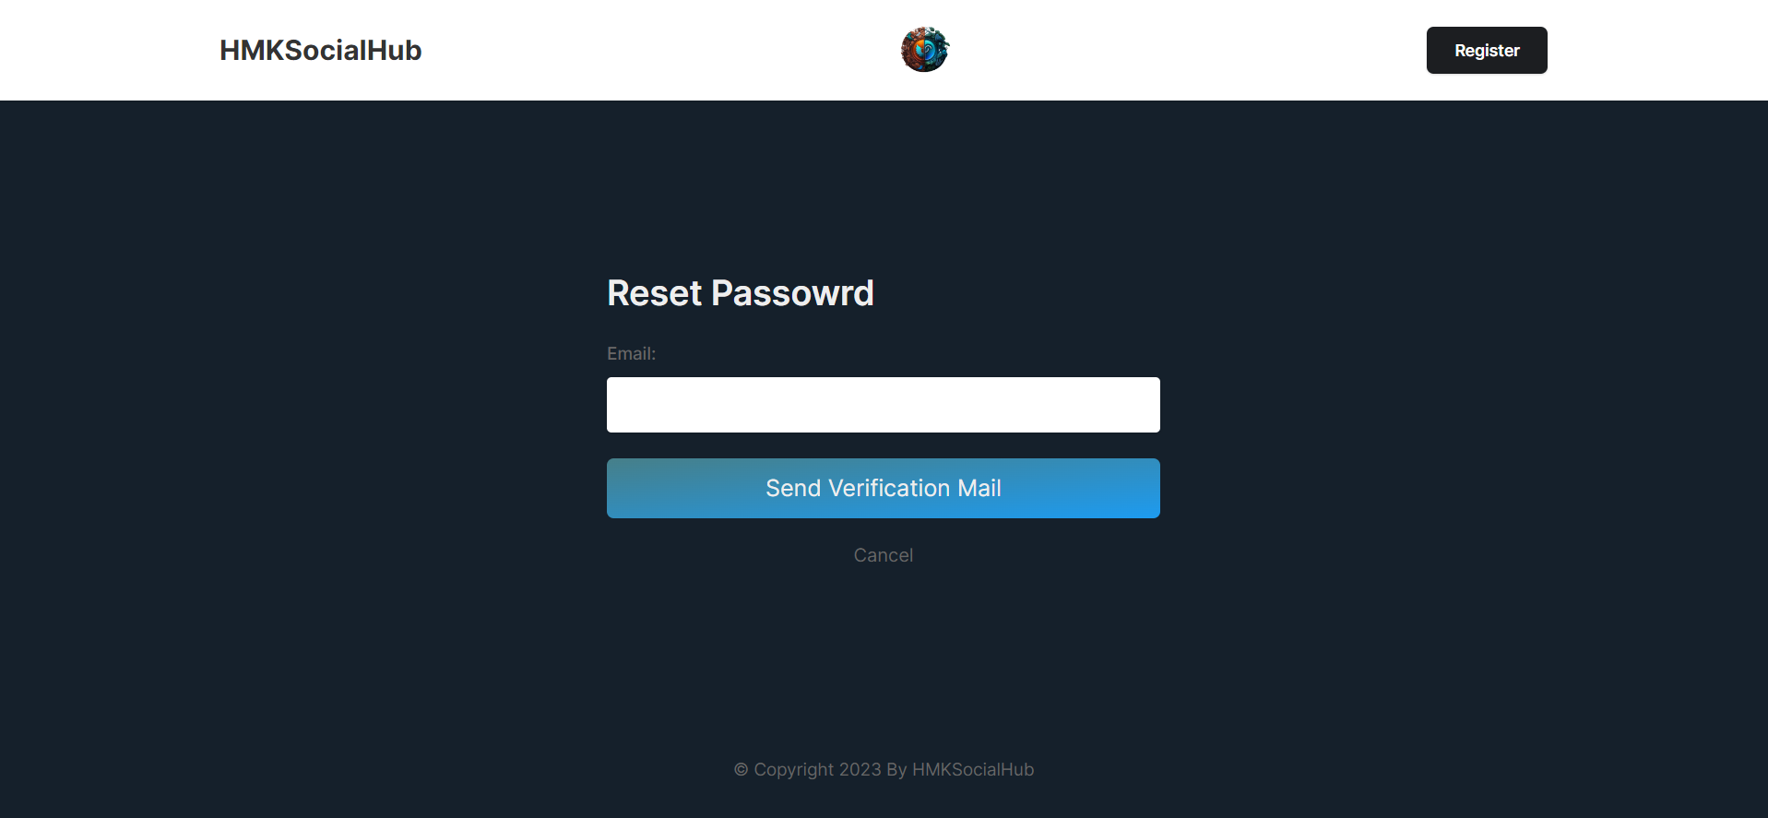

Slide 19
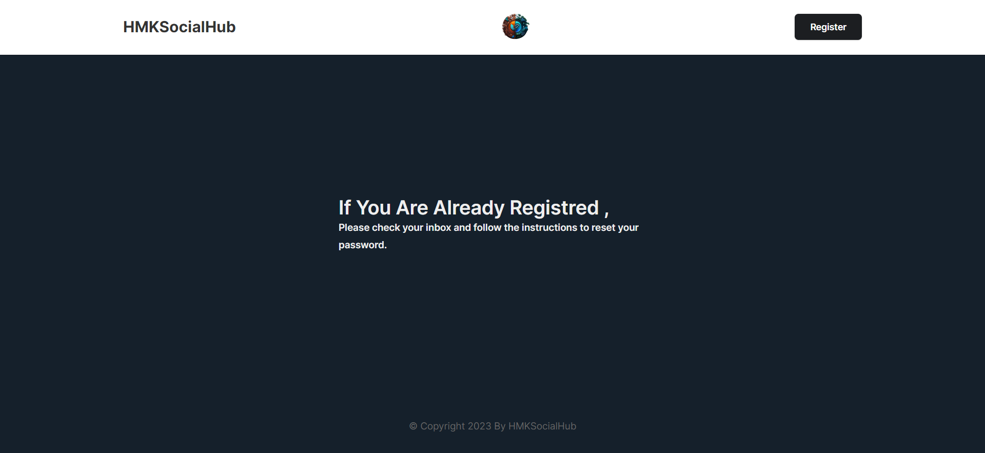

Slide 20
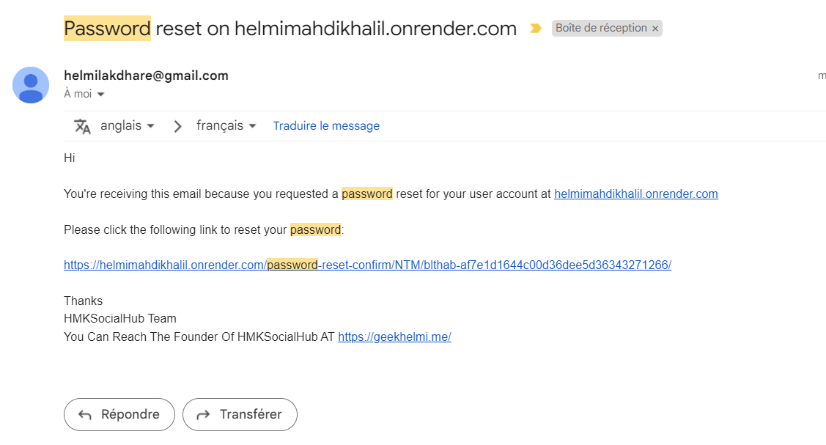

Slide 21
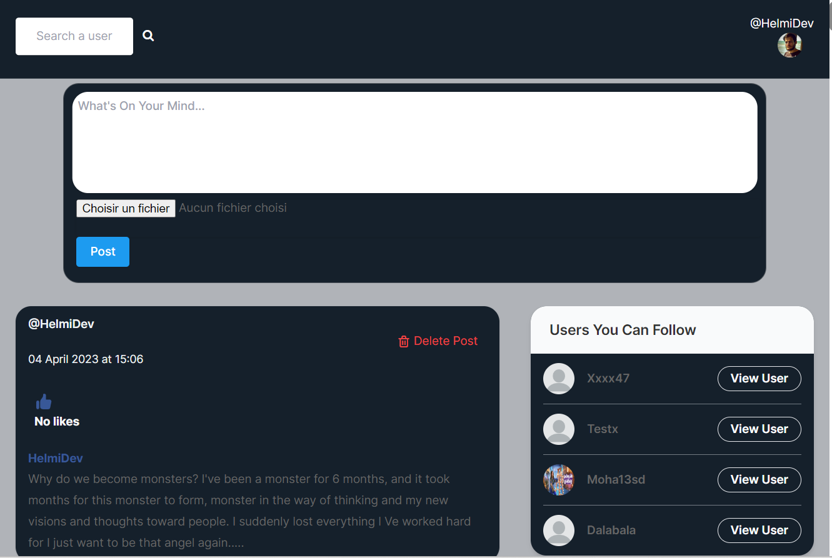

Slide 22
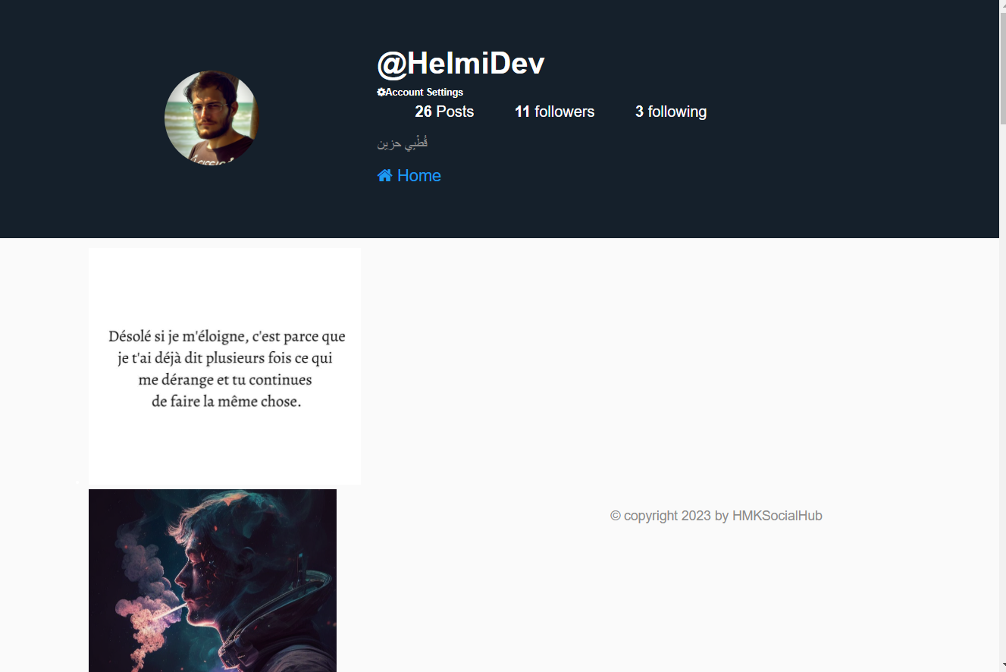

Slide 23
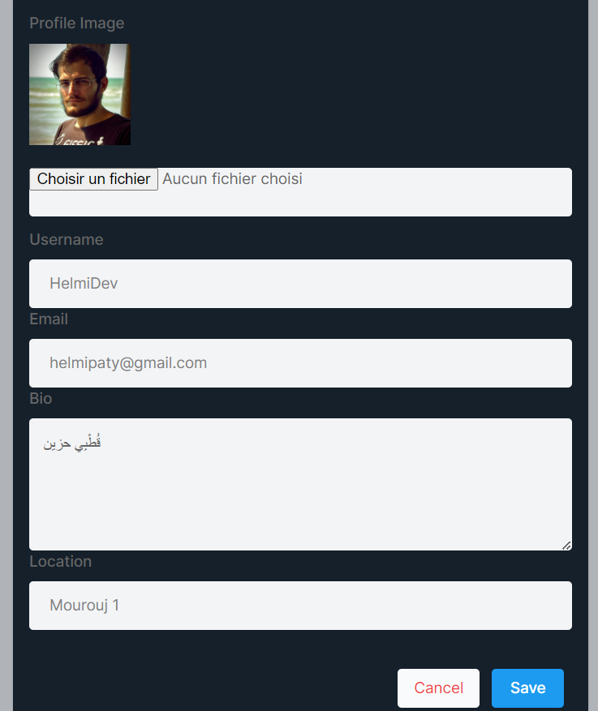

Slide 24
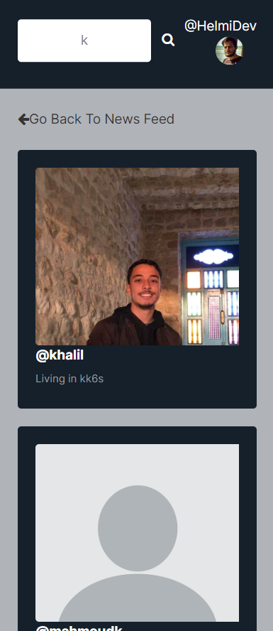

Slide 25
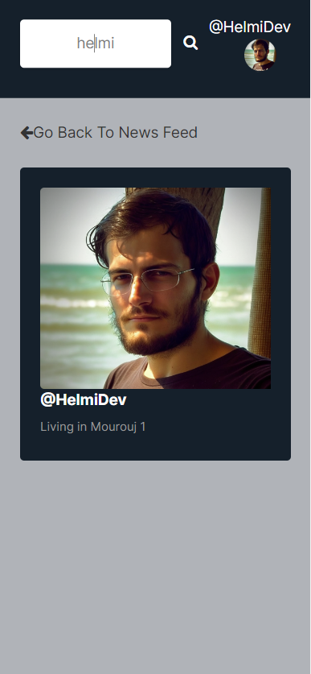

Slide 26
Thank You

