Slide 1


Management Committee Meeting
August 1, 2022

Slide 2

Sales.
70% growth vs. last year
Checking the attractivity of our products and our Marketing & Sales teams’ performances

Slide 3
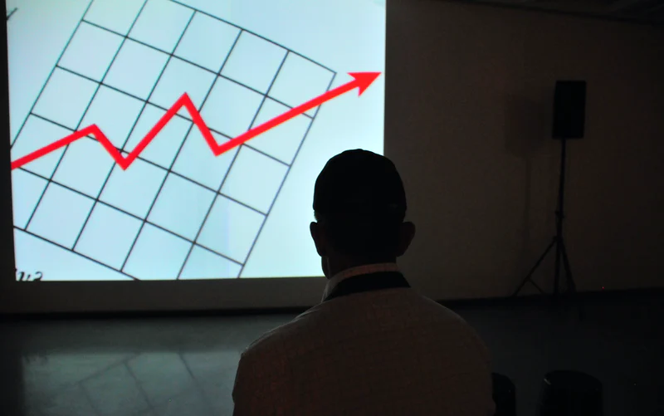
Profit .
Identifying the most/least profitable categories/regions
Margin : 20 % next year

Slide 4
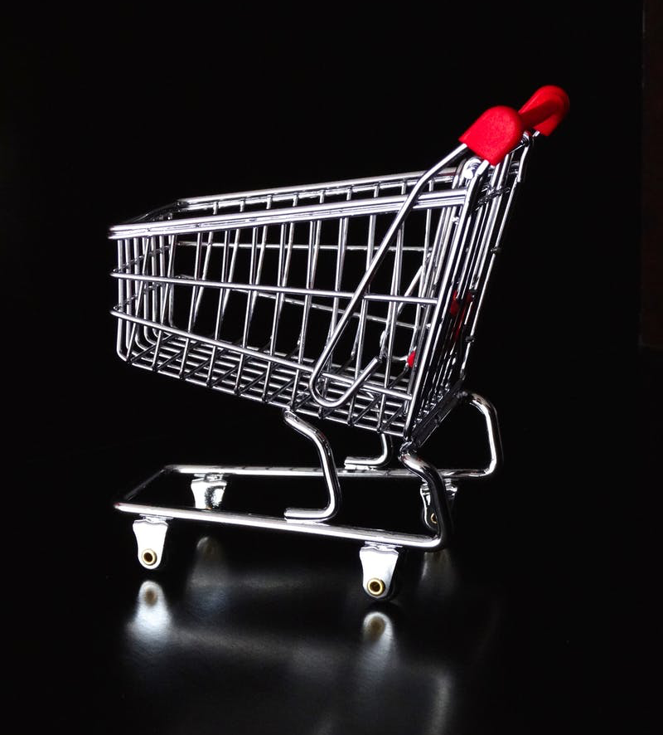
Average basket
Understanding how to improve our sales
Average basket volume
Average basket value

Slide 5
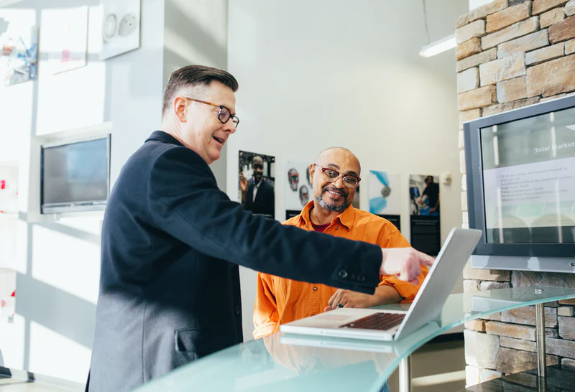
New clients.
Recruit 100 new clients next year
Gain loyal clients (>= 2 orders a year)
Ensuring that we recruit enough new clients

Slide 6
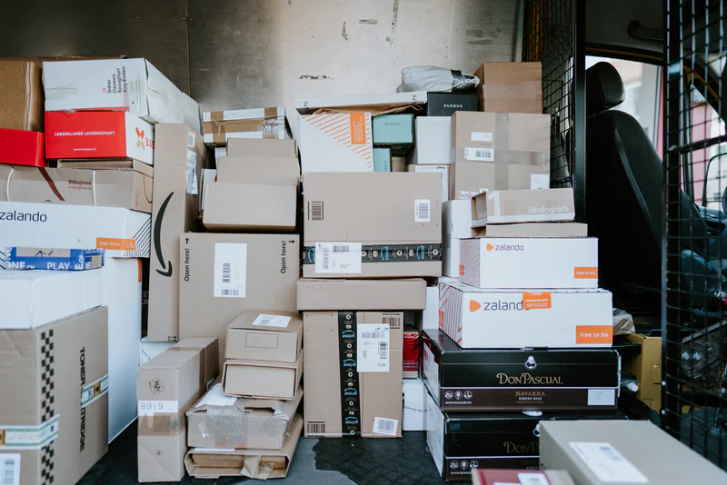
Return rate.
Checking clients’ satisfaction with their order
Reduce return rate below 20 % next year

Slide 7
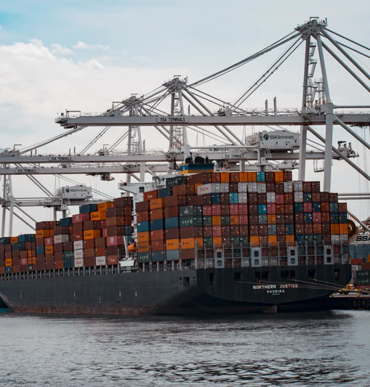
Shipping efficiency
Tracking our Logistics team and our shipping partners’ efficiency
Same day delivery : 0 day
First class delivery : 2 days
Second class delivery : 3 days
Standard class delivery : 5 days

Slide 8
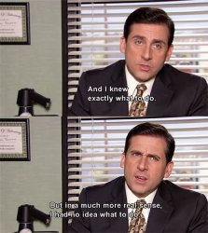
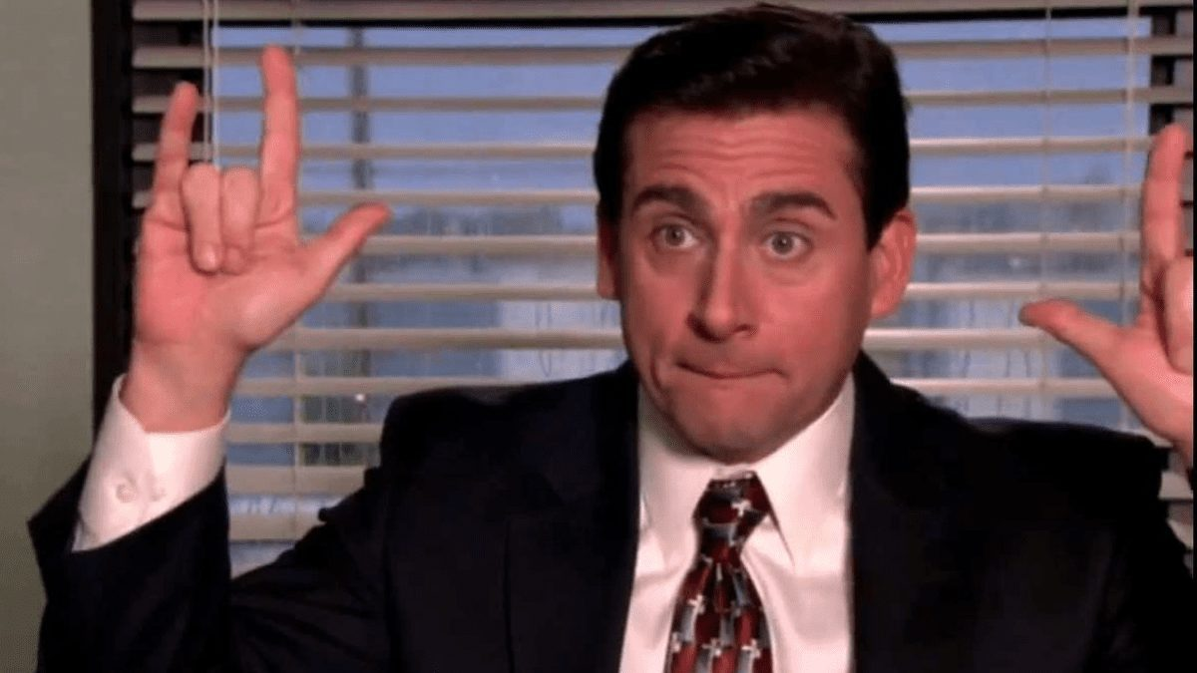
Large image

