Slide 1
Class - Course - Teacher Assignment and TimeTabling
Class: IT3052E - 144217
Group: 6
Nguyen Nhat Minh - 20225510
Ta Ho Thanh Dat - 20225482
Tran Sy Minh Quan - 20225521
Doi Sy Thang - 20225528

Slide 2
Table of contents
01
02
03
04
Introduction
Problem Description
Briefly introduce the topic.
Describe the problem.
Algorithms
Conclusion
Analyze the algorithms used to solve the problem.
Discuss about the problem.

Slide 3

01
Introduction

Slide 4
Scheduling problem
Scheduling is the problem of performing a set of given tasks by a set of limited resources.
In classical university scheduling problems, a set of events is assigned to a number of 'classroom-time' slots so as to satisfy a set of constraints.
JANUARY
FEBRUARY
MARCH
APRIL
MAY
JUNE
PHASE 1
Task 1
Task 2
PHASE 2
Task 1
Task 2

Slide 5

University course scheduling
University course scheduling is a NP-hard problem and it includes two decisions: teacher assignment and class scheduling.
In the teacher assignment, we determine which teacher would present what courses.
In the class scheduling, we specify in which class each course would be presented.

Slide 6
02
Problem Description

Slide 7
Problem Description
Constraints
Each teacher can only teach a specific set of courses.
A teacher can only teach a class - course at a time slot.
A course must be presented consecutively in a period.
A class can only learn a specific set of courses.
A class can only learn 1 course at a time slot.
b. Objective
Maximize the number of courses to be presented.
Notes:
Bổ sung thêm constraint, objectives và constaint thif đảo lại

Slide 8
Problem Description
c. Input & Output
Input:
Line 1: contains T (teachers), N (classes), and M (courses); 1 ≤ T, N, M ≤ 100
Line i + 1 (i = 1, 2, …, N): contains a list of courses class i has to learn
Line i + N + 1 (i = 1, 2, …, T): contains a list of courses teacher t can teach
Line N + T + 2: contains the time slots of courses m (m = 1, 2, …, M)
Output:
Line 1: contains K - number of classes-courses assigned
Line k + 1 (k = 1, 2, …, K): contains a list of assigned course - class - teacher
Notes:
Gộp input và output, viết làm sao cho nó bắt mắt tí,

Slide 9
GenInput.py
Purpose: Create a test case by randomly assigning a “fair” amount of courses to each class and teacher.
Main parameters:
Number of teachers.
Number of classes.
Number of courses.
Additional parameters:
Lower bound for the number of courses a teacher can teach.
Lower bound for the number of courses a class has to take.
Notes:
Chỉnh sửa lại cho nó có điểm nhấn

Slide 10
03
Algorithms

Slide 11
Constraint Programming
Exact
Integer Linear Programming
Algorithms
Greedy
Heuristics
Genetic Algorithm
Notes:
Heuristic thêm cái greedy random nửa

Slide 12
Exact Algorithms

Slide 13
Exact Algorithms
Decision variables:
A( i, j, k, l) = 1 if teacher i is assigned to teach course k for class j at time slot l, otherwise A( i, j, k, l) = 0; ∀ i ∈ T, j ∈ N, k ∈ M, l ∈ [1, 60], domain D( A( i, j, k, l)) = {0, 1}.
courses_for _class(j): a list of courses that class j need to study.
courses_by_teacher(i): a list of courses that teacher i can teach.
cre(k): time slots of course k.

Slide 14
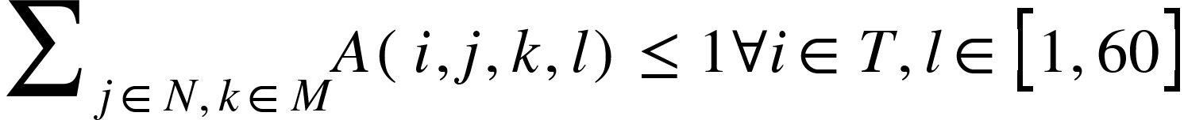
Exact Algorithms
Constraints:
A( i, j, k, l) = 0 ∀ i ∈ T, j ∈ N, k ∉ courses_for_class(j), l ∈ [1, 60]
A( i, j, k, l) = 0 ∀ i ∈ T, j ∈ N, k ∉ courses_by_teacher(i), l ∈ [1, 60]
t is a bool variable, domain D(t) ={0,1}.
Notes:
Chỉnh lại trông đỡ rối

Slide 15
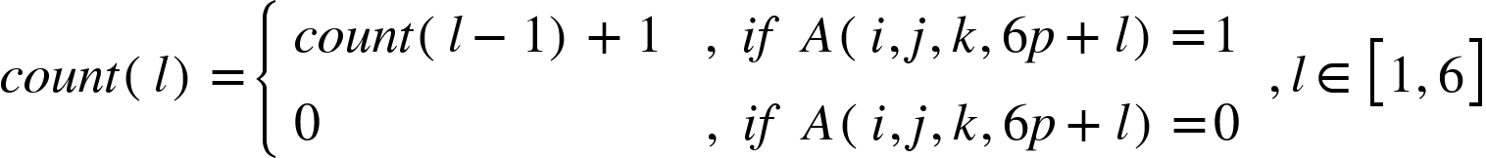
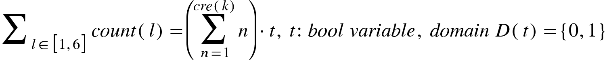
Constraint Programming
Constraint: All courses must be presented consecutively.
For i ∈ T, j ∈ N, k ∈ M, p ∈ [0, 9]:
Initialize variable: count(l), l∈ [1,6], D(count)=[0, cre(k)], count(0)=0,
After building the count(l) variables, check the condition:

Slide 16
Constraint Programming
Example 1: course time slots = 3
l | A | count
1 | 1 | 1
2 | 0 | 0
3 | 1 | 1
4 | 1 | 2
5 | 0 | 0
6 | 0 | 0
:
⇨ 1+0+1+2+0+0 ≠ 1+2+3
⇨ FAIL!

Slide 17
Constraint Programming
Example 2: course time slots = 3
l | A | count
1 | 0 | 0
2 | 1 | 1
3 | 1 | 2
4 | 1 | 3
5 | 0 | 0
6 | 0 | 0
:
⇨ 0+1+2+3+0+0 = 1+2+3
⇨ SUCCESS!

Slide 18
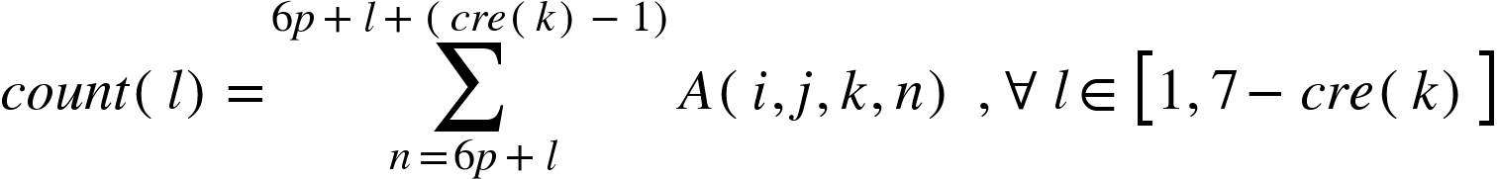
Integer Linear Programming
Constraint: All courses must be presented consecutively.
For i ∈ T, j ∈ N, k ∈ M, p ∈ [0, 9]:
Initialize variable: count(l), l∈ [1, 7-cre(k)], domain D(count(l))=[0, cre(k)].
Calculate count(l) by the formula:
➡ Only need to check if max( count(l), l ∈ [1, 7 - cre(k)]) = cre(k) at the end of period p.

Slide 19




Integer Linear Programming
Indeed, in ILP problems, 4 inequalities are required to model the maximum of 2 variables.
For example, we need to find X = MAX(A, B) satisfying:
t: bool variable, domain D(t)={0, 1}; M: big enough constant
We would apply this modelling to the problem to find the maximum value of the list by initializing max(l):
with max(0) = 0, and M = cre(k).

Slide 20
Example 1: Course time slots = 3
l | A | count | max
1 | 0 | 2 | 2
2 | 1
3 | 1
4 (7 - cre(k)) | 0
5 | 1
6 | 0
l | A | count | max
1 | 0 | 2 | 2
2 | 1 | 2 | 2
3 | 1
4 (7 - cre(k)) | 0
5 | 1
6 | 0
➡

Slide 21
Example 1: Course time slots = 3
l | A | count | max
1 | 0 | 2 | 2
2 | 1 | 2 | 2
3 | 1 | 2 | 2
4 (7 -cre(k)) | 0
5 | 1
6 | 0
l | A | count | max
1 | 0 | 2 | 2
2 | 1 | 2 | 2
3 | 1 | 2 | 2
4 (7 -cre(k)) | 0 | 1 | 2
5 | 1
6 | 0
max(7 - cre(k)) is the maximum value of the list count
⇒ max(7-cre(k)) = 2 ≠ 3
➡FAIL!
➡

Slide 22
Example 1I: Course time slots = 3
l | A | count | max
1 | 0 | 2 | 2
2 | 1
3 | 1
4 (7 - cre(k)) | 1
5 | 0
6 | 0
l | A | count | max
1 | 0 | 2 | 2
2 | 1 | 3 | 3
3 | 1
4 (7 - cre(k)) | 1
5 | 0
6 | 0
➡

Slide 23
Example 1I: Course time slots = 3
l | A | count | max
1 | 0 | 2 | 2
2 | 1 | 3 | 3
3 | 1 | 2 | 3
4 (7-cre(k)) | 1
5 | 0
6 | 0
l | A | count | max
1 | 0 | 2 | 2
2 | 1 | 3 | 3
3 | 1 | 2 | 3
4 (7-cre(k)) | 1 | 1 | 3
5 | 0
6 | 0
max(7 - cre(k)) is the maximum value of the list count
⇒ max(7 - cre(k)) = 3 = 3
➡SUCCESS!
➡

Slide 24
IMPROVED VERSION
Improvement
Reduce the number of variables ➡ the modelling time reduces significantly.
The constraints are also reduced by 2:
A( i, j, k, l) = 0 ∀ i ∈ T, j ∈ N, k ∉ courses_for_class(j), l ∈ [1, 60]
A( i, j, k, l) = 0 ∀ i ∈ T, j ∈ N, k ∉ courses_by_teacher(i), l ∈ [1, 60]
➡ Prevent: Memory Error: bad allocation or Timeout Error: the monitored command dumped core.
⇒ Version2.
Notes:
N Minh

Slide 25
EXPERIMENT RESULTS TABLE
Test case (T, M, N) | Solve time (min)
 | CP(SAT) | ILP(SAT) | CP_version2(SAT) | ILP_version2(SAT)
10, 20, 15 | 0.46 | 0.94 | 0.18 | 0.17
10, 50, 20 | 3.57 | 8.58 | 5.00 | 10.41
20, 50, 30 | ≥ 180 | ≥ 180 | 145.51 | ≥ 180
30, 60, 50 | 10.73 | 25.83 | 0.61 | 1.58
30, 70, 50 | 10.29 | N/A | 3.79 | 8.91
Notes:
N Minh

Slide 26
EXPERIMENT RESULTS TABLE
Test case (T, M, N) | Solve time (min)
 | CP(SAT) | ILP(SAT) | CP_version2(SAT) | ILP_version2(SAT)
40, 80, 60 | N/A | 25.31 | 2.74 | 29.24
40, 90, 60 | ≥ 180 | ≥ 180 | ≥ 180 | ≥ 180
40, 100, 60 | N/A | N/A | 5.92 | 14.23
50, 90, 60 | N/A | N/A | 1.85 | 7.41
60, 100, 80 | N/A | N/A | 5.31 | 44.62
THE EXPERIMENT IS MADE ON CHIP CORE(TM) i5-11400H
Notes:
N Minh

Slide 27
Heuristic Algorithms

Slide 28
Heuristic Algorithms
Parameters:
T, N, M: number of teachers, classes, and courses, respectively.
Class_courses[i] : list of courses class i must study; 0 < i ≤ N
Teacher_courses[j] : list of courses teacher j can teach, 0 < j ≤ T
Time_slot[k] : number of time slots to present course k , 0 < k ≤ M
Variables:
s : time slots of each course, 0 < s < 61
Check[s] =
False, if slot s has been assigned
True, otherwise
Notes:
Hơi rối( Quân), thay kí hiệu

Slide 29
Greedy Algorithm
Implementation:
Step 1: Sorting
For courses in each class, we sort it by the number of teachers who can teach the course.
Initialize a course list of all class-courses, arrange them based on the number of teachers available for that course and the number of courses for that class.
Step 2: Assigning
Iterate through all class-course in course list, for each course we iterate through all time slots and teachers and assign suitable time slots and teacher to that class-course.
Notes:
Quân trình bày bố cục, thắng rút gọn lại nội dung, cần ngắn gọn nội dung. Chèn cái giải thích với pseudo code với giải thích lại với nhau được không. Viết như này màu mè quá. Lúc thuyết trình không trực quan

Slide 30

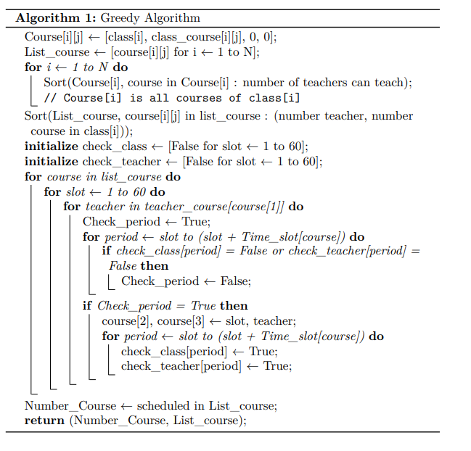
Pseudocode

Slide 31
Greedy Algorithm
Advantage:
Very quick!
Disadvantage:
Follow a fixed path / narrow search space
⇒ May not be very efficient
Solution: Randomness!

Slide 32
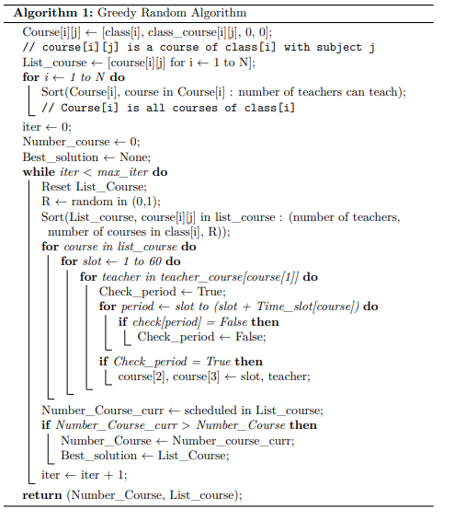
Greedy Random Algorithm
Perform more search iterations
Add a random number R for tie breaking during sorting
-> Wider search space, higher chance of getting better solutions
Notes:
Bổ sung thêm: Greedy+random, ( thắng+ quân+ đạt) greedy+random

Slide 33
Experiment results table
Test case (T, M, N) | Greedy |  | Greedy + Random |  | Exact
 | Obj Value | Time(s) | Obj Value | Time (s) | Obj Value | Time(s)
10, 20, 15 | 69 | 0.01 | 69 | 0.03 | 69 | 8.51
10, 50, 20 | 147 | 0.02 | 148 | 0.09 | 148 | 229.37
20, 120, 40 | 466 | 0.06 | 467 | 0.28 | 467 | 127.65
30, 200, 30 | 200 | 0.02 | 200 | 0.10 | 200 | 143.62
THE EXPERIMENT IS MADE ON CHIP CORE(TM) i5-1245U
Notes:
Chuyển bảng này, sau đồ thị, dùng greedy+random

Slide 34
Experiment results table
Test case (T, M, N) | Greedy |  | Greedy + Random |  | Exact
 | Obj Value | Time(s) | Obj Value | Time (s) | Obj Value | Time(s)
40, 80, 60 | 227 | 0.03 | 227 | 0.12 | 227 | 291.13
40, 90, 70 | 305 | 0.04 | 305 | 0.14 | 305 | 634.24
40, 160, 60 | 583 | 0.04 | 584 | 0.14 | 584 | 1078.36
100, 160, 130 | 554 | 0.09 | 554 | 0.16 | 554 | 1139.65
THE EXPERIMENT IS MADE ON CHIP CORE(TM) i5-1245U
Notes:
Tăng dần của T

Slide 35
Genetic algorithm
Encoding Individual:
Each individual represents a solution to the problem.
Individual = [course[i][j] for i ← 1 to N, for j in class_course[i]]
Course[i][j] = [class[i], class_coures[i][j] , slot, teacher[j]]
A course is scheduled if slot ≠ 0 and teacher ≠ 0.
Example:
Course[1][2] = [class[1], class_course[1][2], 3, teacher[2]] ⇒ scheduled.
Course[1][2] = [class[1], class_course[1][2], 0, 0] ⇒ not scheduled.
Notes:
Slide hơi dít, quân chỉnh, thắng chỉnh lại kí hiệu giống tôi

Slide 36
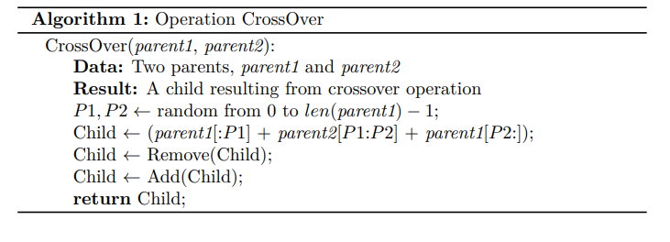
Genetic algorithm
Select two best parents to crossover.
CrossOver operation applies two points binary crossover.
After crossover, remove slot and teacher in all courses that do not satisfy the constraints.
Finally, add random slot, teacher that satisfy the constraints for course that has not been scheduled before.
Notes:
Các pseudocode thì thêm khung vào, giải thích ít chữ hơn.

Slide 37


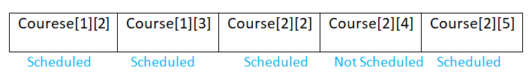

Genetic algorithm
Example: CrossOver
P1 P2
Parent 1 =
Parent2 =
Child =
After removing and adding Child =

Slide 38
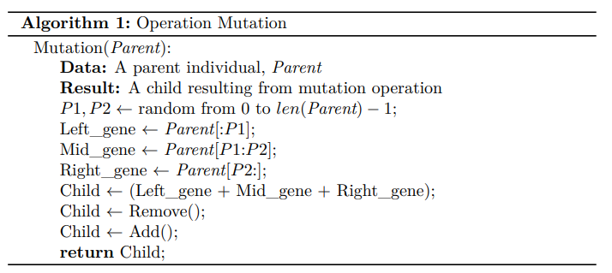
Genetic algorithm
Select a random parent.
Mutation by reverse slot of course in the mid gence in parent.
After Mutation, remove slot and teacher in course that do not satisfy the constraints.
Finally, add random slot and teacher that satisfy the constraints for course that has not been scheduled before.
Notes:
Thêm khung, ít chữ

Slide 39

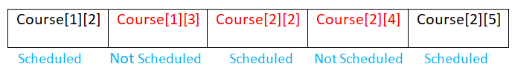

Genetic Algorithm
Example: Mutation
P1 P2
Parent =
Child =
After removing and adding Child =

Slide 40
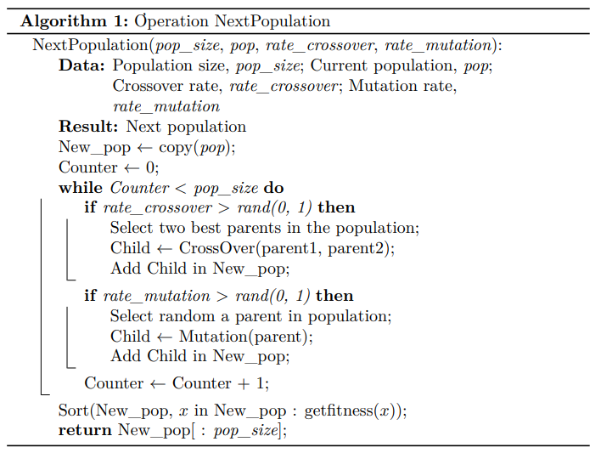
Genetic algorithm
Create a new population by two operations: crossover and mutation.
Copy previous population into the new population.
Sort the new population by the fitness of each individual in the population.

Slide 41
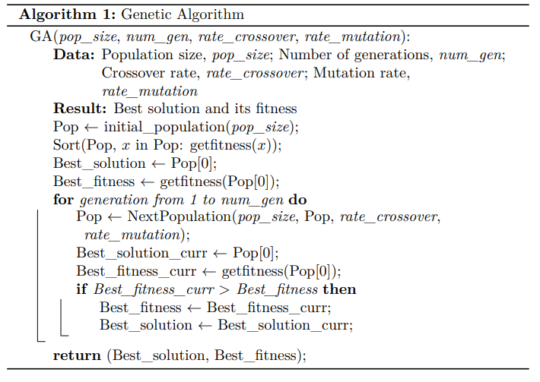
Genetic algorithm
Main Loop:
Step 1: Create the initial population, sort it by the fitness of each individual.
Step 2: Iterate through generations. In each generation, we aim to find a better solution (individual).
Step 3: Compare the best current solution to the best previous solution to update it.
Notes:
Ít chữ, thêm khung

Slide 42
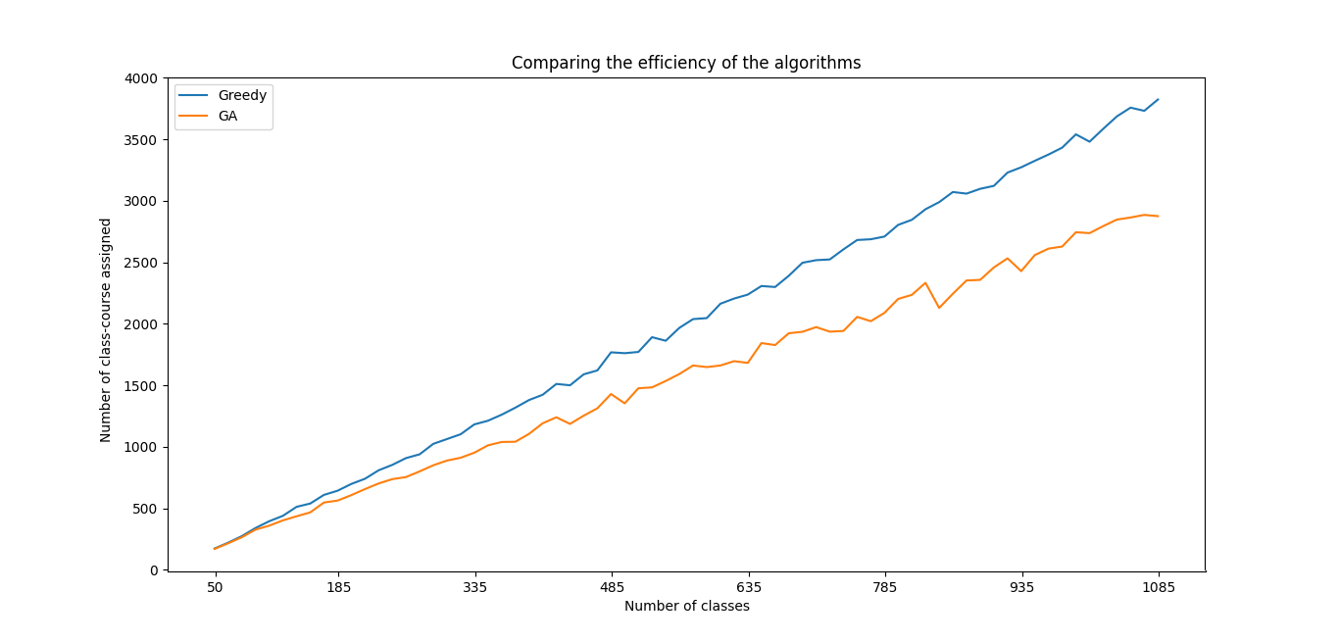
Comparison
Test case 1: 3:5:4
THE EXPERIMENT IS MADE ON CHIP CORE(TM) i5-1245U
Notes:
Chạy lại thêm greedy+random, vẽ lại greedy, vẽ lại GA, 50 test case 50-1000, vẽ 1 thôi , chọn tỉ lệ xấp xỉ 3:5:4,
<100: 2
100<course<200: lower:3
200<c<500, lower: 4
500<c<700, lower:6
>700: lower: 8

Slide 43
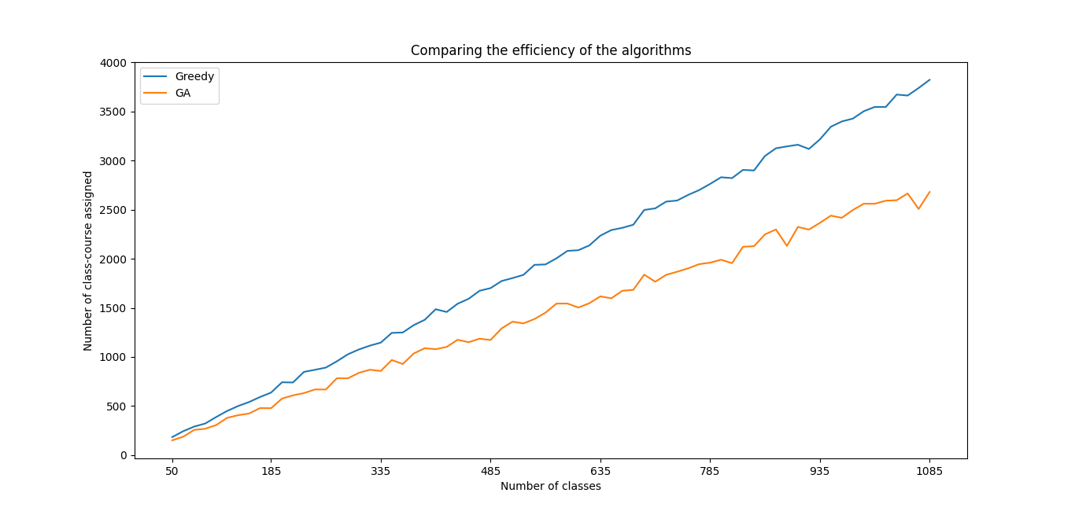
Comparison
Test case 2: 2:5:3
THE EXPERIMENT IS MADE ON CHIP CORE(TM) i5-1245U
Notes:
Chạy lại thêm greedy+random, vẽ lại greedy, vẽ lại GA, 50 test case 50-1000, vẽ 1 thôi , chọn tỉ lệ xấp xỉ 3:5:4,
<100: 2
100<course<200: lower:3
200<c<500, lower: 4
500<c<700, lower:6
>700: lower: 8

Slide 44
04
Conclusion

Slide 45
Conclusion
Exact algorithm with OR-Tools ⇒ Provide exact solution but unstable, slow for large size of test case.
Genetic algorithm ⇒ Only considered as an experimental approach because of its ineffectiveness in objective value and solving time.
Greedy algorithm ⇒ An excellent solution to this problem because of the almost exact objective value in a short period of time.
Greedy + random algorithm ⇒ A better version of greedy; although taking more time due to iterations, it is a better approach for the diverse large size of test case.
Notes:
T viết, quân thuyết trình

Slide 46
Thanks
Do you have any questions?

