Slide 1

Steam Game Analysis
Group 17
Ngo Duy Dat -20225480
Doi Si Thang – 20225528
Nguyen Nhat Minh – 20225510
Nguyen Hoang Son Tung – 20225536
Vu Tuan Truong - 20225535

Slide 2
Problem
Background:
Steam dominates the market, generating massive datasets: player behavior, commercial performance,…
Fragmentation: Data is scattered and historical data is not public.
Target:
Scrape data from SteamSpy and Steam.
Clean, process streaming data using distributed framework.
Analyze the data using PowerBI and ML to provide useful/predictive insights.

Slide 3

Data Source
Steam: the world biggest online game distribution platform
Types of data:
Game details: id, price, rating, current players, …
Game reviews: user ratings, comments, play time
SteamSpy data: backfill data about real-time info (past price/player online)

Slide 4
Architectural Approach
Kappa Architecture for unified processing between batch/stream data
Key Objectives:
Recovering game catalogs and historical reviews/player counts
Capturing new games/reviews within minutes
Distribute the system on Kubernetes for better processing power/error handling/auto distribution.

Slide 5
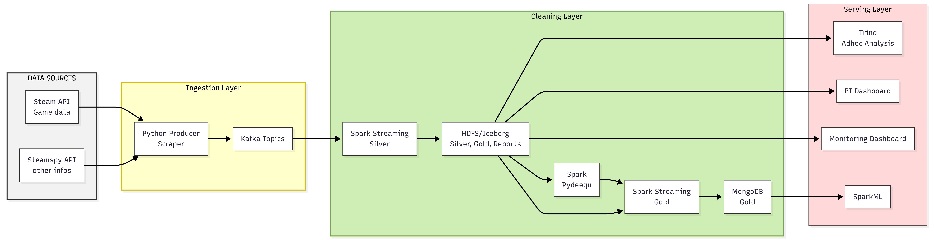
System Architecture & Design

Slide 6
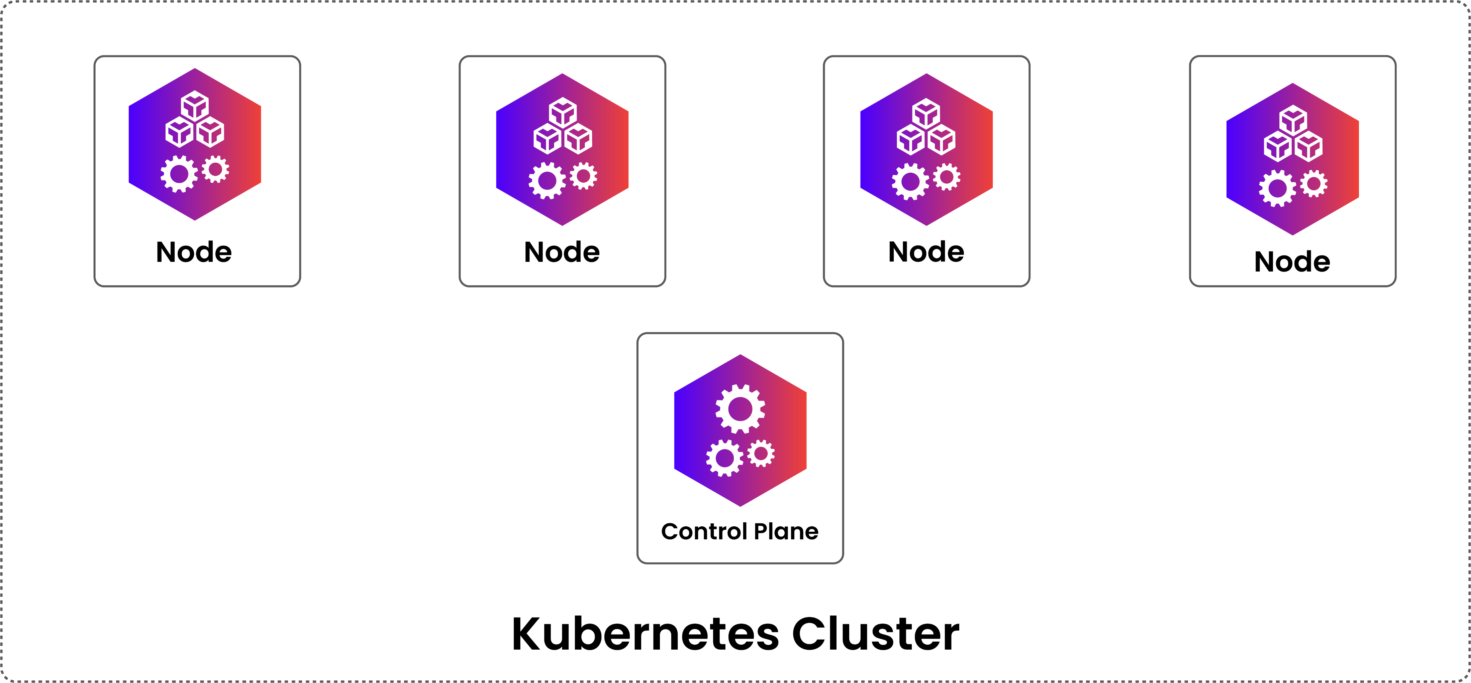
Infrastructure Implementation
Cluster Setup:
Deployed on a distributed cluster of personal laptops.
Tailscale (Mesh VPN): Creates a flat, encrypted overlay network, allowing nodes to communicate across NAT boundaries as if they were on a local LAN.
Orchestration Stack:
Kubernetes with k3s: A lightweight K8s distribution.
Helm: Used to manage complex distributed deployments:
Strimzi Operator for Kafka.
Spark Operator for application lifecycle.
HDFS for distributed storage.

Slide 7
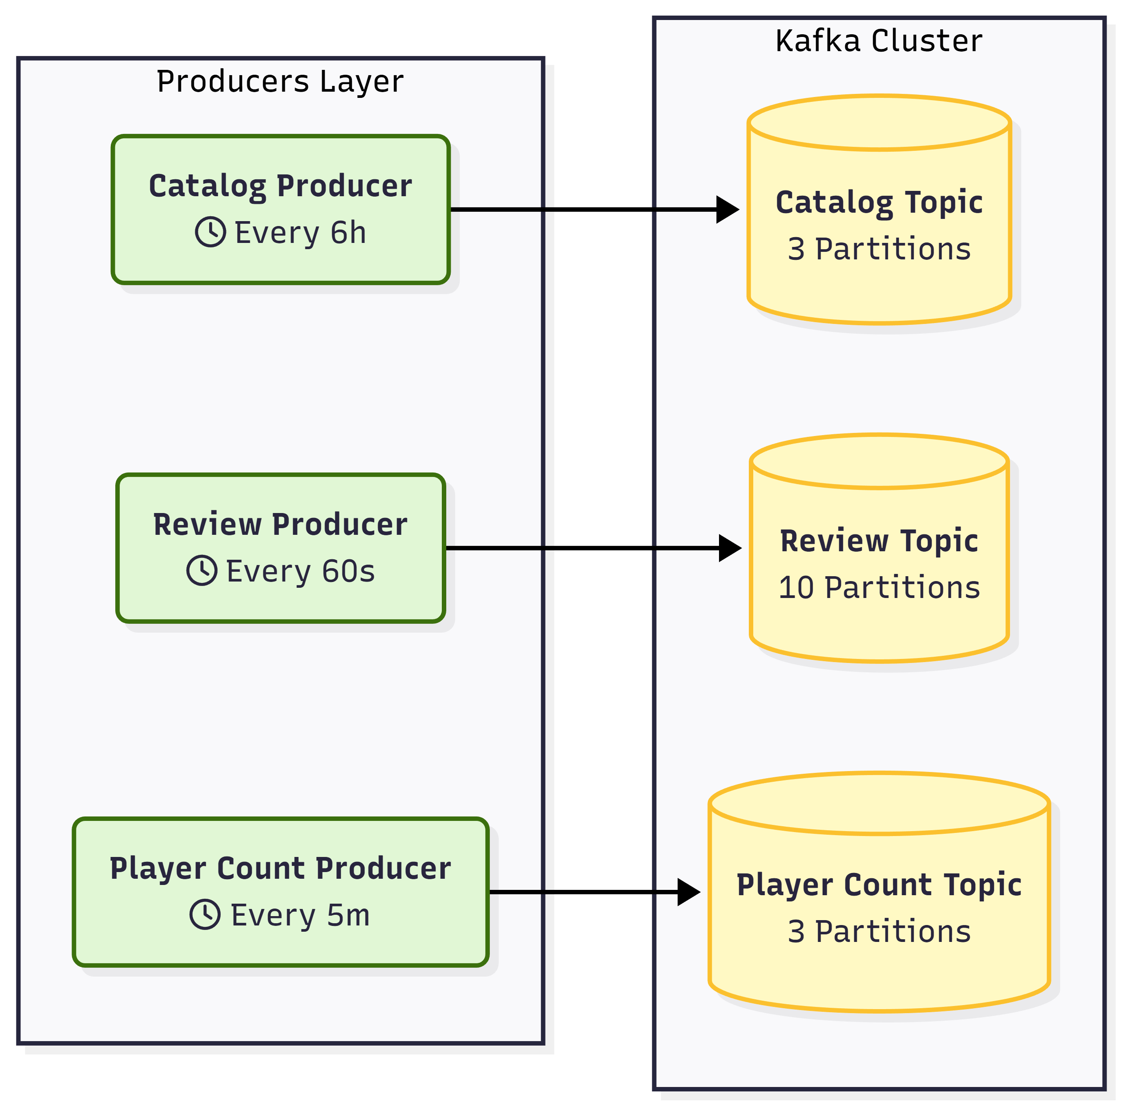
Ingestion Layer
Kafka: 3 Producers & Topics
Retention: -1ms (indefinite)
For historical data: bootstrap Kafka using
mined historical data.

Slide 8

Processing
Silver Layer (Refinement):
Schema Enforcement: Converts raw JSON to strict StructTypes.
Evolution Handling: explicit NULL injection for historical fields.
Sanitization: Regex-based cleaning.
Gold Layer (Complex Aggregations):
Windowing Strategy:
Player Trends: 30-minute tumbling windows to calculate Max/Avg concurrency.
Sentiment: 1-hour tumbling windows to track "Positive vs. Negative" ratios.
Watermarking: configured to handle late-arriving data and out-of-order network packets before finalizing results.
RAW DATA
SILVER
Cleaning + Normalizing + null handling
GOLD
Advanced transform + Analytics

Slide 9
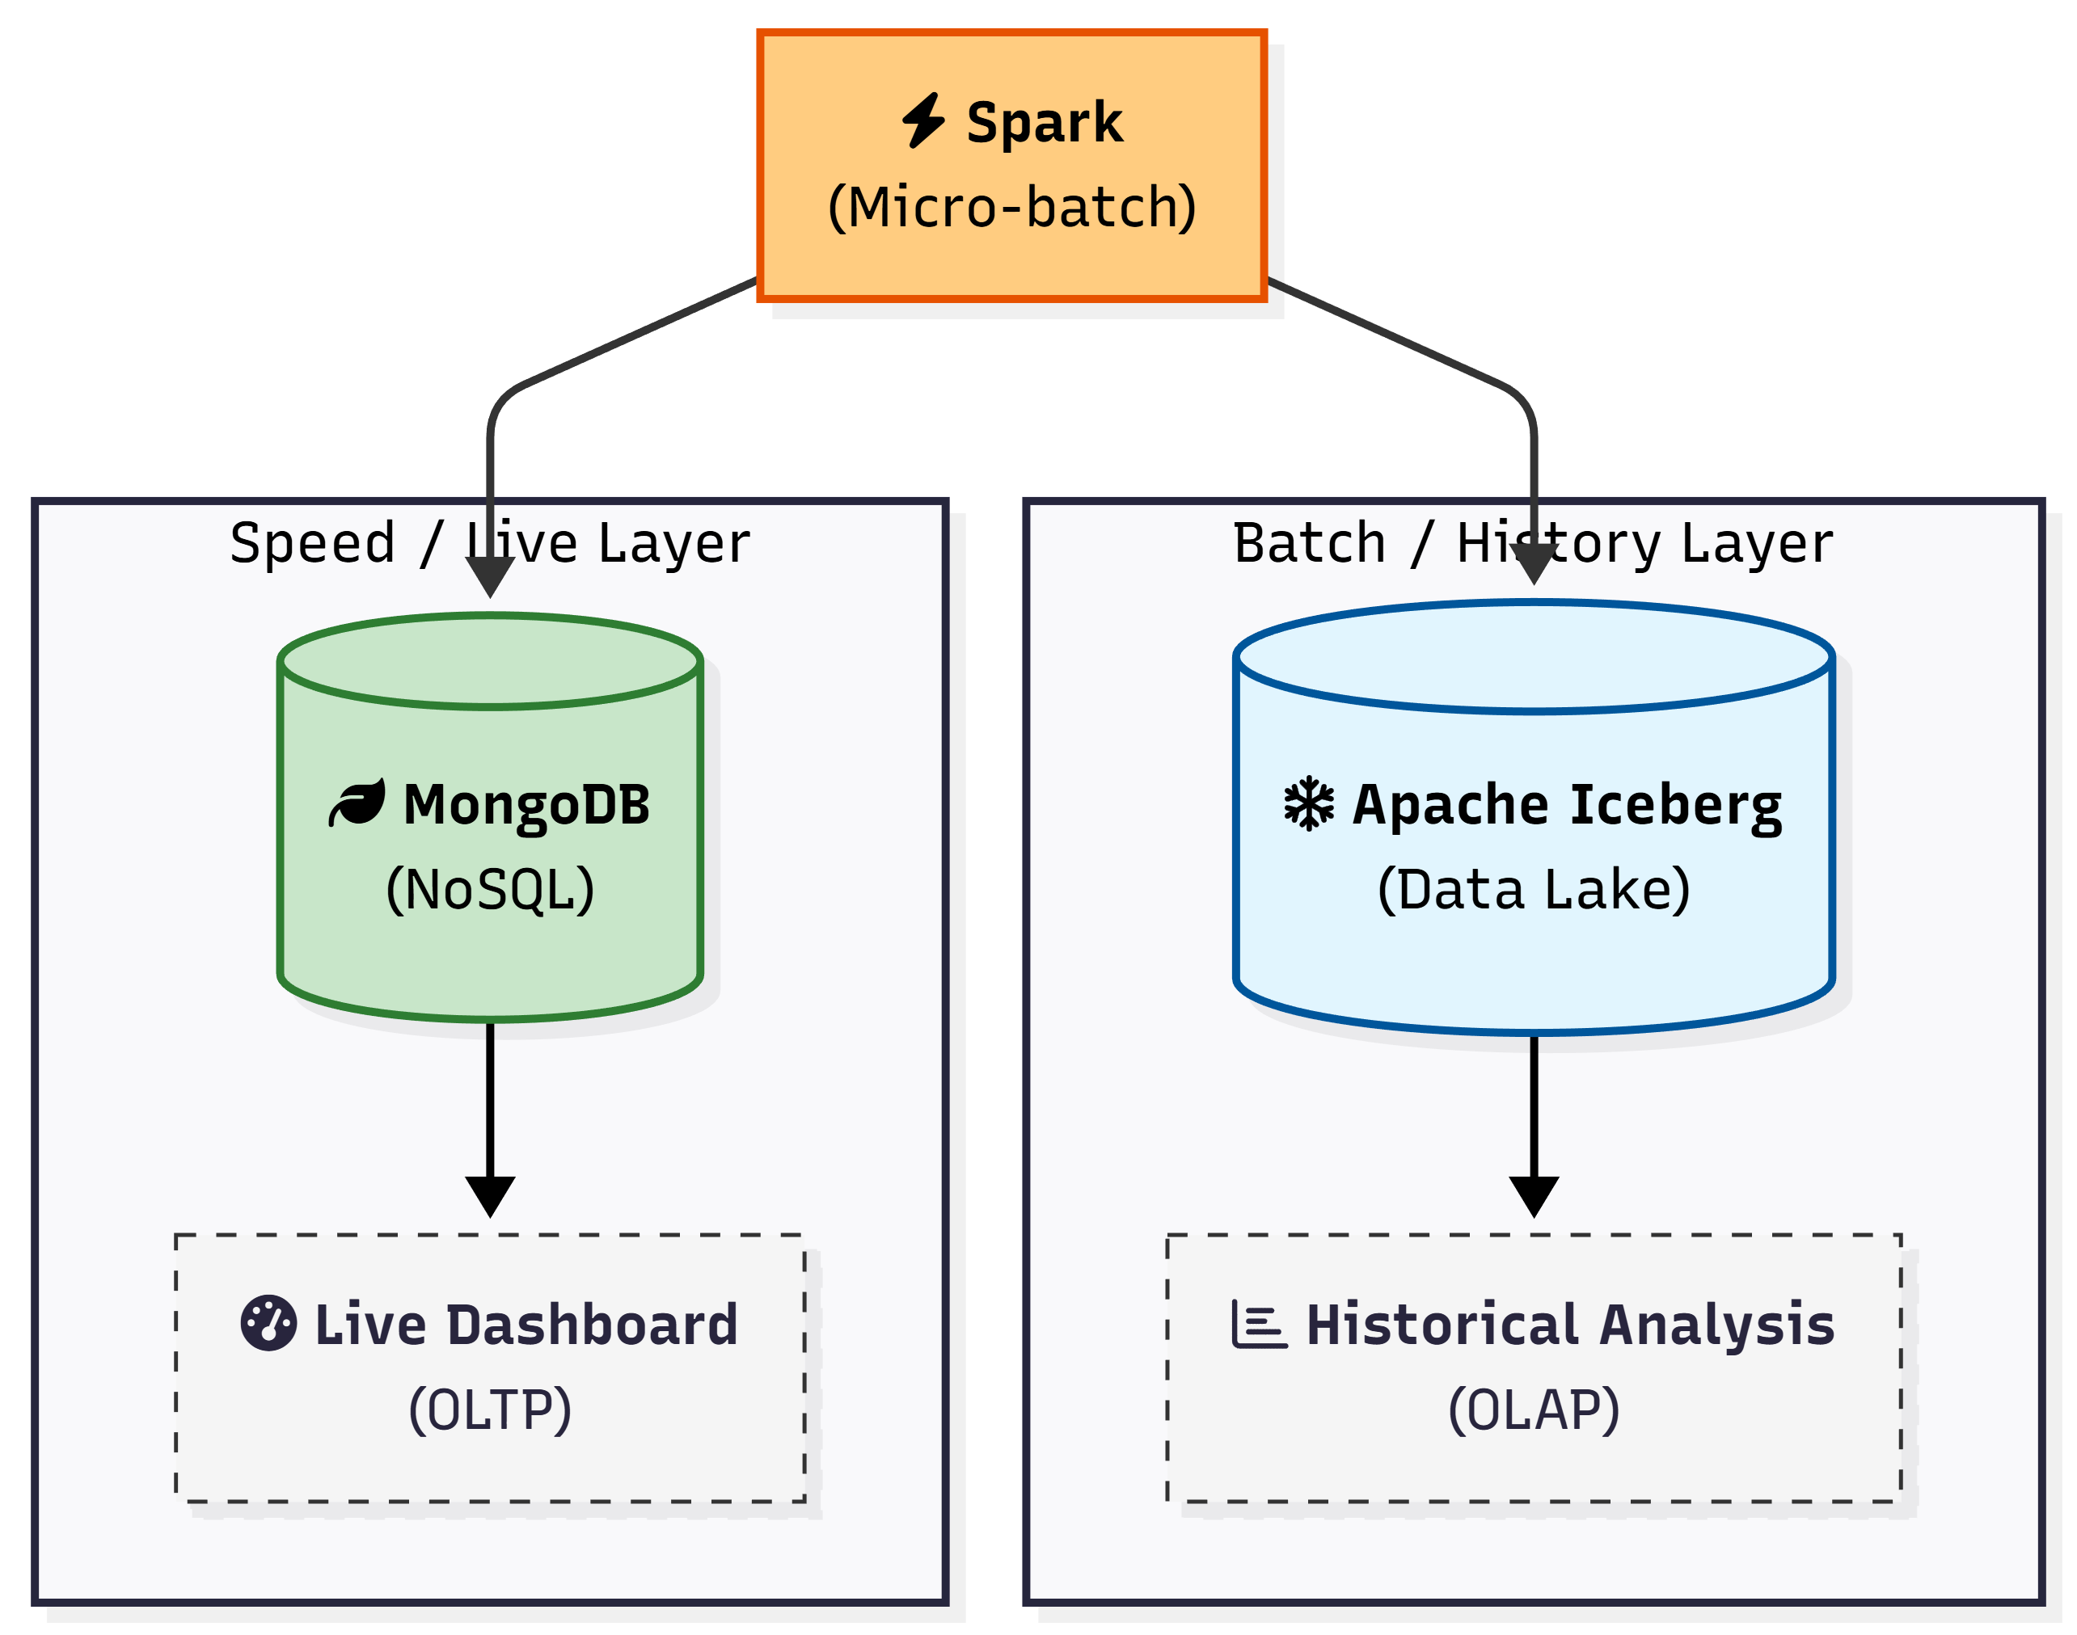
Dual-Sink Storage Pattern
The Challenge:
Analytical users need deep history
Dashboard users need sub-second responsiveness
The Solution: Dual Sink
Sink 1: Data Lake (Apache Iceberg over HDFS)
Sink 2: Operational Store (MongoDB)

Slide 10
Quality Assurance & Observability
Data Quality (The Promotion Gate):
Implemented using PyDeequ
Strategy: Data lands in a staging area first.
Verification Suites:
Critical: Checks for NULL primary keys or duplicates.
Warning: Checks for business logic anomalies (e.g., negative prices).
System Observability:
Prometheus: Scrapes metrics from Kafka, MongoDB, and K8s pods every 15 seconds.
Grafana: Visualizes infrastructure health together with the dashboards.

Slide 11
Data Consumers
Interactive Dashboards (Grafana):
Hybrid Data Source: Uniquely combines Prometheus (for pipeline latency/health) and MongoDB (for game metrics) into a single pane of glass.
Automation: Dashboards are version-controlled via JSON and auto-provisioned at container startup.
Predictive Modeling (SparkML):
Objective: Forecasting Player Count Trends.
Pipeline:
Training: Uses the deep historical baselines stored in Apache Iceberg (Silver Layer) to train Time Series or Linear Regression models.
Features: avg_playtime_2weeks, price_segment, and historical peak_players.
Inference: Predicts traffic spikes for upcoming weekends or sales events, allowing for proactive resource planning.

Slide 12
Dashboard

Slide 13
THANK YOU !

