Slide 1
Food Delivery Database Design
INFO 6210
Team 3
By Mingjun Yang, Qing Hu, Xuanqi Li, Yutong Yan

Slide 2
Introduction of Food Delivery:
Business Model &
Key Components

Slide 3
How this Database could be used?
Thinking from different angles
Customer
Deliver
Restaurant
Food Delivery Service Provider

Slide 4
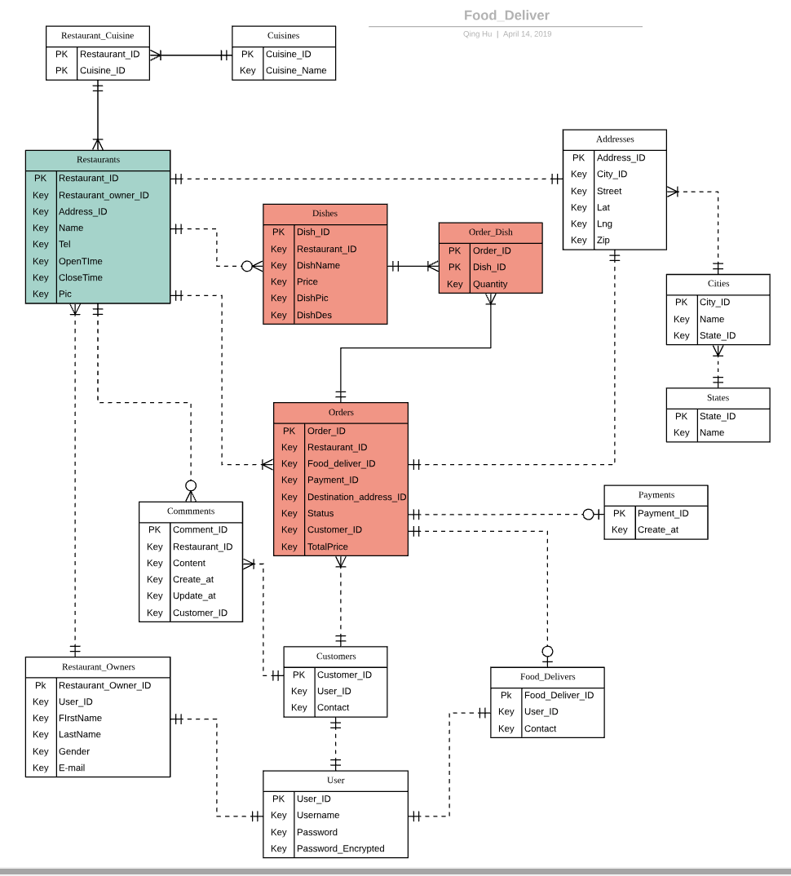
ERD
15 Entities
1 : 1
1 : n
n : n (remove)
Non Identifying relationship
Identifying relationship

Slide 5
Database Implementation
Share DBeaver Screen

Slide 6
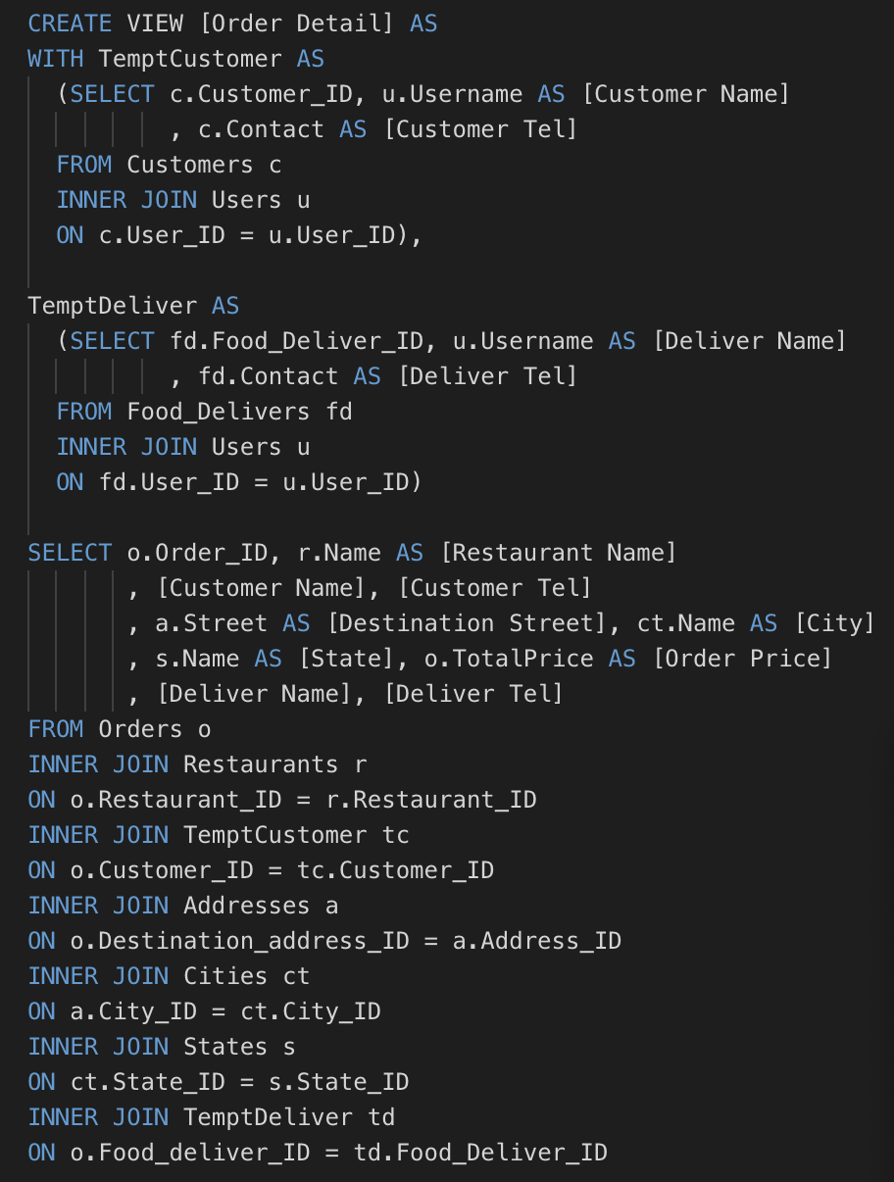
VIEW TABLE I
Order Detail
/*---------------------------------------
Create View: Order Detail
DESC: Retrieve the detail information of
orders.
----------------------------------------*/

Slide 7
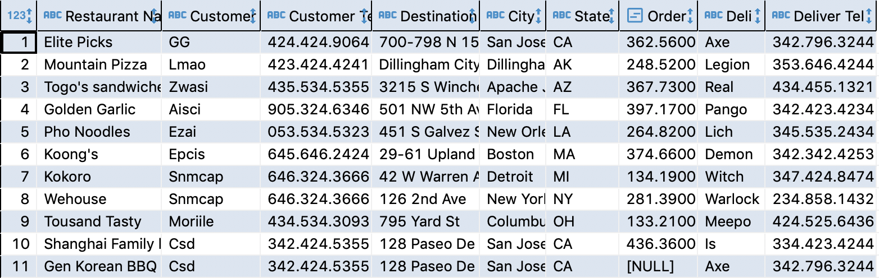
VIEW TABLE I Order Detail
/*-----------------------------------------------------------
Create View: Order Detail
DESC: Retrieve the detail information of orders.
-------------------------------------------------------------*/

Slide 8
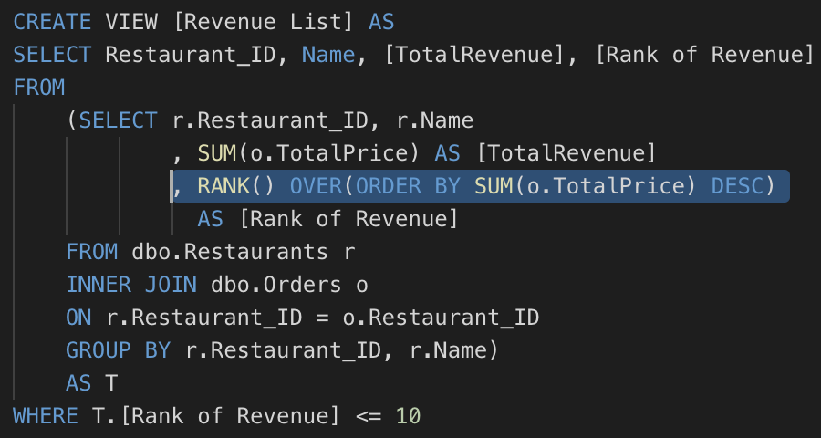
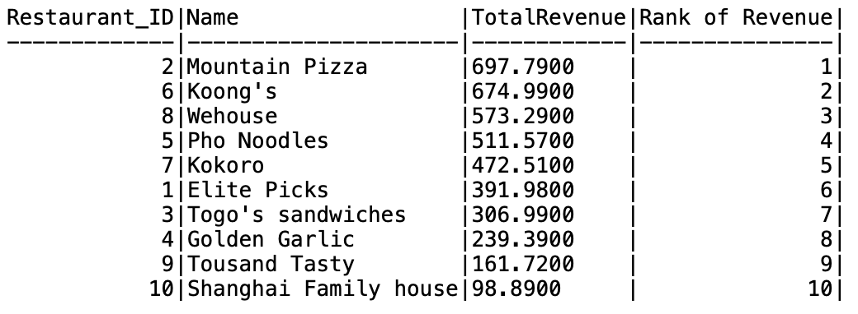
VIEW TABLE II
Top10 Hot Restaurant
SQL Statements
/*---------------------------------------------------
Create View: Top10 Hot Restaurant
DESC: Retrieve the top10 hot restaurant according to the TotalPrice
---------------------------------------------------*/

Slide 9
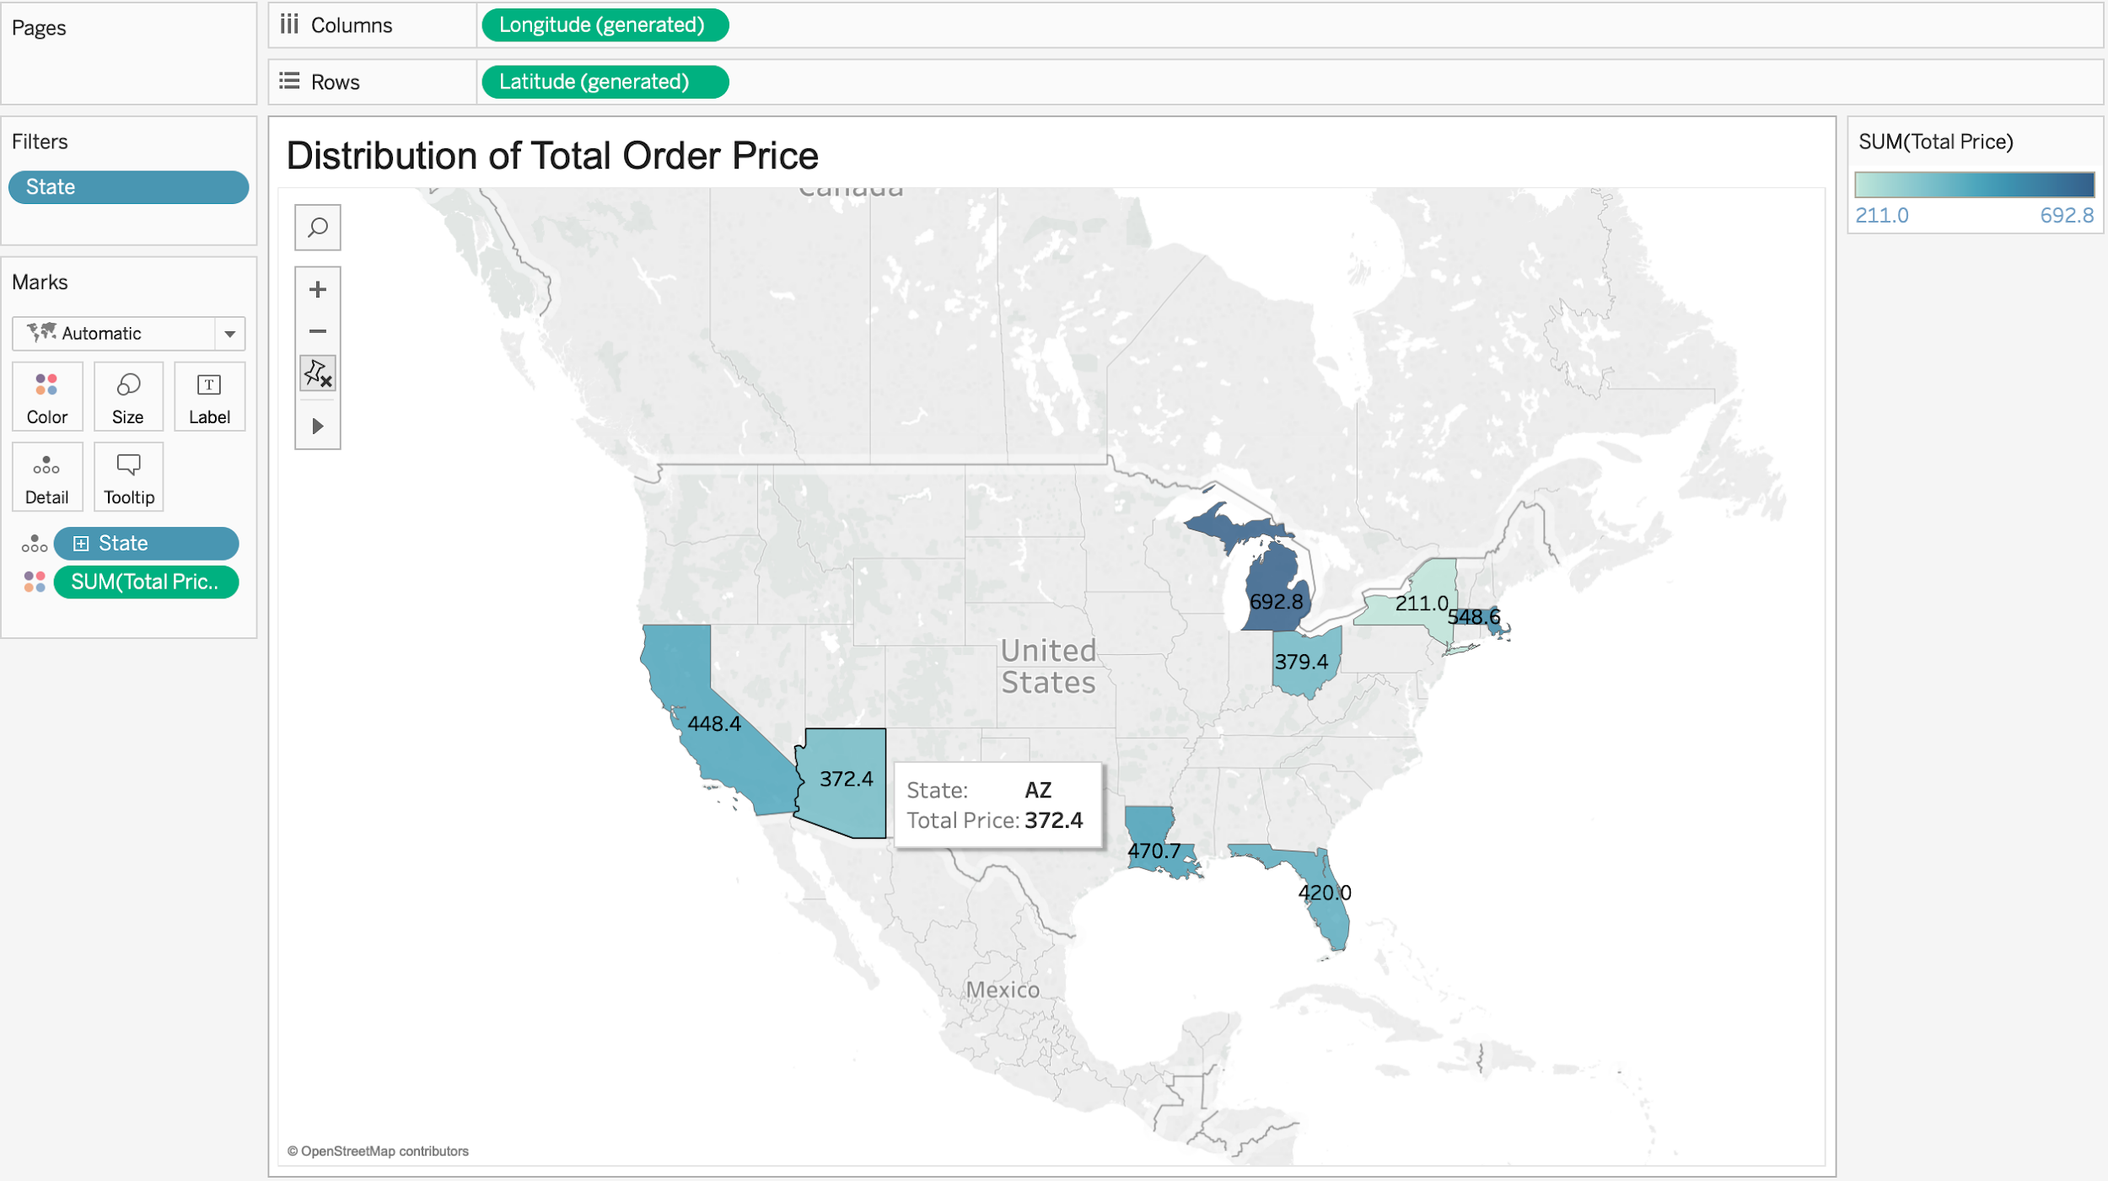
Tableau I - Distribution of Total Price (by Mapping)

Slide 10
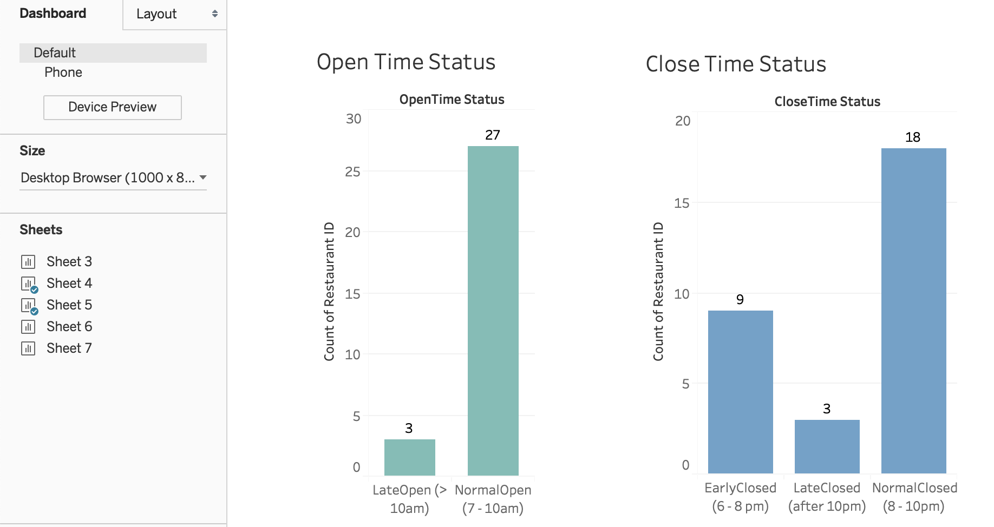
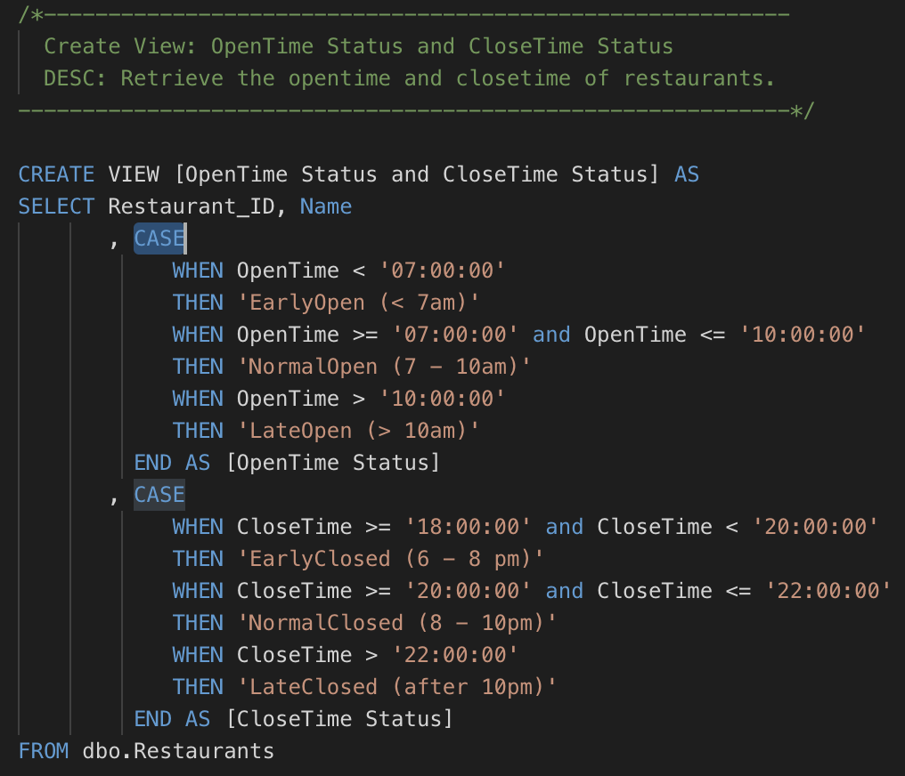
Tableau II - Open & Closed (by Horizontal Bars)

Slide 11
THANK YOU
Q&A

