Slide 1
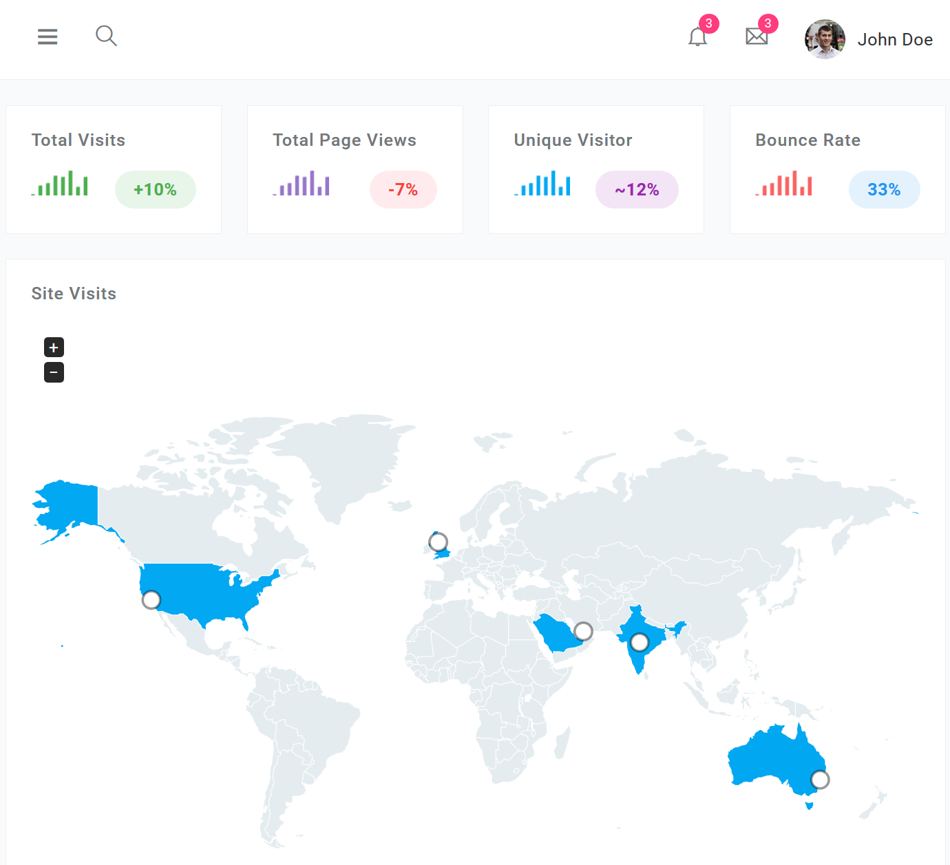




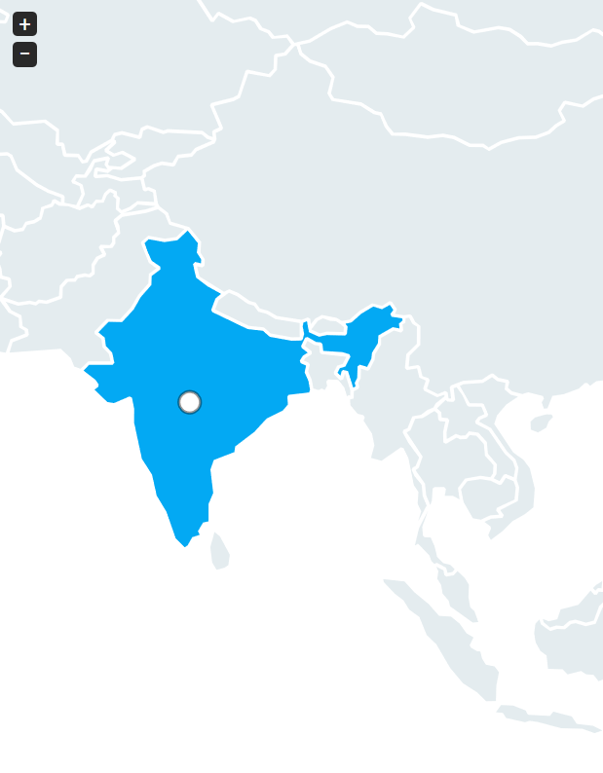








A people’s initiative to help each other
App
Download
Total Requests
for Help
Requests for Help
received today
3,230
Help Offers
received today
3,230
Total Help Offers
received
43,321
■ Initiated &
Sustained by:
Friends, acquaintances & strangers coming together…
Want to help?
Help with….
Translations (download)
Data analytics
Community-level support
Awareness
Media outreach
Write to us:
Captcha
SEND
(we will try to respond as quickly as we can. Please bear with us.)
54,230
14,230
App Languages
English
हिंदी
ಕನ್ನಡ
French
Spanish
Marathi
Gujarati
Bhasa Indo.
54,230
4,230
54,230
4,230
54,230
4,230
54,230
4,230
54,230
4,230
54,230
4,230
Submit
 Help Requests
 Help Offers
54,230
4,230
54,230
4,230

Slide 2
A people’s initiative to help each other
App
Download
Total Requests
for Help
Requests for Help
received today
3,230
Help Offers
received today
3,230
Total Help Offers
received
43,321
■ Initiated &
Sustained by:
Friends, acquaintances & strangers coming together…
Want to help?
Help with….
Translations (download)
Data analytics
Community-level support
Awareness
Media outreach
Write to us:
Captcha
SEND
(we will try to respond as quickly as we can. Please bear with us.)
54,230
14,230
Contributors
Vikas Chaudhary
Vineet Chikarmane
Indra Verman
Ashok Hegde
Karthik Sashidhar
Avneesh Gupta
Sanjiv Sharma
Mitesh Thakkar
Vandana Viswanathan
Arun Ramanujanpuram
V.S.R. V Raghavan
Inna Bochkova
Bharati Mishra
Sandeep Bamane
Gora Mohanty
Inika Chikarmane
App Languages
English
हिंदी
ಕನ್ನಡ
French
Spanish
Marathi
Gujarati
Bhasa Indo.
54,230
4,230
54,230
4,230
54,230
4,230
54,230
4,230
54,230
4,230
54,230
4,230
Submit
 Help Requests
 Help Offers
54,230
4,230
54,230
4,230

