Slide 1
What is Kotlin and why you should use it instead of Java

Slide 2

Who am I?
Name: Akseli Piilola
Senior Software Developer @ Gofore
Full time Kotlin / Part time security specialist for the last 2 years
First job in software development in 2002
Past experience with C, C++, Java, Python, PHP…
No social media, sorry, you can´t find me online :(

Slide 3
What is Kotlin?
Programming language developed by JetBrains
Runs on JVM
Project Kotlin revealed in July 2011, open sourced in February 2012
v 1.0 released on February 2016
“Designed to be an industrial-strength object-oriented language, and a better language than Java, but still fully interoperable with Java code, allowing companies to make a gradual migration from Java to Kotlin”

Slide 4
Philosophy
From developers to developers
Easy transition from Java to Kotlin
Fully compatible with Java (both ways)
Fully compatible with older JVM versions (important for Android)
Leave out the “annoying and unnecessary” things, while retaining functionality
Add new functionality and make things easier

Slide 5
In practice
Adopted by many companies, projects & frameworks
IntelliJ IDEA can translate Java code to Kotlin automatically
Works with Java 6, although more optimal with higher versions (Lambdas to Java 6 :-))
Full support from Google/Android (”official” language for Android)
Full support from Spring (especially awesome with WebFlux)
Full support from JetBrains (obviously)
… and much more

Slide 6
Why should you use Kotlin?
Less code... more time to read Reddit
Rough estimates indicate approximately 40% cut in the number of lines of code
Get modern language features to environments running old JVM
Made by developers for developers, new features based on what people want and need
No more dreaded NPEs (unless you explicitly want to!)
Language level immutability, top level functions, etc…
Everybody else is starting to use it also :)

Slide 7
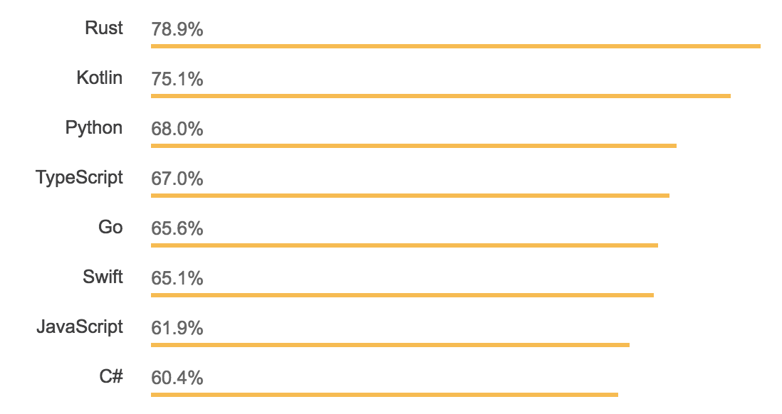
Why should you use Kotlin?
Most loved languages, Stackoverflow survey 2018

Slide 8
What Kotlin has that Java does not?

Slide 9
Extension functions
Efficient way to add new functionality to existing classes
fun String.doSomething() = println(this)
val str: String = ”Hello Kotlin!”
str.doSomething() // ”Hello Kotlin!”

Slide 10
Immutability
Different declarations for mutable and immutable values
Highly encouraged to use immutables as much as possible
Functional programming style functions like map, flatMap, reduce etc. available for standard data structures (no need to cast anything to stream and back)
val foo: Int // immutable integer
var bar: Int // mutable integer

Slide 11
Null-safety
!! -> throw NPE if null
? -> do something if not null, otherwise return null
?: -> do something else if null
Everything is non-nullable by default
Nullable values have to declared as nullable (ie. String?)
val giveMeNPE = request!!.getData()
val canBeNull = request?.getData()
val notNull = request?.getData() ?: doSomethingElse()

Slide 12
Smart casts
No need for senseless cast operations
if (x is String) {
println(x.length) // x is automatically cast to String
}

Slide 13
String templates
Strings may contain template expressions starting with $
Automatically converts variables to String (or calls toString)
Produces shorter and more readable code
val n = 10
val str = “The value of number n is $n”

Slide 14
Data classes and primary constructors
Automatically generate constructor
Automatically generate equals(), hashCode(), toString() and copy().
Produces shorter and more readable code
data class User(val name: String, val age: Int)
val john = User(“John”, 23)
user.toString() // User(name=John, age=23)

Slide 15
Default parameters
Reduces the need for function overloading
fun doSomething(par1: String = “foo”, par2: Int = 0)
doSomething() // par1 = “foo”, par2 = 0
doSomething(par2 = 10) // par1 = “foo”, par2 = 10
doSomething(par1 = “bar”) // par1 = “bar”, par2 = 0

Slide 16
And lots more…
First-class delegation
Type inference
Singletons
Range expressions
Operator overloading
Coroutines
…

Slide 17
What Java has that Kotlin does not?

Slide 18
What Java has that Kotlin has not?
Checked exceptions
Primitive types
Static members
Non-private fields
Wildcard types
Ternary operator a ? b : c
???

Slide 19
So… what’s wrong with Java?
Nothing is essentially wrong, but that doesn´t mean there is no room for improvements
Java is old… very old
Think of Kotlin as a “rebuilt Java”, after 20 years of experience

Slide 20
What can we expect from Kotlin in future?

Slide 21
Future
Keep the language modern over the years
Stay in a constant feedback loop with the users
Make updating to new versions comfortable to users
More projects: Kotlin Script, Kotlin Native, etc…

Slide 22
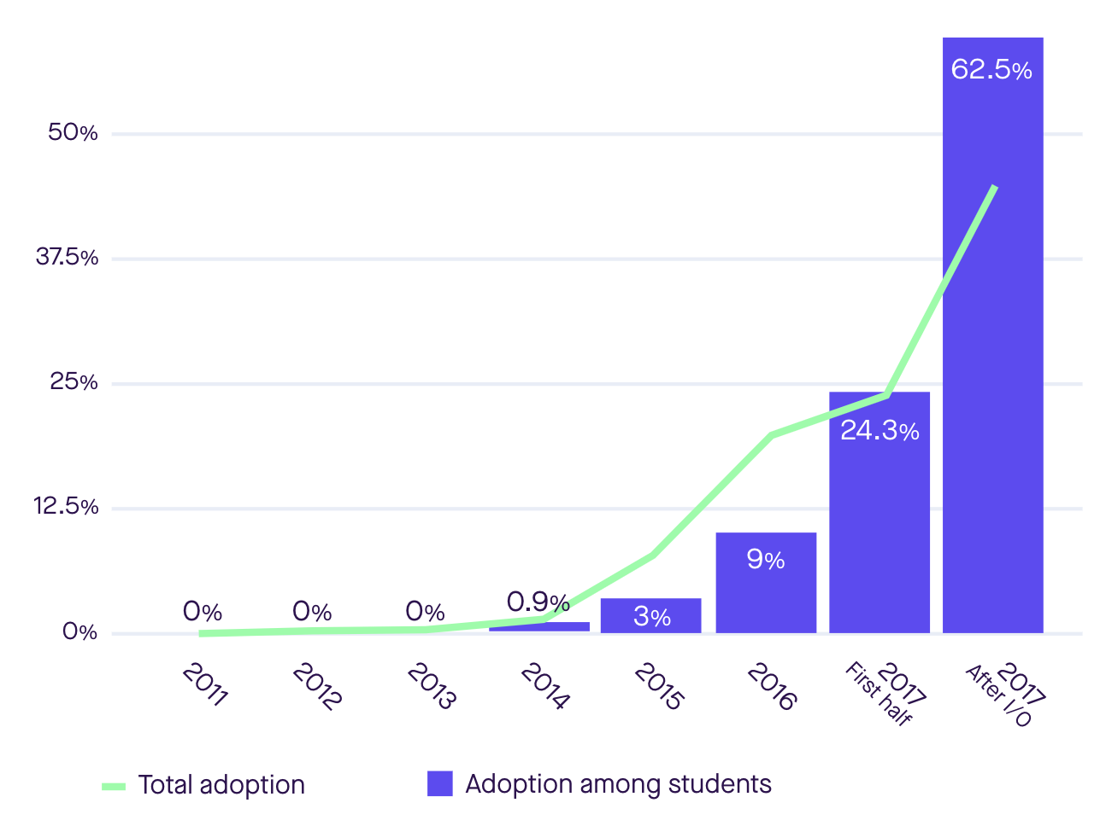
Future
Adoption among students

Slide 23
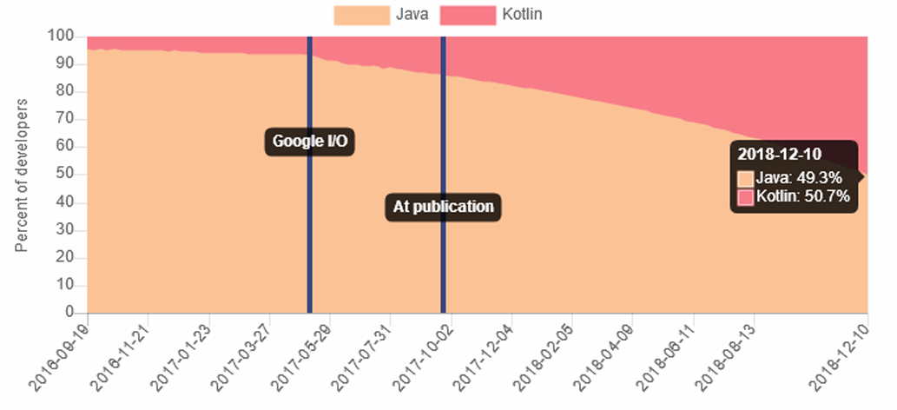
Future
Kotlin for Android development

Slide 24
Thank you for listening! Questions?

