Slide 1
Title: Superstore Analysis
Subtitle: Member 2 Report-
Helen Getachew

Slide 2
Objective
  Goal: Reveal sales patterns to guide inventory and promotions.
  Focus: Correlations, outliers, distributions.

Slide 3
Methods
  Prep: Data cleaning and export.
  Analysis: Correlation heatmap; IQR outliers; Category/Segment/Region distributions.

Slide 4
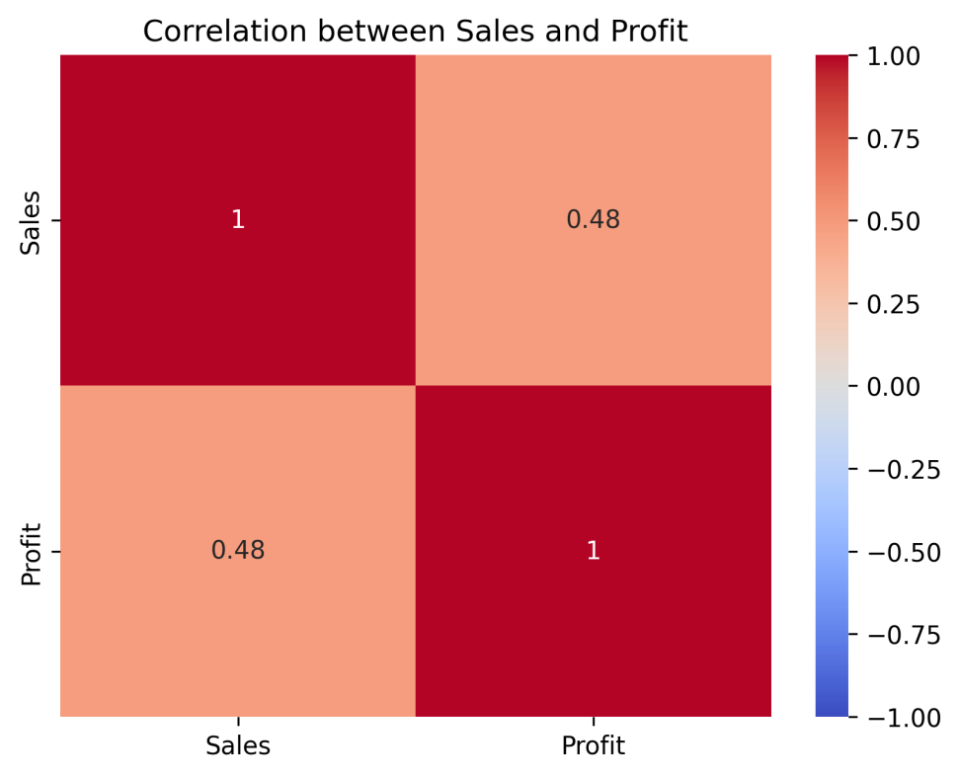
Correlation insights
  Finding: Key numeric relationships.
  Use: Guides feature importance and monitoring.
  Visual: Insert correlation_heatmap.png.

Slide 5
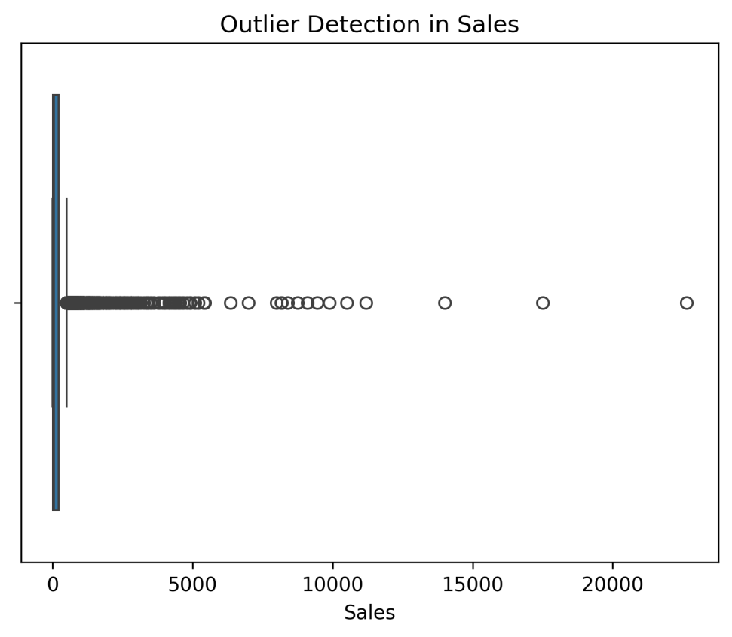
Outliers
  Finding: Extreme discounts/high‑value orders detected.
  Action: Review for margin protection.
  Visual: Insert outliers_boxplot.png.

Slide 6
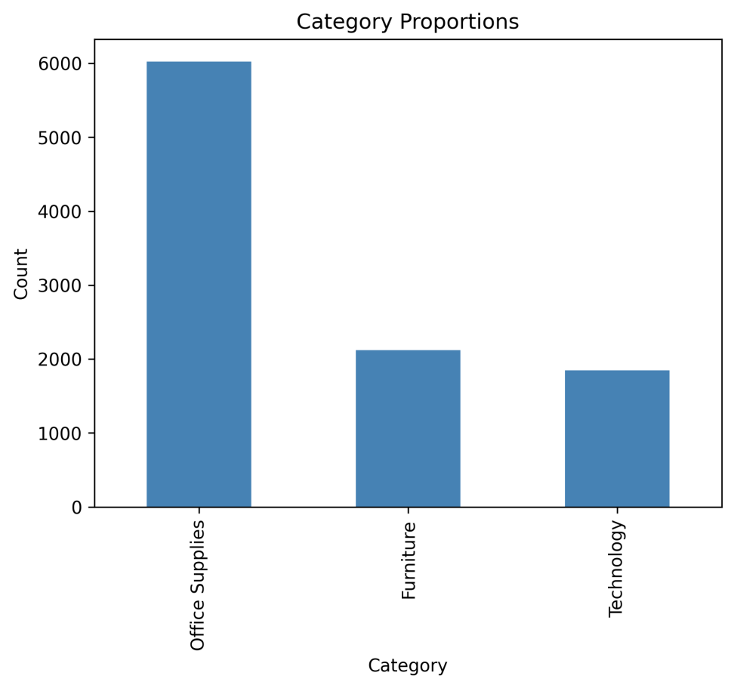
Category distribution
  Finding: Office Supplies dominate.
  Note: Furniture/Technology smaller share.
  Visual: Insert category_proportions_bar.png.

Slide 7
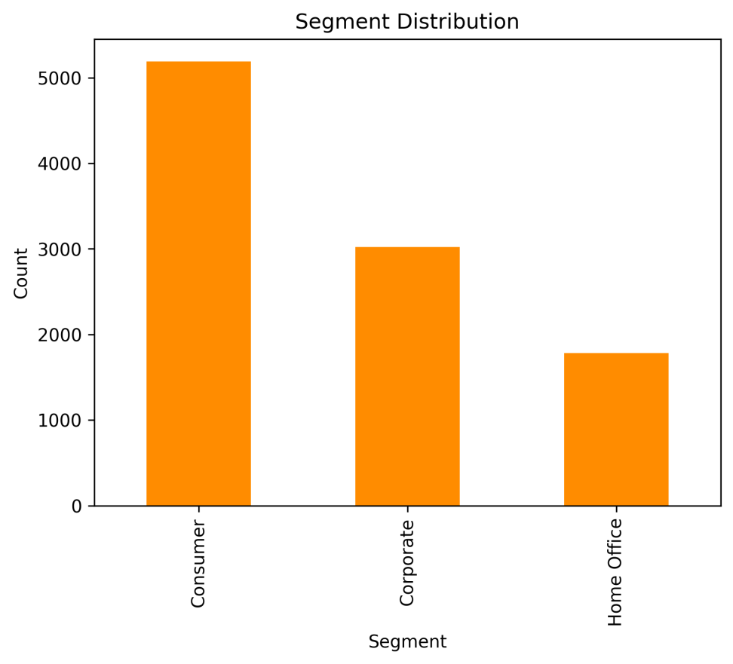
Segment distribution
  Finding: Consumer, Corporate, Home Office differ.
  Action: Target by segment behavior.
  Visual: Insert segment_distribution_bar.png.

Slide 8
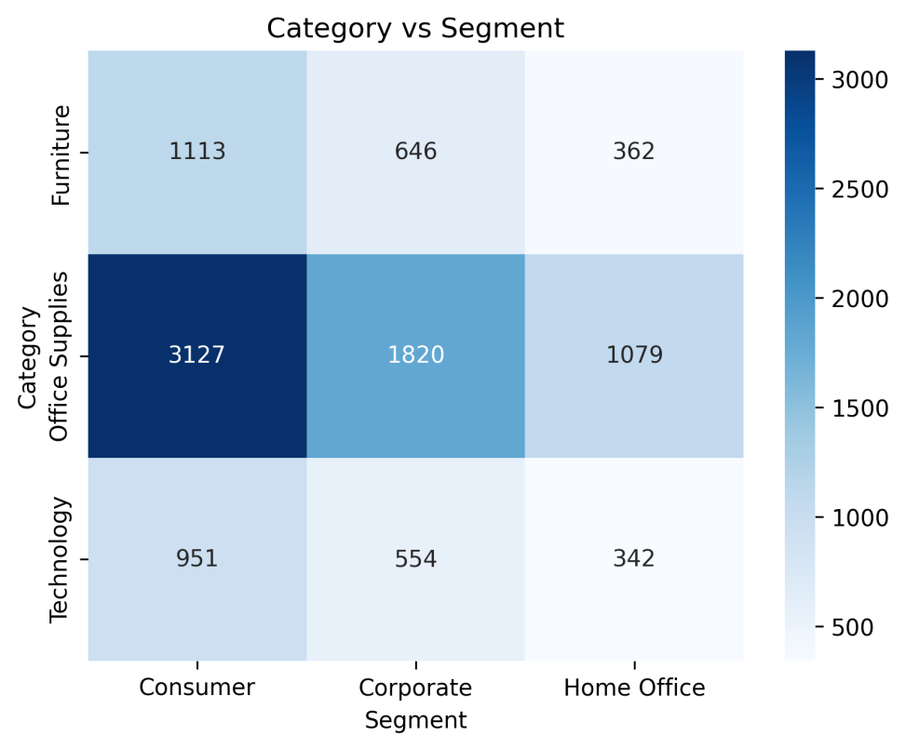
Category × Segment
  Finding: Segment mix varies by category.
  Action: Align offers with segment preferences.
  Visual: Insert category_vs_segment_heatmap.png.

Slide 9
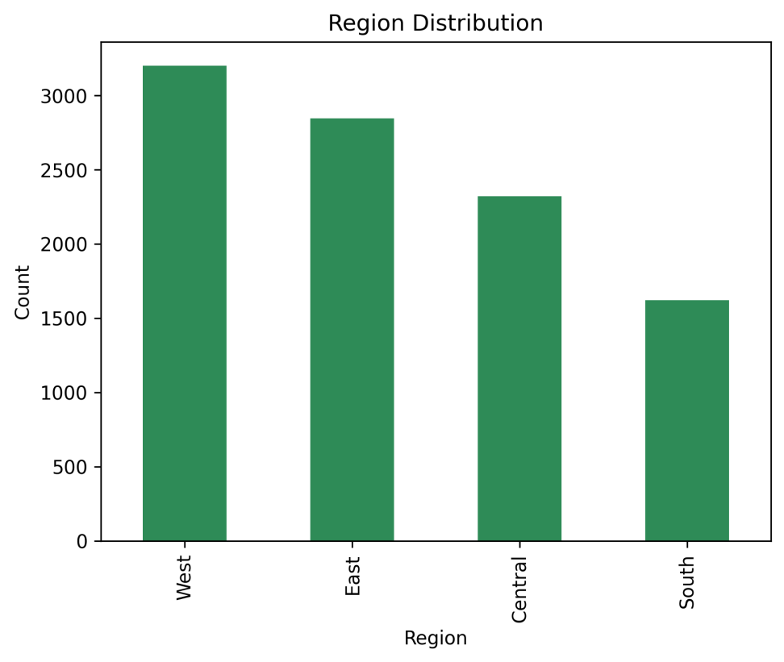
Region distribution
  Finding: West/East dominate; South/Central lag.
  Action: Prioritize stock and promotions in West/East.
  Visual: Insert region_distribution_bar.png.

Slide 10
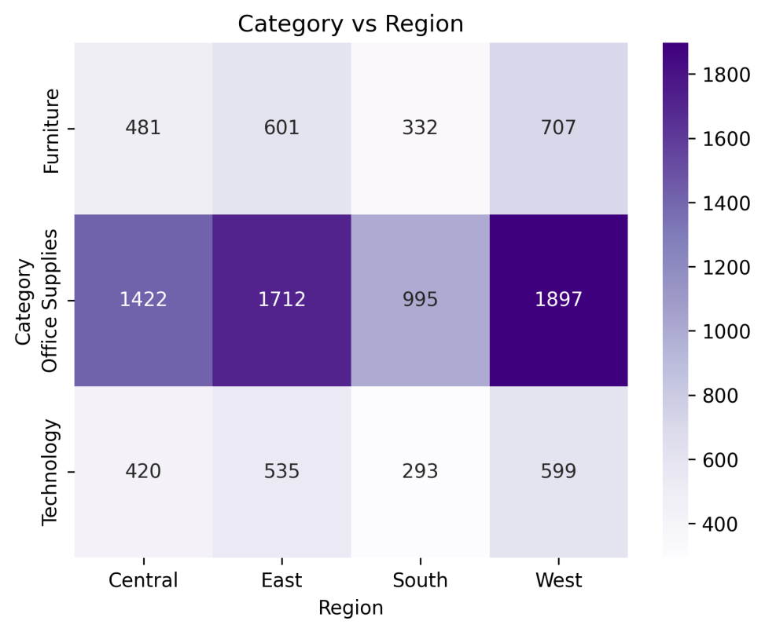
Category × Region
  Finding: Office Supplies strong everywhere.
  Note: Furniture/Technology vary by region.
  Visual: Insert category_vs_region_heatmap.png.

Slide 11
Recommendations
  Inventory: Boost West/East; maintain Office Supplies.
  Promotions: Region‑specific for Furniture/Technology.
  Governance: Monitor outliers.

Slide 12
Conclusion and next steps
Conclusion: Region‑aware, category‑specific strategy improves conversion.
Next: Validate with new sales; A/B test offers; refresh monthly

