Slide 1
嵌入式测试流程
Embedded Testing
01
02
He Cong

Slide 2
CONTENTS
01
嵌入式系统现状
02
嵌入式测试流程体系
03
嵌入式测试发展技能

Slide 3
嵌入式系统现状
01
The Status of Embedded Systems

Slide 4
智能硬件（硬件+软件）:随着物联网、互联网技术的发展和普及，嵌入式系统应用的领域越来越广泛
01发展条件
02
03
04
05
随着互联网络的不断发展，嵌入式设备要连上互联网，互联网已成为必然趋势。就必须要提供网络通讯接口，不仅要支持TCP/IP，有些还需要支持IEEE1394、USB、蓝牙、IrDA等，同时还要提供相应的通信组网协议软件和物理层驱动软件。
… …
Theme color makes PPT more convenient to change.
Adjust the spacing to adapt to Chinese typesetting, use the reference line in PPT.
Copy paste fonts. Choose the only option to retain text.
https://blog.csdn.net/ly930156123/article/details/74898126?utm_medium=distribute.pc_relevant.none-task-blog-2~default~baidujs_utm_term~default-0-74898126-blog-124809892.235^v38^pc_relevant_anti_t3&spm=1001.2101.3001.4242.1&utm_relevant_index=1
… …
Unified fonts make reading more fluent.Copy paste fonts. Choose the only optio to retain text.
Copy paste fonts. Choose the only option to retain text.
… …
Theme color makes PPT more convenient to change.
Copy paste fonts. Choose the only option to retain text.
… …
Adjust the spacing to adapt to Chinese typesetting, use the reference line in PPT.
… …

Slide 5
Use "Title Only" Layout
Text here
Text here
Adjust the spacing to adapt to
Chinese typesetting.
Adjust the spacing to adapt to
Chinese typesetting.
Text here
Adjust the spacing to adapt to
Chinese typesetting.

Slide 6
嵌入式测试流程体系
02
Embedded testing process system

Slide 7
嵌入式工具以及常见问题
Theme color makes PPT more convenient to change.
Adjust the spacing to adapt to Chinese typesetting, use the reference line in PPT……
01
02
03
Theme color makes PPT more convenient to change.
Theme color makes PPT more convenient to change.
Theme color makes PPT more convenient to change.
06
05
04
Theme color makes PPT more convenient to change.
Theme color makes PPT more convenient to change.
内存问题危害很大，不容易排查，主要有三种类型：内存泄露、内存碎片和内存崩溃。

Slide 8
Use "Title Only" Layout
嵌入式软件测试分为4个阶段，即模块测试、集成测试、系统测试、硬件/软件集成测试。前3个阶段适用于任何软件的测试，硬件/软件集成测试阶段是嵌入式软件所特有的，目的是验证嵌入式软件与其所控制的硬件设备能否正确地交互。
模块测试
集成测试
系统测试
硬件/软件集成测试
Supporting text here.
Supporting text here.
Supporting text here.
Supporting text here.
Theme color makes PPT more convenient to change.
Copy paste fonts. Choose the only option to retain text.
Theme color makes PPT more convenient to change.
Copy paste fonts. Choose the only option to retain text.
Theme color makes PPT more convenient to change.
Copy paste fonts. Choose the only option to retain text.
Theme color makes PPT more convenient to change.
Copy paste fonts. Choose the only option to retain text.

Slide 9
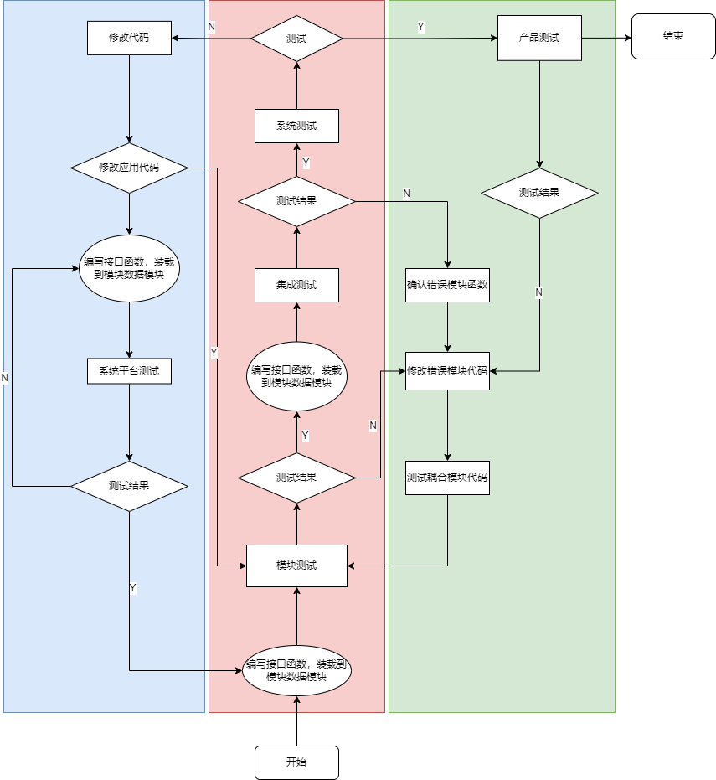
测试流程图
Data
Theme color makes PPT more convenient to change.
Adjust the spacing to adapt to Chinese typesetting, use the reference line in PPT……

Slide 10
AI 机器人发展
03
When you copy & paste, choose "keep text only" option.

Slide 11
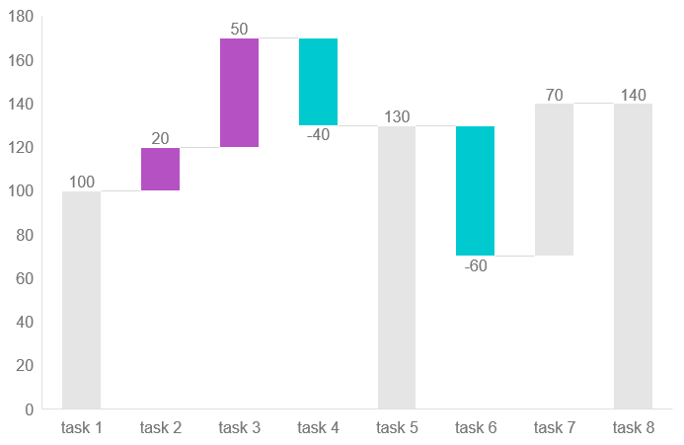
Use "Title Only" Layout
Supporting text here.
Theme color makes PPT more convenient to change.
Adjust the spacing to adapt to Chinese typesetting, use the reference line in PPT.
Unified fonts make reading more fluent.Copy paste fonts. Choose the only optio to retain text……

Slide 12
Use "Title Only" Layout
Unified fonts
make reading more fluent.
Adjust the spacing to adapt to Chinese typesetting, use threference line in PPT.Unified fonts make reading more fluent.Copy paste fonts. Choose the only optio to retain text……
Text here
Adjust the spacing to adapt to Chinese typesetting, use the reference line in PPT.
Supporting text here.
Text here
Adjust the spacing to adapt to Chinese typesetting, use the reference line in PPT.
Adjust the spacing to adapt to Chinese typesetting, use threference line in PPT.Unified fonts make reading more fluent.Copy paste fonts. Choose the only optio to retain text……
Text here
Adjust the spacing to adapt to Chinese typesetting, use the reference line in PPT.
Text here
Adjust the spacing to adapt to Chinese typesetting, use the reference line in PPT.

Slide 13
Thank you for
watching.

