Slide 1


PITCH DECK · MUMBAI · 2026
AEGIS ASCEND
FINANCIAL ADVISORS
Debt, equity or a mix: the independent answer for growing Indian businesses, then the deal.
Smarter Decisions. Stronger Futures.
Confidential draft
Notes:
Aegis Ascend is an independent funding advisory firm in Mumbai. We tell growing Indian businesses whether to raise debt, equity or a mix, and then we deliver that deal.

Slide 2
THE PROBLEM
The biggest funding decision is made on advice from people who each sell one answer
The banker
The investor
The CA
sells loans.
sells equity.
works it out by hand in Excel.
On a Rs 10 crore raise, the right structure can be worth crores to the founder over 5 to 7 years. Nobody independent tests whether debt, equity or a mix is actually best, with the risks shown honestly.
Notes:
Growing Indian businesses decide how to fund the next stage with advice from people who each sell one product. The banker sells debt, the investor sells equity, and the CA builds a spreadsheet by hand. The founder never gets an independent, risk-tested comparison, yet on a Rs 10 crore raise the difference can be worth crores to them over five to seven years.

Slide 3
OUR SOLUTION
The independent, risk-tested answer, and then the deal
1
2
3
Decide
Deliver
Stay
Our engine tests every debt and equity mix under stress (sales −20%, rates +2 points). A named advisor signs off the report.
Curated investors, at most 20 per company, who hold shares in their own name; or loans we arrange from banks and NBFCs.
Five years of covenant monitoring and quarterly revaluations, with private exits for investors and loan sales for lenders.
Independent by design: we sell no loan and run no fund, so the advice has no product to push.
Notes:
One relationship from decision to deal. First we answer the question: our calculation engine tests every mix from all-debt to all-equity, including a stress case with sales down 20% and rates up 2 points, and a named advisor signs the report. Then we deliver whichever route it recommends, with at most 20 platform investors per company. Then we stay for five years: monitoring loans, revaluing shares quarterly, and running private exits and loan sales.

Slide 4
PRODUCT
One platform for founders, investors, lenders and advisors
Funding Twin
Equity vs Debt Optimizer
CMA funding report
A live model of the company: best mix, stress tests and a 2,000-run simulation.
Every mix from 0% to 100% equity, year by year, for the founder’s best outcome.
The bank’s CMA workbook in, a one-page, DSCR-sized PDF for lenders out.
Readiness Score
Term Sheet Analyser
Investor Fit Score
Debt and equity readiness out of 100, with a fix-it plan.
The true cost of a loan offer, and dilution and risky clauses in an equity term sheet.
Each investor scored out of 100 on sector, stage, ticket size and instrument.
Also built: a Sell button on every loan in the lender’s book, automatic fee invoices, and the “Ask Aegis” assistant that guides visitors around the site. Every figure explains itself: its formula, inputs and source.
Notes:
The platform has a workspace for each role. Founders track the raise, the cap table, the data room and their loans. Investors see advisor-approved offers, deal rooms and a demat-style portfolio. Lenders get the loan book, covenant monitoring and a Sell button on every loan. Advisors run the analysis tools shown here and sign off every report. Fees are invoiced automatically, and the Ask Aegis assistant answers visitors' questions and points them to the right page. Click any number and it shows how it was calculated.

Slide 5
WHY NOW
SME numbers are finally checkable, and founders have a real choice
Digital records
Equity is open to SMEs
GST returns, audited accounts and bank statements make a company’s numbers checkable in hours, not weeks.
243 SME IPOs raised about Rs 8,700 crore in 2024. Founders now weigh equity, not just loans.
A Rs 30 lakh crore gap
The tools are ready
MSMEs face a credit gap of about Rs 30 lakh crore (SIDBI with Crisil, 2025), yet sit between loan apps and investment banks.
Tested calculation code, with AI reading the documents, puts bank-grade analysis at SME prices.
Sources: Business Today (Dec 2024); SIDBI and Crisil (May 2025)
Notes:
Four reasons this works now. Company financials are digital and verifiable. SMEs can raise equity, not only loans: 243 SME IPOs raised about Rs 8,700 crore in 2024 (Business Today, 27 Dec 2024). The need is large: SIDBI's May 2025 report with Crisil puts the addressable MSME credit gap at about Rs 30 lakh crore, roughly 24% of credit demand. And calculation engines plus AI document reading make this analysis affordable at SME prices.

Slide 6
MARKET
TAM, SAM and SOM
TAM
5.1 lakh companies
TAM · Small and medium enterprises
4.76 lakh small and 35,682 medium enterprises on Udyam (July 2025). One raise every 5 years at about Rs 13.5 lakh in fees (a Rs 5 crore raise).
≈ Rs 13,800 crore a year
SAM
35,682 companies
SAM · Medium enterprises
Our band: Rs 20–150 crore revenue, raising Rs 5–30 crore. One raise every 5 years at about Rs 26 lakh in fees (a Rs 10 crore raise).
≈ Rs 1,850 crore a year
SOM · Mumbai region, 5% share
SOM
4,220 companies
4,220 medium enterprises in Mumbai and Mumbai Suburban (Dec 2023). Winning 5% of their raises is about 42 clients a year.
≈ Rs 11 crore a year, plus the revenue share
Sources: Udyam data via Financial Express B2B and Lok Sabha; assumptions in speaker notes
Notes:
Counts are sourced; rupee values use two assumptions: each company raises once every 5 years, and fees follow our schedule (Rs 1 lakh advisory plus 2.5% success fee, equity or debt). TAM: 4.76 lakh small + 35,682 medium = about 5.12 lakh companies; 1.02 lakh raises a year x Rs 13.5 lakh (Rs 5 crore raise) = about Rs 13,800 crore a year. SAM: 35,682 medium enterprises, all sectors (the manufacturing share is not yet sourced); 7,136 raises a year x Rs 26 lakh (Rs 10 crore raise) = about Rs 1,850 crore a year. SOM: 2,754 medium enterprises in Mumbai plus 1,466 in Mumbai Suburban = 4,220 (as of Dec 2023; Thane and Pune not included); 844 raises a year, 5% = 42 clients x Rs 26 lakh = about Rs 11 crore a year in deal fees, before the 0.4% revenue share on equity clients and lenders' monitoring fees. Sources: Financial Express B2B, Udyam milestone, July 2025; Lok Sabha unstarred question data, Dec 2023 (AU863).

Slide 7
BUSINESS MODEL
We earn at every step of the deal
FEE | RATE | PAID BY | WHEN
Advisory engagement | From Rs 1 lakh | Company | At engagement
Equity success fee | 2.5% of amount raised | Company | At deal close
Revenue share | 0.4% of revenue, 5 years | Company | Quarterly
Debt success fee | 2.5% of the loan | Company | At disbursal, invoiced automatically
Resale fee | 0.3–0.5% of sale value | Selling investor | At transfer, invoiced automatically
Debt arranging | Commission per lender | Lender | At disbursal
Debt monitoring | 0.25–0.5% a year | Lender | Yearly
Loan transfer | 0.3–0.5% of amount | Selling lender | At completion, invoiced automatically
All fees plus 18% GST. Buying shares is free. Example: a Rs 10 crore equity raise at Rs 50 crore revenue ≈ Rs 1.26 crore over 5 years.
Notes:
Recurring revenue comes from the revenue share and debt monitoring; one-off revenue from advisory and success fees. Investors pay nothing to invest, only a small fee when they sell. Lenders pay for arranging, monitoring and loan sales. Debt success, resale and loan transfer fees are invoiced automatically by the platform. Worked example: a Rs 10 crore equity raise at Rs 50 crore revenue earns Rs 1 lakh advisory, Rs 25 lakh success fee and Rs 100 lakh revenue share over five years.

Slide 8
COMPETITOR ANALYSIS
Others sell one product. We test which one is right.
PLAYER TYPE | WHAT THEY DO | OUR ADVANTAGE
Fundraising marketplaces | Connect startups with angels and funds | We first test whether equity is right at all
Venture debt funds | Lend to VC-backed startups | We compare every option independently
Revenue-based financing | Short-term, revenue-linked capital | One product versus our full recommendation
SME lenders | Small business loans | We add the equity view and founder-value analysis
CA firms | Project reports, CMA data, tax | We model dilution and risk ranges, and close the deal
Boutique advisors | Full-service capital raising | The same rigour at SME-friendly prices
Our edge: independence, every number traceable to its formula, and an advisor’s signature on every report.
Notes:
Every alternative sells one route: equity marketplaces sell equity, lenders sell loans, CA firms prepare documents. We are the only one whose job is to compare the routes independently, show the risk honestly, and then close whichever deal wins, at prices an SME can afford.

Slide 9
TRACTION AND ROADMAP
The platform is built; next we prove the model
6 WEEKS
16 WEEKS
PHASE 2
PHASE 3
Validate
MVP
Ongoing services
Debt desk
20 founder interviews and a concierge pilot with 10 SMEs.
Engine, Funding Twin, AI layer, reports, Readiness Score, CMA, curated deals.
Monitoring, Term Sheet Analyser, lender view, early-exit resale advisory.
Loan sales between regulated lenders, started from the lender’s loan book.
Gate: 3 paying clients, or deals reaching a lender or investor.
Gate: engine passes 100% of golden tests; 2 live deals.
Gate: signed agreements with partner lenders.
Gate: an active, monitored loan book with partner lenders.
Built today: the website with its 3D intro and assistant, four role workspaces, the calculation engine, every analysis tool, automatic fee invoices, loan sales, compliance rules and a full audit log. No paying clients yet.
Notes:
Be straight about traction: the product is built and demonstrable, but there are no paying clients yet. The screens for all four phases exist, including loan sales from the lender's loan book and automatic fee invoicing; the business gates are ahead. The next milestone is three paying clients from a concierge pilot with ten SMEs.

Slide 10
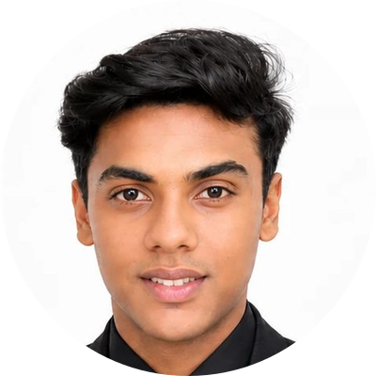
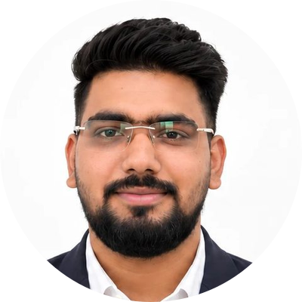
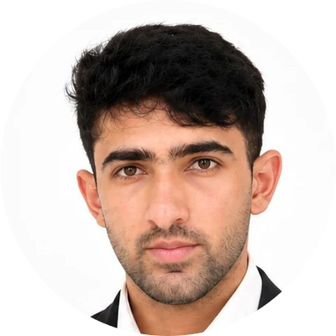
TEAM AND THE ASK
Three founders who sign their names to the advice
The ask
We are raising [Rs __ crore] to:
run the concierge pilot with 10 SMEs
sign partner lenders and build the investor panel
finish the AI layer, KYC and security work
Hem Parekh
Yash Sharma
Vivan Shah
Co-founder
Co-founder
Co-founder
[Name] · [email] · [phone]
Smarter Decisions. Stronger Futures.
Notes:
Close on the team and the ask. Fill in the amount, the contact line and the use of funds before presenting: the three uses listed come from the roadmap and the open items in the company overview. Add a short line on each founder's background when you have it.

