Slide 1

HEART DISEASE PREDICTION WITH MECHINE LEARNING -HEMANTA B SHAHI

Slide 2
Python notebook uses various Python based machine learning and data science libraries in an attempt to build a machine learning model capable of predicting whether someone has a Heart Disease based on their medical attributes. I have considered the following approach: 1. Problem Definition 2. Data 3. Evaluation 4. Features 5. Modelling 6. Experimentation

Slide 3
1. Problem Definition:
- The objective is to develop a machine learning model using Python libraries that can accurately predict whether a person has heart disease or not.
- This model aims to assist in the early detection and diagnosis of heart disease, facilitating timely medical intervention.
2. Data:
- The dataset comprises medical attributes of individuals, such as age, blood pressure, cholesterol levels, etc., which are considered relevant indicators of heart disease.
- These attributes serve as inputs to train and evaluate the machine learning model.
- Data taken from https://www.kaggle.com/datasets/abhinashjena/heartdiseasecsv

Slide 4
3. Evaluation:
- The performance of the machine learning model will be evaluated using appropriate metrics, such as accuracy, precision, recall, or F1-score.
- The evaluation will measure how well the model can classify individuals correctly as having a heart disease or not, providing insights into its effectiveness and reliability.
4. Features:
- The selected features from the dataset will be used as input variables for the machine learning model.
- These features could include attributes like age, gender, blood pressure, cholesterol levels, and other relevant medical indicators.
- The model will learn from these features to identify patterns and make predictions about the presence of heart disease.

Slide 5
5. Modelling:
Various machine learning algorithms, such as logistic regression, decision trees, support vector machines, or neural networks, will be used to build the predictive model.
These algorithms will be trained on the dataset, learning from the relationship between the features and the presence or absence of heart disease.
The goal is to find the most suitable algorithm that achieves the highest prediction accuracy.
6. Experimentation:
Different experiments will be conducted to improve the model's performance and refine its predictions.
This may involve trying different algorithms, adjusting hyperparameters, feature engineering techniques, handling missing data, or using ensemble methods.
The experimentation phase aims to optimize the model's performance and identify the best approach for predicting heart disease accurately.

Slide 6
The following are the features(medical attributes) used to predict target variable (heart disease or no heart disease).
age - age in years
sex - (1 = male; 0 = female)
cp - chest pain type
0: Typical angina: chest pain related decrease blood supply to the heart
1: Atypical angina: chest pain not related to heart
2: Non-anginal pain: typically, esophageal spasms (non heart related)
3: Asymptomatic: chest pain not showing signs of disease
trestbps - resting blood pressure (in mm Hg on admission to the hospital)
anything above 130-140 is typically cause for concern
chol - serum cholesterol in mg/dl
serum = LDL + HDL + .2 * triglycerides
above 200 is cause for concern
fbs - (fasting blood sugar > 120 mg/dl) (1 = true; 0 = false)
'>126' mg/dL signals diabetes
restecg - resting electrocardiographic results
0: Nothing to note

Slide 7
1: ST-T Wave abnormality
can range from mild symptoms to severe problems
signals non-normal heartbeat
2: Possible or definite left ventricular hypertrophy
i. Enlarged heart's main pumping chamber
thalach - maximum heart rate achieved
exang - exercise induced angina (1 = yes; 0 = no)
old peak - ST depression induced by exercise relative to rest
looks at stress of heart during exercise
unhealthy heart will stress more.
slope - the slope of the peak exercise ST segment.
0: Upsloping: better heart rate with exercise (uncommon)
1: Flat sloping: minimal change (typical healthy heart)
2: Down sloping: signs of unhealthy heart
12. ca - number of major vessels (0-3) colored by fluoroscopy
(colored vessel means the doctor can see the blood passing through)
13. thal - thallium stress result
1,3: normal
6: fixed defect: used to be defect but ok now
7: reversable defect: no proper blood movement when exercising
14. target - have disease or not (1=yes, 0=no) (= the predicted attribute)

Slide 8
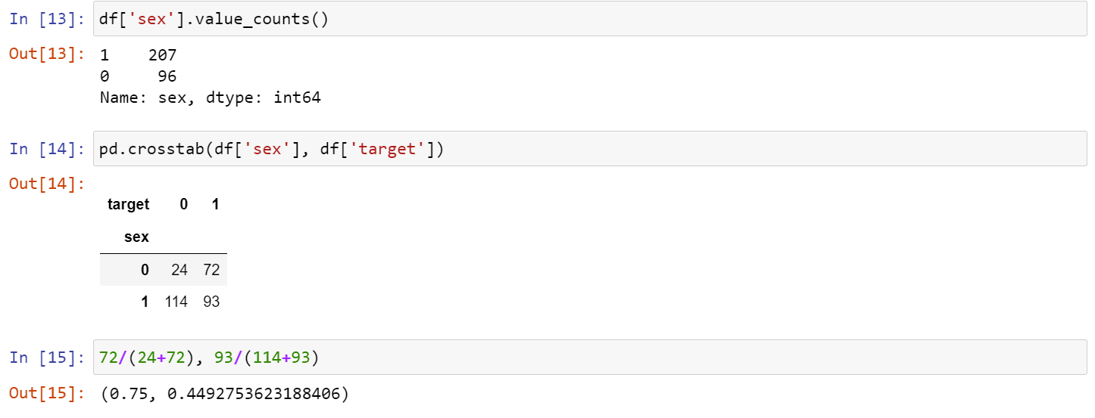
Based on the existing data, there is 75% chances that female can have heart disease.
For male there is almost 45% of chance of having heart disease.

Slide 9
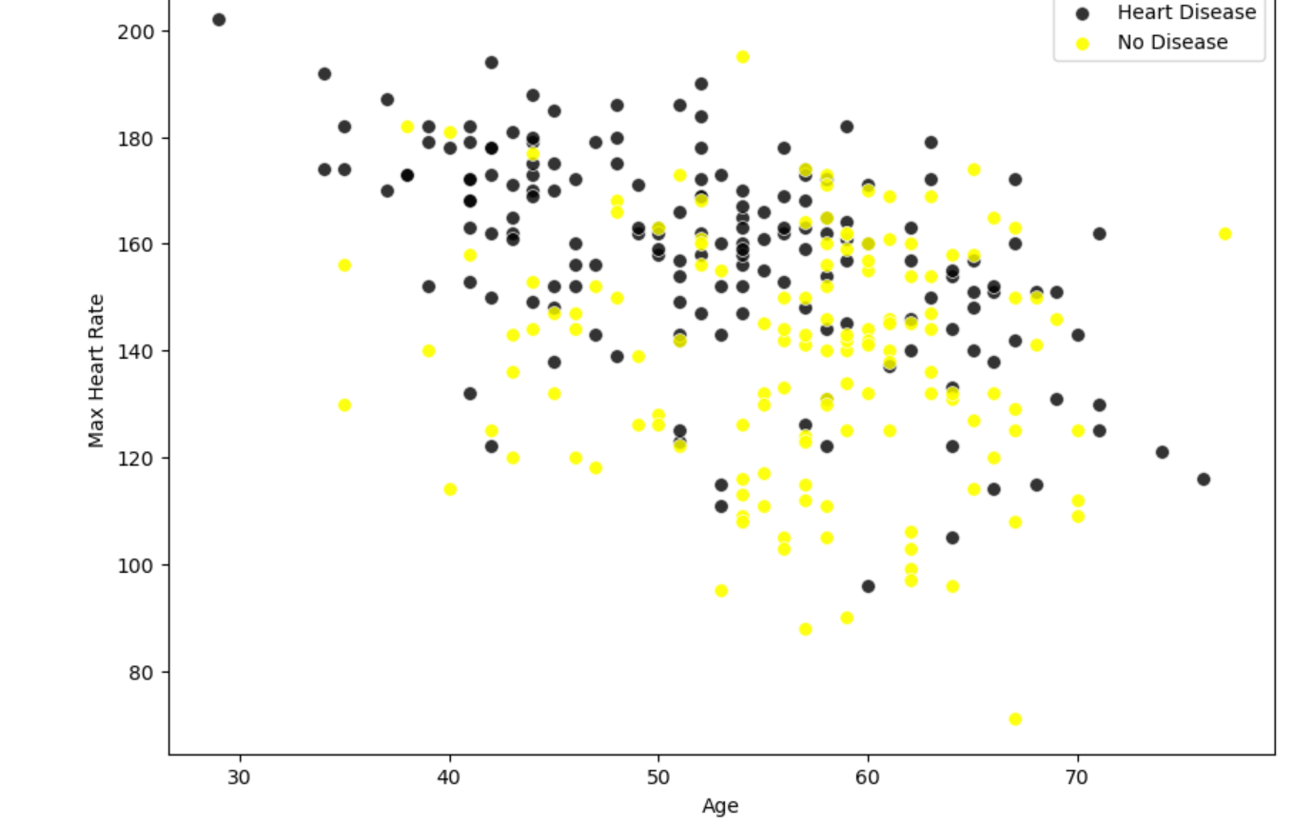
Maximum heart rate refers to the highest heart rate a person can achieve during physical activity.
lower maximum heart rate during exercise may be associated with an increased risk of heart disease.
From the scatter plot, age with 40-50, 50-60 with heart rate of 140-190 have maximum number of heart disease.
Whereas people with the age of 50-70 having heart rate of 140-170 does not have any heart disease.

Slide 10
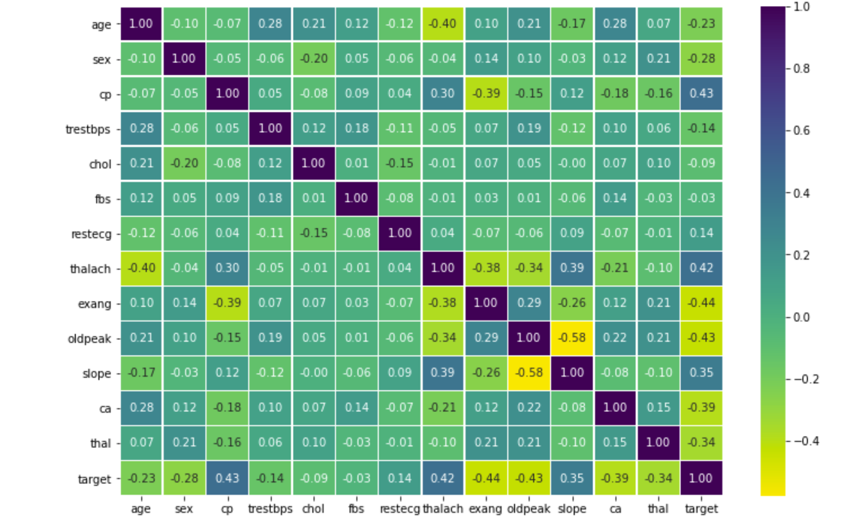
.
As per the heatmap on right side, chest pain(CP) has the highest positive correlation with the target variable among the features, followed by thalach (maximum heart rate) variable.
On the other hand, exang- exercise induced angina and oldpeak- ST depression induced by exercise relative to rest have the lowest correlation with target variable.
positive correlations indicate attributes that are positively associated with the likelihood of heart disease, while negative correlations suggest attributes that are negatively associated with the likelihood of heart disease

Slide 11
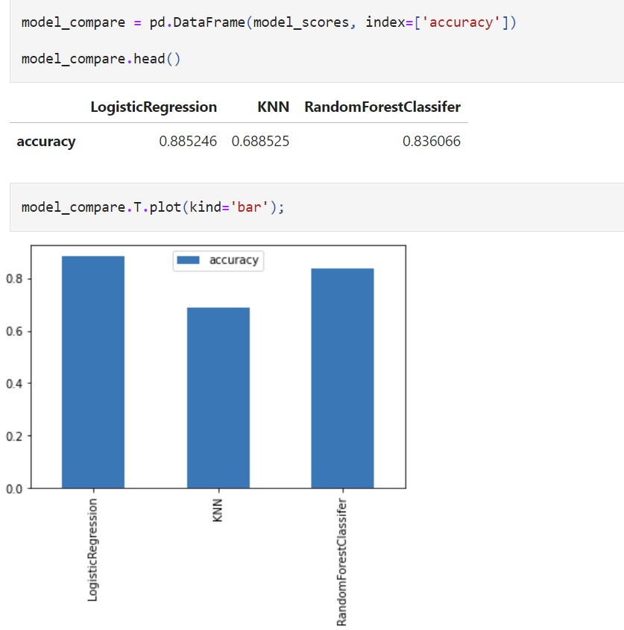
- In this case, the Logistic Regression model correctly predicts the outcome(whether someone has heart disease or not) approximately 88.5% of the time.
The accuracy achieved by the KNN model is 0.688525. This means that the KNN model correctly predicts the outcome approximately 68.9% of the time.
The accuracy achieved by the Random Forest Classifier model is 0.836066. This indicates that the Random Forest model correctly predicts the outcome approximately 83.6% of the time.
From this comparison, we can see that the logistic regression model has the highest accuracy among the three models, followed by the random forest classifier.

Slide 12
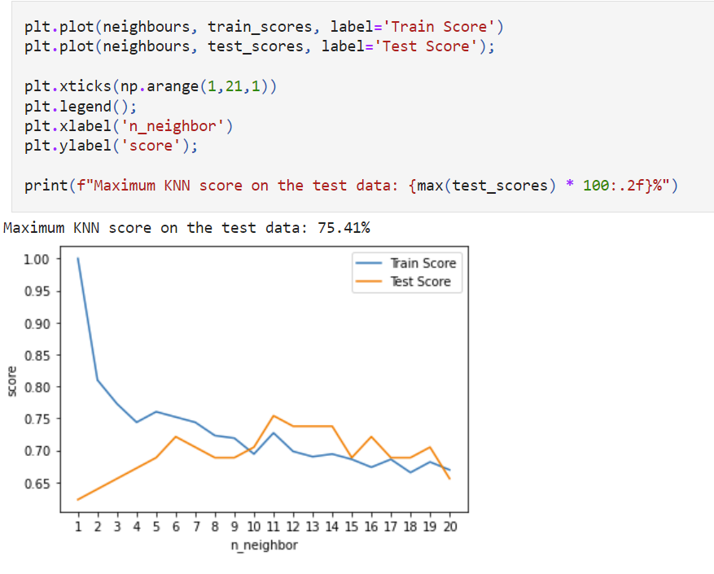
The legend will indicate which line corresponds to the train scores and which line corresponds to the test scores.
The plot is showing the train scores and test scores for different values of the number of neighbors (n_neighbor)
We can see the maximum KNN score on the test data is 75%

Slide 13
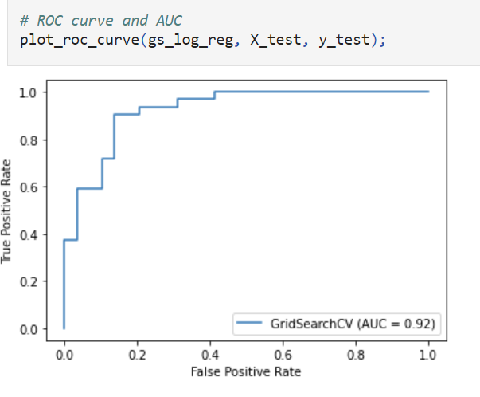
The plot makes predictions using the logistic regression model on the test set and visualizes the model's performance using the ROC curve and AUC plot.
It helps to assess how well the model is able to distinguish between positive and negative instances (heart disease and non-heart disease) and provides an evaluation of the model's predictive accuracy.
ROC curve, which shows the trade-off between the true positive rate and the false positive rate at different classification thresholds.

Slide 14
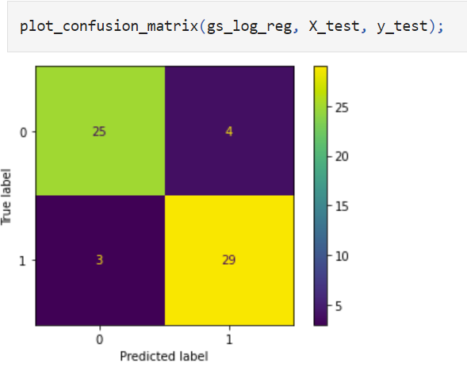
25 true negatives: These are instances correctly classified as not having heart disease.
4 false positives: These are instances wrongly classified as having heart disease when they actually do not.
3 false negatives: These are instances wrongly classified as not having heart disease when they actually do have it.
29 true positives: These are instances correctly classified as having heart disease.
The confusion matrix provides valuable information about the model's performance, allowing us to evaluate its accuracy, precision, recall, and other performance metrics.

Slide 15
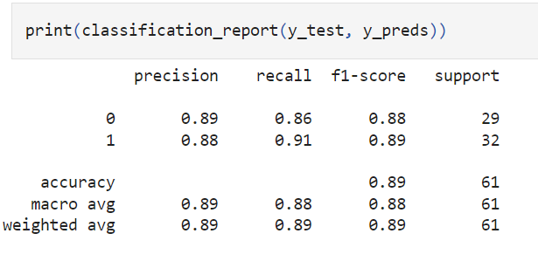
-For class 0 (no heart disease), the precision is 0.89, which means that 89% of the instances predicted as not having heart disease are correct. For class 1 (heart disease), the precision is 0.88, indicating that 88% of the instances predicted as having heart disease are correct.
-he F1-score is the harmonic mean of precision and recall and provides a single metric to assess the balance between precision and recall. It considers both false positives and false negatives. For class 0, the F1-score is 0.88, and for class 1, the F1-score is 0.89.
-Support represents the number of instances in each class in the test set. For class 0, the support is 29, meaning there are 29 instances of no heart disease in the test set. For class 1, the support is 32, indicating there are 32 instances of heart disease in the test set.
-In this case, the accuracy is 0.89, meaning that the model correctly predicts the outcome (heart disease or no heart disease) approximately 89% of the time.
-The weighted average calculates the weighted average performance based on the number of instances in each class. In this case, the weighted average for precision, recall, and F1-score is 0.89, considering the support for each class.

Slide 16
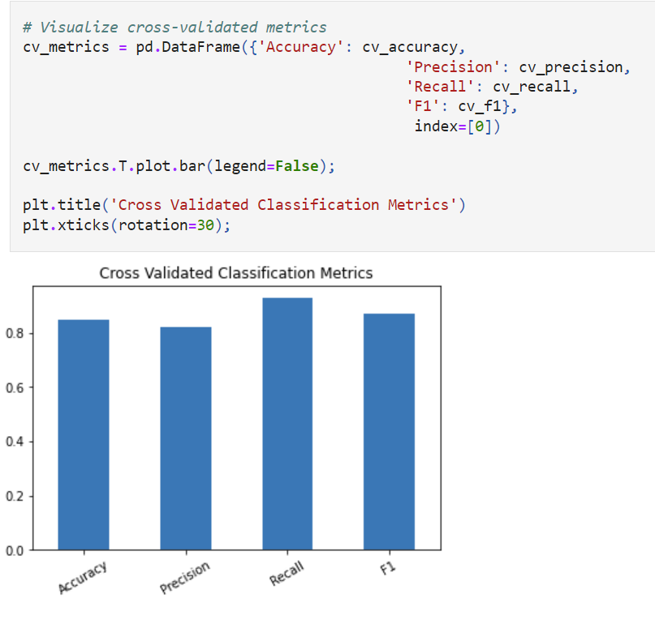
-The bar chart showing the cross-validated metrics (accuracy, precision, recall, and F1-score) for the classification model.

Slide 17
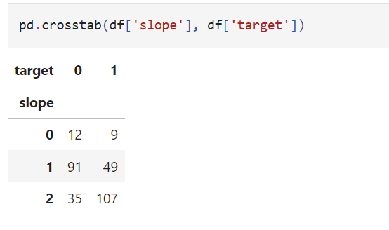
The table shows the distribution of 'target' values for different levels of 'slope'. It provides insights into how the presence of heart disease (target = 1) varies with different slope levels. For example, it indicates that when 'slope' = 0, there are more instances with target = 1 compared to instances with target = 0.
For 'slope' = 0:
There are 12 instances with 'slope' = 0 and 'target' = 0 (indicating no heart disease).
There are 9 instances with 'slope' = 0 and 'target' = 1 (indicating the presence of heart disease).
- For 'slope' = 1:
There are 91 instances with 'slope' = 1 and 'target' = 0.
There are 49 instances with 'slope' = 1 and 'target' = 1.
- For 'slope' = 2:
There are 35 instances with 'slope' = 2 and 'target' = 0.
There are 107 instances with 'slope' = 2 and 'target' = 1.

Slide 18
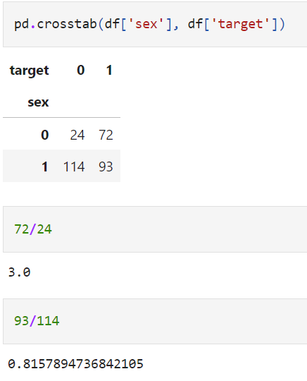
The values in the table represent the counts of instances that fall into each combination of 'sex' and 'target' categories.
For 'sex' = 0:
There are 24 instances with 'sex' = 0 and 'target' = 0 (indicating no heart disease).
There are 72 instances with 'sex' = 0 and 'target' = 1 (indicating the presence of heart disease).
For 'sex' = 1:
There are 114 instances with 'sex' = 1 and 'target' = 0.
There are 93 instances with 'sex' = 1 and 'target' = 1.
based on the coef_, the higher the value of sex (0 => 1), the model tends to predict lower value.
For Sex 0 (female), Target changes from 0 => 1 is 72/24 = 3.0
For Sex 1 (male), Target changes from 0 => 1 is 93/114 = 0.81
So, the value got decrease from 3.0 to 0.8157894736842105.

Slide 19
End of Heart Disease Prediction using Machine Learning

