Slide 1
ONLINE FASHION STORE
Prepared By : Kamli Hem Manoj
Enrollment No : 2101007

Slide 2
OVERVIEW OF PROJECT
First user has to input their Details on the Signup Page after entering the details clicking on signup sent the user to Online Fashion Store Home Page.
On the Home Page User can Select the product for purchase clicking on the any product open the product details (Name, Original M.R.P and Discounted Price)
After Selecting the Liked Product when user press the BUY button they will redirect to the Payment Page.
If user wants to Buy another product they can go back and select and can buy the product accordingly.

Slide 3
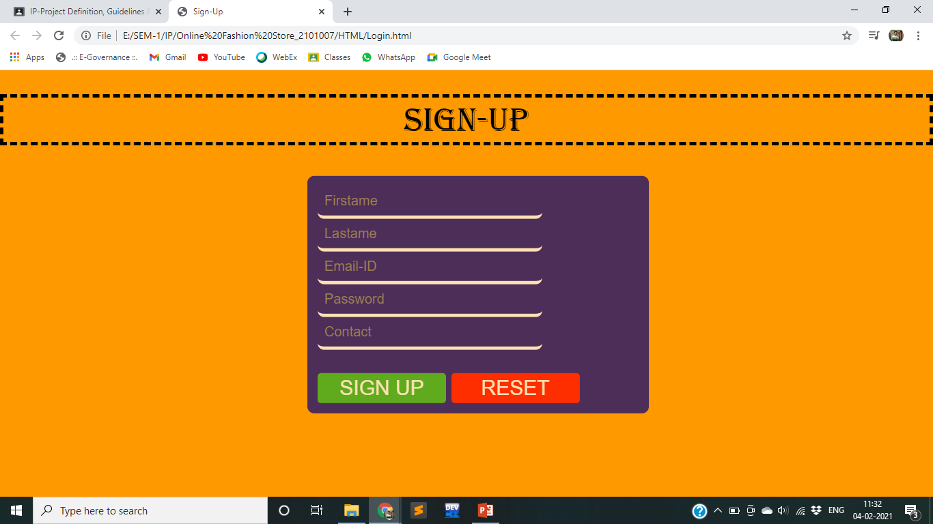
SCREENSHOT

Slide 4
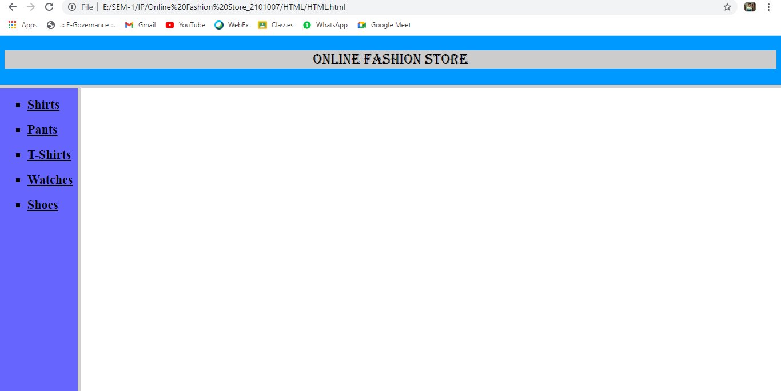
SCREENSHOT

Slide 5
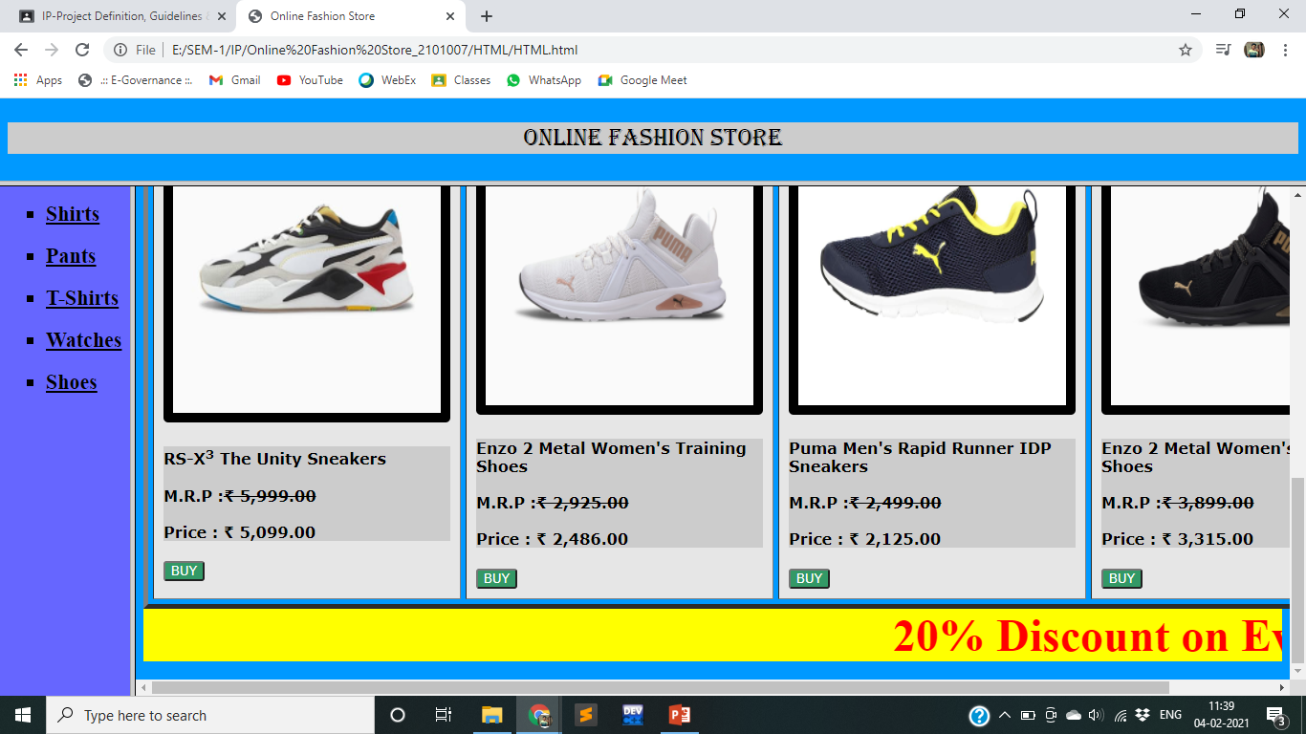
SCREENSHOT

Slide 6
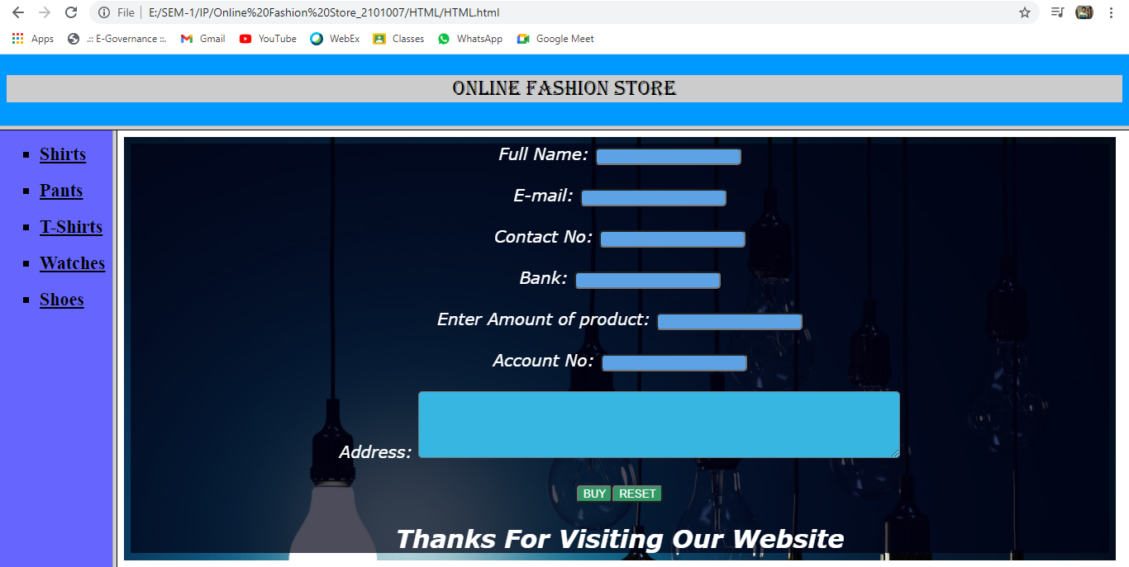
SCREENSHOT

