Slide 1


HOSPITAL MANAGEMENT SYSTEM

Slide 2
PROJECT MEMBERS
Team Lead -D Hema
Backend Lead -Diddigunta Karthik
FRONTEND
2484111 D Hema
2484646 Ediga Lavanya
2483727 Bokkisam Jothsna
2484769 Chanda Akanksha
2485807 Derangula Lavanya
BACKEND
2485036 Ayithayathish Sai
2486987 Diddigunta Karthik
2485818 B Dhanu Priya
2487179 Asif Ahmed
2484574 Ellanthakunta Sai Manasa

Slide 3
HOSPITAL MANAGEMENT SYSTEM
Hospital management system (HMS) is an element of medical informatics solutions that focuses mainly on the administration needs of hospitals.
An HMS is a computer or web-based application that manages the functioning of an entire hospital.
customizable integrated system is designed to manage all the operations of the hospital, such as administration, patient details, medical history of the patient, appointment booking, inventory management, billing, drug management, revenue management and so on.

Slide 4
Introduction
Why hospital management system ???
Objectives
Tools & languages used
System Requirements
App Flow
Features Available
Future Scope & Improvement
Conclusion

Slide 5
Hospital Management Systems of multiple branches of the same hospital have to be integrated so that if a patient consults a doctor in a different branch, their medical history can be retrieved easily. HMS should provide secure storage of data and a cloud-based solution to access it from anywhere at any time.
HMS is essential for all healthcare establishments, be it hospitals, nursing homes, health clinics, rehabilitation centres, dispensaries,
or clinics. The main goal is to computerise all the details regarding the patient and the hospital. The installation of this healthcare
software results in improvement in administrative functions and hence better patient care, which is the prime focus of any healthcare unit.

Slide 6
Objectives
Design a system for better patient care.
Reduce hospital operating costs.
Better co-ordination among the different departments.
Provide top management a single point of control.
The Hospital Management System can be entered using a username and password.
Hospital Management System enables you to develop your organization and improve its effectiveness and quality of work.

Slide 7
Modules of hospital management system
Admin Module
Patient Module
Doctor Module
Appointment Module
Discharge Module
Feedback Module

Slide 8
ADMIN MODULE
In the Admin Module the Admin could login and signup .
The Admin can see the Doctor List, Patient List and Feedback List.
In the Doctor’s List the Admin can perform UPDATE and DELETE operation.
In the Patient’s List the Admin can perform DELETE operation.


Slide 9
DOCTOR MODULE
Doctor can Login and SignUp
Doctor can see the Appointment List and Discharge List
Doctor can DELETE the Appointment

Slide 10
PATIENT MODULE
Patient can Login and SignUp
Patient can see the Doctor List
Patient can Register the Appointment.
Patient can fill the form of Discharge Patients.
Patient can give the Feedback to the Doctor

Slide 11
ADVANTAGES
Nowadays, due to pandemic people are prefering online clinical treatment of health and everything is digitalized.
Patient self-service.
Avoid errors and track every single details.
Cost efficiency and less time consumption.
We can maintain the digital medical records.
Establish our hospital to be Technical advanced.

Slide 12
DISADVANTAGES
The chances of employment usually become less with the automation of the system.
It is more expensive for the hospital.
Software implementation in the process is tough

Slide 13
Why is Hospital Mannagement System?
Cost Effective Reduction
Processing Speed & Results
Reduction in Errors
Data Security & Retrieving Ability
Quality & Compliance
Improved Patient Care

Slide 14
Front End
Angular
Html
CSS
BOOTSTRAP
Back End
MySQL Server
Spring Tool Suite
Postman API

Slide 15
SYSTEM REQUIREMENTS
The Basic System Requirements for Running this project are listed below:
Visual studio, STS, Postman and MySql to be installed to the system
1 GB Random Access Memory
200 MB of Free Space on Hard Disk
Microsoft Windows 8,10,11 or Linux or Equivalent OS
Web Browser (Microsoft Edge, Google Chrome)

Slide 16

HOME PAGE

Slide 17
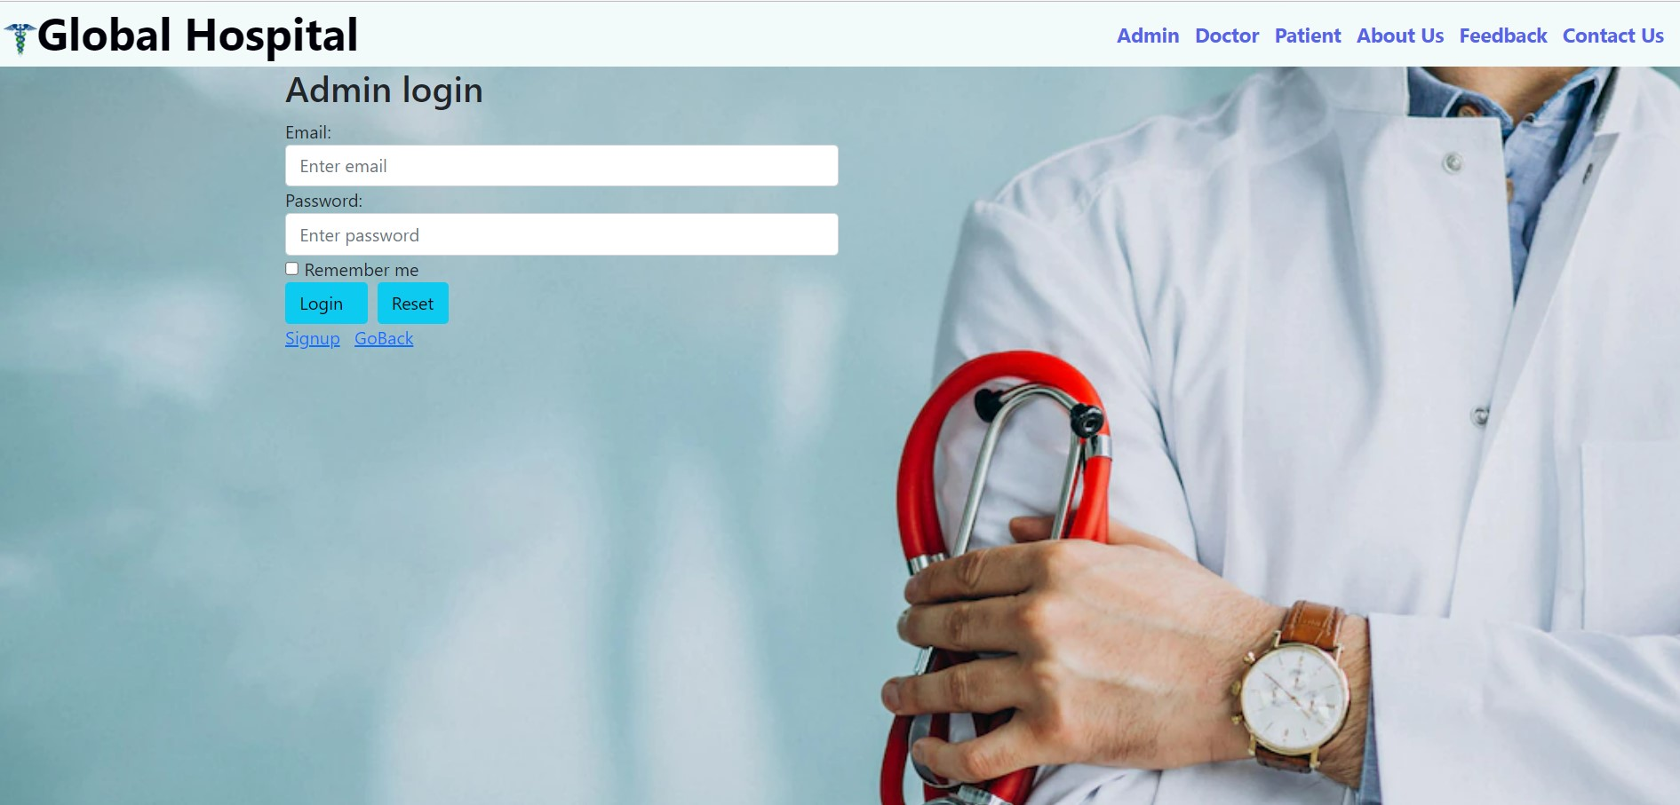
ADMIN LOGIN

Slide 18
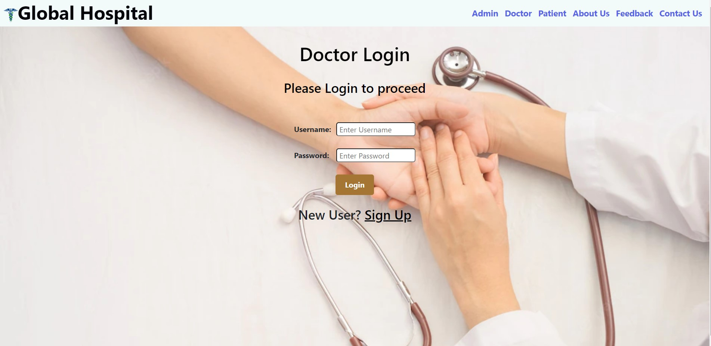
DOCTOR LOGIN

Slide 19
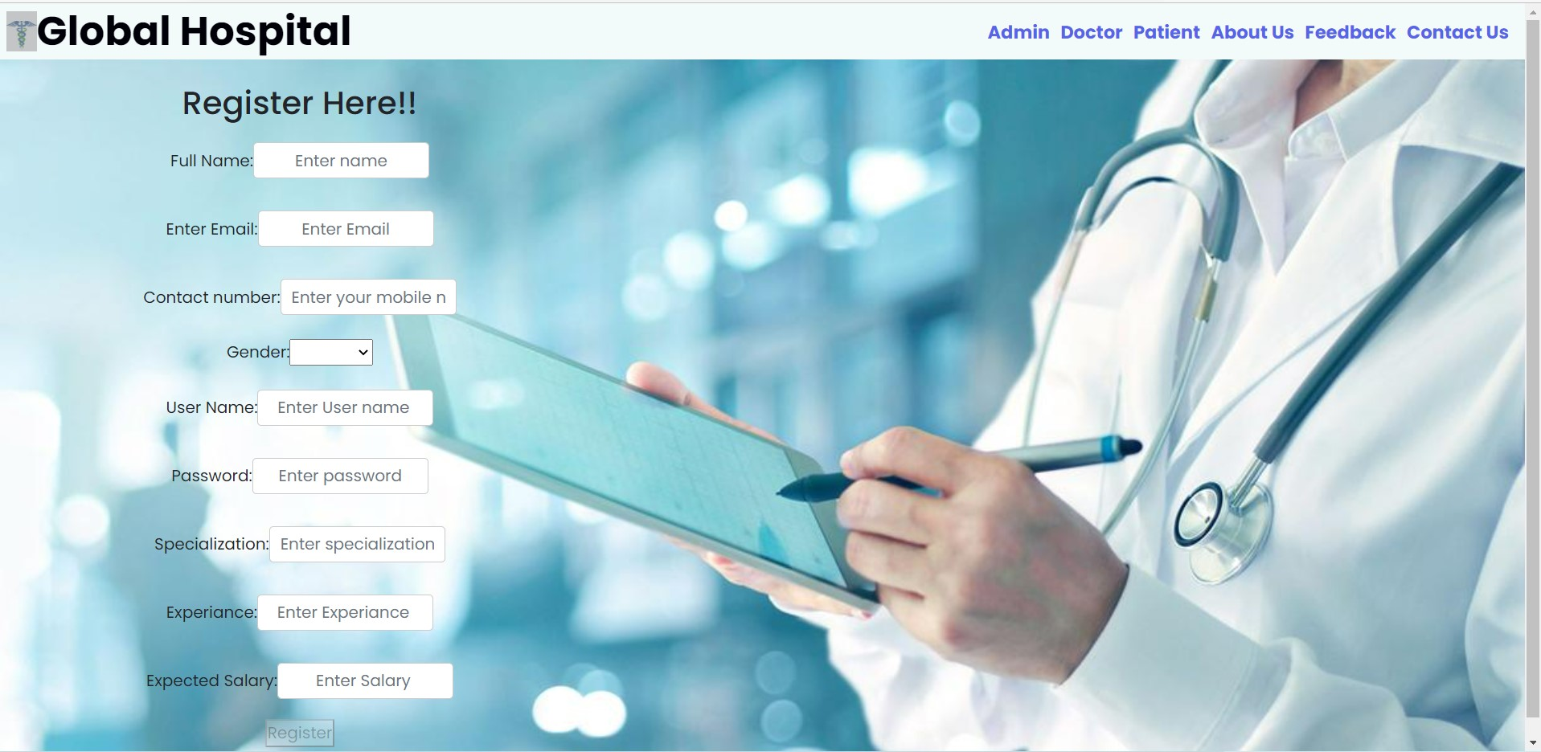
DOCTOR SIGNUP

Slide 20
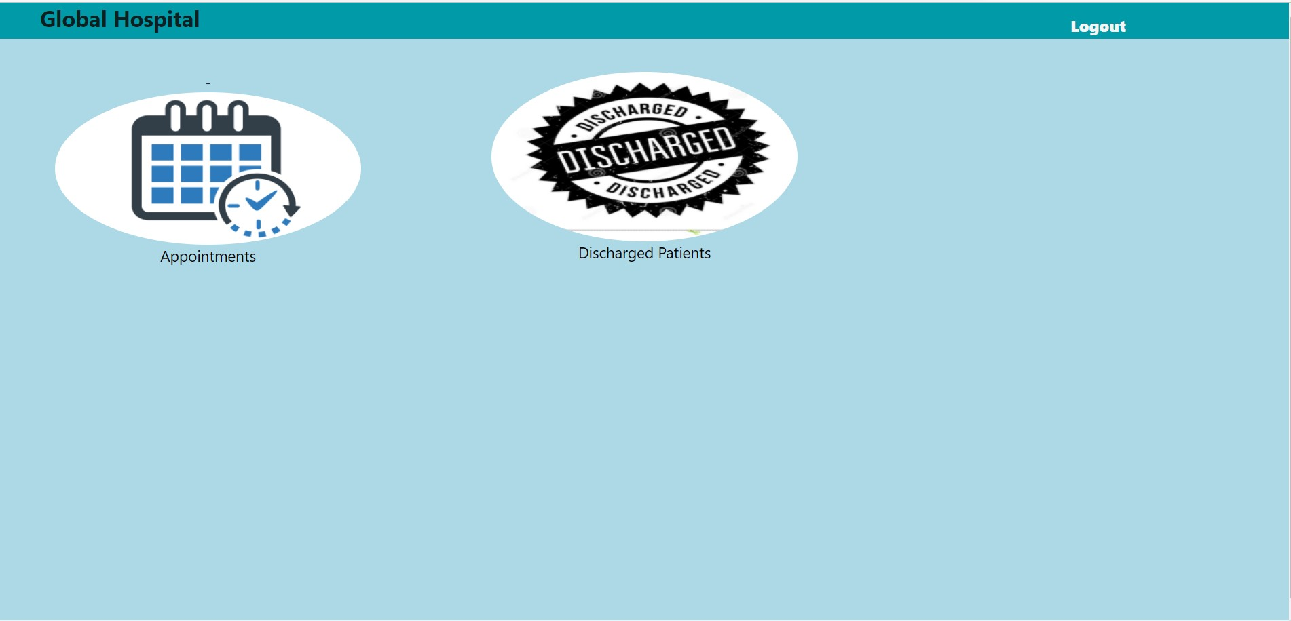
DOCTOR SUBMODULES

Slide 21
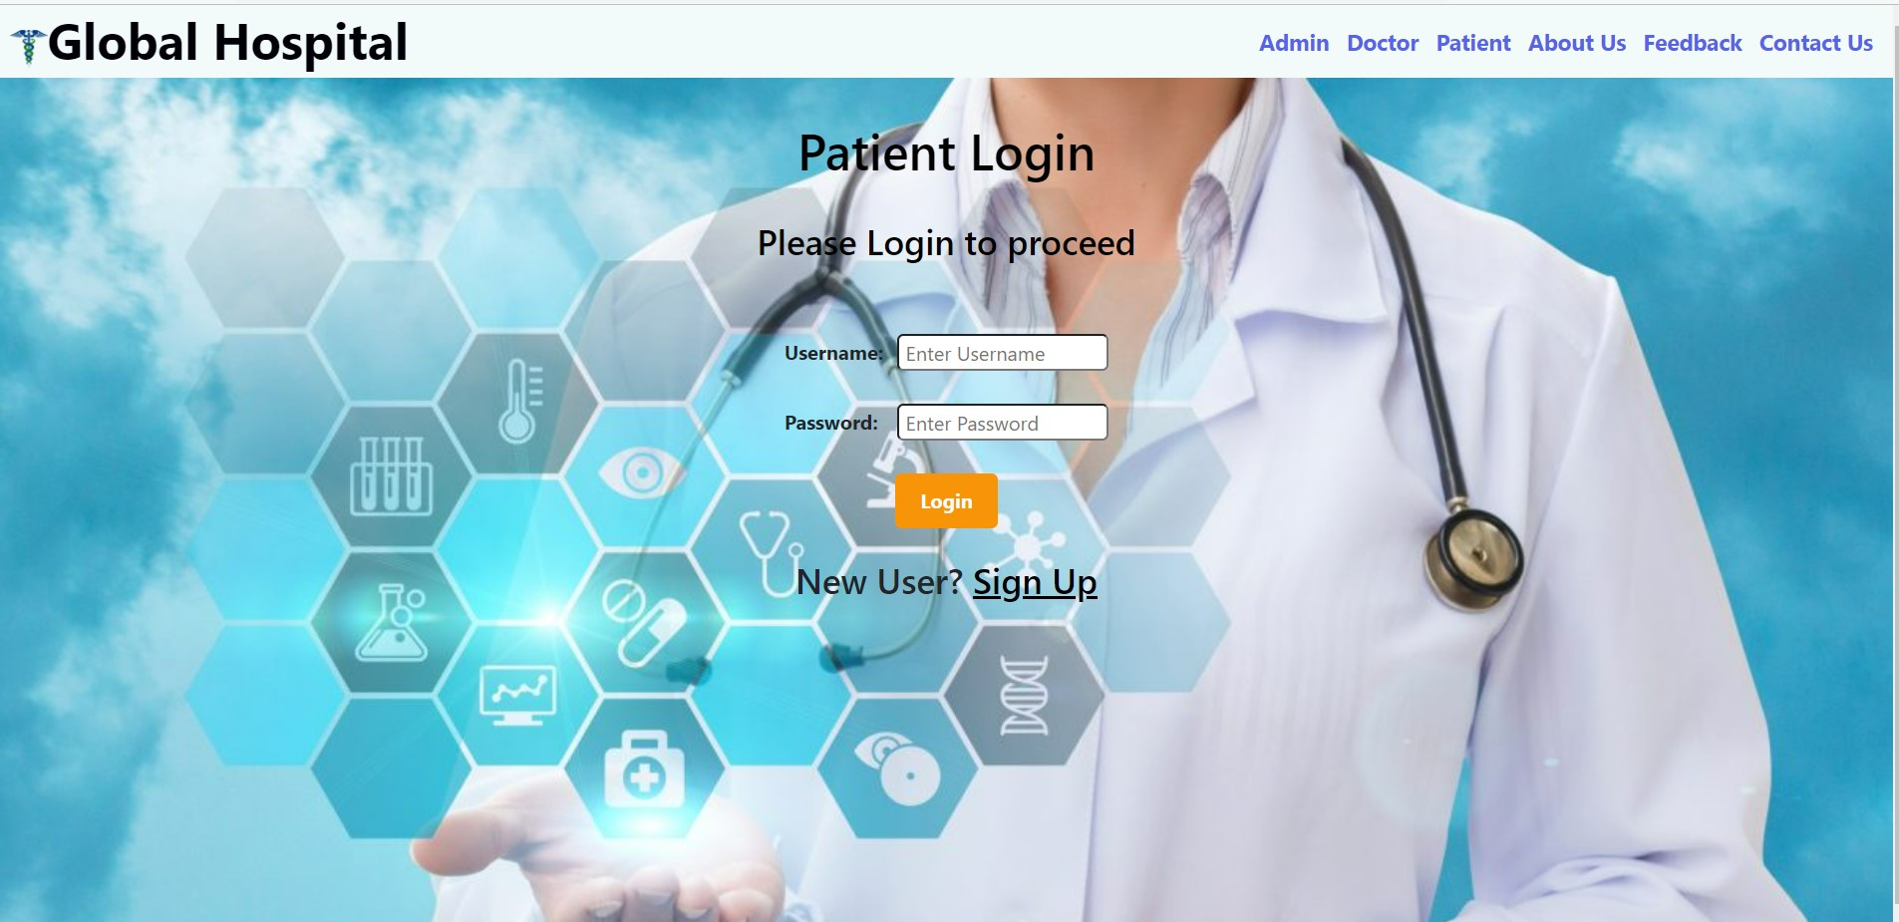
PATIENT LOGIN

Slide 22

PATIENT SIGNUP

Slide 23
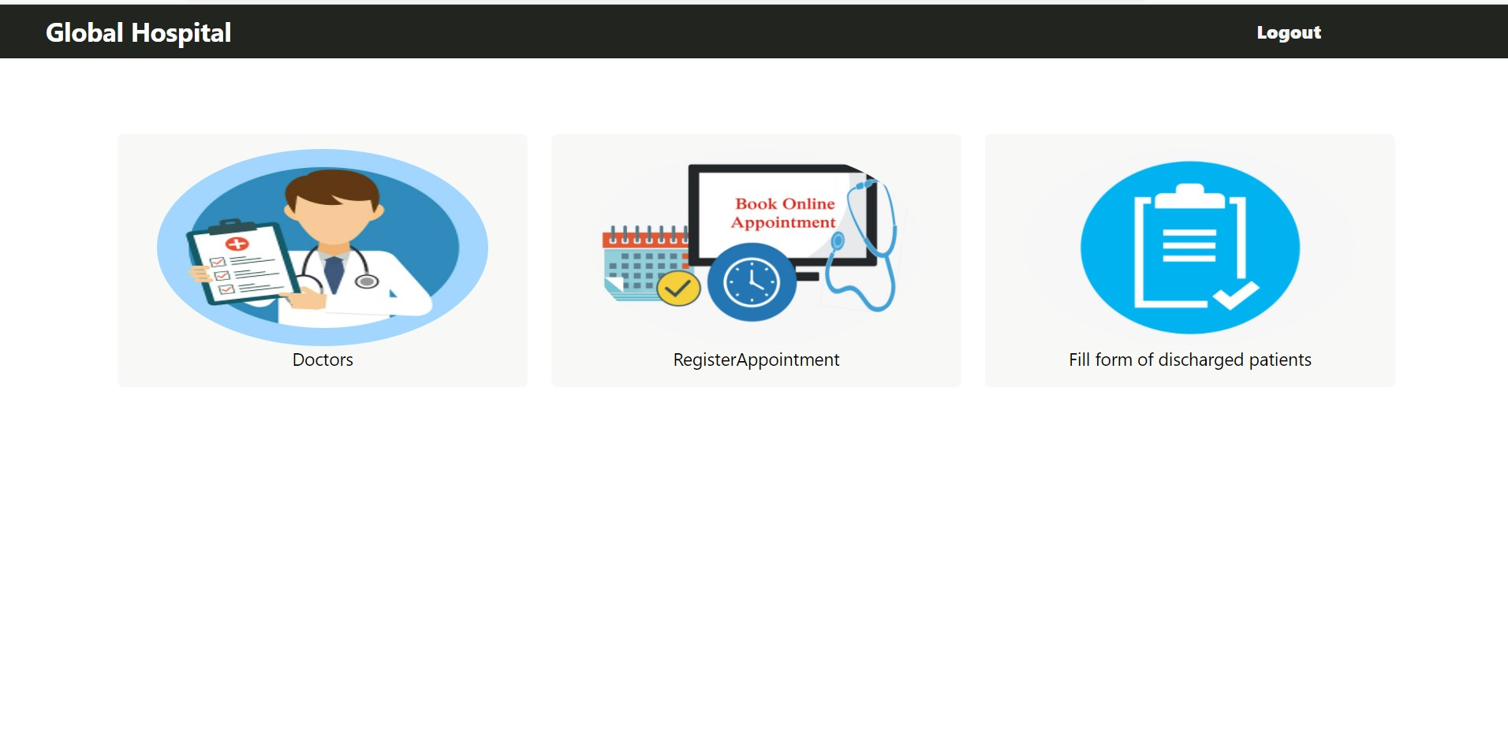
PATIENT SUBMODULES

Slide 24
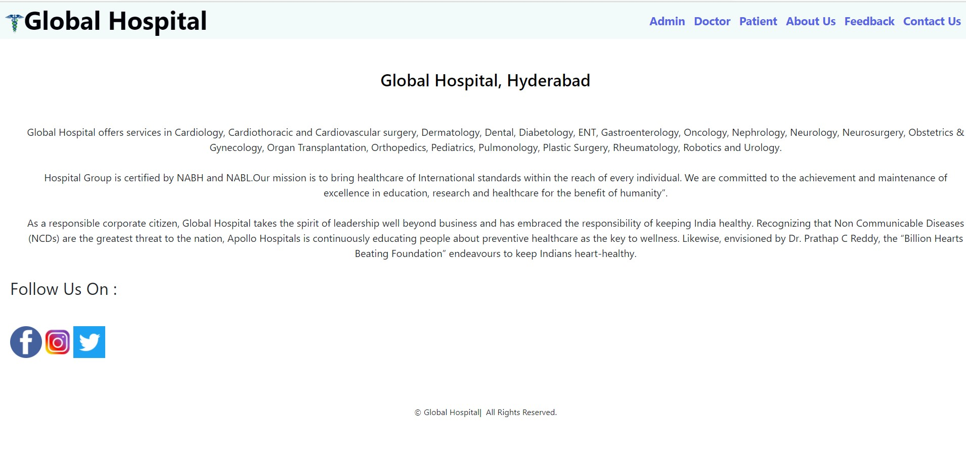
ABOUT US

Slide 25
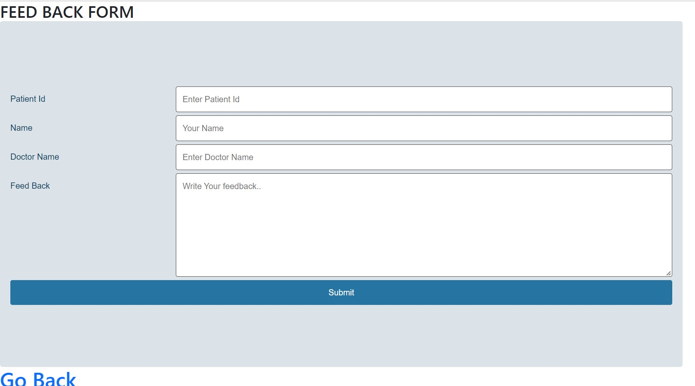
FEEDBACK FORM

Slide 26
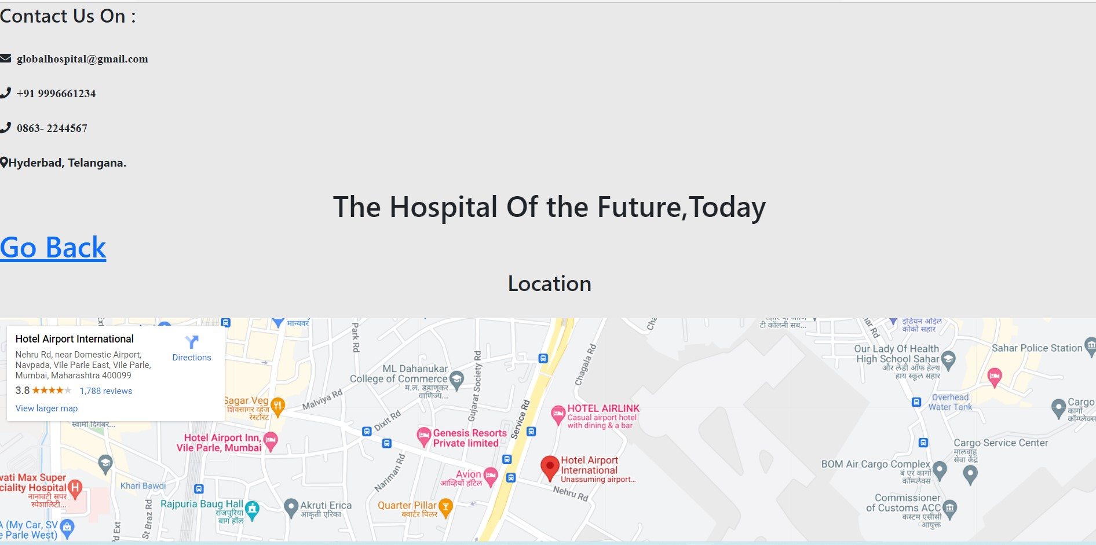
CONTACT US

Slide 27
Future Scope & Improvements
Hospitality is one of the fastest growing industries in the world today.
The proposed system is Hospital Management System, the system include more facilities like pharmacy system for the stock details of medicines in the pharmacy.
They providing such features enable the users to include more comments into the system.

Slide 28
Conclusion:
Hospital management systems allows us the ability to optimize and digitize all the processes within the institution.
It will help to improve customer service, reduce process costs, streamline the search of medical records, bills, patients, doctors, etc.
Hospital Management System will contributed enormously to better health and influenced the lives and well-being of billions of humans.

Slide 29
Bibliography
www.google.com
www.stackoverflow.com
www.w3school.com
www.angular.io
https://www.partech.nl/nl/publicaties/2020/07/9-trending-best-practices-for- rest-api-development.com

Slide 30

Thank You

