Slide 1
Git

Slide 2
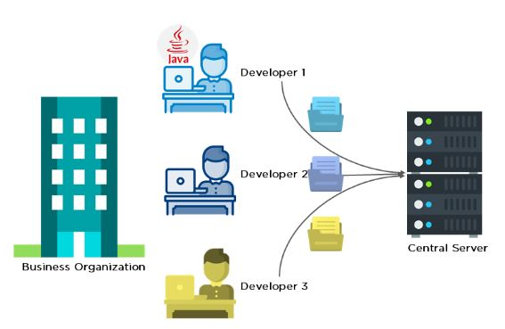
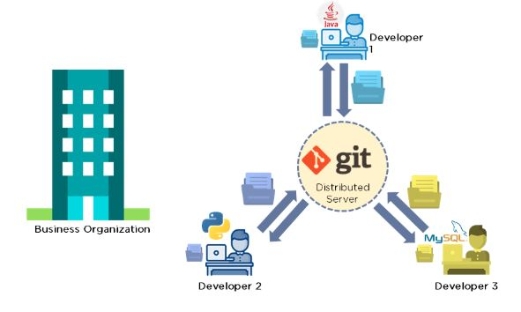
What is Git & Why it is used
Git is a version control system used for tracking changes in computer files. It is generally used for source code management in software development.
Centralised VCS Distributed VCS
There is no regular communication between developers There is a communication between developers

Slide 3
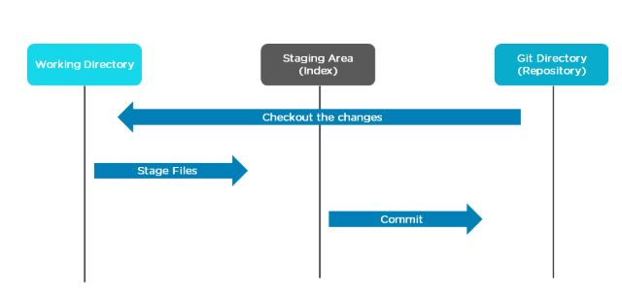
Features and workflow of git
Tracks history
Free and open source
Creates backups
Supports collaboration
Branching is easier
Distributed development
After commit it will be ready to push into remote repository(Github)
We can use git without github but we cant use github without git.

Slide 4
Pre requisites
First we need to create one repository in git hub
Click on new repo and give name and enable readme file and click create .
Copy the https link and generate token for further use
How to generate token
In github > profile >settings>developer settings >personnel access token>classic>generate classic option>enable delete packages,workflow,admin.org,admin.public key and admit remaining options and finally generate token.

Slide 5



Git commands
Create folder and get into it.(git bash)
Git init is used to create a new repository

Slide 6

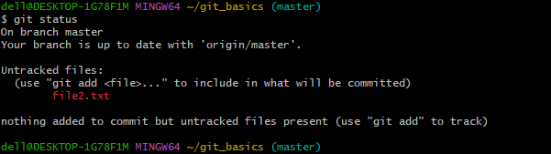
Create one file in the directory
2. To know the status of file whether it will be in staged or unstaged

Slide 7
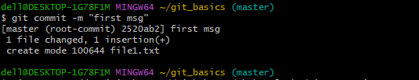
3. To get that file from working area staging area give below command
4. To get the file from staging area to local repo give below command

Slide 8
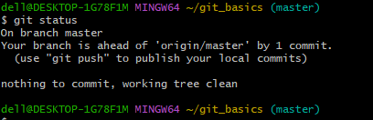
Now check check the status of file
Now it is ready to push the file to remote repo.so we need to use the below commands
5. Git remote is used to mange connection to remote repo

Slide 9

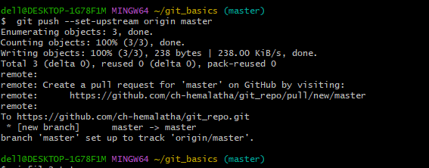
6.Now push the files or changes to remote repo by giving token as password

Slide 10
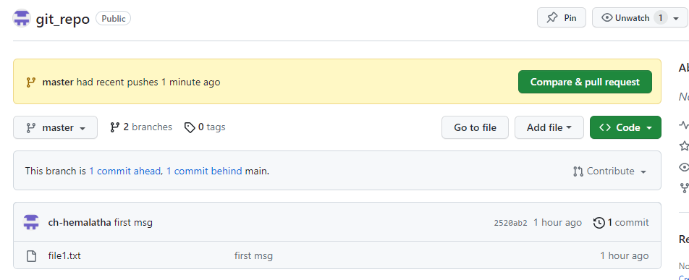
By that local files are coming to remote repo as below

Slide 11
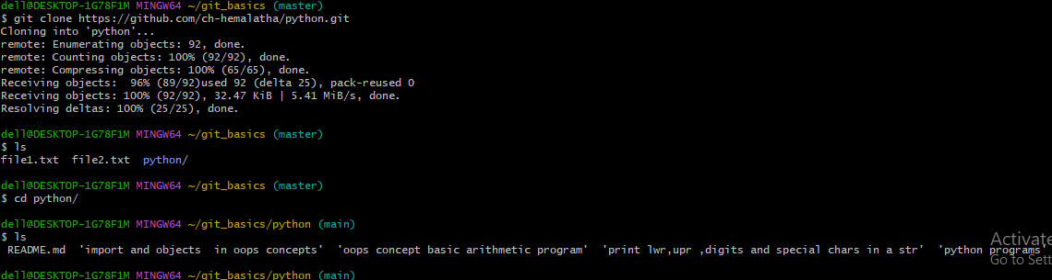
7. Git clone makes a local copy of remote repo (or) it creates the files or folders in local repo from remote repo

Slide 12
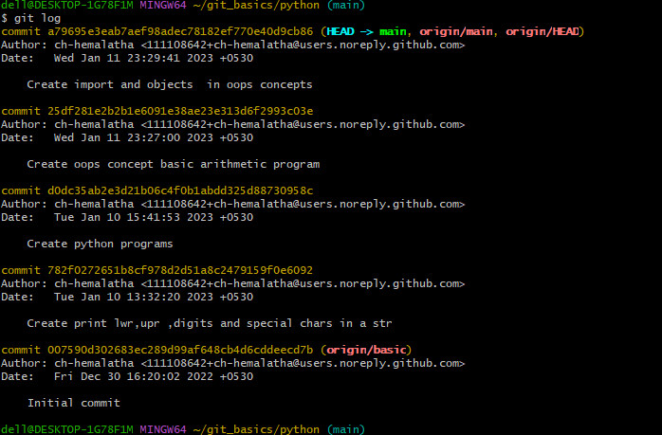
8.Git log. It displays all the commits being made in that repository in multiple lines along with the commit id, author name, date and commit message. If we have large no. of commits then press q to quit

Slide 13
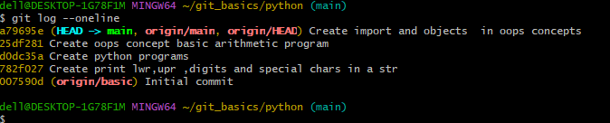
9. Git log –one will print a single commit in a single line as a output and remaining all is similar to git log.
10.git log --stat is for viewing the files that were modified in each commit, along with the number of lines added or removed. It also provides a summary line that shows the total number of lines and files that were modified.

Slide 14
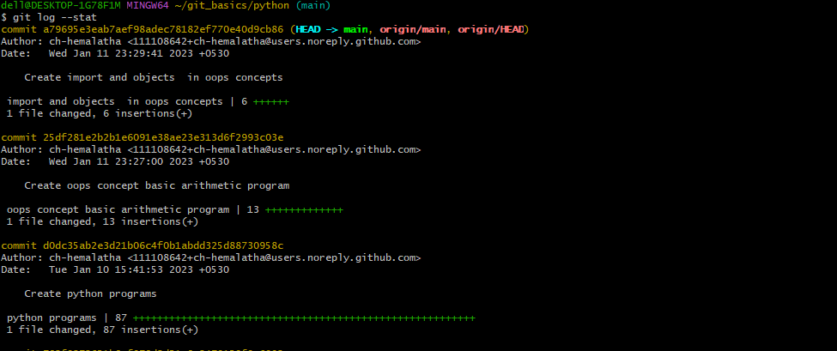

Slide 15
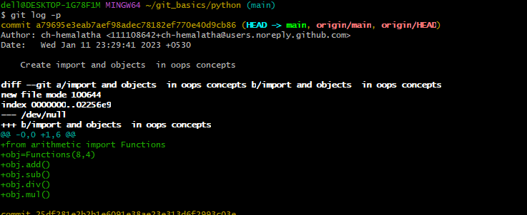
11. Git log -p will give log details of commit and insertions and deletions made in that commit file and code lines in that file

Slide 16
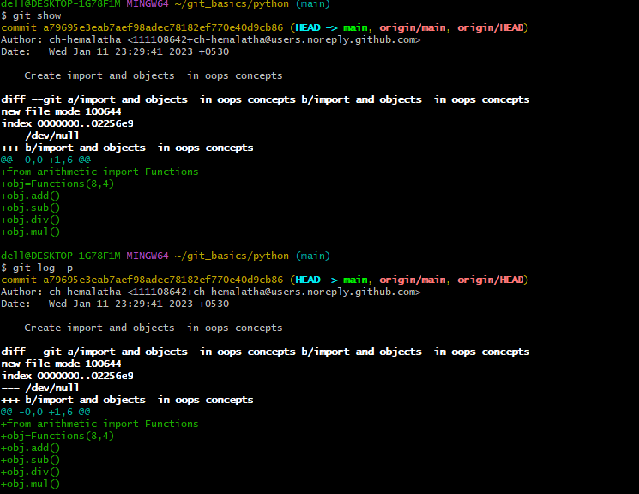
12. git show is also similar to git lop -p

Slide 17
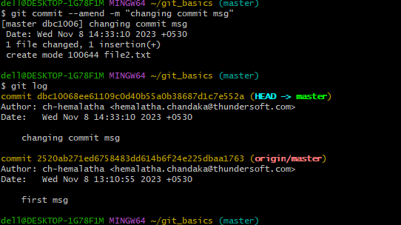
13. The git commit --amend command is a convenient way to modify the most recent commit.

Slide 18
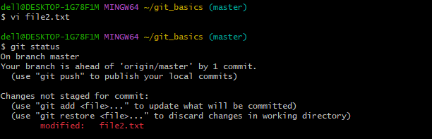
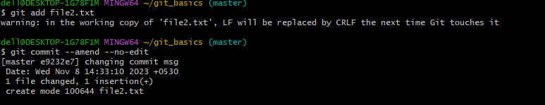
14. Git commit – amend –no-edit is used to commit the file without changing commit msg.

Slide 19
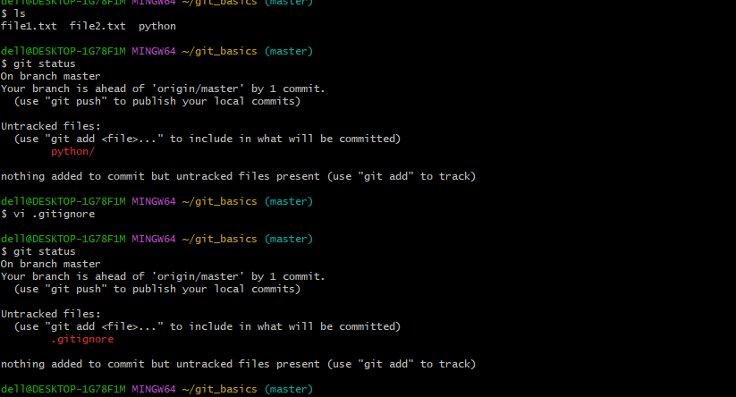
15. .gitignore command is used to ignore some unwanted files or directories. This is a way to tell git, which untracked files should remain untracked and never get commited

Slide 20
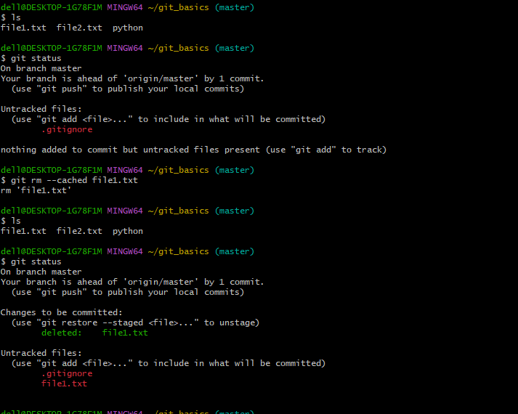
16.Git rm is used to remove file completely from repository and git rm –catched will remove file from staging area but still there in working directory.

Slide 21
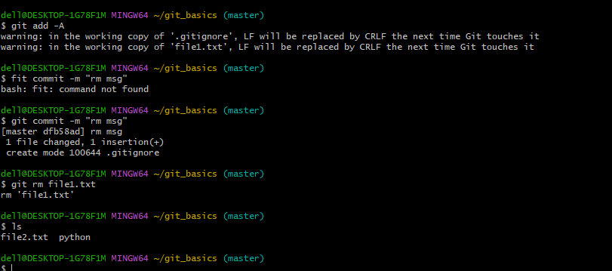

Slide 22
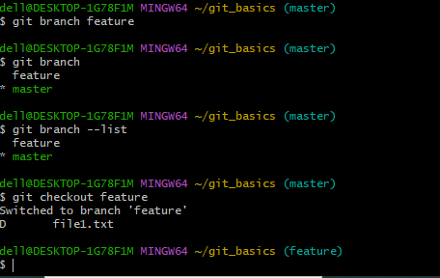
17. Create branch and check the list of branches and how to switch that created branch.

Slide 23
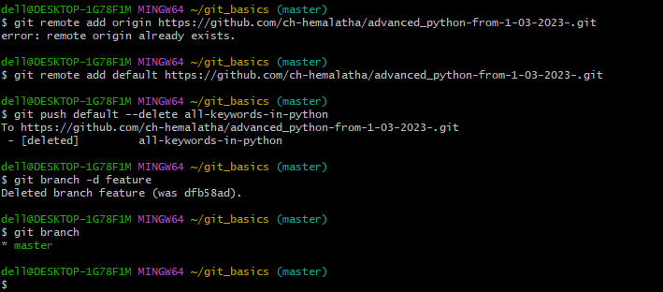
18. Delete the branch in locally as well as remote repository

Slide 24
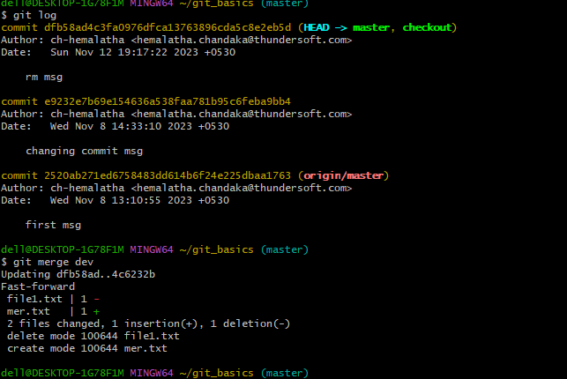
19.Git merge is used to merge the branches

Slide 25
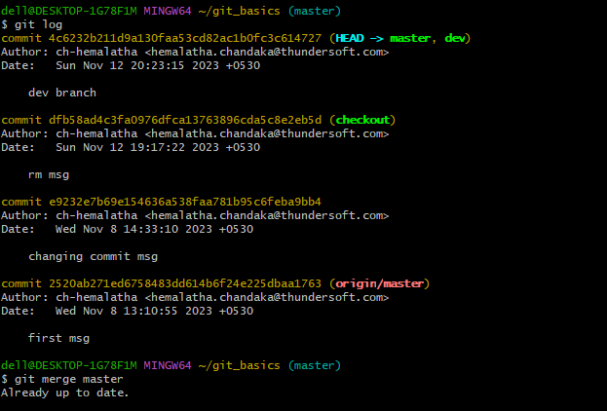
After merging all dev commits present in master branch
For reference merge conflicts: Git Merge and Merge Conflict - GeeksforGeeks

Slide 26
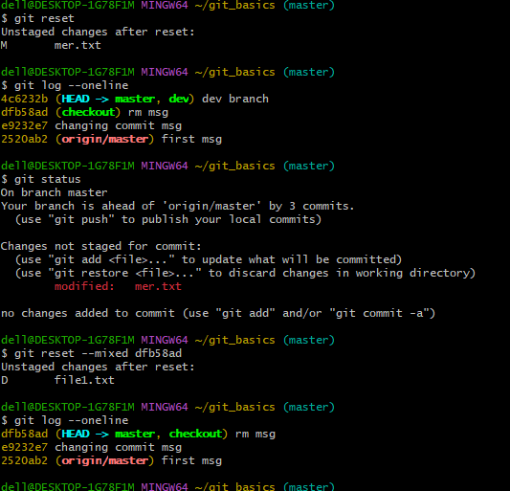
20. git reset command is used move the repo back to previous commit

Slide 27
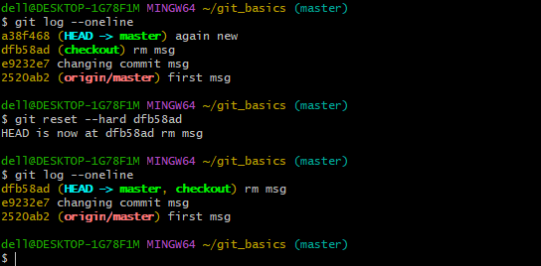
We have 3 types of resets
Soft,hard and mixed reset

Slide 28
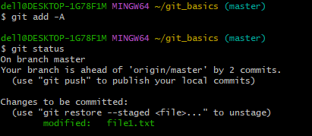
21.git reset can be used to undo the effect of ‘git add’ and unstaged the changes you have previously added in the staging area.

Slide 29
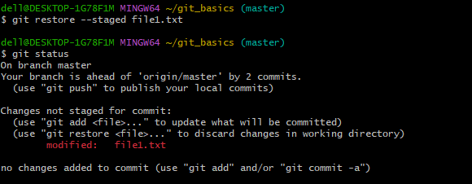

Slide 30

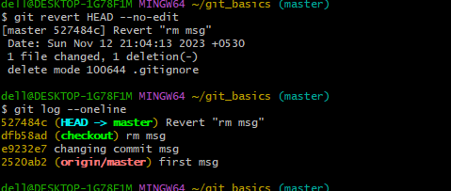
22. Revert command is used when we want to take a previous commit and add it to new commit

Slide 31
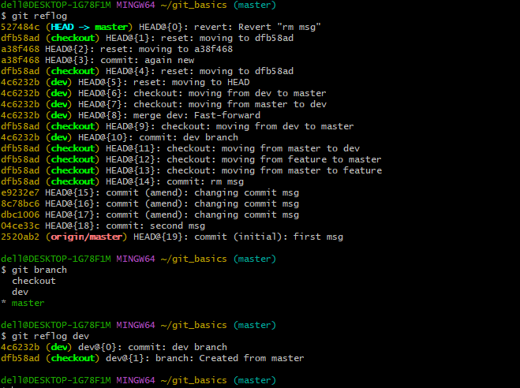
23.the reflog command is used for git to record updates made to the tip of branches.

Slide 32
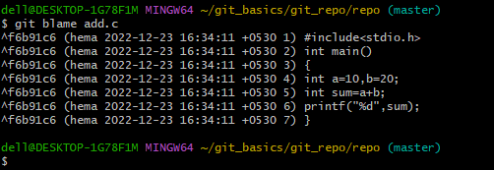
24.Git blame is the command that can tell you who was the last person to modify each line of code and when.

Slide 33
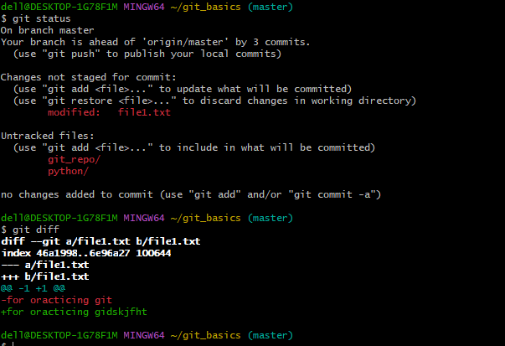
25.git diff command is used to see the changes before and after the commit

Slide 34
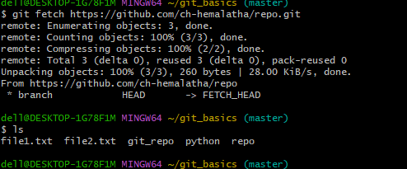
26.git fetch is used to download new commits rom remote repo without merging them into local repo . git clone is used to make a local copy of existing repo from the remote repo and git pull is used to update the local branch with latest commits from remote repo by fetching and merging them.

Slide 35
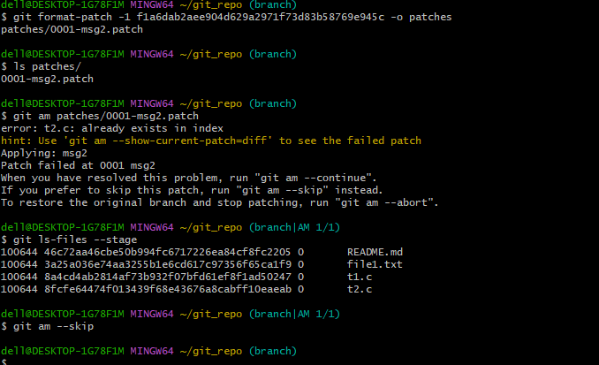
27.Git patch files are very beneficial : they are used in order to store differences that need to be applied to a file or a group of files on your system. The below fig shows how to create and apply patches.

Slide 36
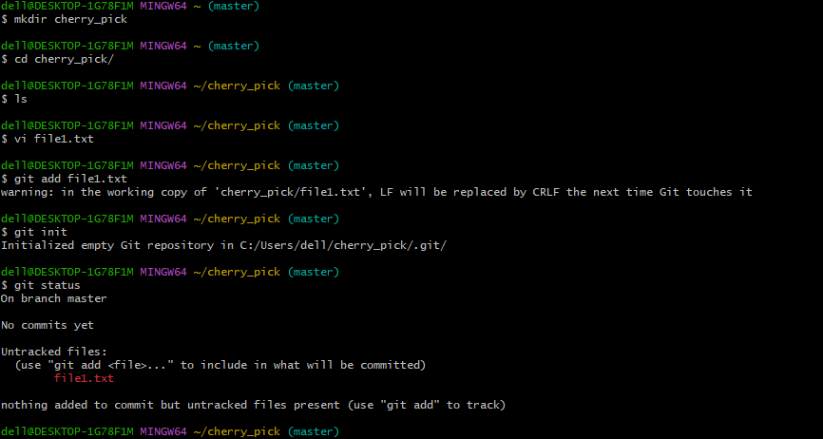
28.git cherry pick is used for choosing a commit from 1 branch and applying to another branch

Slide 37
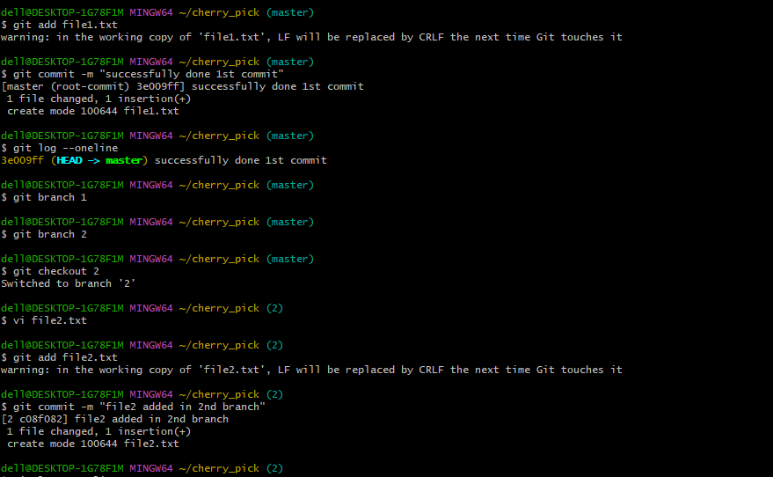

Slide 38
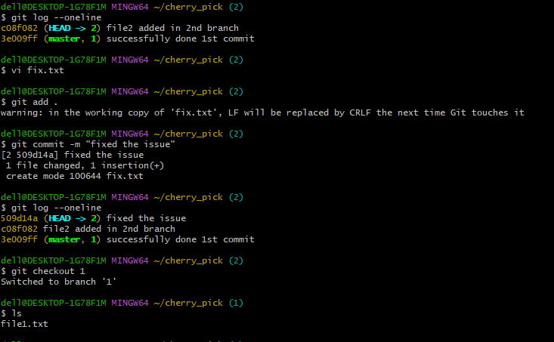

Slide 39
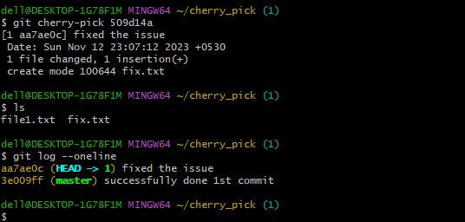
For reference: Git - Cherry Pick - GeeksforGeeks

