Slide 1



CLarte_HR_Dashboard
View in Power BI
Last data refresh:
6/22/2026 12:39:15 PM UTC
Downloaded at:
6/22/2026 12:57:37 PM UTC

Slide 2
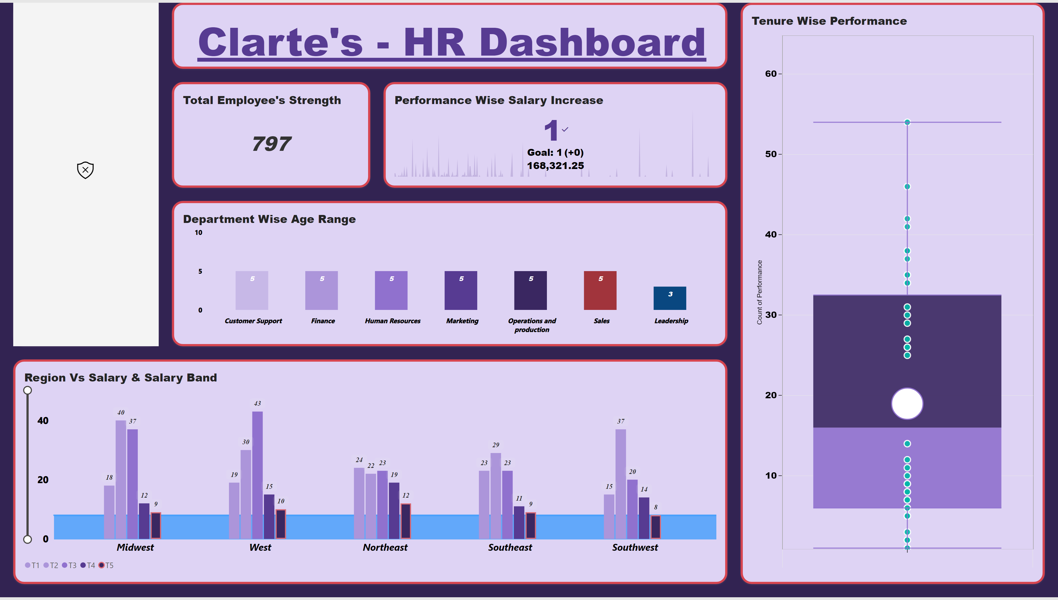
Clarte_HR_Dashboard_1
Notes:
Salary Band Wise Hours
No alt text provided
Total Employee's Strength
No alt text provided
Department Wise Age Range
No alt text provided
textbox
No alt text provided
Tenure Wise Performance
No alt text provided
Clarte's - HR Dashboard
No alt text provided
Performance Wise Salary Increase
No alt text provided
Region Vs Salary & Salary Band
No alt text provided

Slide 3
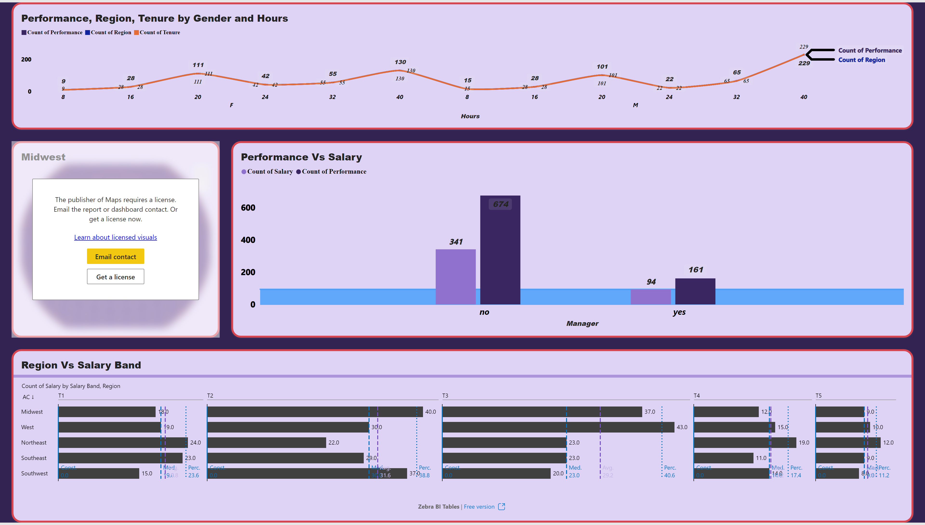
Clarte_HR_Dashboard_2
Notes:
Performance, Region, Tenure by Gender and Hours
No alt text provided
Performance Vs Salary
No alt text provided
Region Vs Salary Band
No alt text provided
Midwest
No alt text provided

Slide 4
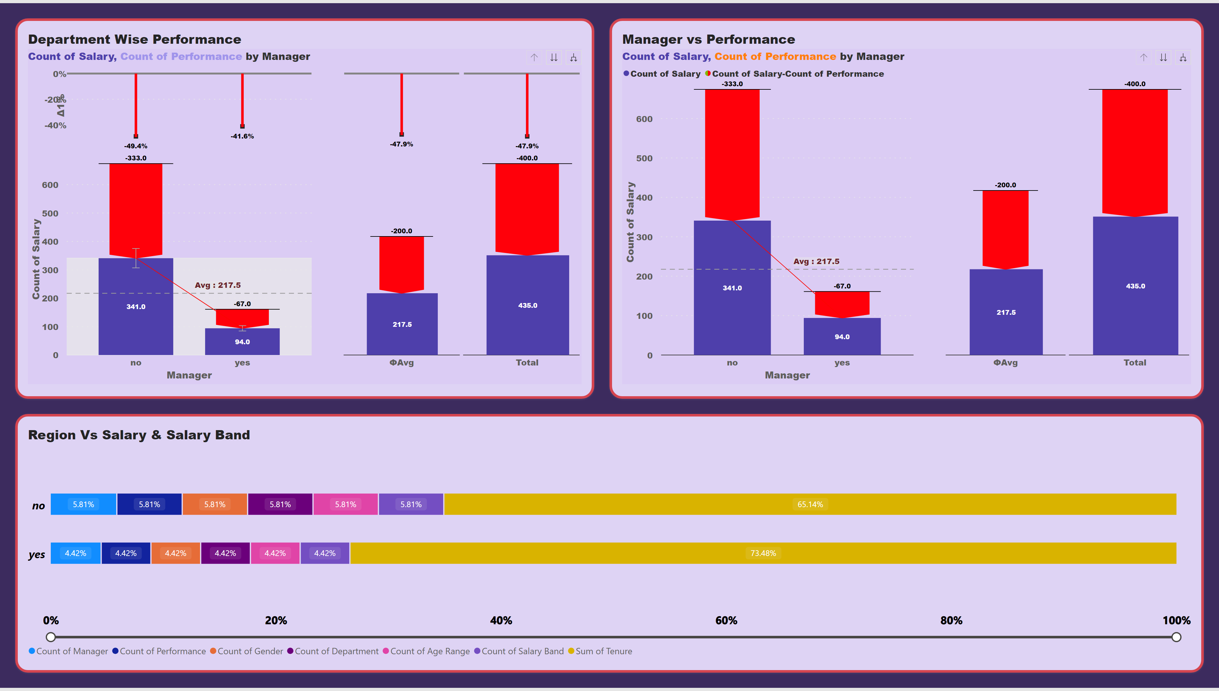
Clarte_HR_Dashboard_3
Notes:
Department Wise Performance
No alt text provided
Manager vs Performance
No alt text provided
Region Vs Salary & Salary Band
No alt text provided

