Slide 1

Heart Disease Prediction
SRN : PES1PG25CA081
Name: Hema Shree A
Project Domain: Section B – Health
Goal: SDG 3 — Good Health and Well Being

Slide 2

AIML
Abstract
Heart diseases are a leading cause of death worldwide, making early prediction crucial for effective prevention and treatment.
This project uses a dataset of 1025 patient records with 14 clinical features such as age, chest pain type, blood pressure, cholesterol, etc.
It predicts the presence of heart disease (0 = No, 1 = Yes).
And also categorizes patients into Low, Medium, and High-risk levels based on prediction probabilities.
The proposed system helps in early diagnosis and supports timely medical intervention.
This project contributes to improved healthcare decision-making and aligns with SDG Goal 3 (Good Health and Well-being).

Slide 3
AIML
Dataset
Source URL: https://www.kaggle.com/datasets/johnsmith88/heart-disease-dataset
Dataset Name: Heart Disease Dataset
Size / Shape: 1025 rows and 14 columns
Simple description about the dataset:
Dataset contains clinical details of patients such as Age, Sex, Chest Pain Type, Resting Blood Pressure, Cholesterol, Fasting Blood Sugar, ECG Results, Maximum Heart Rate, Exercise-Induced Angina, ST Depression (oldpeak), Slope of ST segment, Number of Major Vessels, and Thalassemia. The target column indicates the presence of heart disease (0 = No, 1 = Yes).

Slide 4
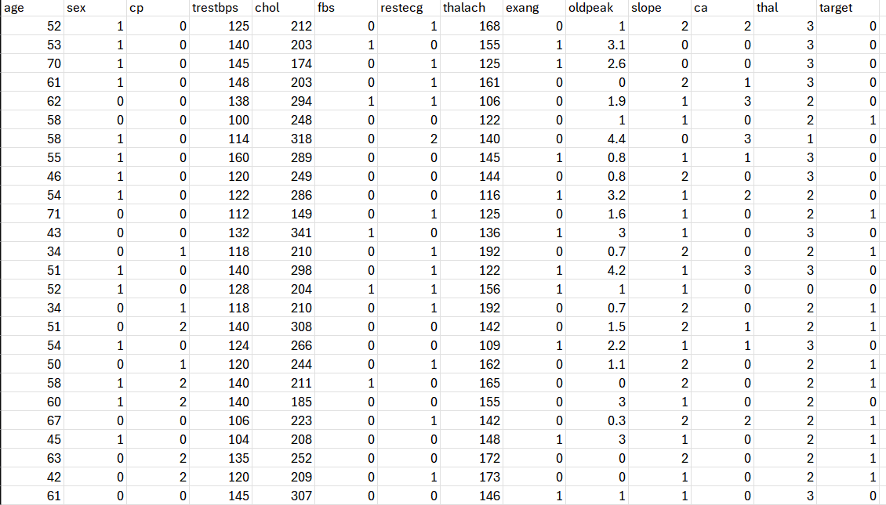
AIML
Dataset Snapshot

Slide 5
AIML
Methodology
Learning Type: Supervised Learning
What are you trying to do: Prediction (predicting the presence of heart disease as a binary outcome: 0 = No, 1 = Yes).
What is your choice of Algorithms (tentative) : Random Forest Classifier (Primary), Logistic Regression and Support Vector Machine (SVM) for comparison.
UI Tool (tentative): Flask / Gradio.
Cloud Platform (tentative): AWS / Google Colab

Slide 6
THANK YOU

