Slide 1



Name of Project
Tree Species Identification

Slide 2

Learning Objectives
Understand the role of Convolutional Neural Networks in image identification.
Build and train a CNN to identify different tree species from leaf images.
Explore dataset preprocessing, model evaluation, and deployment using Gradio.
Learn how plant biodiversity can be digitally documented and identified.
GOAL
Source :
www.freepik.com/

Slide 3
Tools and Technology used
Python
TensorFlow / Keras
Google Colab
Gradio
Matplotlib (for evaluation graphs)
ImageDataGenerator (for augmentation)

Slide 4
Methodology
Collected and preprocessed dataset of 30 tree species.
Split dataset using ImageDataGenerator with validation subset.
Built a CNN model with multiple Conv2D, MaxPooling, Dropout, and BatchNormalization layers.
Trained the model using categorical crossentropy and softmax activation.
Evaluated the model using validation accuracy and loss curves.
Deployed the model using Gradio with a detailed plant info display.

Slide 5
Problem Statement:
Manual identification of tree species by leaf is time-consuming and requires expert knowledge.There's a need for an automated, accessible, and scalable solution to identify tree species efficiently, especially for ecological, educational, and conservation purposes.

Slide 6
Solution:
A trained deep learning model that:
Accepts an image of a leaf.
Predicts the tree species from 30 possible classes.
Displays species name, confidence, scientific name, uses, and region.
Provides a simple web interface using Gradio.
GitHub Link : https://github.com/Hema1237/tree_species_classification

Slide 7
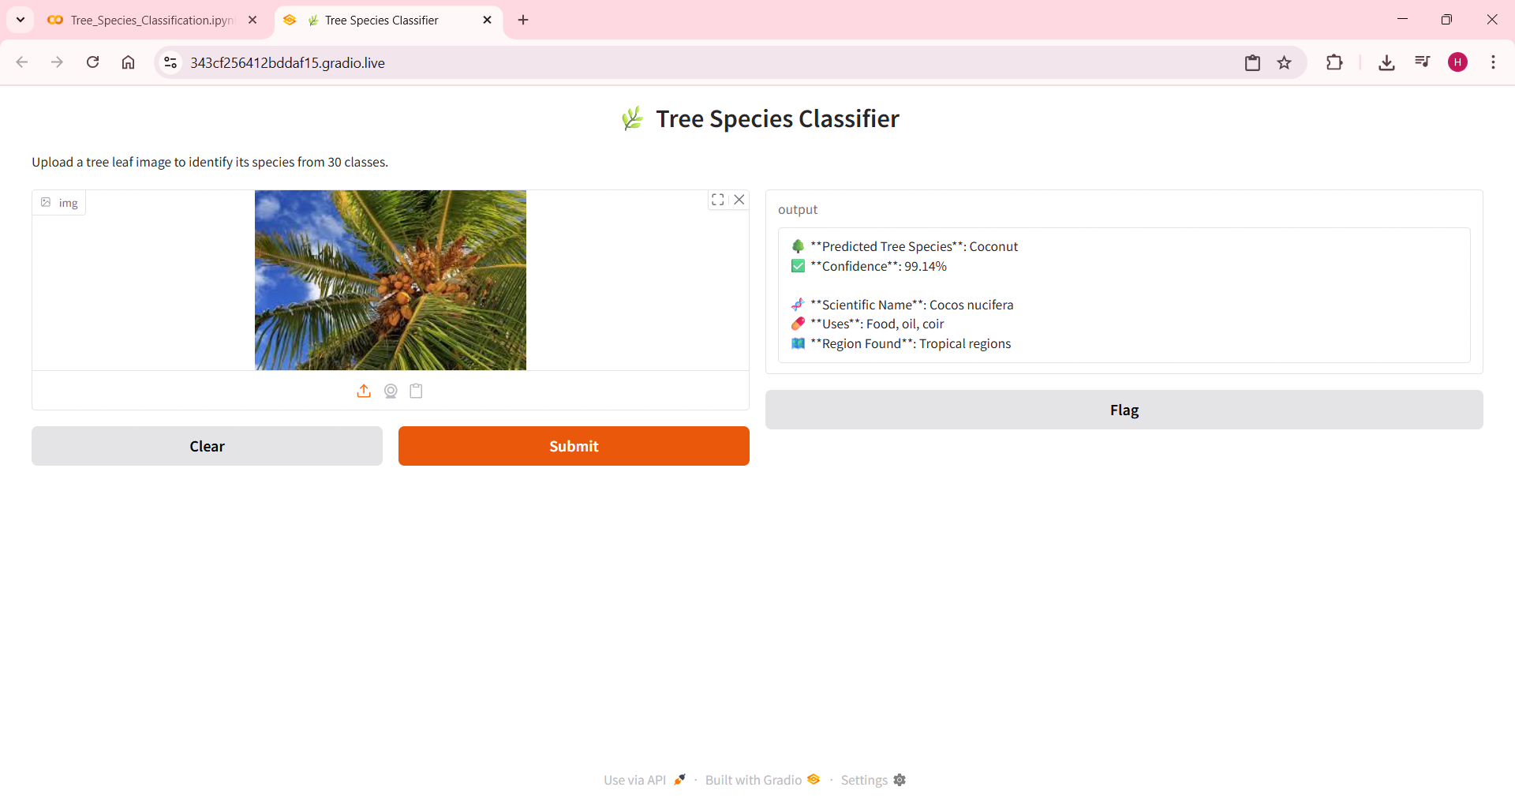
Screenshot of Output:

Slide 8
Conclusion:
The CNN-based tree species classifier successfully identifies 30 different species with high confidence and accuracy. The tool can be further expanded to include more species and real-time mobile application deployment. This project demonstrates how AI can be used to support biodiversity tracking and ecological education.

