Slide 1



State Level Hackathon
Adaptive Waste Collection Scheduler with Overflow Override
QNX eHACK 2026 | SL37 | Team Trash Track
Real-time waste collection scheduling using QNX RTOS

Slide 2
Problem Synthesis & Scenario
Scenario: Waste bins fill at different and unpredictable rates, while fixed collection routes treat all bins alike.
Criticality: An overflowing bin cannot wait for the next periodic route update; emergency handling must take priority.
Our requirement: Continuously monitor bin status, generate an adaptive route, and trigger an immediate route override when fill reaches 90%.
Success metric: Overflow event → Emergency Task → override pulse → route recomputation.

Slide 3
Design and Execution
Application model: One QNX process with multiple POSIX threads for independent real-time tasks.
Priority setup: SCHED_FIFO: Emergency 25 > Route 20 > Bin Monitor 15 > Vehicle 10.
IPC: QNX channels, connections and pulses: BIN_READING_PULSE and OVERRIDE_PULSE.
Synchronization: Mutexes protect shared bin data, route data and logging.
Timing: Bin updates every 1 s; normal route recalculation every 5 s; vehicle cycle every 3 s.

Slide 4
Technical Execution: Logic & Route Algorithm
Bin monitoring: Four simulated bins are updated periodically; fill level is capped at 100%.
Route score: Score = 0.6 × fill + 0.3 × (1/distance) + 0.1 × wait time.
Ordering: A local snapshot is sorted using qsort() so shared data is not held during route calculation.
Emergency path: At ≥90% fill, Emergency Task marks overflow and sends OVERRIDE_PULSE to the Route Scheduler.
Vehicle: The simulated Vehicle Task services the first route bin and resets its status.
Bin
Monitor
Emergency
Route

Slide 5
Resilience & Emergency Override
Stress scenario: A bin crosses the 90% overflow threshold during normal route operation.
Mitigation: Emergency Task runs at the highest priority and receives BIN_READING_PULSE independently of the normal 5 s route timer.
Recovery path: Emergency Task → OVERRIDE_PULSE → Route Scheduler → immediate recompute_route().
Protection: The overflowed flag prevents repeated handling of the same overflow condition until service/reset.
Boundary: The current baseline has no watchdog timer or hard worst-case latency guarantee; these are validation/future extensions.
Fill ≥ 90%?
Override
Recompute

Slide 6
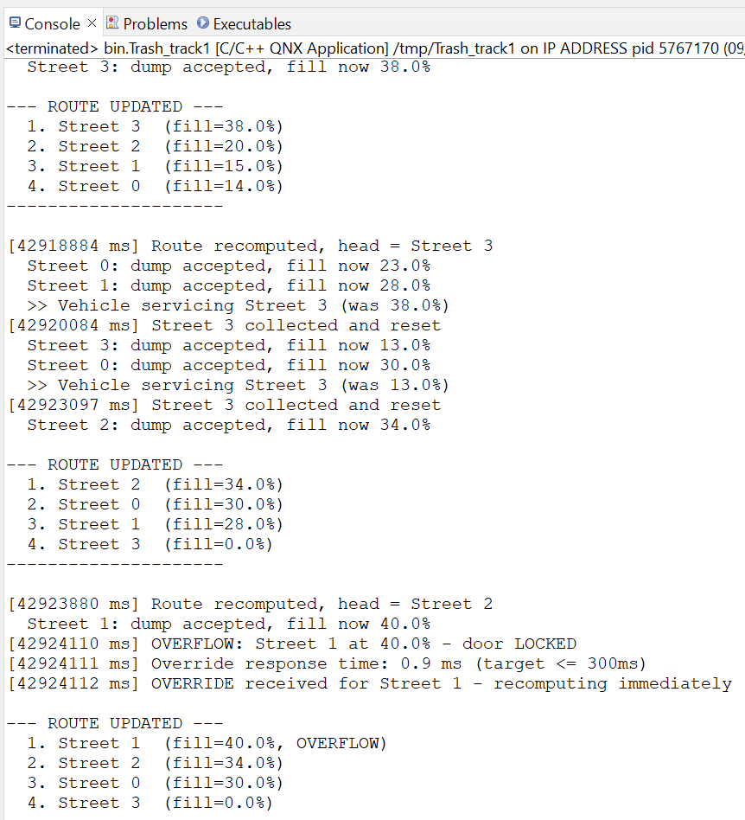
Performance Proof & Demonstration
Live demonstration: Show four simulated bin fill levels changing and the route order updating.
Normal timing: Bin Monitor update period: 1 s; normal route recalculation period: 5 s.
Emergency timing: Overflow does not wait for the next 5 s route timer; an override pulse triggers route recomputation.
Evidence: Insert the QNX Momentics System Profiler screenshot/log required by the hackathon template.
What the proof shows: Priority-based task separation and pulse-driven emergency handling work as designed.

Slide 7
Scalability & Conclusion
Current prototype: QNX-based multi-threaded simulation with four bins and one simulated vehicle.
Industrial extension: Integrate real ultrasonic sensors, GPS/vehicle position, road distance and multiple collection vehicles.
RTOS extension: Add watchdog/fault recovery and formally measure bounded overflow-response latency.
Key learning: The main challenge was coordinating periodic scheduling, shared data and emergency events without race conditions.
Closing vision: A real-time collection system that spends less effort on low-priority bins and reacts immediately to critical overflow conditions.

Slide 8
Resilience & "The Hack" Response
The Vulnerability: A bin crosses the 90% fill limit between two 5 s route updates. A fixed periodic schedule would leave the overflow waiting for the next timer tick.
Mitigation Strategy: The Emergency Task (SCHED_FIFO priority 25, the highest) is woken by BIN_READING_PULSE, flags the bin as overflowed and sends OVERRIDE_PULSE. The Route Scheduler recomputes the route immediately instead of waiting for its timer.
Recovery Path: Overflow → OVERRIDE_PULSE → recompute_route(). The overflowed flag stops the same bin being handled twice until the vehicle services and resets it.

Slide 9
Demonstration
Section 02.

Slide 10
Performance Proof
Console evidence of route recomputation and emergency override response
System Profiler Screenshot: (Mandatory). Show the CPU usage and thread timing.
Latency Benchmarks: Present your final data for the Key Metric (e.g., "Stable 40µs interrupt response under 90% load").
Analysis: One sentence on what the data proves about your system's determinism.

Slide 11
Future Scalability & Conclusion
Innovation Arbitrage: Replace the simulated bins with real ultrasonic fill sensors, add GPS vehicle position and road distance, and support multiple collection vehicles. QNX priority scheduling and pulses carry over to industrial and automotive-grade systems.
RTOS Extension: Add watchdog and fault recovery, and formally measure the bounded overflow-response latency.
Learning Outcome: The main challenge was coordinating periodic scheduling, shared data and emergency events without race conditions.
Closing Statement: A real-time collection system that spends less effort on low-priority bins and reacts immediately to critical overflow.

Slide 12
Thank you

