Slide 1
AI-Powered Personalized Nutrition Agent using IBM watsonx Orchestrate IBM SkillsBuild – University Engagement Program
Domain: Healthcare
Submitted By:
Name: N. Hemasri
Roll Number: CB.SC.U4AIE24335
College: Amrita VISHWA VIDHYAPEETHAM
Department: AIML

Slide 2
Introduction
Nutrition plays a vital role in maintaining a healthy lifestyle. However, many individuals find it difficult to select a balanced diet based on their health condition, body weight, lifestyle, and food preferences.
To solve this problem, we developed an AI-powered Personalized Nutrition Agent using IBM watsonx Orchestrate. The agent interacts with users, understands their health-related information, and provides personalized nutrition guidance using an AI model and a knowledge base.

Slide 3
Problem Statement
People often rely on generic diet plans that do not consider their personal health conditions, dietary preferences, allergies, or activity levels. This may result in poor nutrition and unhealthy eating habits.
There is a need for an intelligent AI assistant capable of providing personalized nutrition recommendations based on individual user information.

Slide 4
Objectives
Build an AI-powered Nutrition Agent.
Collect user information through natural language conversation.
Generate personalized diet recommendations.
Suggest healthy meal plans.
Promote healthy lifestyle habits.
Provide reliable nutrition information using a knowledge base.
Improve user awareness regarding healthy eating.

Slide 5
Proposed Solution
The proposed system is an AI-powered Nutrition Agent developed using IBM watsonx Orchestrate.
The agent:
Interacts with users conversationally.
Collects age, weight, activity level, dietary preference, and medical conditions.
Uses uploaded nutrition documents as a knowledge base.
Generates personalized diet plans.
Provides healthy lifestyle recommendations.

Slide 6
Technologies Used
Technology | Purpose
IBM Cloud | Cloud Platform
IBM watsonx Orchestrate | AI Agent Development
GPT Foundation Model | Natural Language Processing
Knowledge Base | Nutrition Information
PDF Documents | Trusted Nutrition Data
AI Agent Builder | Agent Configuration

Slide 7
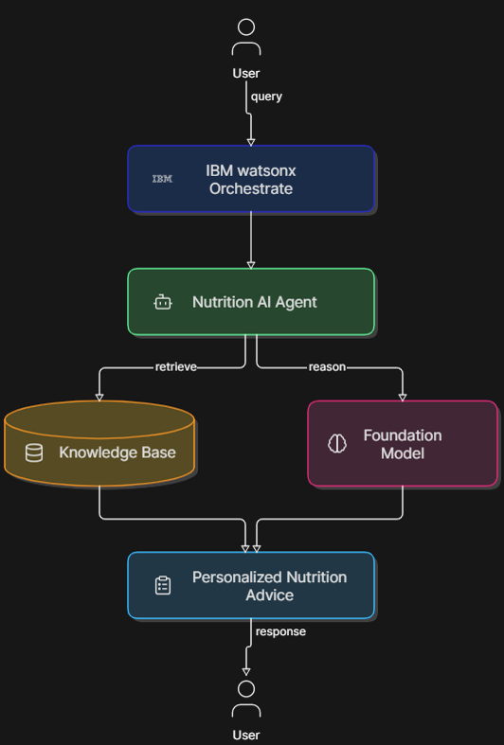
System Architecture

Slide 8
Workflow
User opens Nutrition Agent.
Agent asks for health details.
User enters age, weight, activity level, etc.
Agent retrieves nutrition knowledge.
AI analyzes user information.
Personalized nutrition plan is generated.
User receives healthy diet recommendations.

Slide 9
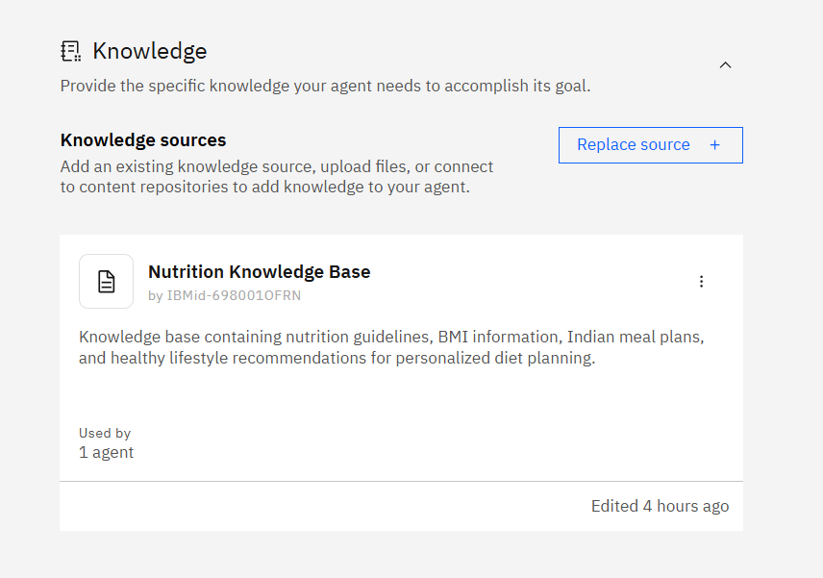
Knowledge Base
The following nutrition documents were uploaded into the agent:
Nutrition Guidelines
BMI & Calorie Guide
Healthy Lifestyle Guide
Indian Meal Planner
The knowledge base helps the agent provide accurate and context-aware responses.

Slide 10
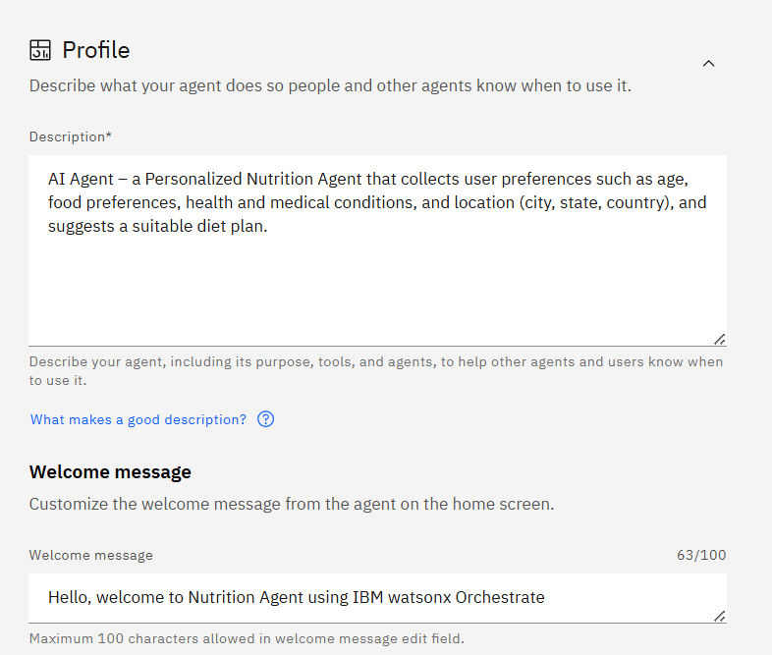
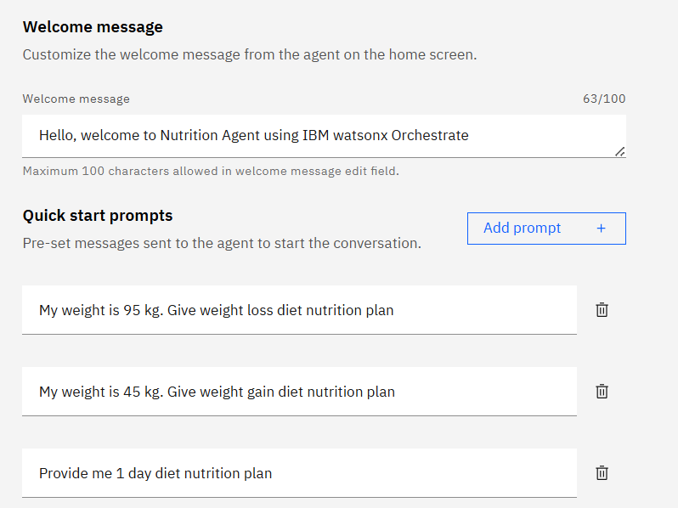
Agent Configuration

Slide 11
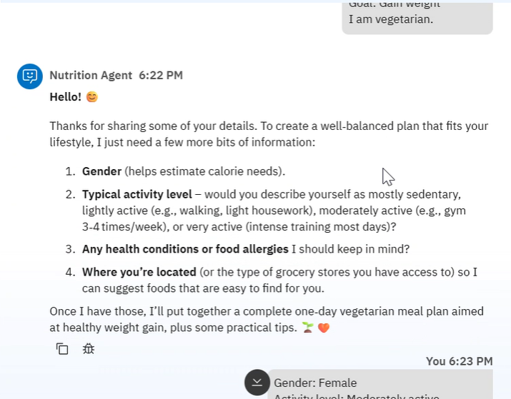
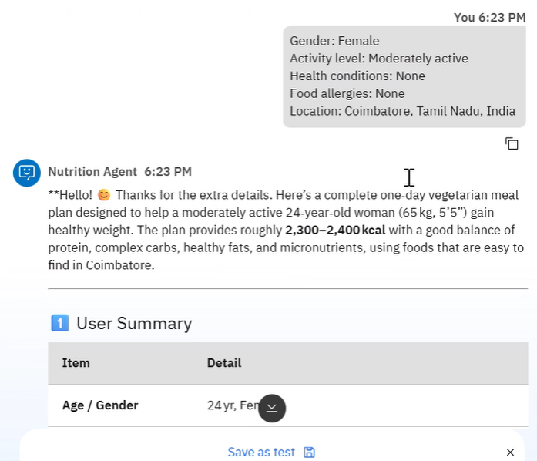
Testing

Slide 12
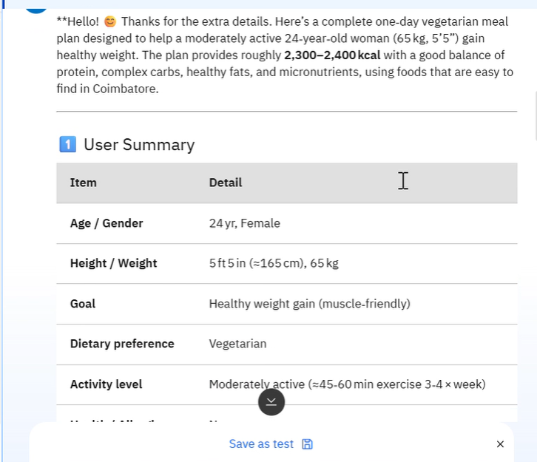
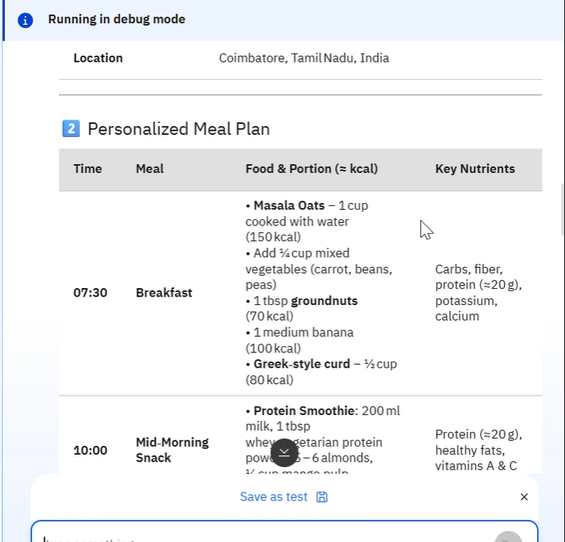
Results

Slide 13
Advantages
Personalized recommendations
Easy to use
Knowledge-driven responses
Supports preventive healthcare
Scalable AI solution
Fast response generation
Interactive conversational interface

Slide 14
Future Scope
Voice-enabled interaction
Mobile application
Integration with wearable devices
Image-based food recognition
AI calorie tracking
Multilingual support
Nutrition progress dashboard

Slide 15
GitHub Repository
https://github.com/Hema1806/IBM-Nutrition-Agent.git
Repository Name:
IBM-Nutrition-Agent

Slide 16
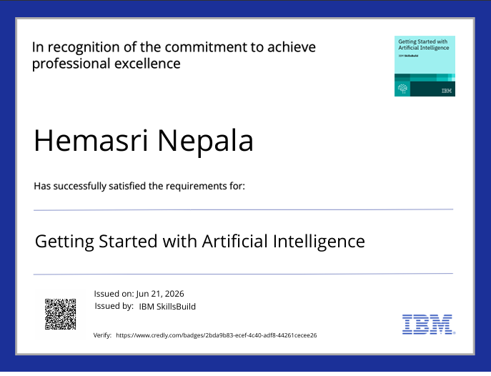

Slide 17


Slide 18
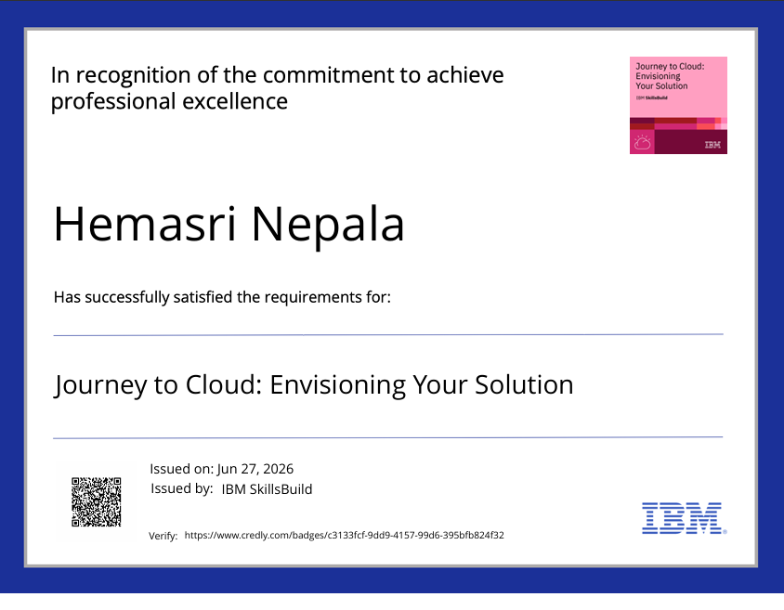

Slide 19
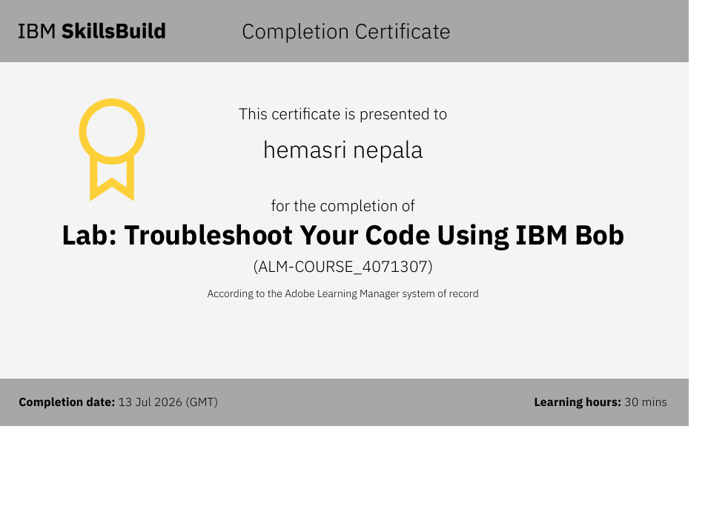

Slide 20
Conclusion
The AI-Powered Personalized Nutrition Agent demonstrates how IBM watsonx Orchestrate can be used to develop intelligent healthcare assistants. By combining conversational AI with a curated nutrition knowledge base, the system provides personalized diet recommendations and promotes healthier lifestyle choices. The project highlights the practical application of AI in healthcare and showcases the capabilities of IBM watsonx Orchestrate for building domain-specific AI agents.

Slide 21
Thank You
Questions & Answers

