Slide 1
AI-Powered Medical Symptom Checker & First Aid Assistant using IBM watsonx Orchestrate IBM SkillsBuild – University Engagement Program
Domain: Healthcare
Submitted By:
Name: N. Hemasri
Roll Number: CB.SC.U4AIE24335
College: Amrita VISHWA VIDHYAPEETHAM
Department: AIML

Slide 2
Introduction
Healthcare information should be accessible to everyone. The Medical Symptom Checker is an AI-powered assistant that helps users understand common symptoms, receive first aid guidance, and learn healthy lifestyle practices through conversational AI.

Slide 3
Problem Statement
Many people cannot immediately consult healthcare professionals for minor health concerns or first aid situations. They require reliable preliminary guidance that helps them understand symptoms and determine whether professional medical attention is required.

Slide 4
Objectives
Build an AI-powered medical assistant. Guide users regarding common symptoms. Suggest first aid. Promote healthy living. Identify emergency warning signs. Use a knowledge base for medical guidance.

Slide 5
Proposed Solution
The Medical Symptom Checker uses IBM watsonx Orchestrate to:
Understand user symptoms.
Retrieve information from a medical knowledge base.
Provide first aid recommendations.
Suggest healthy lifestyle practices.
Encourage consultation with healthcare professionals.

Slide 6
Technologies Used
Technology | Purpose
IBM Cloud | Cloud Platform
IBM watsonx Orchestrate | AI Agent Development
GPT Foundation Model | Natural Language Processing
Knowledge Base | Medical Information
AI Agent Builder | Agent Configuration

Slide 7
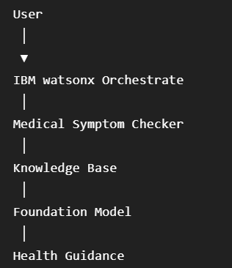
System Architecture

Slide 8
Workflow
User
↓
Medical Symptom Checker
↓
Collect Symptom Information
↓
Knowledge Base
↓
IBM Foundation Model
↓
General Health Guidance
↓
User

Slide 9
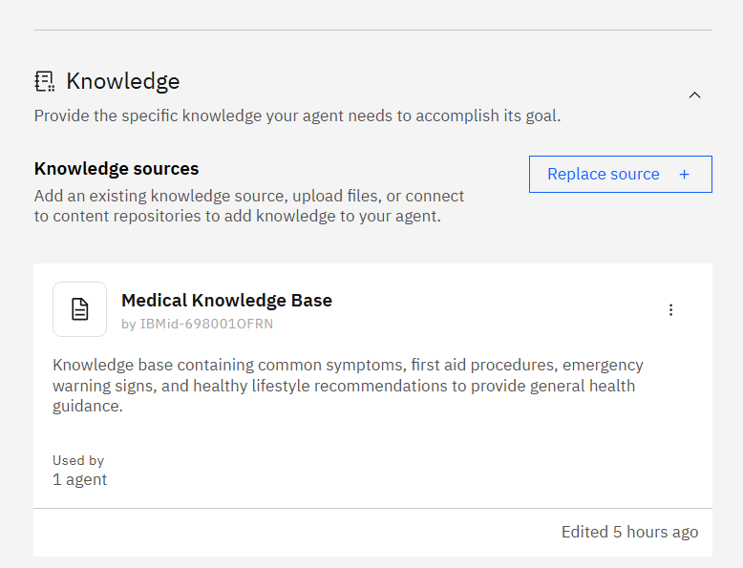
Knowledge Base
Uploaded documents:
Common Symptoms Guide
First Aid Guide
Emergency Warning Signs
Healthy Lifestyle Guide

Slide 10
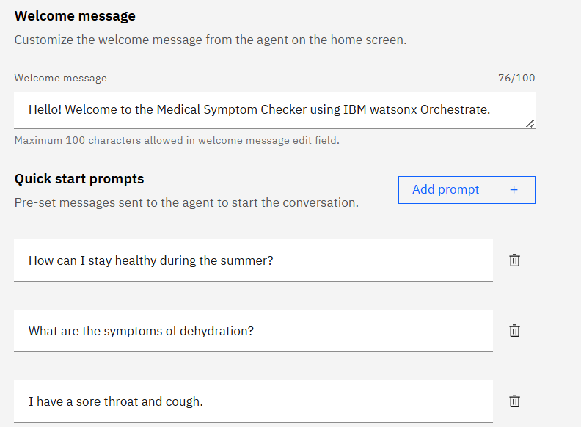
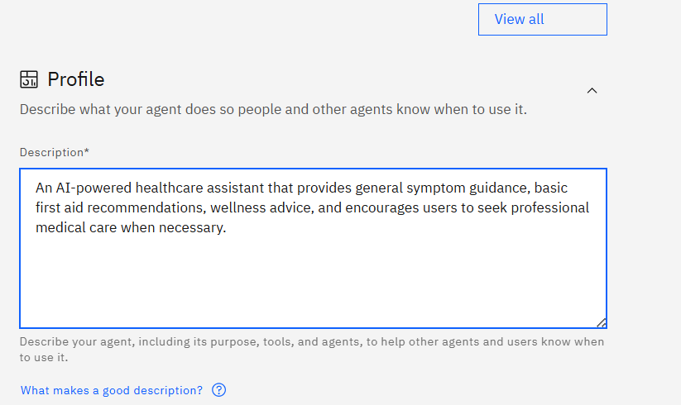
Agent Configuration

Slide 11
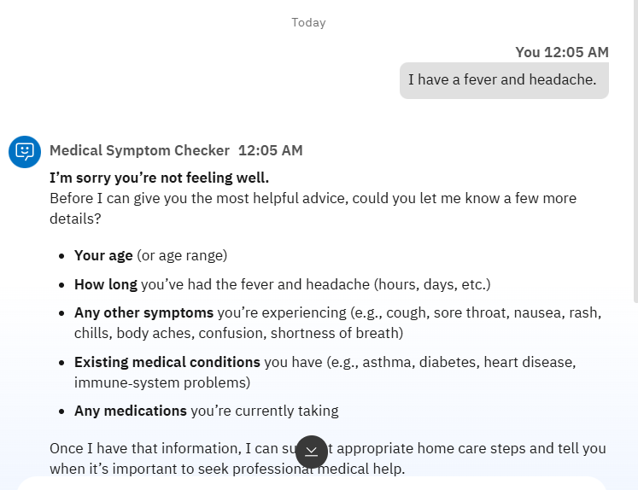
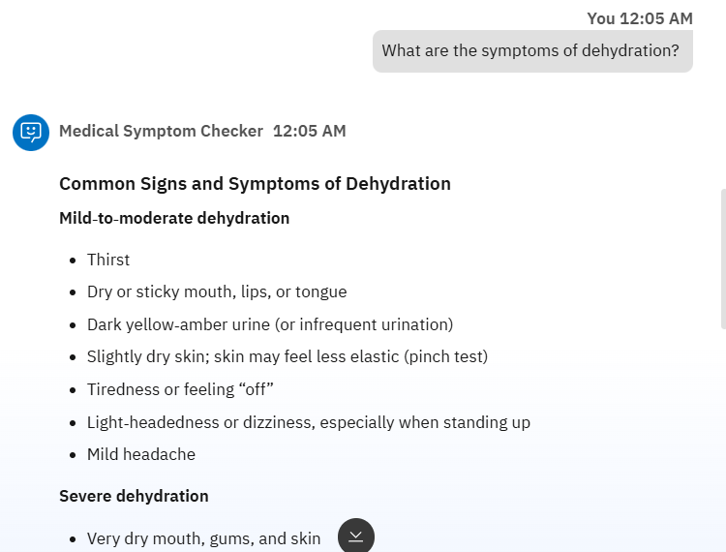
Testing

Slide 12
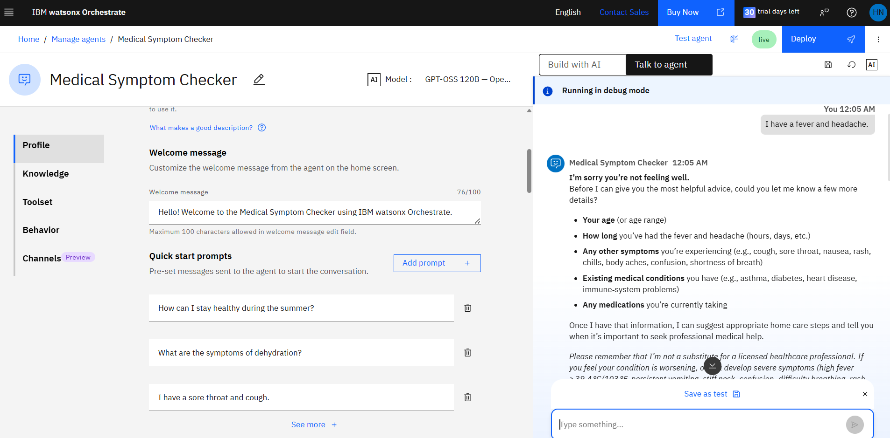
Results

Slide 13
Novelty
AI-powered health guidance. Knowledge-based responses. Emergency awareness. Easy conversational interface. Preventive healthcare focus.

Slide 14
Future Scope
Hospital integration. Wearable device connectivity. Voice assistant. Medical image analysis. Multilingual support. Appointment booking.

Slide 15
GitHub Repository
https://github.com/Hema1806/IBM_Medical_Symptom_Checker.git
Repository Name:
IBM_Medical_Symptom_Checker

Slide 16
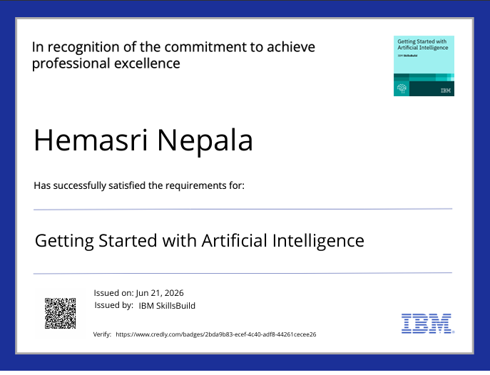

Slide 17


Slide 18


Slide 19


Slide 20
Conclusion
The Medical Symptom Checker demonstrates how IBM watsonx Orchestrate can be used to build intelligent healthcare assistants that provide reliable symptom guidance, first aid recommendations, and preventive healthcare information. The project highlights the potential of conversational AI to improve healthcare awareness while promoting safe and responsible use of medical information.

Slide 21
Thank You
Questions & Answers

