Slide 1
AI-Powered Smart Farming Advisor using IBM watsonx Orchestrate IBM SkillsBuild – University Engagement Program
Domain: Agriculture
Submitted By:
Name: N. Hemasri
Roll Number: CB.SC.U4AIE24335
College: Amrita VISHWA VIDHYAPEETHAM
Department: AIML

Slide 2
Introduction
Agriculture plays a vital role in ensuring food security and economic growth. Farmers often need timely advice regarding crop selection, fertilizer usage, irrigation, and pest management. The Smart Farming Advisor uses IBM watsonx Orchestrate to provide intelligent agricultural recommendations through natural language conversations.

Slide 3
Problem Statement
Farmers often face challenges in:
Selecting suitable crops.
Applying fertilizers correctly.
Managing irrigation efficiently.
Controlling pests and diseases.
Accessing expert agricultural guidance.
An AI-powered farming assistant can provide personalized recommendations to improve productivity and sustainability.

Slide 4
Objectives
Build an AI-powered farming assistant. Recommend crops. Suggest fertilizers. Provide irrigation advice. Assist in pest and disease management. Promote sustainable agriculture.

Slide 5
Proposed Solution
The Smart Farming Advisor is an AI-powered conversational assistant that:
Understands farmer queries.
Retrieves agricultural knowledge.
Generates personalized farming recommendations.
Supports sustainable farming practices.

Slide 6
Technologies Used
Technology | Purpose
IBM Cloud | Cloud Platform
IBM watsonx Orchestrate | AI Agent Development
GPT Foundation Model | Natural Language Processing
Knowledge Base | Agricultural Information
AI Agent Builder | Agent Configuration

Slide 7
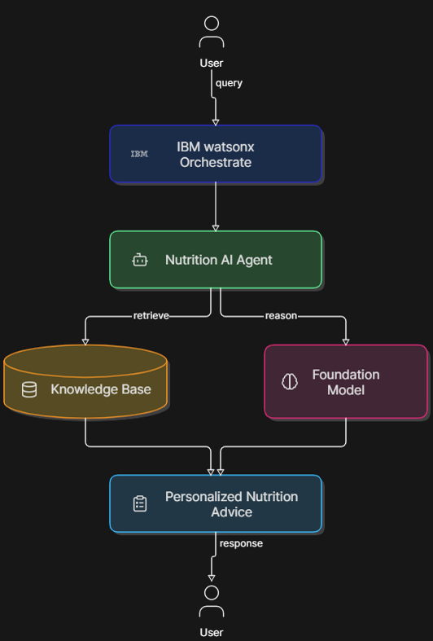
System Architecture

Slide 8
Workflow
Farmer
↓
Smart Farming Advisor
↓
Collect Farming Query
↓
Knowledge Base
↓
IBM Foundation Model
↓
Personalized Recommendation
↓
Farmer

Slide 9
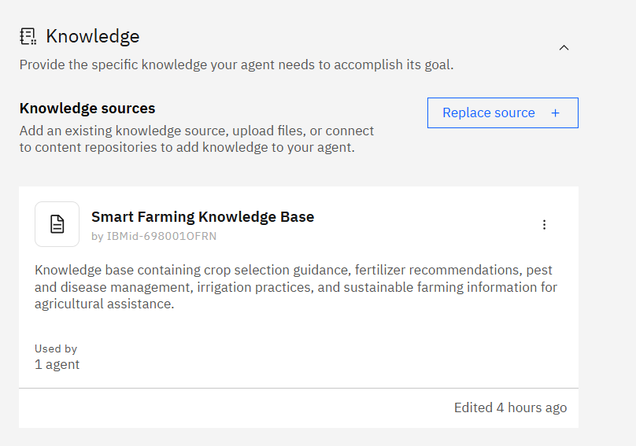
Knowledge Base
Uploaded agricultural knowledge documents:
Crop Selection Guide
Fertilizer Guide
Pest & Disease Management Guide
Irrigation & Sustainable Farming Guide

Slide 10
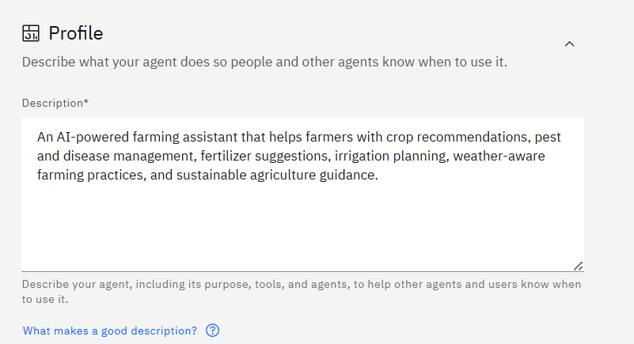
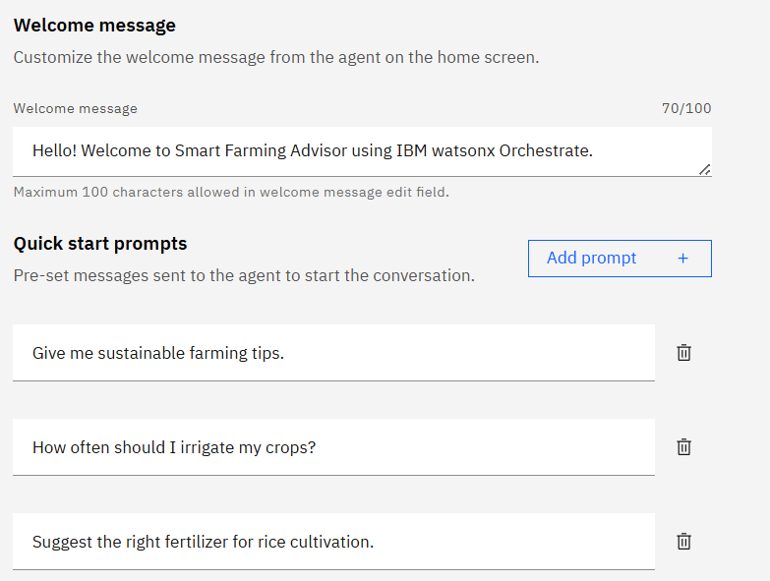
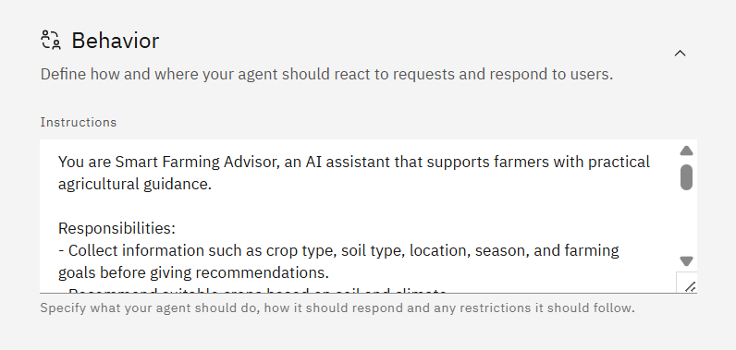
Agent Configuration

Slide 11
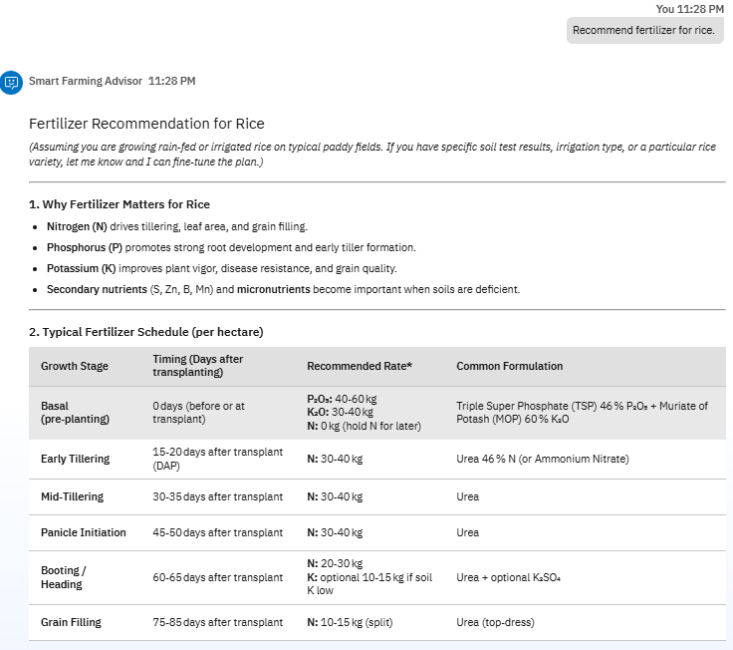
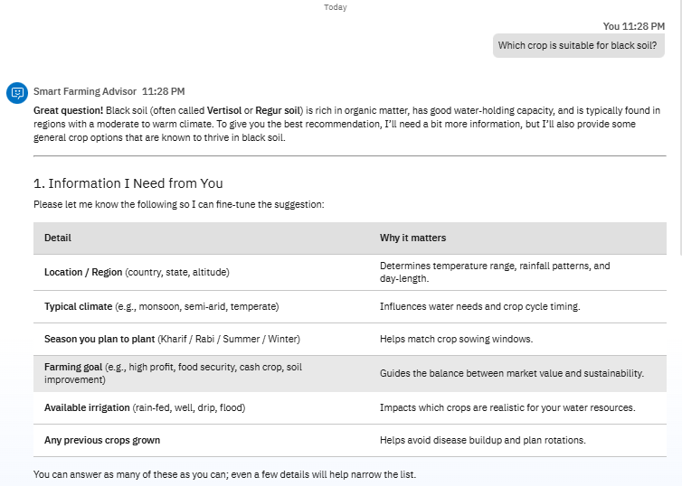
Testing

Slide 12
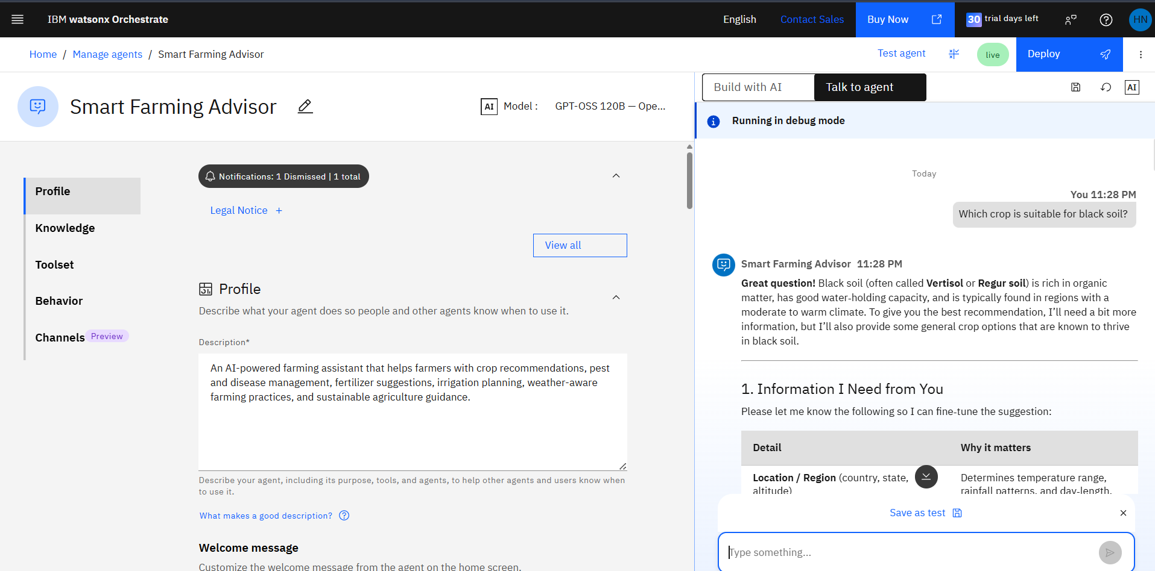
Results

Slide 13
Novelty & Uniqueness
AI-powered agricultural assistant. Knowledge-based recommendations. Personalized farming guidance. Easy conversational interface. Sustainable farming focus. Scalable IBM watsonx Orchestrate solution.

Slide 14
Future Scope
Weather API integration.
Satellite image analysis.
IoT sensor connectivity.
Mobile application.
Regional language support.
AI-based crop disease detection from images.

Slide 15
GitHub Repository
https://github.com/Hema1806/IBM_Smart_Farming_Advisor.git
Repository Name:
IBM_Smart_Farming_Advisor

Slide 16
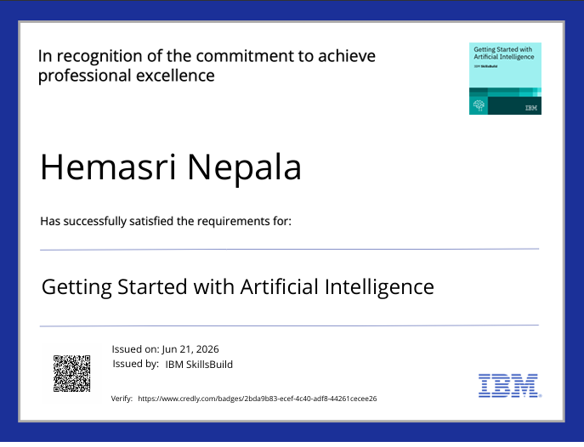

Slide 17


Slide 18
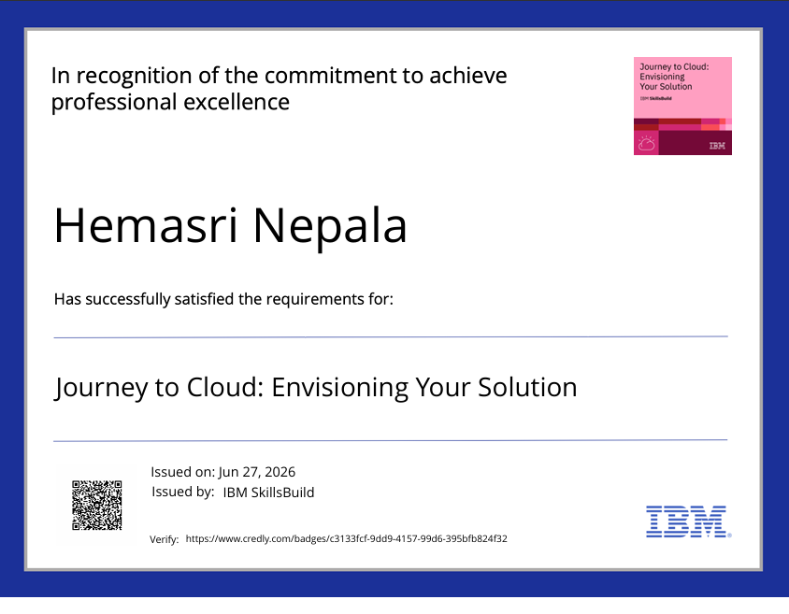

Slide 19
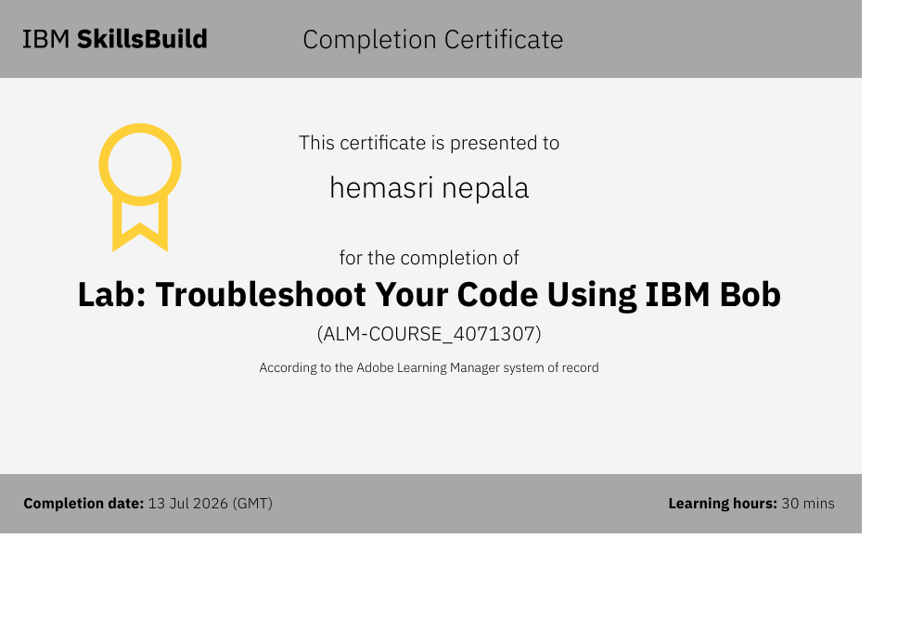

Slide 20
Conclusion
The Smart Farming Advisor demonstrates how IBM watsonx Orchestrate can be used to build an intelligent agricultural assistant. By integrating conversational AI with a curated farming knowledge base, the system provides practical recommendations for crop selection, fertilizer usage, irrigation planning, and sustainable farming. The project highlights the potential of AI to improve agricultural productivity and support informed decision-making.

Slide 21
Thank You
Questions & Answers

