Slide 1
STUDENT MANAGEMENT SYSTEM
Presented by: D. HEMALAKSHMI
Enrollment No: EBEON03251076550
Batch : 2024-14789

Slide 2
Objective
• Build a simple Student Management System using core Java OOP concepts.
• Simulate: Register students, generate student IDs, enroll in courses, track balance.

Slide 3
System Architecture
[MainApp.java] -> [StudentService.java] -> [Student.java]
• MainApp handles user input and flow
• StudentService manages student records
• Student stores individual data and actions

Slide 4
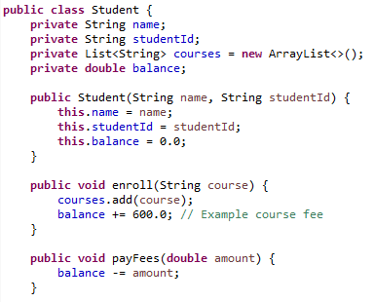
Class - Student.java
Attributes: name, studentId, courses, balance
Methods: enroll(), payFees(), showStatus()

Slide 5
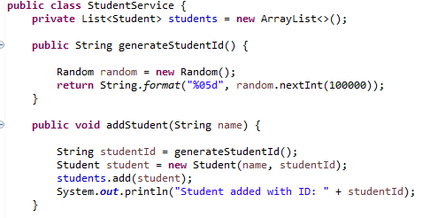
Class - StudentService.java
Manages student list and IDs
Finds and adds students

Slide 6
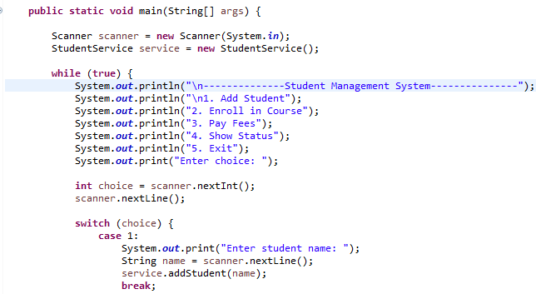
MainApp.java – User Interaction
Menu with options using switch-case
Handles user input and delegates actions

Slide 7
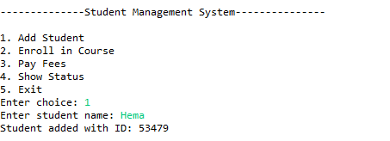

Output

Slide 8
Features
Student Registration
Course Enrollment
Tuition Fee Payment
Status Viewing
Console-Based Menu Navigation

Slide 9
OOP Concepts Used
Encapsulation: private vars, public methods
Objects: Student instances
Reusability: logic separation
ArrayList: dynamic data

Slide 10
Conclusion
• Built a working console-based student system
• Applied Java fundamentals effectively

Slide 11
Future Enhancements:
• Add database, GUI
• Admin/instructor roles
• Course scheduling, notifications

