Slide 1
GIT
Working with GIT Repositories
Notes:
Add instructor notes here.

Slide 2

Lesson Objectives
Working with GIT
Installation
Creating project with UI
Creating project through command line interface
Notes:
Add instructor notes here.

Slide 3
OS Support
Linux
Mac
Windows
Notes:
Ref : A 40-byte hex representation of a SHA1 or a name that denotes a particular object. They may be stored in a file under $GIT_DIR/refs/ directory, or in the $GIT_DIR/packed-refs file
Reachable: All of the ancestors of a given commit are said to be "reachable" from that commit. More generally, one object is reachable from another if we can reach the one from the other by a chain that follows tags to whatever they tag, commits to their parents or trees, and trees to the trees or blobs that they contain.
Porcelain: Cute name for programs and program suites depending on core git, presenting a high level access to core git. Porcelains expose more of a SCM interface than the plumbing
Alternate object database: Via the alternates mechanism, a repository can inherit part of its object database from another object database, which is called "alternate
Add instructor notes here.

Slide 4
Windows Installation
Install Cygwin
Install Msys

Slide 5
Configuring GIT
Git requires a few pieces of information from you to work. Since it is
distributed, there’s no central repository to ask what your name or
email address is. You can tell Git this information by using the git config
command.
To start with, we’ll configure a few global values. These are the default
configuration values used by every repository you create on your system.
To set these configuration values as global, add the --global option.
The first two settings that must be set are user.name and user.email. The
first is how you want your name to appear when you commit a change, and the second is an email address that other developers can use to contact you regarding your change.
Of course, substitute your name for mine:
prompt> git config --global user.name "Travis Swicegood"
prompt> git config --global user.email "development@domain51.com"
You can verify that Git stored your settings by passing git config the –list parameter:
prompt> git config --global --list
user.name=Travis Swicegood
user.email=development@domain51.com

Slide 6
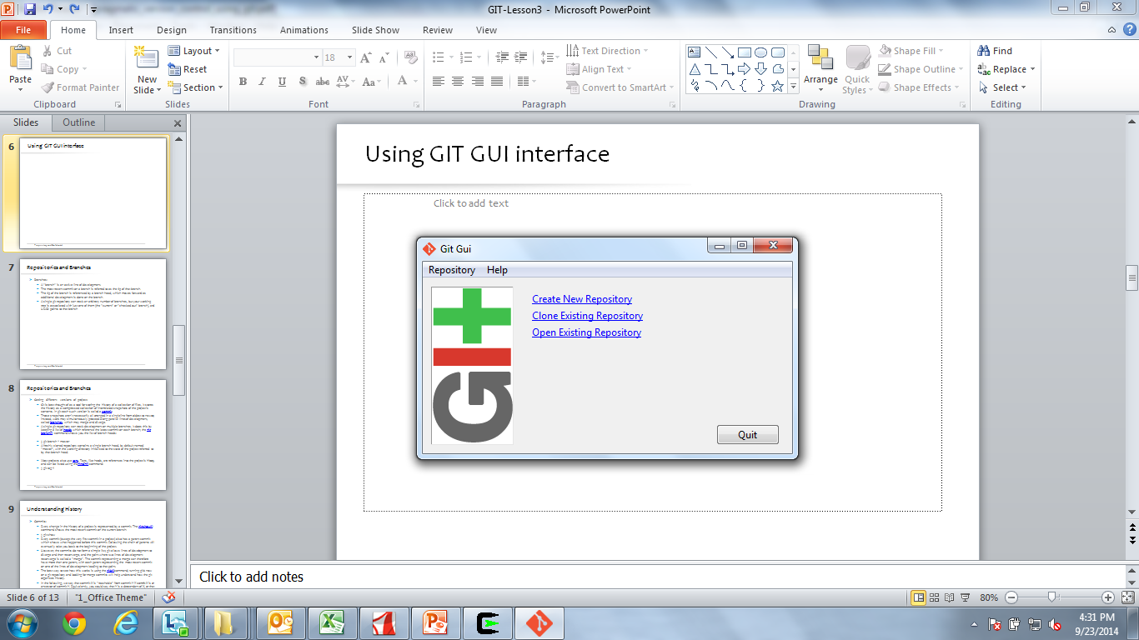
Using GIT GUI interface

Slide 7

Creating GIT project using UI
Demo: with UI

Slide 8
Creating GIT project using Command prompt
Demo: with command prompt

Slide 9
Working with GIT
# switch to home cd ~/ # create a directory and switch into it
mkdir ~/repo01
cd repo01 # create a new directory mkdir datafiles
# Initialize the Git repository# for the current directory
git init
# switch to your new repository
cd ~/repo01 # create another directory # and create a few files
mkdir datafiles
touch test01
touch test02
touch test03
touch datafiles/data.txt
# Put a little text into the first file
ls >test01
# add all files to the index of the # Git repository
git add .

Slide 10
Working with GIT
# commit your file to the local repository
git commit -m "Initial commit"
# show the Git log for the change
git log
# Create a file and commit it
touch nonsense2.txt git add . && git commit -m "more nonsense"
# remove the file via
Git git rm nonsense2.txt
# commit the removal
git commit -m "Removes nonsense2.txt file"
# Create a file and put it under version control
touch nonsense.txt git add . && git commit -m "a new file has been created"
# Remove the file
rm nonsense.txt
# Try standard way of committing -> will NOT work
git add . && git commit -m "a new file has been created"

Slide 11
Working with GIT
# commit the remove with the -a flag
git commit -a -m "File nonsense.txt is now removed"
# alternatively you could add deleted files to the staging index via
# git add -A .
# git commit -m "File nonsense.txt is now removed"
# create a file and add to index
touch unwantedstaged.txt
git add unwantedstaged.txt
# remove it from the index
git reset unwantedstaged.txt
# to cleanup, delete it
rm unwantedstaged.txt
# assume you have something to commit
git commit -m "message with a tpyo here"
git commit --amend -m "More changes - now correct"

Slide 12
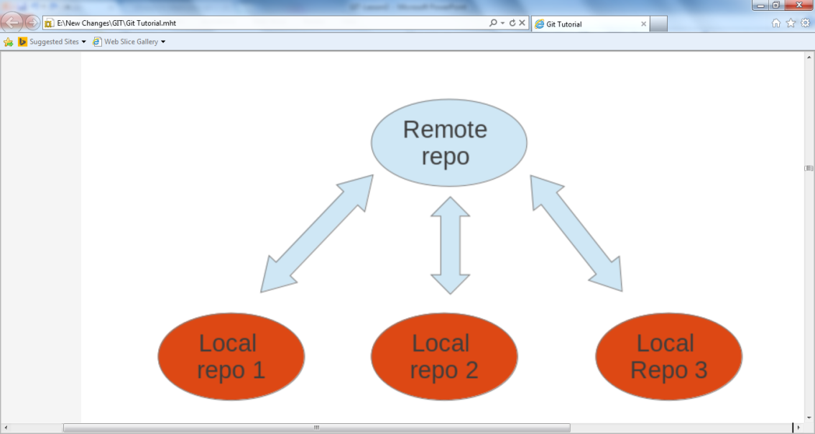
Working with GIT – Remote repositories
Remote repositories are repositories that are hosted on the Internet or network. Such remote repositories can be use to synchronize the changes of several Git repositories. A local Git repository can be connected to multiple remote repositories and you can synchronize your local repository with them via Git operations.
I is possible that users connect their individual repositories directly, but a typically Git workflow involve one or more remote repositories which are used to synchronize the individual repositories.

Slide 13
Working with GIT – Remote repositories
# create a bare repository
git init --bare
# switch to the first repository
cd ~/repo01
# create a new bare repository by cloning the first one
git clone --bare ../remote-repository.git
# check the content, it is identical to the .git directory in repo01
ls ~/remote-repository.git
# Add ../remote-repository.git with the name origin
git remote add origin ../remote-repository.git
# do some changes
echo "I added a remote repo" > test02
# commit
git commit -a -m "This is a test for the new remote origin"
# to push use the command:
# git push [target]
# default for [target] is origin
git push origin
Notes:
You can always connect to a remote repository if you know its URL and if you have access to it. If you clone (copy) a repository from another repository, a connection to this original repository is automatically created under the name origin. You can use this name to get and retrieve data from the remote repository.

Slide 14
Working with GIT – Remote repositories
# show the details of the remote repo called origin
git remote show origin
# show the existing defined remote repositories
git remote
# show details about the remote repos
git remote -v
# Switch to home cd ~ # Make new directory
mkdir repo02
# Switch to new directory cd ~/repo02 # Clone
git clone ../remote-repository.git .
# Make some changes in the first repository cd ~/repo01
# Make some changes in the file
echo "Hello, hello. Turn your radio on" > test01
echo "Bye, bye. Turn your radio off" > test02
# Commit the changes, -a will commit changes for modified files # but will not add automatically new files
git commit -a -m "Some changes"
# Push the changes
git push ../remote-repository.git

Slide 15
Working with GIT – Remote repositories
# switch to second directory
cd ~/repo02
# pull in the latest changes of your remote repository
git pull
# make changes
echo "A change" > test01
# commit the changes
git commit -a -m "A change"
# push changes to remote repository
# origin is automatically created as we cloned original from this repository
git push origin
# switch to the first repository and pull in the changes
cd ~/repo01
git pull ../remote-repository.git/
# check the changes
git status
Notes:
Cloning remote repositories
Git support remote operations with other Git repositories. For communication with these repositories Git supports several transport types; the native protocol for Git is also called git.
The following will clone an existing repository via the Git protocol.
# switch to a new directory mkdir ~/online cd ~/online # clone online repository git clone git@github.com:vogella/gitbook.git
Alternatively you could clone the same repository via the http protocol.
# The following will clone via HTTP git clone http://vogella@github.com/vogella/gitbook.git
Remote operations via http and a proxy
It is possible to use the HTTP protocol to clone Git repositories. This is especially helpful, if your firewall blocks everything except http.
Git also provides support for http access via a proxy server. The following Git command could, for example, clone a repository via http and a proxy. You can either set the proxy variable in general for all applications or set it only for Git.
This example uses environment variables.
# Linux export http_proxy=http://proxy:8080 # On Windows # Set http_proxy=http://proxy:8080 git clone http://dev.eclipse.org/git/org.eclipse.jface/org.eclipse.jface.snippets.git # Push back to the origin using http git push origin
This example uses the Git config settings.
// Set proxy for git globally git config --global http.proxy http://proxy:8080 // To check the proxy settings git config --get http.proxy // Just in case you need to you can also revoke the proxy settings git config --global --unset http.proxy

Slide 16

Summary
Discussed how to work with Local and Remote repositories
Notes:
Add the notes here.
Add instructor notes here.

