Slide 1
REAL-TIME FINANCIAL NEWS & MARKET STREAMING PIPELINE
Connecting Financial News Sentiment with Stock Market Movements
TECHNOLOGY STACK
Python
Apache Kafka
PySpark
FinBERT
Delta Lake
PostgreSQL
Streamlit
Team Project Presentation
Team Members: Member 1 | Member 2 | Member 3 | Member 4

Slide 2




Project Overview
BACKGROUND
OBJECTIVE
Financial news and stock market prices are generated continuously from different sources. Analyzing these datasets independently makes it difficult to understand how financial news and market sentiment relate to stock-price movements.
To develop a streaming data pipeline that collects financial news and stock market data, processes them through dedicated data layers, and combines news sentiment with stock-price observations for financial analysis.
KEY OBJECTIVES
1
Collect financial news for 13 Indian companies using Google News.
2
Ingest stock market data for the same 13 companies through a market data API.
3
Process and enrich news using company ticker extraction and FinBERT.
4
Validate and structure stock-price observations.
5
Aggregate news sentiment and stock-price movements.
6
Present the resulting insights through an interactive dashboard.
EXPECTED OUTCOME
A unified financial analytics platform that helps visualize the relationship between company-related news, sentiment and market-price movements.

Slide 3
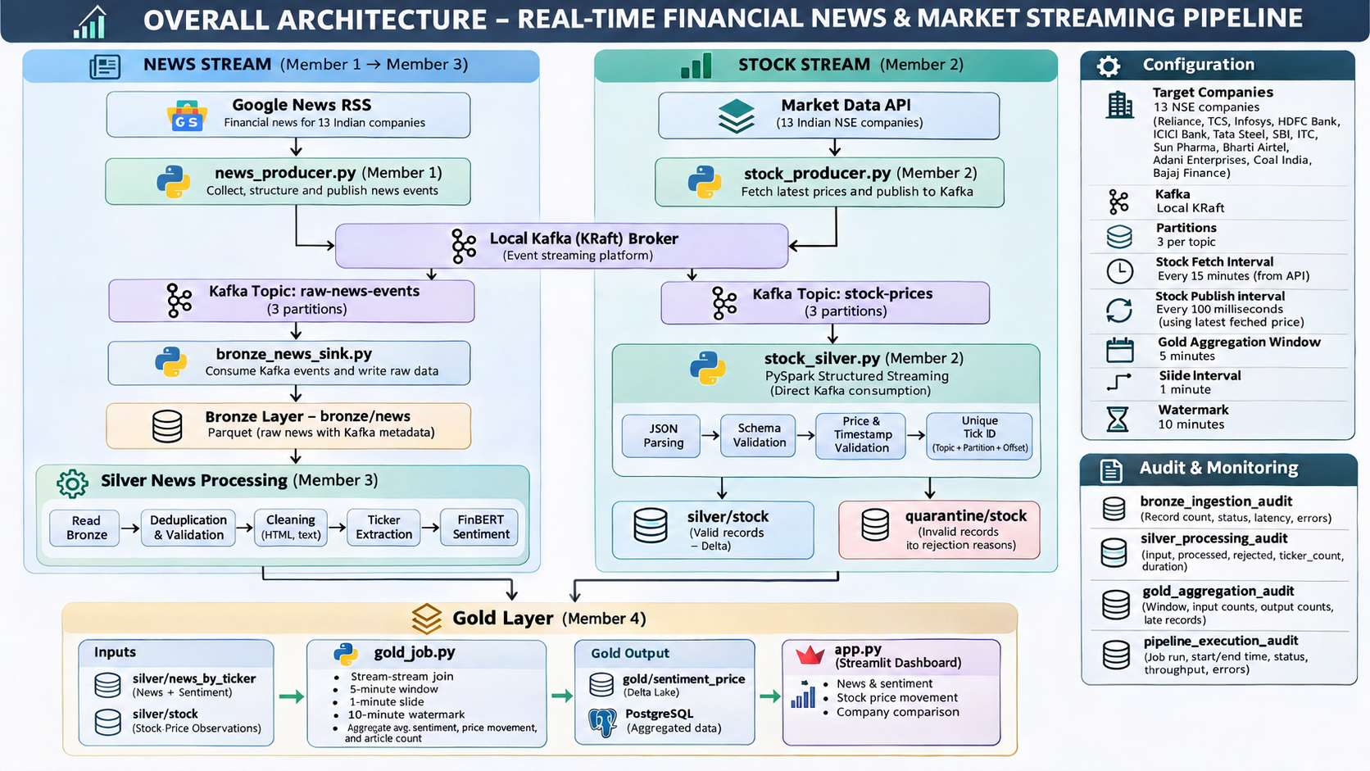

Overall Architecture – Real-Time Financial News & Market Streaming Pipeline
Two independent ingestion streams are processed through their respective pipelines and combined in the Gold layer to generate financial insights.

Slide 4
Project Organization – Four Implementation Phases
1
PHASE 1
2
PHASE 2
FINANCIAL NEWS INGESTION
STOCK DATA INGESTION
Responsible: Member 1
Responsible: Member 2
Collect financial news from Google News RSS, structure incoming articles, publish events to Kafka and store raw news records in the Bronze layer.
Fetch market prices for 13 Indian companies through the configured API, publish stock observations to Kafka and process them directly into the Silver layer using PySpark Structured Streaming.
3
PHASE 3
4
PHASE 4
SILVER NEWS PROCESSING
GOLD AGGREGATION & DASHBOARD
Responsible: Member 3
Responsible: Member 4 + Member 2
Process Bronze news files through deduplication, validation, text cleaning, company ticker extraction and FinBERT sentiment analysis to generate structured Silver datasets.
Combine Silver news and stock data through stream-stream aggregation, generate Gold analytics and prepare the results for PostgreSQL and Streamlit dashboard visualization.

Slide 5
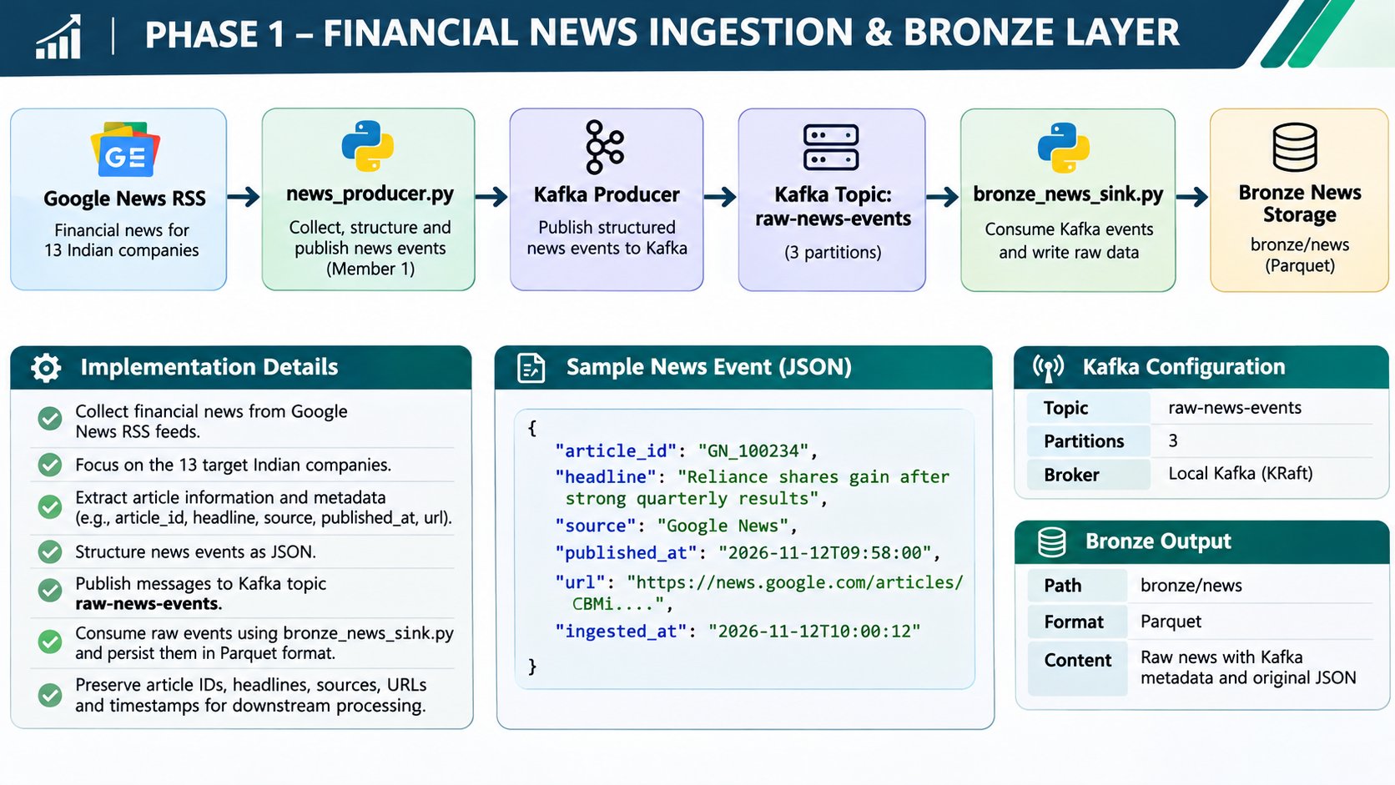
Phase 1 – Financial News Ingestion & Bronze Layer
PHASE 1
IMPLEMENTATION HIGHLIGHTS
Google News RSS is used to collect company-related financial news.
News is collected for the 13 target Indian companies.
“news_producer.py” structures collected articles into JSON events.
Kafka transports the news events through the “raw-news-events” topic.
The Kafka topic is configured with three partitions.
“bronze_news_sink.py” consumes the events and persists raw records in Parquet format.
Article metadata is preserved for downstream processing.
OUTPUT
PURPOSE
bronze/news
Provides raw financial news records with original article information and Kafka metadata for downstream Silver processing.
Format: Parquet

Slide 6
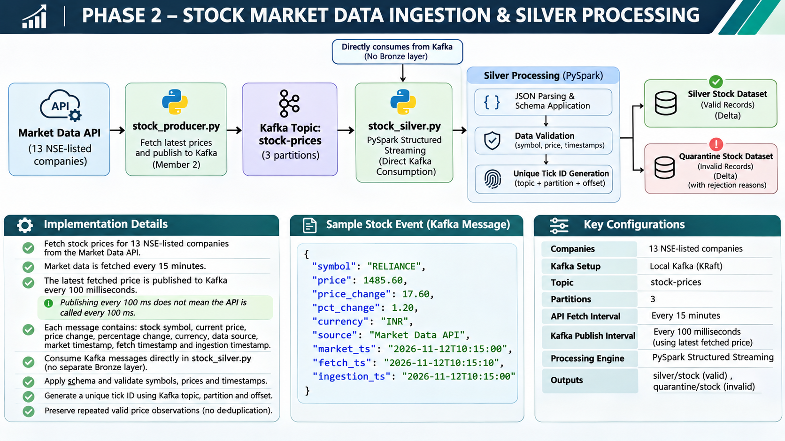
Phase 2 – Stock Market Data Ingestion & Silver Processing
PHASE 2
IMPLEMENTATION HIGHLIGHTS
Prices are fetched for 13 Indian NSE-listed companies through the configured market data API.
“stock_producer.py” publishes stock observations to the “stock-prices” Kafka topic.
The Kafka topic is configured with three partitions.
The latest fetched price is published every 100 milliseconds.
“stock_silver.py” directly consumes Kafka messages using PySpark Structured Streaming.
Incoming JSON records are parsed and validated against the defined schema.
Unique tick IDs are generated using Kafka topic, partition and offset.
Valid and invalid records are separated into Silver and quarantine outputs.
Repeated valid price observations are preserved.
IMPORTANT CONFIGURATION
IMPORTANT CLARIFICATION
OUTPUTS
API fetch interval: 15 minutes.
Kafka publishing interval: 100 milliseconds using the latest fetched price.
Publishing every 100 milliseconds does not mean that the market data API is called every 100 milliseconds. New market data is fetched every 15 minutes.
Valid records:
silver/stock
Invalid records:
quarantine/stock

Slide 7
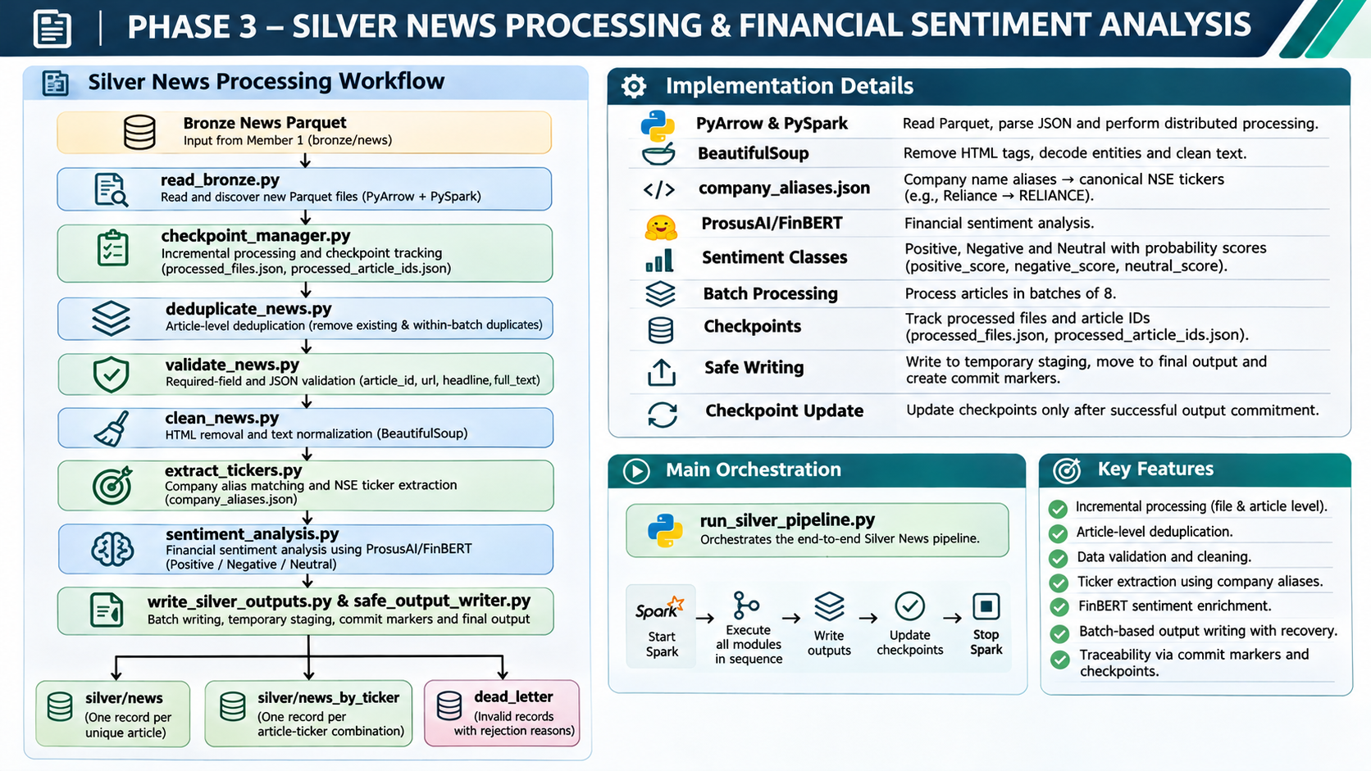
Phase 3 – Silver News Processing & Sentiment Analysis
PHASE 3
IMPLEMENTATION HIGHLIGHTS
Reads Bronze News Parquet files produced by Member 1.
Uses incremental processing and checkpoint tracking to avoid unnecessary reprocessing.
Performs article-level deduplication.
Validates required fields and JSON parsing.
Cleans HTML tags and normalizes news text using BeautifulSoup.
Extracts company tickers through alias-based matching.
Applies ProsusAI FinBERT to classify financial news sentiment.
Generates article-level and article-ticker-level datasets.
Stores rejected records separately with their rejection reasons.
ACTUAL TEST RESULTS
FINAL OUTPUTS · FORMAT: PARQUET
14
16
14
0
silver/news
silver/news_by_ticker
dead_letter
Bronze articles processed
Article-ticker mappings
Valid articles
Rejected records
Incremental processing was also tested through a second run, which correctly skipped the previously processed files without generating duplicate outputs.

Slide 8
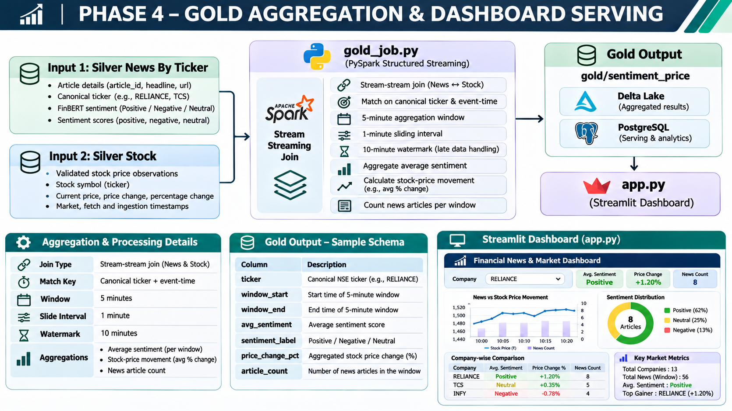
Phase 4 – Gold Aggregation & Dashboard Serving
PHASE 4
IMPLEMENTATION HIGHLIGHTS
Uses Silver News By Ticker and Silver Stock as input datasets.
Combines news and market observations through a stream-stream join.
Matches records using canonical ticker symbols and event-time information.
Applies window-based aggregation to analyze market activity.
Calculates average news sentiment and stock-price movement.
Counts relevant news articles within each aggregation window.
Stores aggregated results in Delta Lake and PostgreSQL.
Makes the results available for dashboard visualization.
STREAMING CONFIGURATION
DASHBOARD FEATURES · PROTOTYPE
Aggregation Window | 5 minutes
Sliding Interval | 1 minute
Watermark | 10 minutes
OUTPUT
Company selection
Key market metrics
gold/sentiment_price
News vs stock-price movement
Storage: Delta Lake + PostgreSQL
Sentiment distribution
Company-wise comparison

Slide 9
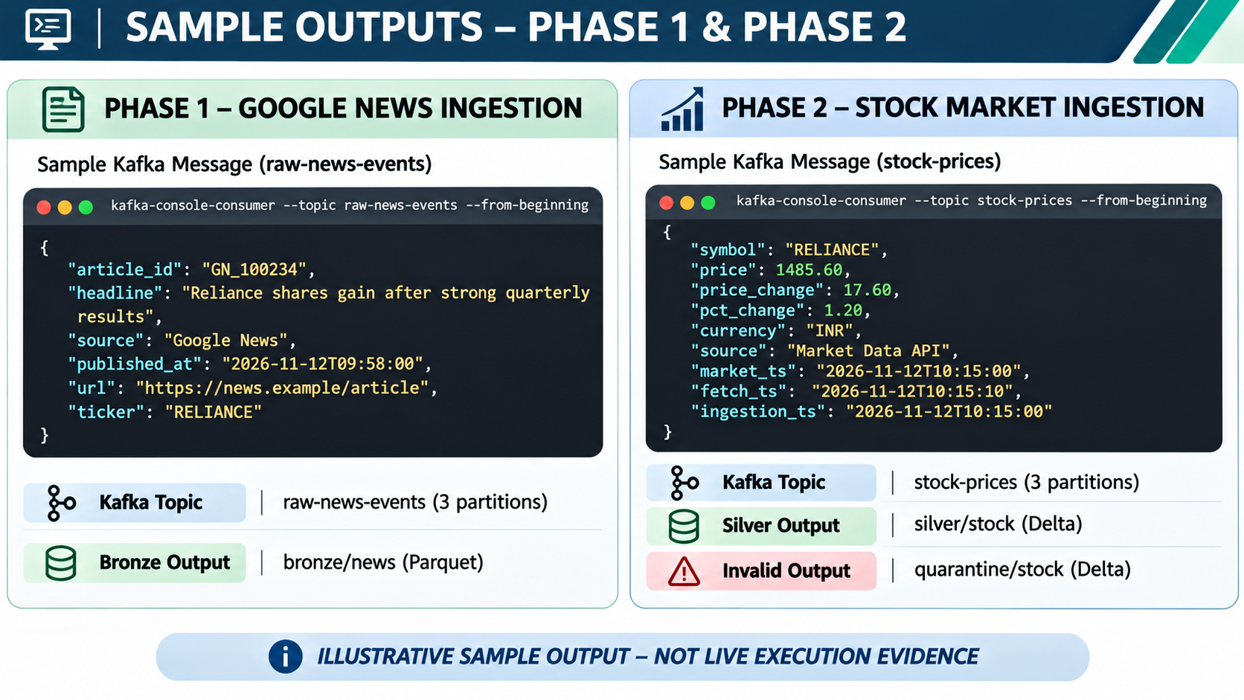

Sample Outputs – News & Stock Ingestion
PHASE 1
Structured Google News article events are published to Kafka and persisted in Bronze storage.
PHASE 2
Stock market observations are published to Kafka and processed into valid Silver and quarantine datasets.
KEY INFORMATION CAPTURED
Article identifiers, headlines, sources and publication timestamps.
Stock symbols, prices, price changes and percentage changes.
Market, fetch and ingestion timestamps.
Kafka topic and storage information.
Illustrative sample outputs for demonstration, not live execution evidence.

Slide 10
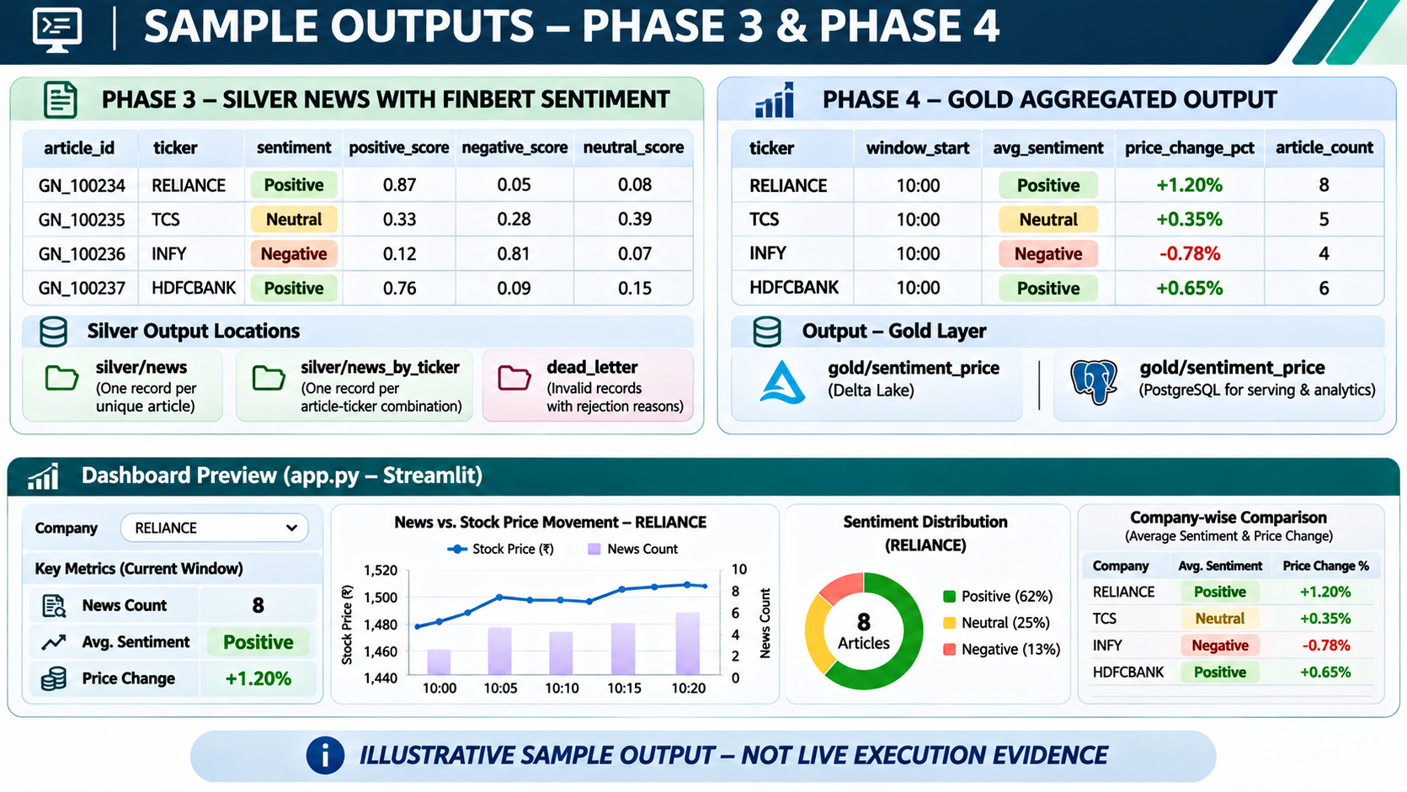
Sample Outputs – Silver Processing & Gold Aggregation
PHASE 3
Cleaned and ticker-mapped news articles are enriched with FinBERT sentiment classifications and probability scores.
PHASE 4
Aggregated sentiment and stock-price movement are calculated for each company within the configured time window.
KEY INFORMATION CAPTURED
Company ticker and article ID.
Positive, negative and neutral sentiment scores.
Average sentiment per aggregation window.
Stock-price percentage movement.
Number of news articles associated with each company.
Illustrative sample outputs for demonstration, not live execution evidence.
FINAL OUTCOME
Structured financial insights prepared for dashboard visualization.

Slide 11



Project Progress – Completed vs Pending
COMPLETED
PENDING
News ingestion and Kafka publishing.
End-to-end integration of all pipeline components.
Bronze news data storage.
Connect the live Gold output to the Streamlit dashboard (current dashboard prototype uses dummy data).
Stock data ingestion and Kafka integration.
Stock Silver streaming and validation.
Validate the complete integrated pipeline.
Silver News processing and FinBERT sentiment analysis.
Verify dashboard analytics using actual pipeline data.
Individual phase development and testing.
NEXT MILESTONE
Complete end-to-end integration and demonstrate the relationship between financial news sentiment and stock-price movements using actual pipeline outputs.

