Slide 1

Vidyalaya: AI – Powered Telugu Language Learning Platform
Course Name: Natural Language Processing
Course Code: 22AIE315
Faculty – Ms. Priyanka Vivek
Team (2) members:
Anusha C Reddy – BL.EN.U4AIE22004
M Hemasri - BL.EN.U4AIE22028

Slide 2
Introduction
Language learning is crucial for global communication, education, and cultural exchange.
Digital education demands personalized, interactive AI-driven language learning tools.
AI/NLP transforms language education through real-time understanding and feedback.
Key technologies:
Speech recognition (e.g., pronunciation analysis).
Grammar correction (e.g., contextual error detection).
Conversational AI (e.g., interactive practice).
Transformer-based LLMs enable zero/few-shot learning, ideal for low-resource languages.
Benefits: Accuracy, scalability, and inclusivity in multilingual education.
Notes:
🌍 Language learning is a fundamental aspect of education and global communication, enabling access to knowledge, culture, and opportunities across linguistic boundaries.
🧠 With the rise of digital education and e-learning, there is an increasing demand for intelligent systems that offer personalized, interactive, and context-aware language learning experiences.
🤖 Artificial Intelligence (AI) and Natural Language Processing (NLP) have revolutionized language education by enabling machines to understand, generate, and evaluate human language in real time.
🎙️ Techniques such as speech recognition, grammar correction, machine translation, and conversational AI have become integral in enhancing both spoken and written language proficiency.
🏆 Advanced NLP models, including transformer-based LLMs, support zero-shot and few-shot learning, making it possible to teach and evaluate languages even in low-resource settings with minimal data.
📈 The integration of AI in language learning not only improves accuracy and adaptability but also enables scalable, multilingual education systems that bridge gaps in linguistic accessibility and inclusion.

Slide 3
Problem statement
There is a lack of AI-powered tools for learning Telugu.
A low-resource and morphologically rich language.
Existing platforms don’t provide real-time grammar and pronunciation feedback, making learning less effective.
Current Telugu learning tools are often non-interactive and not tailored to individual progress.
There's a research gap in applying NLP and speech technologies for Telugu language education.
Our project aims to build a user-friendly AI-tutored platform.
Offers interactive grammar & pronunciation analysis with personalized feedback to enhance learning.

Slide 4
Summary of Literature
Transformer-based ASR models (e.g., hybrid MLP-LSTM) achieve ~98% accuracy for English, with 55.7% error reduction in fluency detection.
DPCSpell (Telugu/Bangla): 94.78% accuracy; lacks open corpora.
AraSpell (Arabic): 1.11% CER; struggles with dialects.
Malayalam typo correction: 91.26% accuracy; limited by data scarcity.
Telugu STT parser works for basic sentences but fails on dialects.
Code-switched parsing (Telugu-English) has 56% POS accuracy due to romanization issues.
Code-Switching & Multilingual ASR: Q-learning-enhanced transformer achieves WER 0.28 but faces accent variability. Universal Challenge: Limited annotated datasets for low-resource languages and code-mixed speech.
Notes:
1. Advances in ASR & Language Learning
✅ Transformer-based ASR models (e.g., hybrid MLP-LSTM) achieve ~98% accuracy for English, with 55.7% error reduction in fluency detection. ✅ Real-time feedback tools (e.g., ELSA) significantly improve pronunciation but need curriculum integration. ⚠ Gaps: Dialogue handling, multilingual support, and long-term efficacy studies.
2. Low-Resource Language Challenges
🌍 Spelling/Grammar Tools:
DPCSpell (Telugu/Bangla): 94.78% accuracy; lacks open corpora.
AraSpell (Arabic): 1.11% CER; struggles with dialects.
Malayalam typo correction: 91.26% accuracy; limited by data scarcity.
🗣 Speech & Parsing:
Telugu STT parser works for basic sentences but fails on dialects.
Code-switched parsing (Telugu-English) has 56% POS accuracy due to romanization issues.
3. Code-Switching & Multilingual ASR
🔀 Hindi-Marathi ASR: Q-learning-enhanced transformer achieves WER 0.28 but faces accent variability. 📉 Universal Challenge: Limited annotated datasets for low-resource languages and code-mixed speech.
4. Future Directions
🚀 Priority Areas:
Lightweight models for multilingual ASR.
Hybrid methods (e.g., rules + ML) for code-switching.
Synthetic data generation to address data scarcity.
Why This Matters
🔹 High-resource languages (English) dominate; Telugu, Arabic, etc., need more focus. 🔹 Real-world impact: Tools like ELSA and DPCSpell show promise but require scaling and adaptation.
Slide Suggestion: Use icons (✅, ⚠, 🌍) and bold highlights for visual appeal!

Slide 5
Research Gap
Bias Toward High-Resource Languages
Lack of Nuanced Support for Telugu
Absence of Bilingual Feedback Mechanisms
Underutilization of Speech Technologies
Scalability in Few-Shot/Low-Resource Settings
Integration Gaps in Multimodal Learning
Preservation of Linguistic Diversity

Slide 6
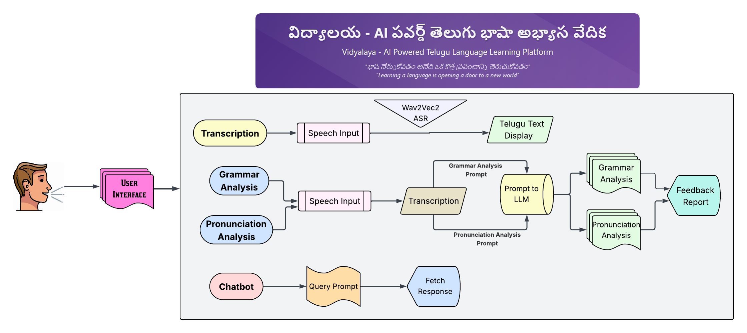
Proposed Methodology
Architecture Diagram

Slide 7
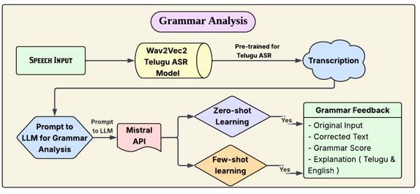
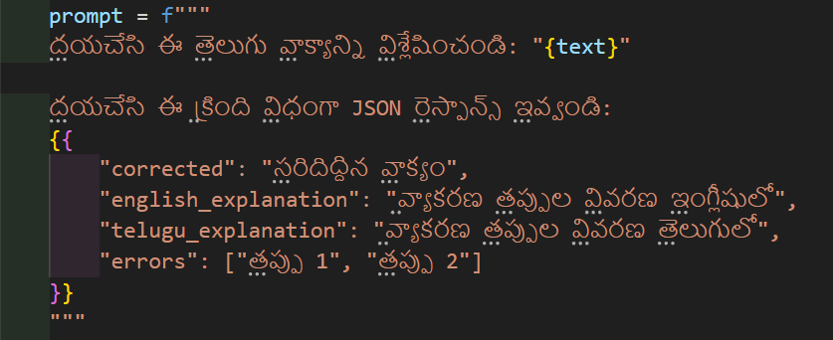
Proposed Methodology
Zero-shot prompt Explanation:
• ”Please analyze this Telugu sentence: ’[User’s sentence]’
• Respond in the following JSON format, including:
• The corrected sentence
• Explanation of grammar mistakes in English
• Explanation of grammar mistakes in Telugu
• A list of the identified grammar errors”

Slide 8
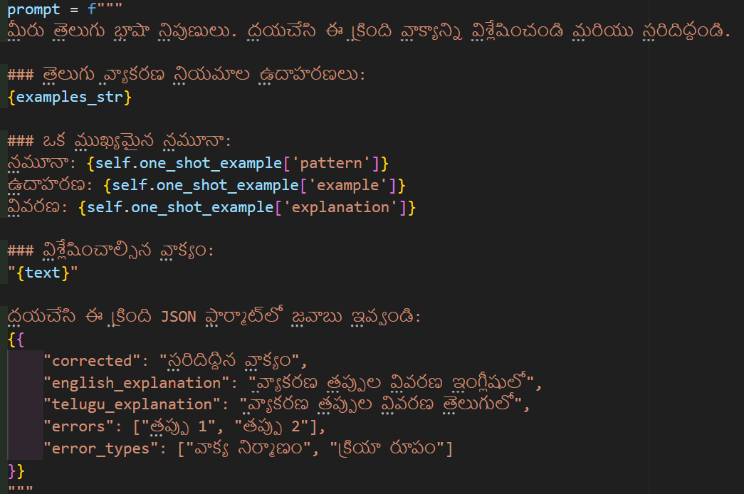
Proposed Methodology
Few-shot Prompt Explanation:
• Meaning in English: ”You are an expert in the Telugu language. Please analyze the following sentence and correct it.
• A key pattern example: Pattern: [grammar rule] Example: [sample sentence] Explanation: [explanation of the correction]
• Sentence to be analyzed: ’[User’s Telugu sentence]’Please respond in the following JSON format, including the corrected sentence, explanations in both English and Telugu, a list of grammar errors, and their corresponding error types (e.g., sentence structure, verb form, etc.).”

Slide 9
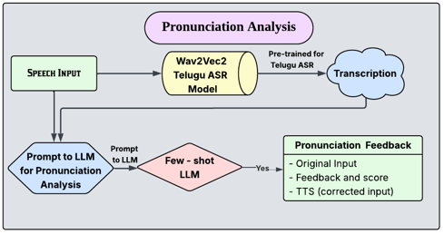
Proposed Methodology

Slide 10
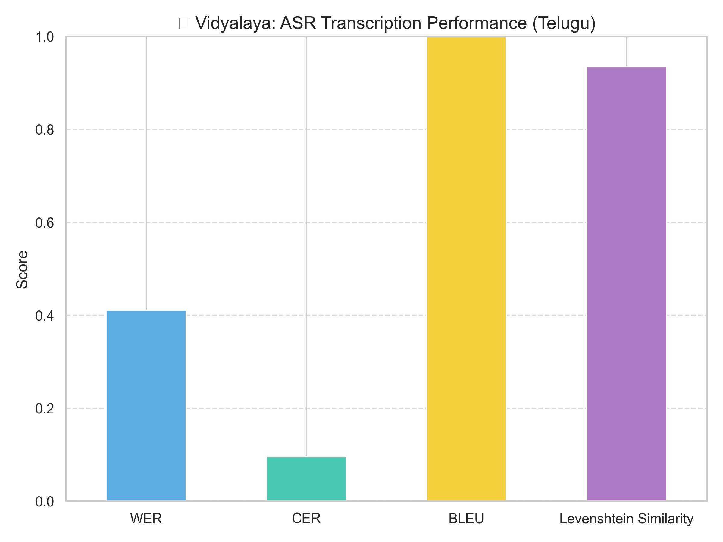
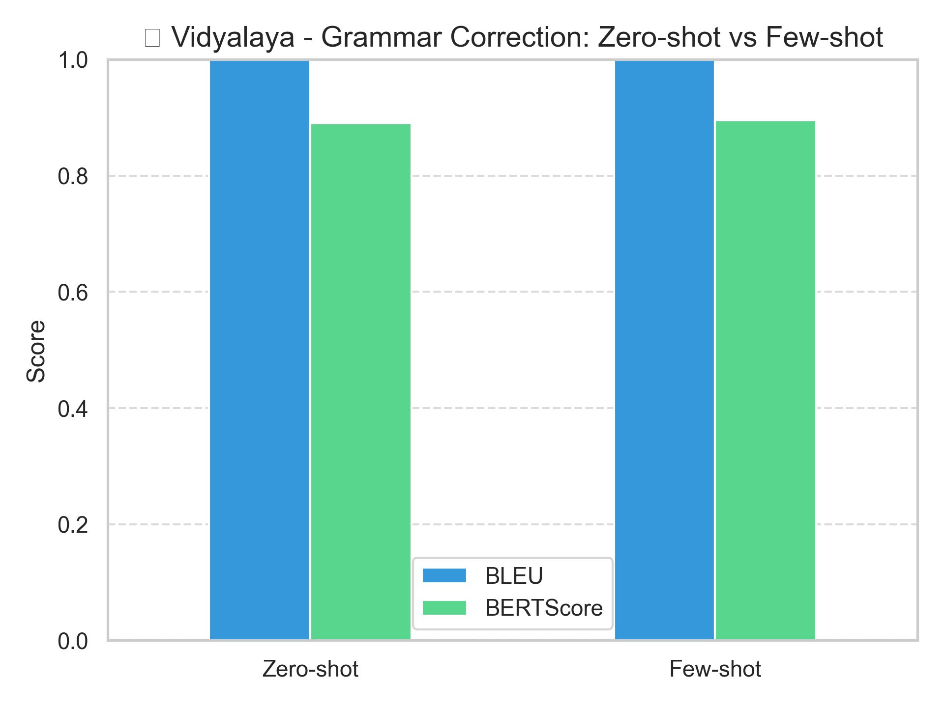
Results and Analysis
1. Speech-to-Text (ASR) Performance
Wav2Vec2-based ASR achieved:
Word Error Rate (WER): 0.45 (moderate, due to phonetic nuances in Telugu).
Character Error Rate (CER): 0.10 (highly accurate at character level).
BLEU Score: 1.0 (perfect semantic alignment despite minor structural errors).
Levenshtein Similarity: 0.90 (near-perfect transcription matches).
2. Grammar Correction Module
Zero-shot vs. Few-shot (Mistral API):
Both achieved BLEU = 1.0 (exact matches to references).
BERT Score: 0.90 (high semantic similarity).
Few-shot outperformed zero-shot in:
Restructuring complex sentences (e.g., verb tense/aspect corrections).
Handling context-dependent errors (e.g., idiomatic phrasing).

Slide 11
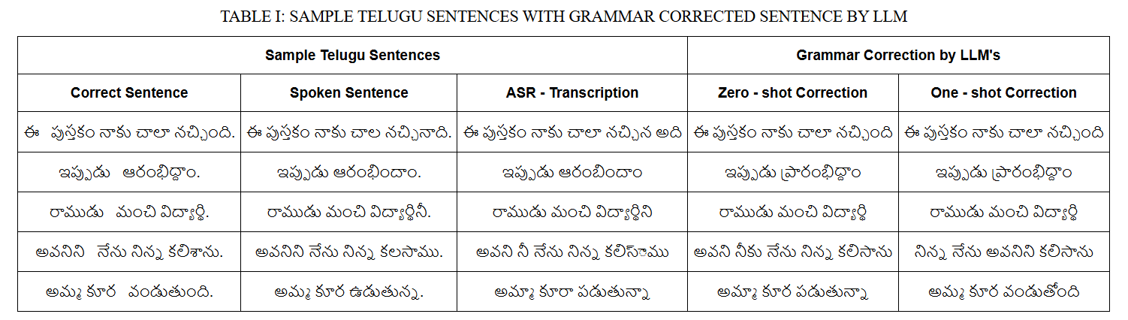
Results and Analysis

