Slide 1



ECOMMERCE PRODUCT CATEGORIZATION
by Hema Moravapalli

Slide 2

PROJECT OVERVIEW
In the rapidly evolving world of eCommerce, accurate product categorization is crucial for ensuring seamless customer experiences, reducing search friction, and increasing product discoverability. However, the sheer volume of diverse products poses a significant challenge. Current classification systems struggle to handle ambiguities, unconventional naming conventions, and multi-language data. This hackathon aims to address these challenges.
We need to develop a text classification model that categorizes products with maximum accuracy based on description of the product.
.

Slide 3

APPROACH TO THE PROJECT
Since we will be working with textual descriptions, this is an NLP Problem. Here are the steps involved
Load the dataset
Perform Exploratory Data Analysis to extract valuable business insights
Using NLTK for Data Pre-Processing and Feature Engineering.
Transform Textual Descriptions to numerical features using techniques like TF-IDF or Word2Vec.
Perform train-test split
Train and evaluate various suitable Machine Learning and Deep Learning models,
Fine Tune them if necessary using Hyperparameter Tuning
Get our predictions.
Finally, we will compare the various models to get the best performing model.

Slide 4

KEY INSIGHTS
The Online Platform’s highest selling product Category is Clothing followed by Jewellery.
The Online Platform has moderate sales in Categories such as Footwear, Automotive, Mobiles & Accessories, Home Decor & Festive Needs, Kitchen & Dinning, Computers.
The Online Platform’s least selling product Category is Bags, Wallets & Belts followed by Baby Care, Pens & Stationary, Toys & School Supplies, Tools & Hardware, Watches.

Slide 5

CLASS IMBALANCE HANDLING
Balancing the Data:
As we can see the target column has imbalanced data as the value counts of the categories are varying. So, balancing an imbalanced dataset can improve the performance of the machine learning models. Oversampling is one way to address the imbalance by increasing the representation of minority classes.
Here I used Random Oversampling technique to oversample the data. This involves duplicating rows from the minority classes to match the size of the majority class.

Slide 6

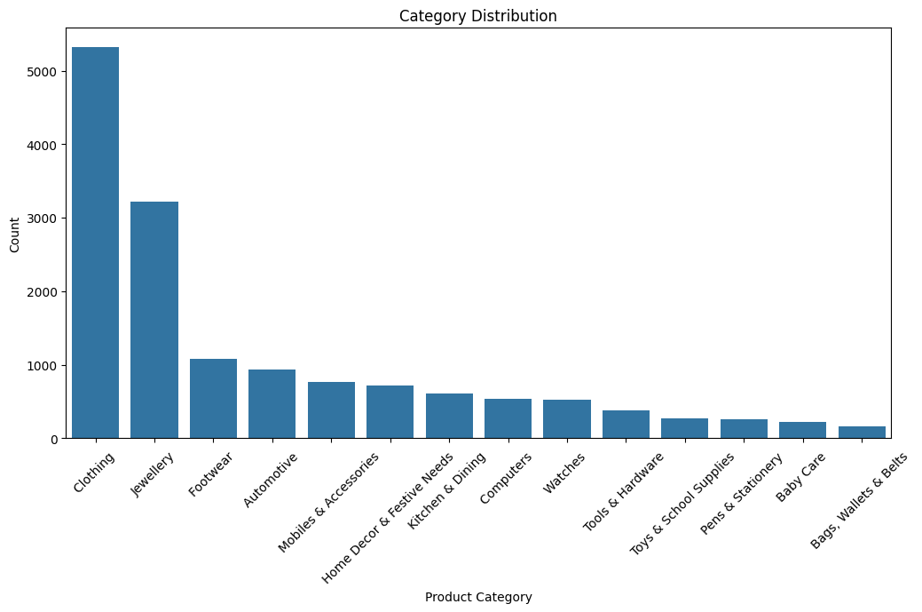
PRODUCT CATEGORY DISTRIBUTION

Slide 7
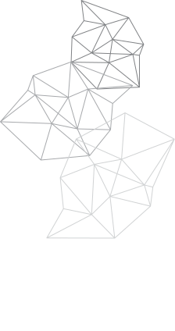
INSIGHTS
The Mean length of the product descriptions before data pre-processing is in the range of 50-125.
However, after pre-processing by
Removing Stopwords
Removing Punctuations
Non Alpha-numeric characters
Hashtags
Mentions
Links,
The Mean length of the product descriptions is 30 - 40 which helps to train the models in an efficient way. The company should make sure that their product descriptions and other data are to the point and clean for future analysis.

Slide 8
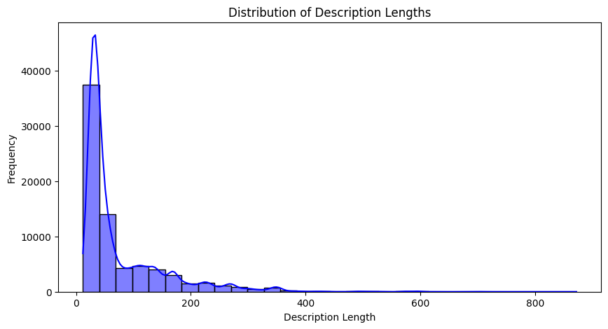
BEFORE PRE-PROCESSING

Slide 9
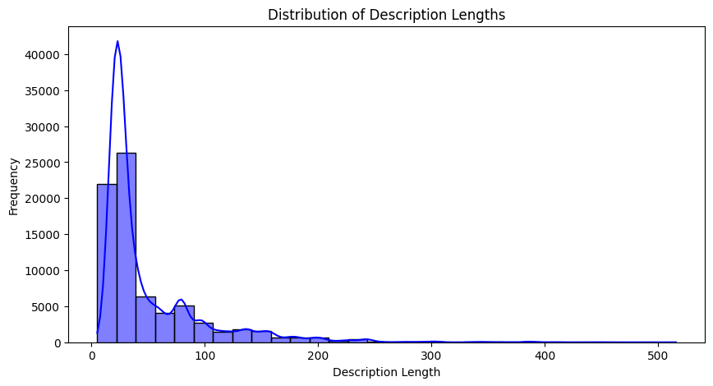
AFTER PRE-PROCESSING

Slide 10
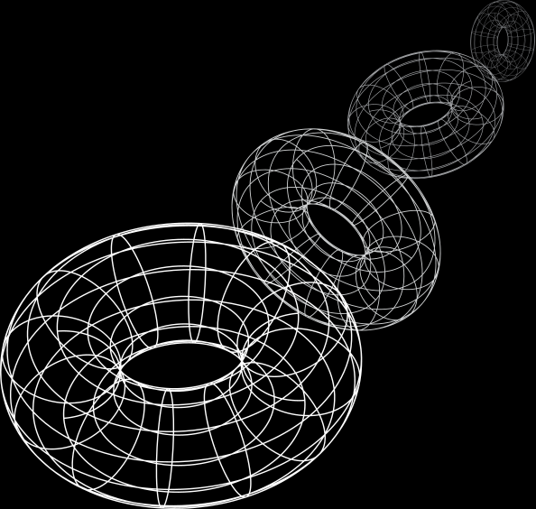
MODELS USED
I have used 6 models in this project namely
Logistic Regression
Random Forest
Support Vector Machines (SVM)
Naive Bayes
Gradient Boosting (e.g., XGBoost, LightGBM)
Deep Learning (e.g., Neural Networks with Keras/TensorFlow)
All of these models performed well but the SVC and LR models required Hyperparameter tuning to improve their performance slightly.
However RFC & LSTM performed brilliantly without requiring any Hyperparameter Tuning.

Slide 11
BUSINESS VALUE PROVIDED BY THIS SOLUTION:
The business value of using a multi-class text classification model for product categorization can be significant, especially in e-commerce or large retail environments. Here’s how it adds value across various aspects:
Improved Customer Experience
Enhanced Marketing and Analytics
Operational efficiency
Revenue growth
Competetive Advantage

Slide 12
IMPROVED CUSTOMER EXPERIENCE
Enhanced Search and Navigation: With accurate product categorization, customers can more easily find what they’re looking for, improving search relevancy and reducing the time spent browsing.
Personalized Recommendations: By categorizing products accurately, companies can tailor recommendations based on category similarities, improving customer satisfaction and increasing chances of conversion.

Slide 13
ENHANCED MARKETING AND ANALYTICS
Targeted Marketing Campaigns: Accurate categories help segment products, allowing marketing teams to target specific product categories for promotions or discounts, leading to higher engagement rates.
Detailed Sales Analytics: Categorization helps analyze product performance by category, providing insights into what categories drive sales, enabling more effective decision-making and inventory investment.

Slide 14
OPERATIONAL EFFICIENCY
Automated Product Management: Text classification reduces the time spent manually categorizing products, which can be labor-intensive and error-prone, especially in marketplaces with thousands or millions of items.
Inventory Organization: Clear categorization helps the inventory and supply chain teams organize, restock, and manage products efficiently, optimizing logistics and storage.

Slide 15
REVENUE GROWTH
Higher Conversion Rates: By making relevant products easier to find, customers are more likely to make purchases, positively impacting revenue.
Reduced Returns: Improved product discovery can reduce instances where customers buy incorrect items, reducing return rates and associated costs.

Slide 16
COMPETETIVE ADVANTAGE
Enhanced User Trust and Loyalty: A well-organized catalog improves customer perception of the brand and trust in the platform, encouraging repeat purchases and customer loyalty.
Adaptability to Market Trends: Automated categorization keeps the platform agile, allowing for faster adaptation to trends, new product lines, or seasonal items, giving the business a competitive edge.

Slide 17
THANK YOU

