Slide 1
Personality prediction system Through CV Analysis

Slide 2

Main Objective
Our system can used in many business sectors that may require expert candidate.
This system will reduce workload of the human resources.
This system will help the human resource to select right candidate for desired job profile, which in turn provide expert workforce for the organization. Admin can easily shortlist/select the appropriate candidate for particular job profile.
This will enable a more effective way to short list submitted candidate CVs from a large number of applicants providing a consistent and fair CV ranking policy, which can be legally justified.

Slide 3

Plan
Design
creating classes and interfaces
Identifying required attributes and methods.
creating Layers:
Making independent and modular approach
TDD approach:
Identifying Test Cases for each module
preparing fail and success cases as well.

Slide 4
Actors
Candidate-
Candidate can access the site and can apply for the job application. Candidate is required to fill the fields as well as profile summary. Candidate can view all jobs according to his/her interest can apply for a job.
Admin-
Admin will validate all the CV's and will provide an acknowledgemwnt to candidate whether applied Job meets according to the requirements or not.
“Our system helps to the HR unit to shortlist the candidate in more precise way and ensuring candidate meets the job requirement”

Slide 5
Tools Used:
Technology:
Spring boot,Angular 9
web Technologies:
HTML,CSS,Bootstrap
Database:
MYSQL

Slide 6
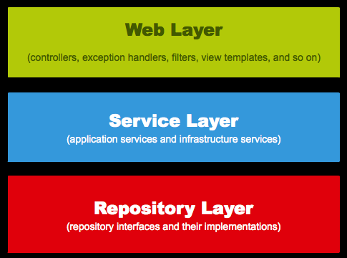
Architecture

Slide 7
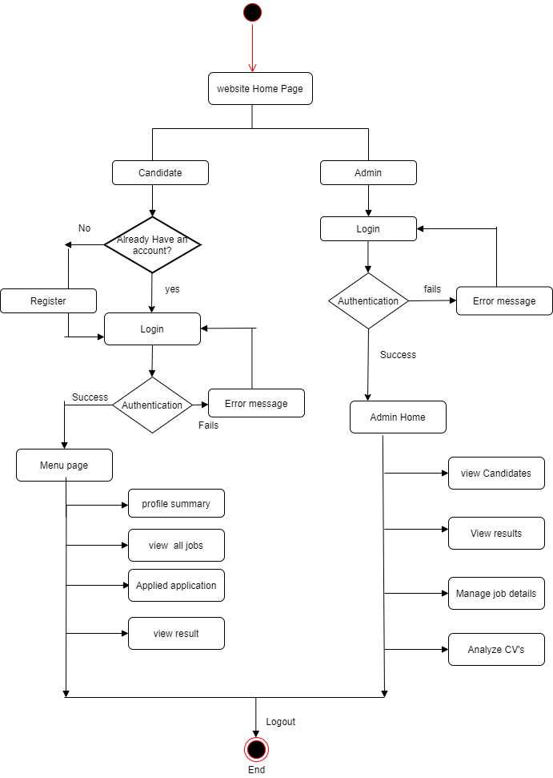
Main Flow of our system

Slide 8
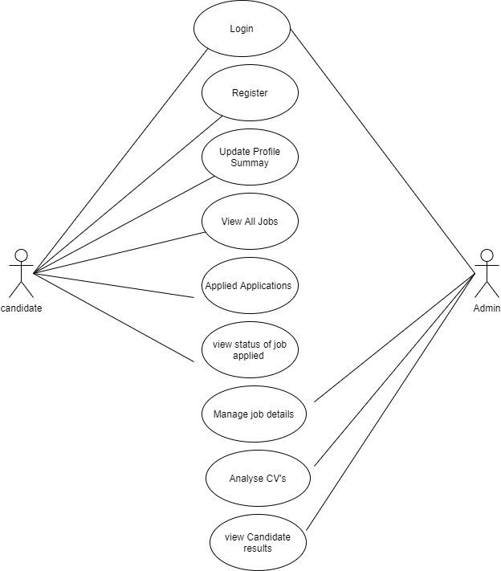
Use Case Diagram

Slide 9
Team Details:
Shraddha Padaye
Madhura Gondhalekar
Hema Mounika Garre
Anita Yadav
Annaporna
Harshit

