Slide 1

Predicting Current Asthma Prevalence (CASTHMA)

Slide 2
Project Objective
In this project we aim to develop predictive models for CASTHMA by utilizing health behavior metrics, preventive measures, demographic information, and geospatial data. By identifying key predictors and building accurate models, we seek to aid early detection efforts, support targeted interventions, and demonstrate the value of integrating health datasets with machine learning for public health forecasting.

Slide 3
Dataset Description
Source: PLACES Project (CDC) - Small area
health estimates.
Size: 240,886 rows, 22 columns.
Key Attributes:
Geographic: State Desc, Location Name, Geolocation.
Health Measures: Measures, Measure ID, Data Value.
Demographics: Total Population.
Target Variable: CASTHMA (Current Asthma Prevalence)
Data derived from:
Behavioral Risk Factor Surveillance System (BRFSS)
U.S. Census Bureau
American Community Survey

Slide 4
Data Preprocessing
Data cleaning and filtering
Removed rows where StateDesc = 'United States'
Kept only crude estimates (DataValueTypeID != 'AgeAdjPrv')
Dropped columns with >99% missing values.
Removed redundant metadata (e.g., Measure, CategoryID, Confidence Limits)
Geolocation Handling
Parsed Geolocation into separate Latitude and Longitude columns
Applied sine and cosine transformations to capture spatial patterns (lat_sin, lat_cos, lon_sin, lon_cos)
Pivot table and Feature Engineering
Pivoted health measures into columns (one row per geographic unit)
Imputed missing values with 0
Encoded state-wise mean CASTHMA prevalence (StateDesc_encoded)
Merged spatial and health features into final dataset

Slide 5
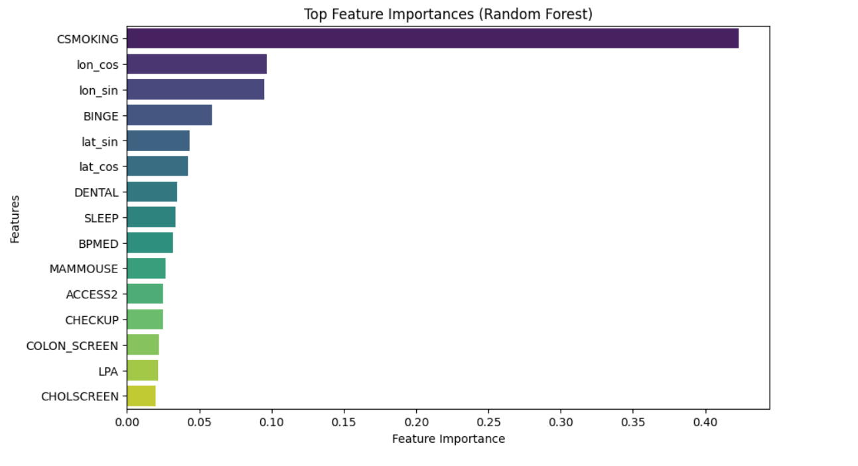
Feature Engineering & Feature Selection
Spatial Feature Engineering:
Encoded latitude and longitude using sine and cosine transformations (lat_sin, lat_cos, lon_sin, lon_cos).
Target Encoding:
Created StateDesc_encoded by encoding mean CASTHMA prevalence per state.
Feature Selection:
Focused on prevention, behavior measures, population, and spatial features.
Used Random Forest Regressor to compute feature importances.
Selected top 15 features using SelectFromModel.
Advantages:
Reduced overfitting risk.
Improved model interpretability and training efficiency.

Slide 6
Model Performance SUMmary
Model | Train R^2 | Test R^2 | Test MSE
SVR | 0.816140 | 0.788724 | 0.167920
Gradient Boosting Tuned | 0.807549 | 0.785188 | 0.001242
Ridge Regression | 0.795196 | 0.751685 | 0.001436
Linear Regression | 0.777802 | 0.744693 | 0.001476
Neural Network Tuned | -0.269391 | 0.016371 | 0.005687

Slide 7
Gaussian Process Regression (GPR) Summary
Goal: Predict asthma prevalence using behavioral and spatial features.
Approach: Spatial features (Latitude and Longitude) along with top behavioral features such as CSMOKING and BINGE were used as inputs. Both predictors (X) and the target variable (y) were scaled using MinMaxScaler to ensure numerical stability during model training.
Why GPR: Probabilistic, non-parametric.
Kernel Tuning: RandomizedSearchCV
Performance: Test R^2 (0.7397) , Test MSE (0.2231)
Highlights : The GPR model's predictions closely matched observed values, with 95% confidence intervals highlighting the model’s reliability. It effectively captured both large-scale patterns and local variations in the data.

Slide 8
Conclusion
Multiple regression models were applied to predict current asthma prevalence (CASTHMA) using health behavior, prevention, and geographic features from the CDC PLACES dataset.
Support Vector Regression (SVR) and Tuned Gradient Boosting achieved the highest Test R² (~0.79), showing strong predictive performance.
Gradient Boosting Regressor achieved the lowest Test MSE (0.0012), indicating the most precise predictions.
Ridge Regression and Linear Regression performed reasonably well, confirming the relevance of selected features and linear relationships.
The Neural Network (MLP) underperformed despite tuning, suggesting deep models may require larger or more complex datasets for this task.
Overall, tree-based ensemble methods (like Gradient Boosting) and kernel-based methods (like SVR) demonstrated the best generalization ability for predicting small-area health estimates.

Slide 9
References
Centers for Disease Control and Prevention (CDC) – PLACES Dataset https://www.cdc.gov/places/
Friedman, J., Hastie, T., Tibshirani, R. – The Elements of Statistical Learning (for Gradient Boosting concepts)
Rasmussen, C.E., Williams, C.K.I. – Gaussian Processes for Machine Learning (for GPR methodology)
Scikit-learn Documentation – Model Implementations and Tuning https://scikit-learn.org/stable/
Géron, A. – Hands-On Machine Learning with Scikit-Learn, Keras, and TensorFlow (for general model building and evaluation)

Slide 10
Thank you !!
Group 2
Hari Prasannaa Thangavel Ravi
Darsini Lakshmiah
Ayush Sudhir Meshram

