Slide 1



needed
View in Power BI
Last data refresh:
9/24/2025 3:12:08 PM UTC
Downloaded at:
9/24/2025 3:51:39 PM UTC

Slide 2
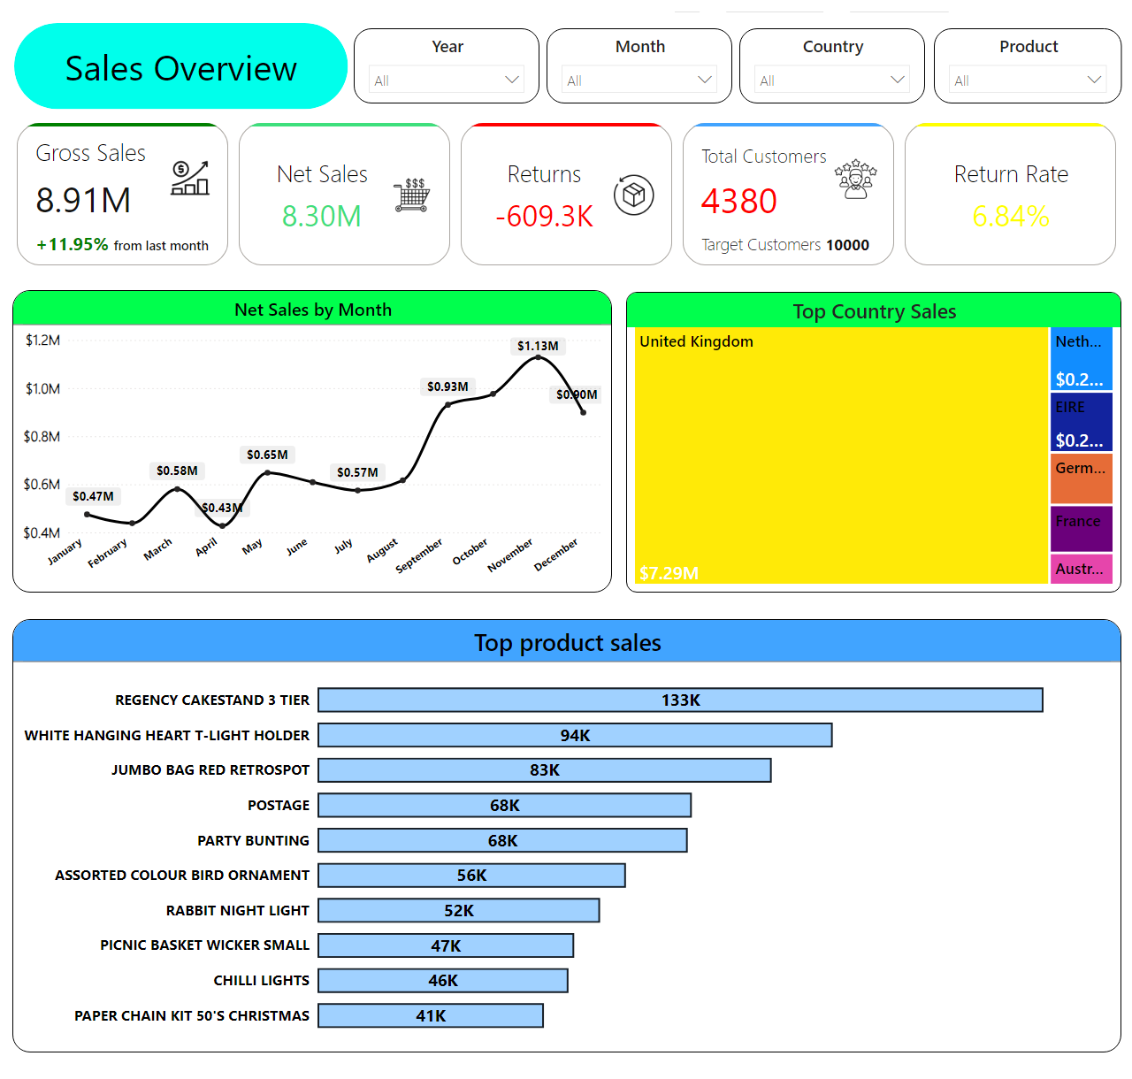
Overview
Notes:
lineChart
No alt text provided
Top product sales
No alt text provided
erwe
No alt text provided
Year
No alt text provided
Month
No alt text provided
Country
No alt text provided
Product
No alt text provided
Top Country Sales
No alt text provided
shape
No alt text provided

Slide 3
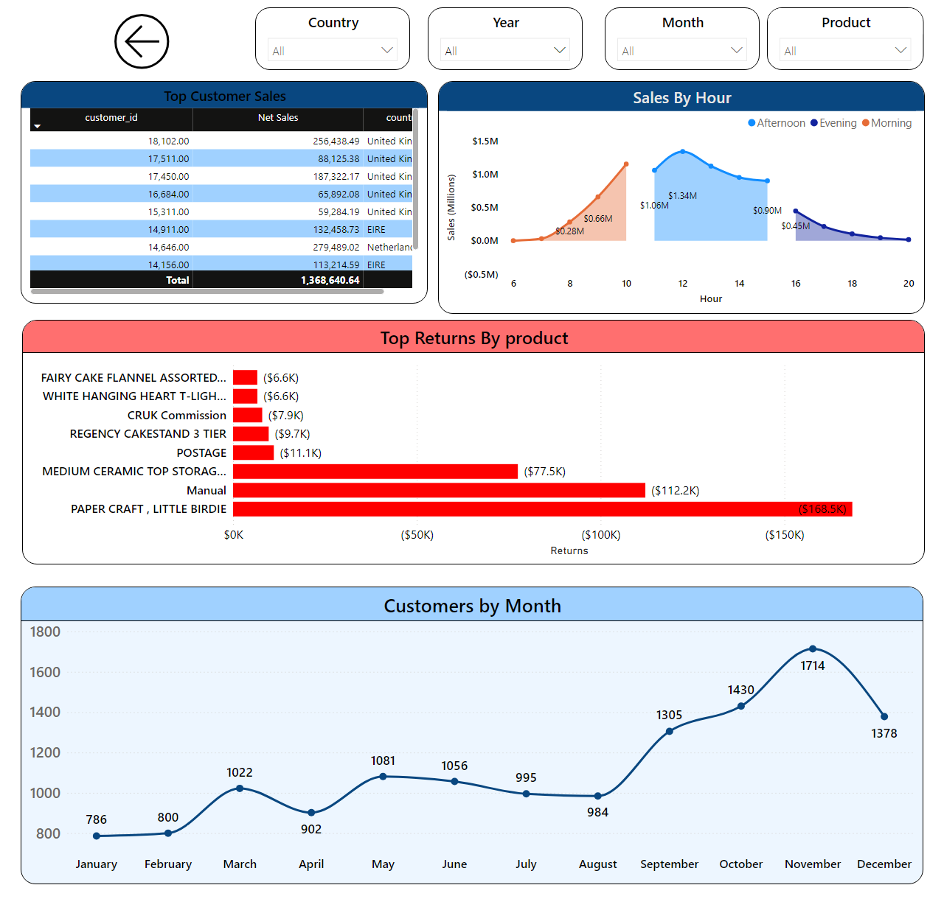
Sales
Notes:
Top Customer Sales
No alt text provided
Sales By Hour
No alt text provided
Top Returns By product
No alt text provided
Customers by Month
No alt text provided
Year
No alt text provided
Month
No alt text provided
Country
No alt text provided
Product
No alt text provided
csdsad
No alt text provided

