Slide 1
ReAl-Time Pothole Detection & Smart Road Monitoring Using Computer Vision and Deep Learning
CAPSTONE PROJECT
Presented By:
Student Name- HEMAVARSHINI M
College Name- RMD ENGINEERING COLLEGE
Department- ELECTRONICS AND COMMUNICATION ENGINEERING

Slide 2
OUTLINE
Problem Statement
Proposed System/Solution
System Development Approach
Algorithm & Deployment
Result
Conclusion
Future Scope
References

Slide 3
Problem Statement
Roads in both urban and rural areas deteriorate continuously due to traffic load, weather, and ageing infrastructure, resulting in potholes that pose serious safety hazards and damage vehicles.
Municipal authorities currently depend on manual inspection drives, citizen phone complaints, or periodic visual surveys to identify damaged road stretches. These methods are slow, inconsistent, and cover only a small fraction of the total road network at any given time. As a result, many potholes remain unreported for weeks, complaint records are not centralized, and there is no objective way to compare the condition of one road against another or prioritise repair budgets. Administrators therefore lack a real-time, data-driven view of road health across the area they manage.

Slide 4
Proposed Solution
Data Collection A dataset of 1,455 annotated road images was sourced from Roboflow Universe, containing potholes captured under varied conditions including daylight, night, rain, and snow, with YOLO-format bounding box labels.
Data Preprocessing Images and labels were validated for consistency, orphan annotations were removed, and the dataset was organised into train, validation, and test splits using Python, OpenCV, and the Ultralytics framework.
Model Selection YOLOv8 was selected over CNN, Faster R-CNN, and SSD architectures for its single-stage real-time detection speed, anchor-free design, and strong accuracy on small custom datasets through transfer learning.
Model Training A YOLOv8s model pretrained on COCO was fine-tuned for 50 epochs on the pothole dataset using a Tesla T4 GPU on Google Colab, with built-in augmentation including mosaic, flip, and HSV colour jitter.
Severity & Road Health Logic Each detected pothole is classified as Small, Medium, or Large based on its bounding box area, and an aggregate Road Health Score (0 to 100) with a letter grade is computed to summarise overall road condition.
Deployment The trained model is served through an interactive Streamlit web application, allowing users to upload road images, adjust the detection confidence threshold, and view annotated results in real time.

Slide 5
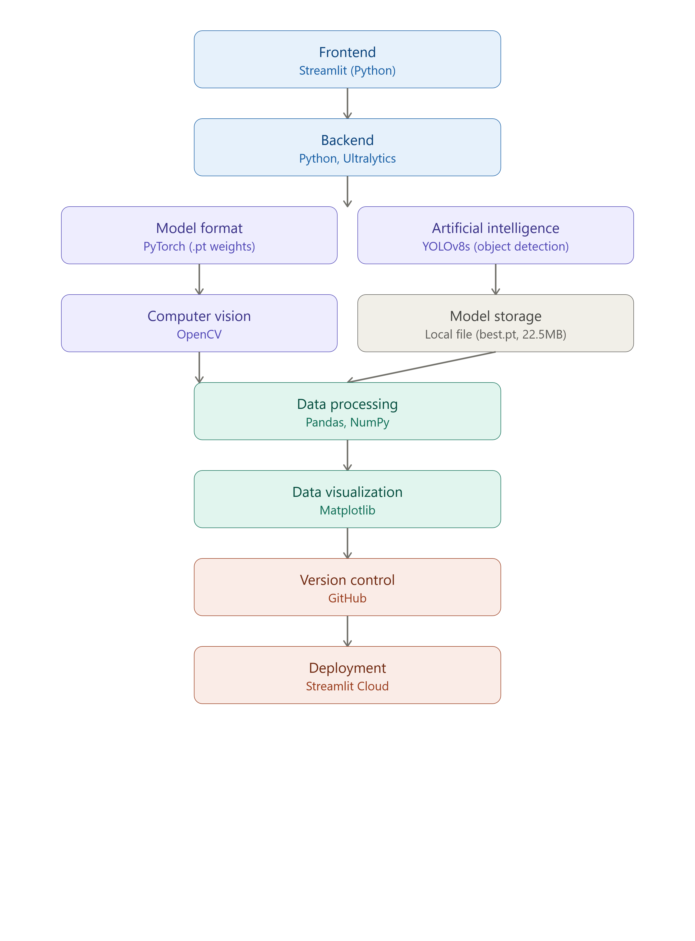
System Approach
Frontend:
• Streamlit (Python)
Backend:
• Python, Ultralytics
Model Format:
• PyTorch (.pt weights)
Artificial Intelligence:
• YOLOv8s (Object Detection)
Computer Vision:
• OpenCV
Data Processing:
• Pandas, NumPy
Data Visualization:
• Matplotlib
Model Storage:
• Local file (best.pt, 22.5MB)
Version Control:
• GitHub
Deployment:
• Streamlit Cloud

Slide 6
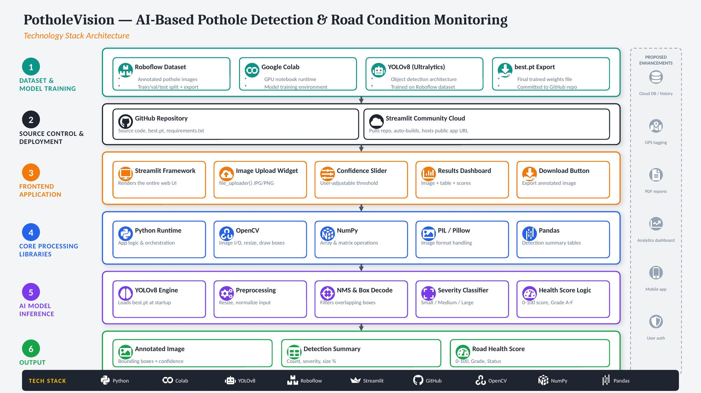

Slide 7
Algorithm & Deployment
Machine Learning Algorithm:
YOLOv8s (You Only Look Once, version 8 - Small variant)
Purpose:
Detect potholes in road images and classify their severity in real time.
Input:
• Road image (JPG / PNG) uploaded by the user
• User-adjustable confidence threshold
Output:
• Bounding boxes around detected potholes
• Confidence score per detection
• Severity label (Small / Medium / Large)
• Road Health Score (0–100) with letter grade
Deployment:
• Application deployed using Streamlit Cloud
• Source code hosted on GitHub
• Model trained on Google Colab (Tesla T4 GPU)
• Trained weights deployed as a best.pt file (22.5 MB)
YOLOv8 was selected for its single-stage real-time detection speed, anchor-free design, and strong accuracy on small custom datasets through transfer learning.

Slide 8
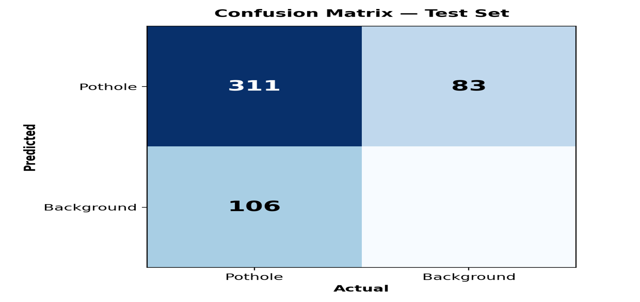
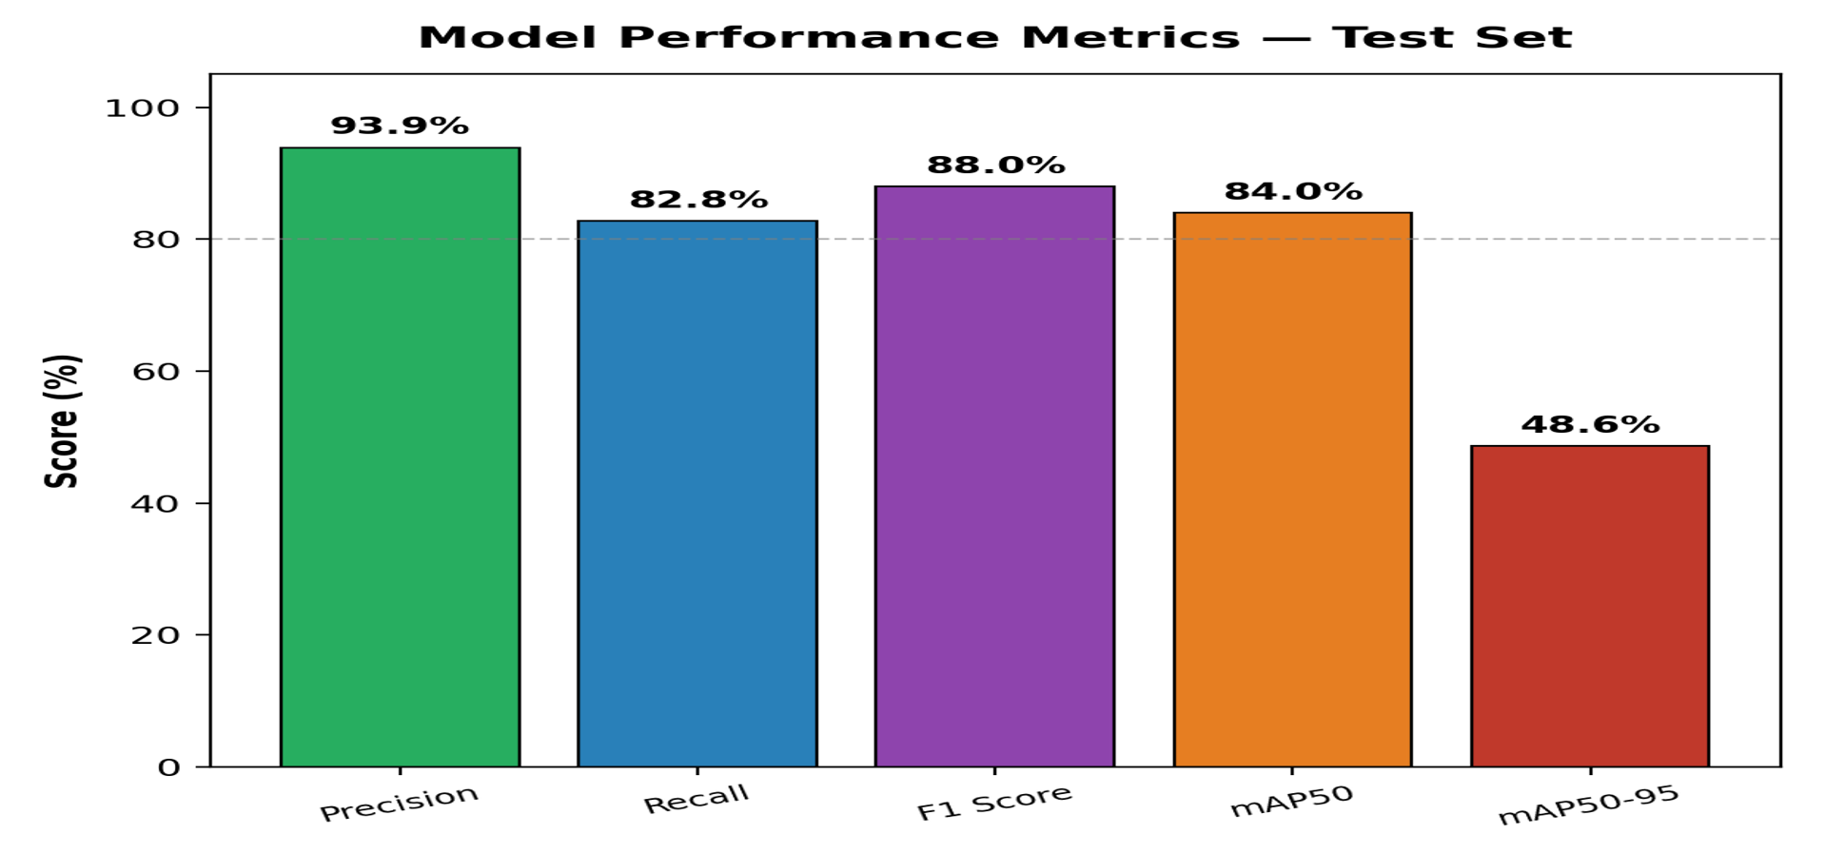
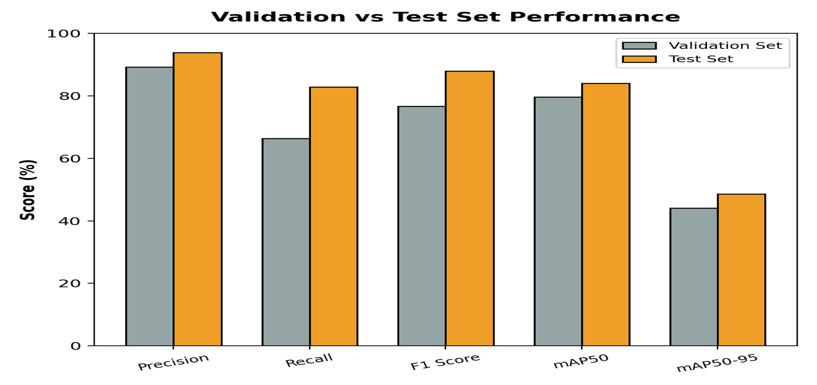
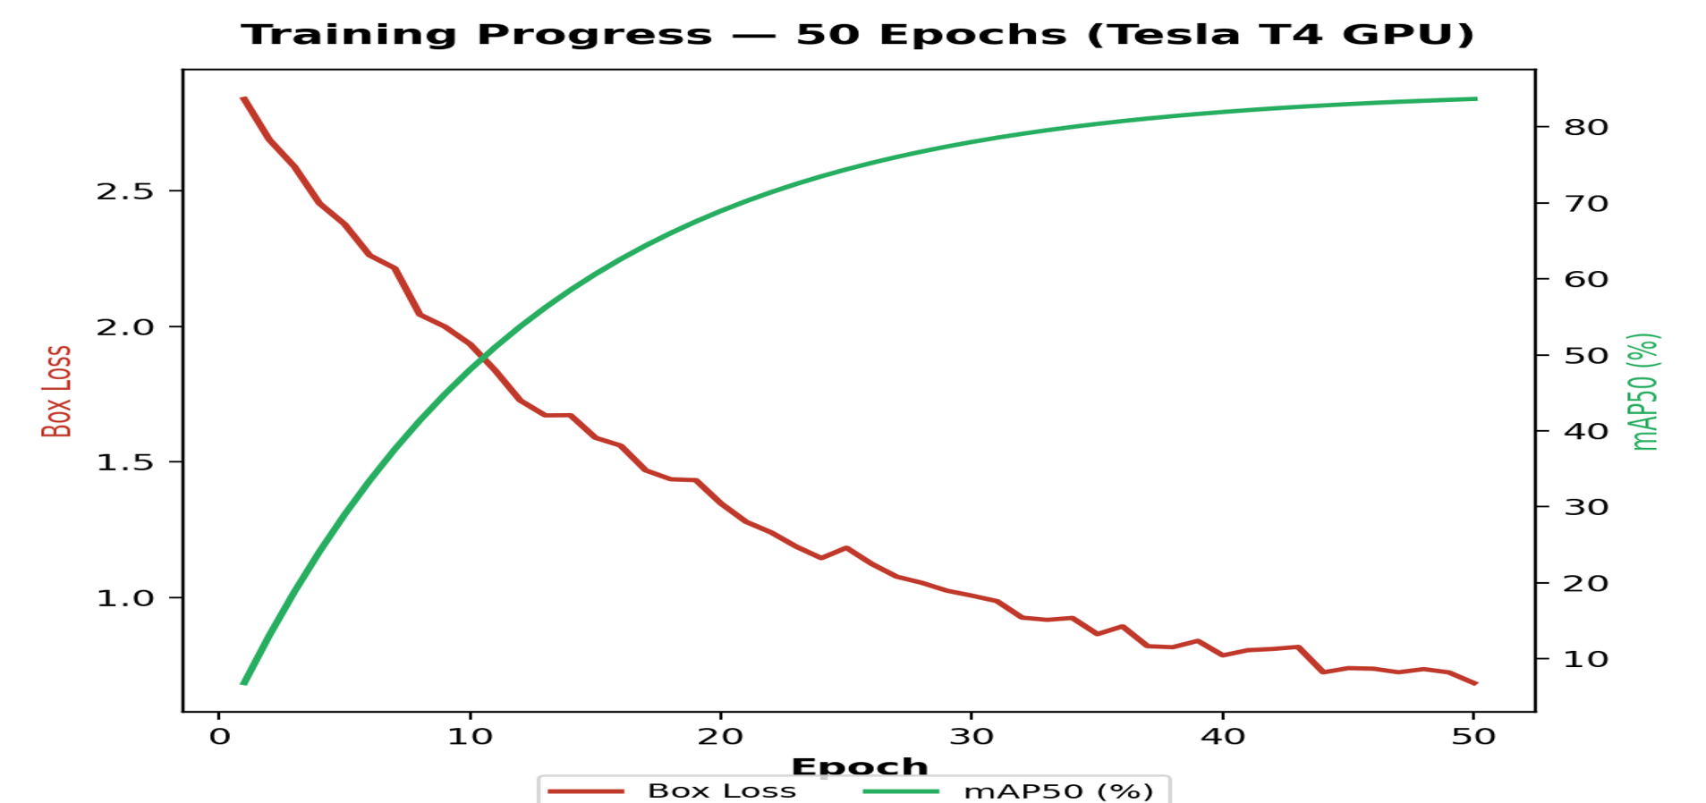
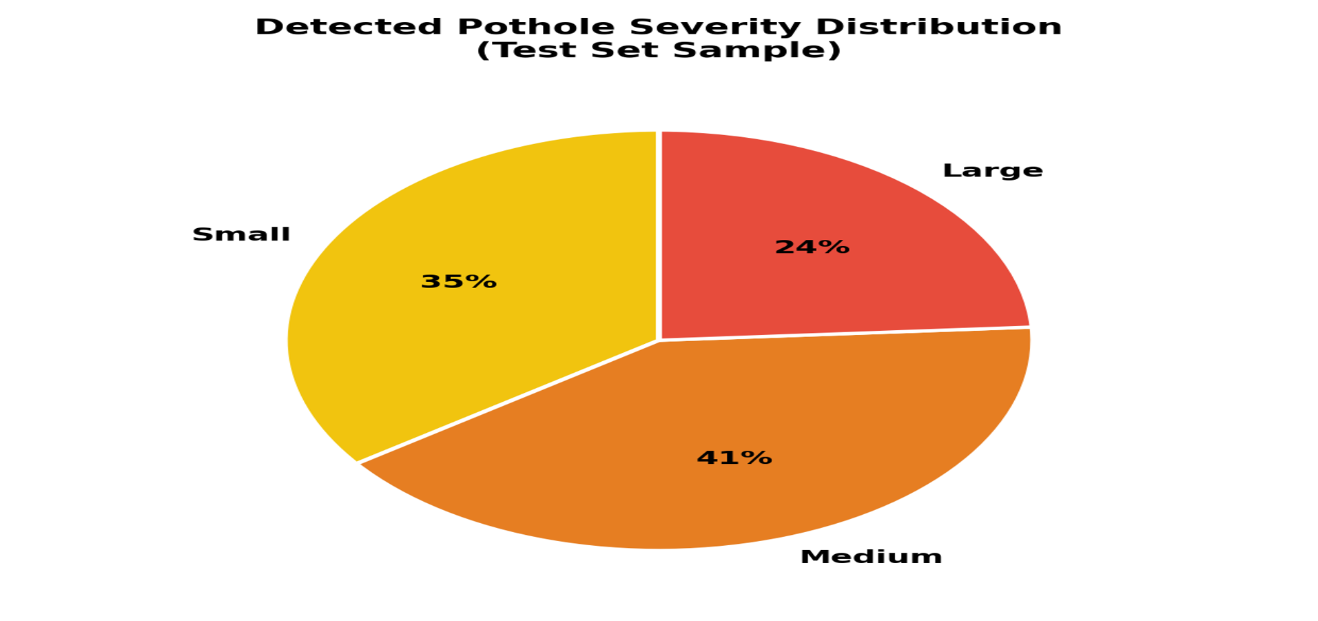
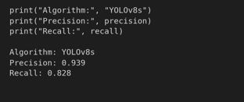
Result stasistics
Model Evaluation Results

Slide 9
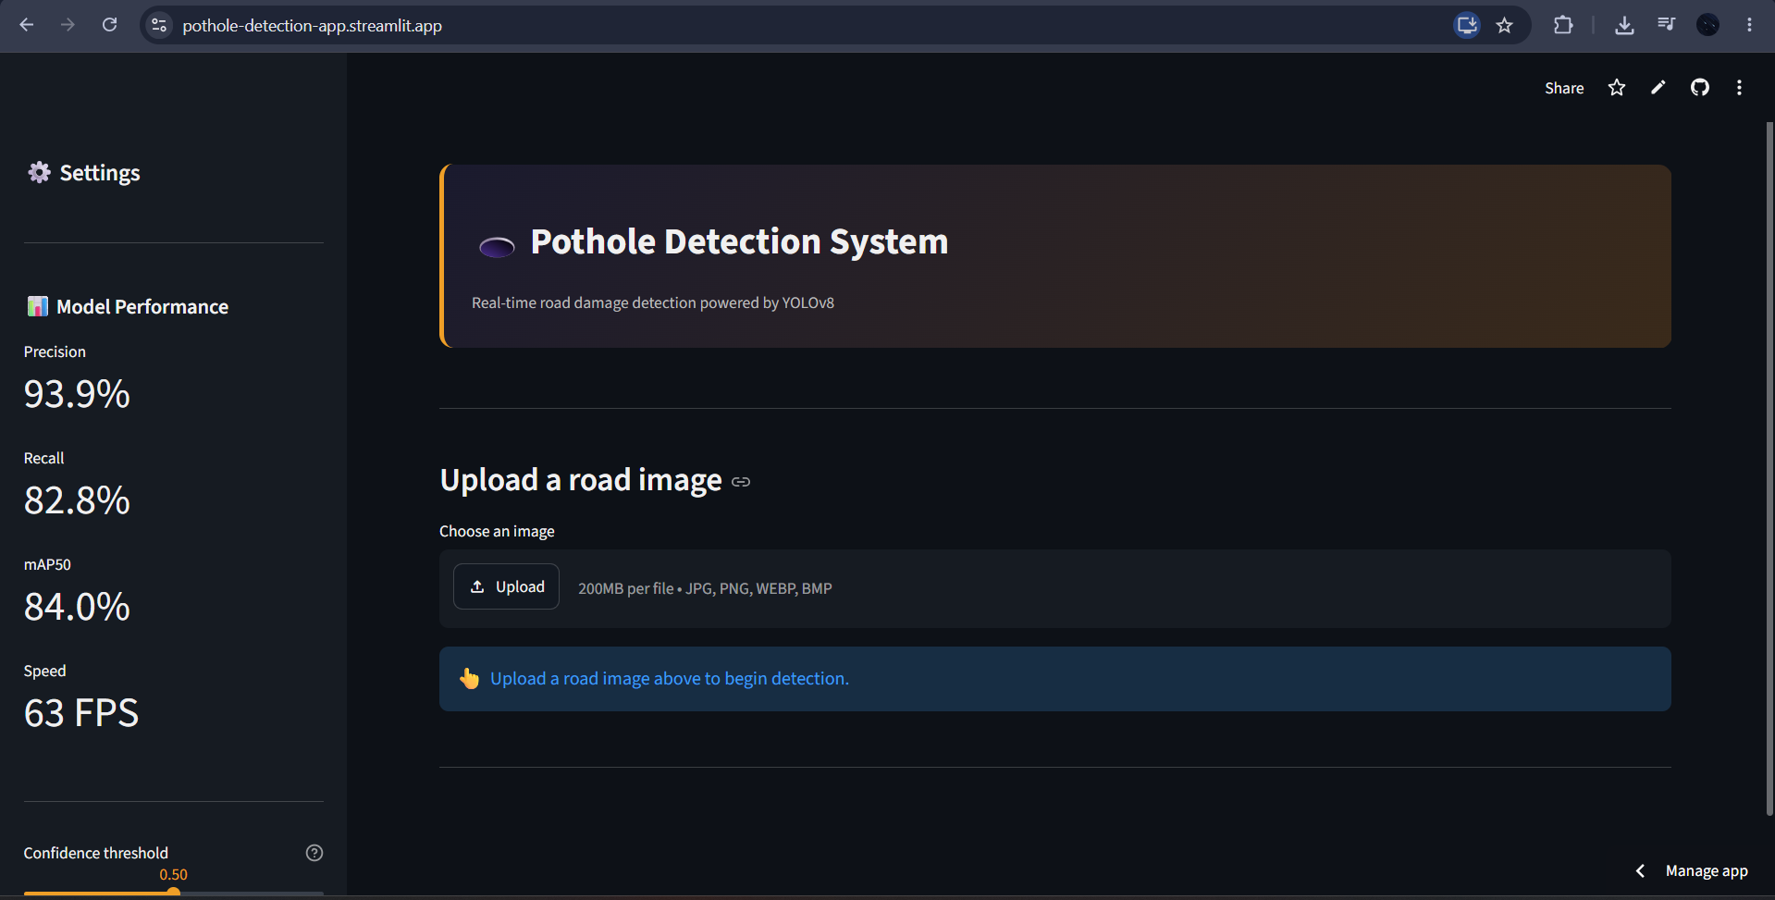
Homepage

Slide 10
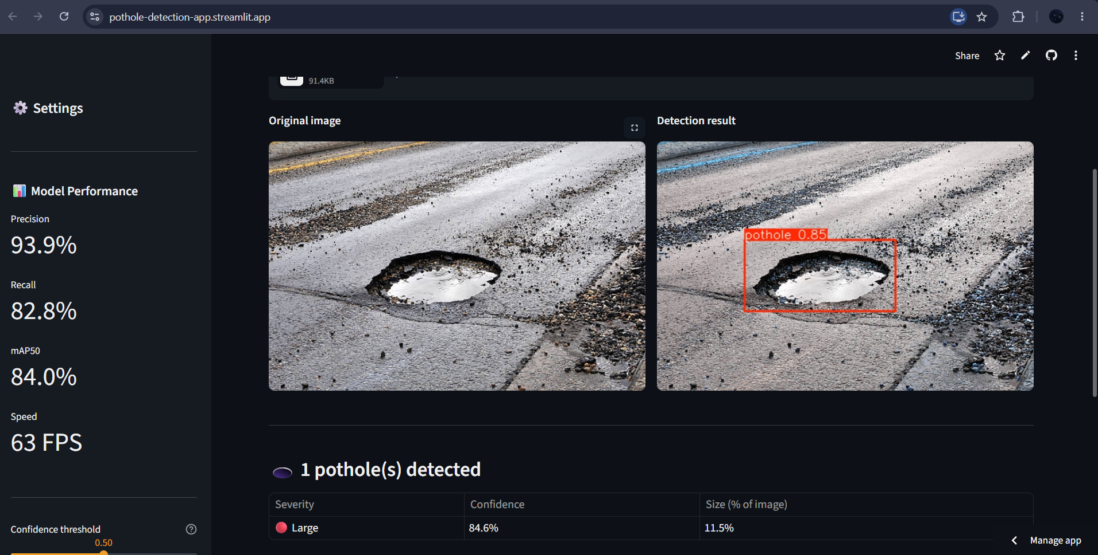
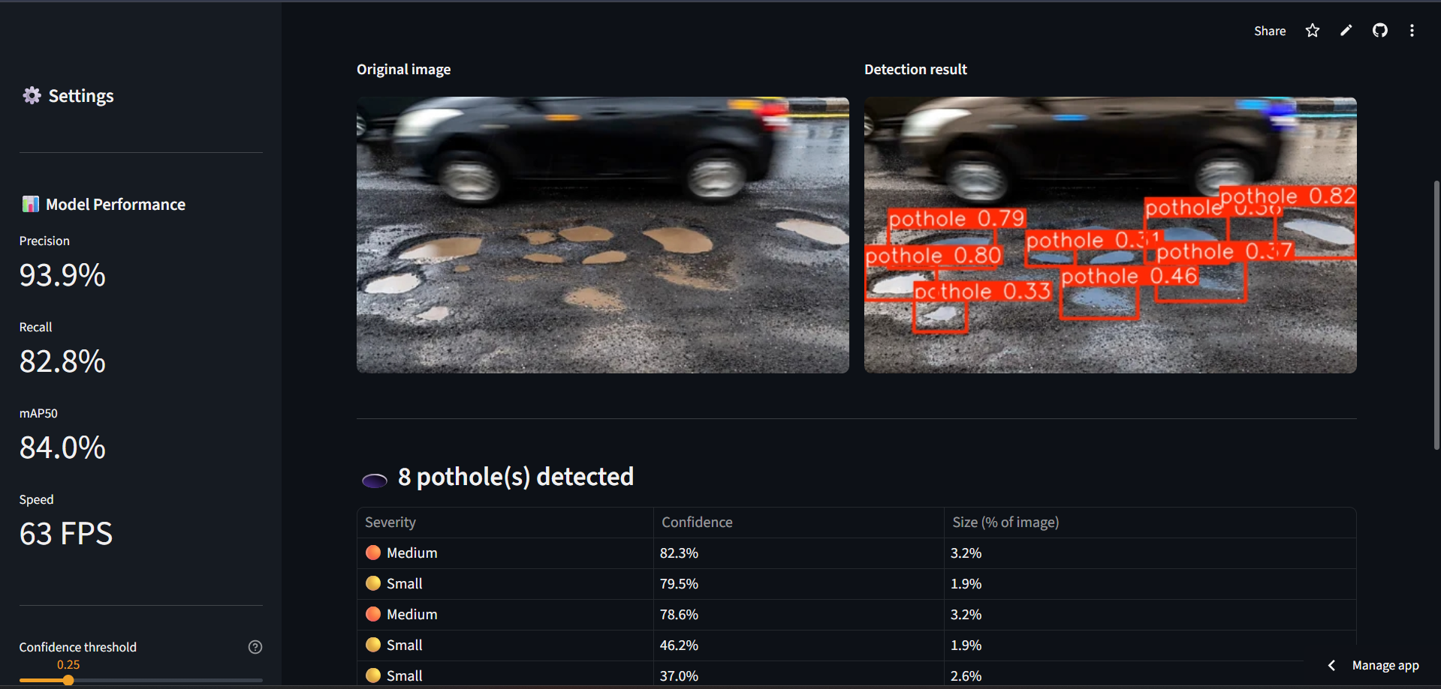
outputs

Slide 11
Conclusion
The Pothole Detection System successfully integrates Artificial Intelligence and Deep Learning into a unified road damage detection and monitoring platform.
The trained YOLOv8s model achieves 93.9% precision, 82.8% recall, and 84.0% mAP50 on unseen test images, with real-time inference at approximately 63 frames per second.
The system goes beyond simple detection by introducing a Severity Classification scheme and a composite Road Health Score, offering administrators a single, interpretable measure of road condition.
By giving the model real-time visual feedback, the system can help municipal administrators prioritise repairs, allocate maintenance budgets, and track road conditions over time.
The project demonstrates the practical, real-world impact of AI-driven computer vision in supporting safer, smarter, and more responsive civic infrastructure management.
Overall, this project establishes a scalable foundation for future intelligent road maintenance systems and smart city infrastructure.

Slide 12
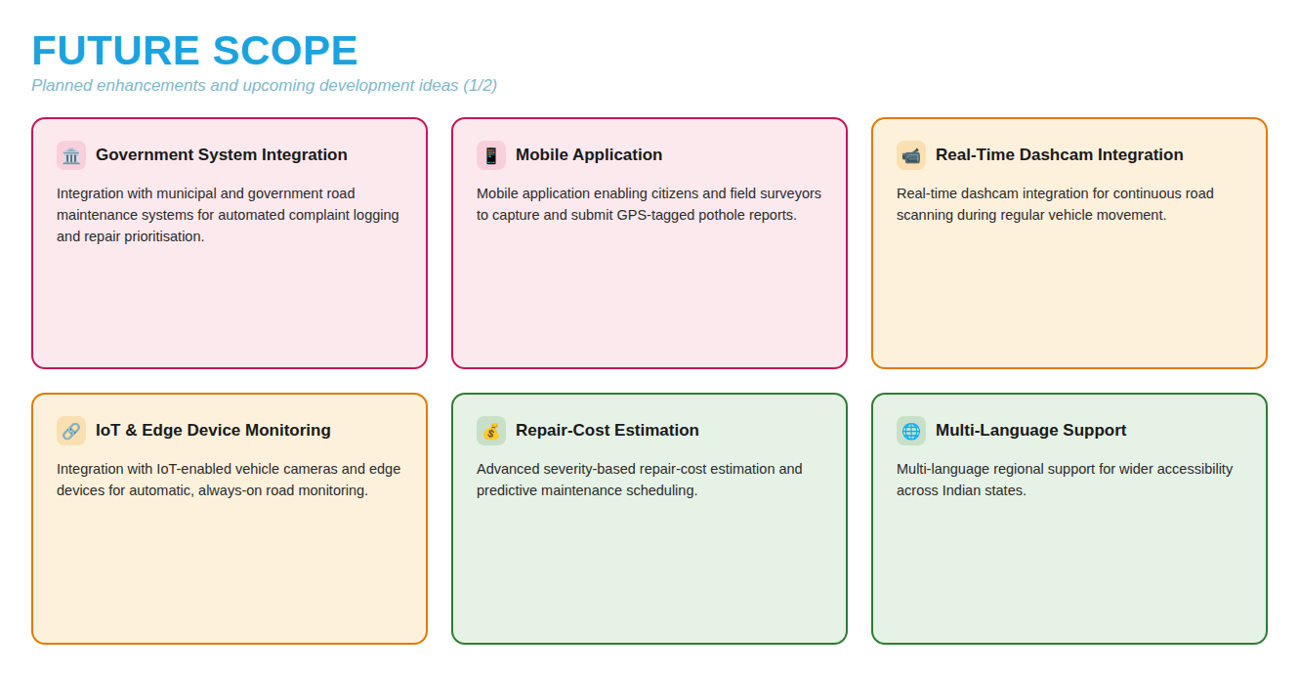

Slide 13
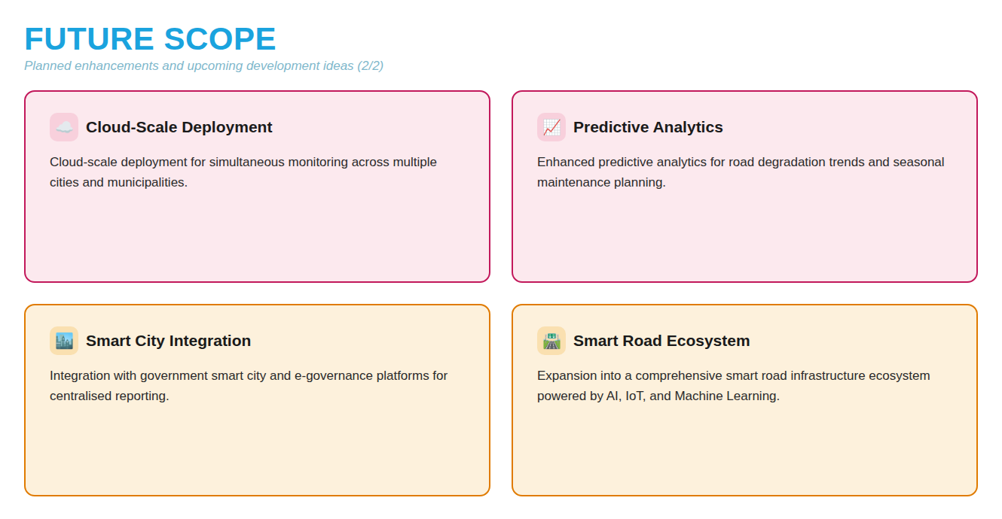

Slide 14
References
Ultralytics YOLOv8 Documentation https://docs.ultralytics.com/
Streamlit Documentation https://docs.streamlit.io/
OpenCV Documentation https://docs.opencv.org/
Pandas Documentation https://pandas.pydata.org/docs/
NumPy Documentation https://numpy.org/doc/
PyTorch Documentation https://pytorch.org/docs/
Roboflow Universe Documentation https://docs.roboflow.com/
Pothole Detection Dataset (Roboflow Universe) https://universe.roboflow.com/search?q=pothole
Pothole Detection GitHub Repository https://github.com/Hemaa-varsh/Pothole-detection-app.git

Slide 15

Github link/Deployment link
🐙 GitHub Repository
https://github.com/Hemaa-varsh/Pothole-detection-app.git
🚀 Deployment Link (Streamlit)
https://pothole-detection-app.streamlit.app/

Slide 16
THANK YOU

