Slide 1

Team Name : Elegant Ensemble
Team Details : Members { Supriya K , Choppa Hemalatha, Gudla Hemalatha}, Institution {Gayatri Vidya Parishad College of Engineering for Women (GVPCEW)}.

Slide 2
Solution :
Sustaining meaningful interactions with customers beyond initial transactions and creating a personalized experience that has a lasting impression on the customer, which allows them to visit the site on a habitual basis and fosters community participation can help to increase customer engagement.
A way to implement this is by creating ‘Personalized space’ for the customer where they can try on different styles, share them with their peers just like on a social media platform, view user generated content (UGC) by influencers and also participate in contests and marketing campaigns.
This creates an indulging virtual experience for the customers which increases conversion rates, customer loyalty, repeat purchases and habitual visits.
This can be achieved by leveraging the power of Generative AI models that can generate personalized digital content like images that can be shared on the ecommerce platform either as UGC or as messages to peers for suggestions or as posts on a particular social media platform.

Slide 3
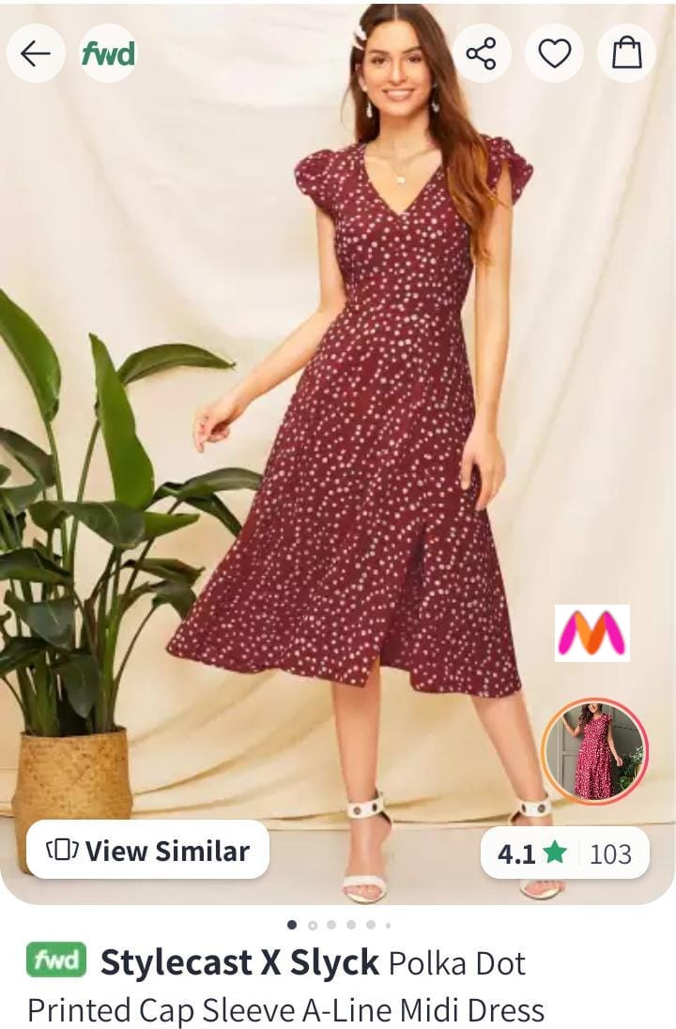
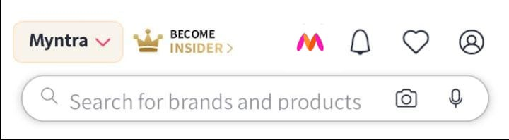
Ways to navigate to the personalized space “My Space” for the user may include the following ways. The user can directly navigate to My Space using the icon in homepage or by using the icon displayed in the product page which the user wants to share to their My Space.

Slide 4
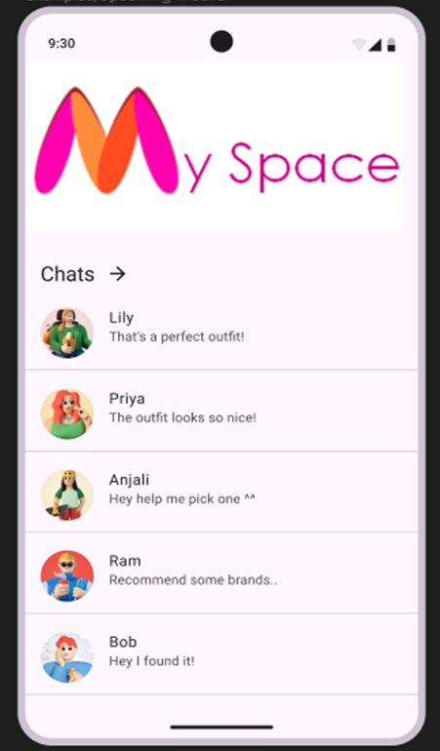
The personalized My Space enables the users to chat with their peers as shown in the image. The users can share their outfit collections and take reviews from their peers. The My Space logo on the above section of the screen also allows the users to navigate to the page where the users can try on various styles and the generated images can be shared to their peers and also as user generated content (UGC) on the platform and the generated images can also on various other social media sites.

Slide 5
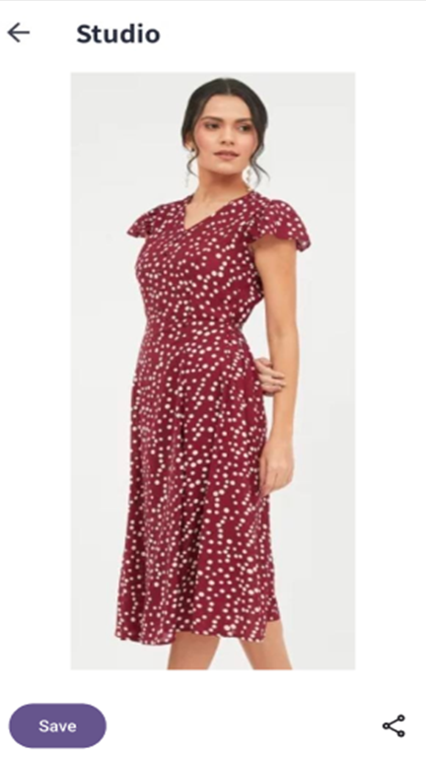
Users can try on various styles with the help of deep learning architectures like unet and diffusion models that give the users an idea of how the outfit or style look like upon them. Certain data like the facial features are extracted from the facial image of the user and body measurements are taken as input from the user. Based on this data the deep learning architecture creates a realistic and customized image of the user with the help of the product’s meta data and images stored.

Slide 6
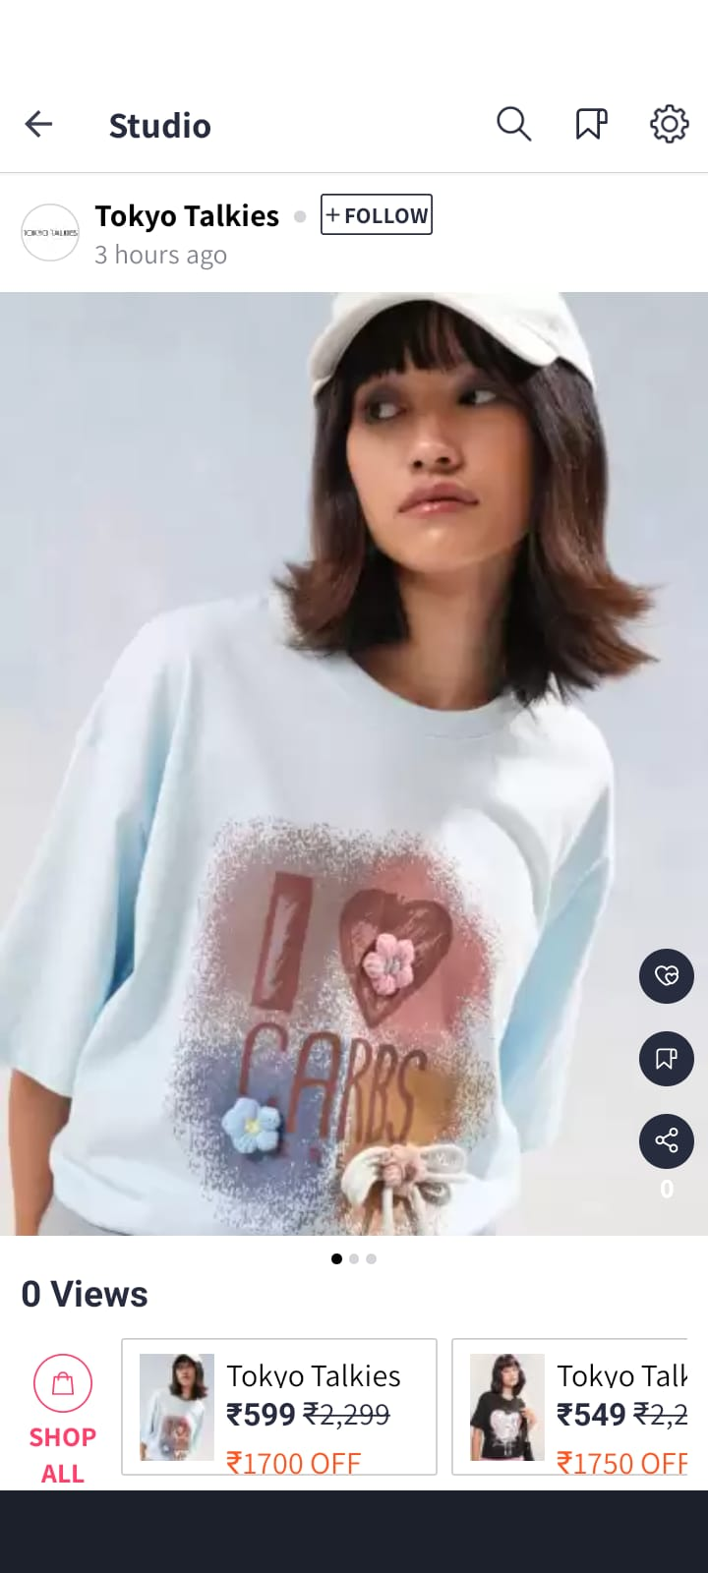
Along with messaging, the users can also discover new trends and user generated content in the My Space which allows for product discovery and engagement. This can also be used for brand campaigns and also facilitates the organization of contents in which the users can generate content according to the contest and share them on the platform.

