Slide 1
Decision Tree Based Heart Disease Prediction using Machine Learning Algorithms
Under the Guidance of:
Mrs. S. TAHSEEN BANU M. Tech.
Assistant Professor, Dept. of CSE
Project Team:
C. Hemavathamma (20091A0554)
V. Sai Praneetha (20091A05D3)
M. Mohammad Anees (20091A0586)
N H Uday Shankar Reddy (20091A05H5)

Slide 2
Agenda
Abstract
Introduction
Literature review
Problem Statement
Objectives
Methodology
Requirements
Modules
Modules Descriptions
System Design
Implementation
Result
Conclusion
References
Queries

Slide 3
Abstract
Heart disease is a commonly occurring disease and is the major cause of sudden death now a days. This disease attacks the person instantly. Most people are not aware of the symptoms of heart disease. Timely attention and proper diagnosis of heart disease will reduce the mortality rate.
Medical data mining is to explore hidden patterns from the data sets. In this project, we have applied five machine learning algorithms namely KNN, Logistic Regression, Decision Tree, Random Forest, and Navie Bayes predict the heart disease.
Result shows that DT gives high accuracy score with 96% compare to other algorithms LR is 86%, RF is 90%, NB is 83%and KNN is 95%.

Slide 4
Introduction to Machine Learning
Machine learning is a subset of artificial intelligence that focuses on the development of algorithms and models that enable computers to learn from and make predictions or decisions based on data.
These algorithms assess heart disease risk using diverse data, enabling personalized treatment. Machine learning can detect early signs in medical images and ECG data .
Machine learning advances drug discovery, patient monitoring, and public health initiatives, ultimately improving heart disease management and reducing its societal impact.

Slide 5
Why we work on Machine Learning?
Machine learning algorithms find natural patterns in data that generate insight and help you make better decisions and predictions. They are used every day to make critical decisions in medical diagnosis, stock trading, energy load forecasting, and more.
Pros
Applications
Automation of Everything
Wide Range of Applications
Scope of Improvement
Efficient Handling of Data
Best for Education
Risk Prediction
Data Integration
Treatment Planning
Remote Monitoring
Health Care

Slide 6
Literature Review
Enhancing Prognosis Accuracy for Ischemic CVD using KNN algorithm
Authors | Objective | Methodology | Future Scope
Ghulam Muhammad Saad Naveed, Tariq Mahmood, Lubna Nadeem | The dataset obtained for a comprehensive collection of over 918 observations and 12 essential features. | KNN, Random forest, Logistic Regression, support vector machine, Naïve Bayes and DT. | valuable tools in clinical practice. helping healthcare professio- nal identify patients at risk ischemic disease
Machine Learning Heart Diseases Prediction Using KNN And RTC Algorithm
Authors | Objective | Methodology | Future Scope
Senthil G. A R. Prabha M. Razmah | Machine learning helps to predict the vulnerability of a heart disease with few elemental symptoms and health factors. | KNN and DT. | A decision tree algorithm attains an impressive 98% accuracy It is suitable for real-time applications. additional features

Slide 7
Performance Evaluation Of Supervised ML Algorithms in prediction of heart disease
Authors | Objective | Methodology | Future Scope
P .Sujatha K. Mahalakshmi | It is observed that the random forest techniques increase the accuracy of the heart disease prediction system. | DT , Naïve Bayes, RF ,SVM, KNN & LR Algorithms. | Work with a large dataset to enhance model accuracy. Multiple ML techniques for more reliable and accurate predictions.
Gradient boosting based model for elderly heart failure, Aortic Stenosis and Dementia classification.
Authors | Objective | Methodology | Future Scope
Khomkrit Yolgcharoench-aiyasit, Sujitra Arwatc- hananukul | GB based model is proposed for the multiclass classification of elderly people with heart failure Aortic Stenosis and Dementia | DT ,SVM, KNN ,RF extra tree and Gradient Boosting | The data should be imbalance By using oversampling or under sampling techniques applying more advanced preprocessing

Slide 8
Problem Statement
Ischemic disease (Blood Flow Blockage) is the global leading cause of death, making early detection crucial in mitigating its impact.
In recent years, ML-based model has exhibited promising results in creating accurate and efficient AI models for cardiac disorders.
This study examines existing Algorithm prediction systems research using ML-based approaches.
We trained five machine learning algorithms on this data, including KNN, RF, Logistic Regression, Gaussian Naïve Bayes, DT.
The best results came from the Decision Tree algorithm, which achieved 98% accuracy, by taking this disadvantage and converted to advantage and make further.

Slide 9

Objectives
Use a machine learning model to predict future possibility of heart disease
Determine significant risk factors based on medical dataset which may lead to heart disease
Reduce the cost of medical tests
Provides new approach to concealed patterns in the data.
Develop a model which can discover and extract hidden knowledge associated with diseases from a historical heart data set

Slide 10
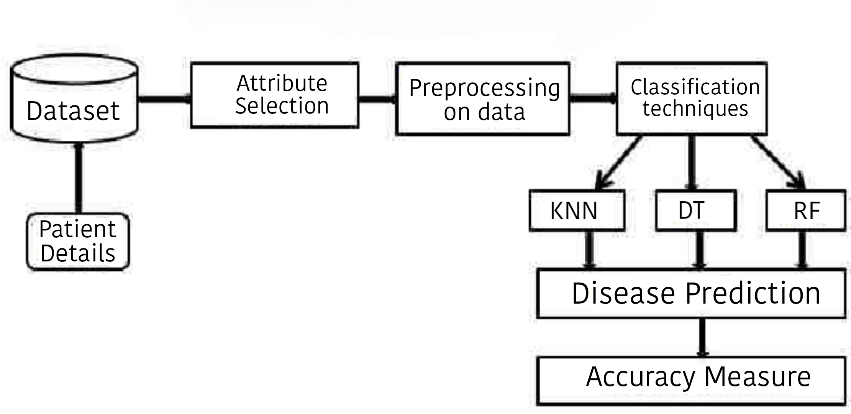
Proposed Methodology
We had selected 3 methodologies for best prediction of heart disease i.e., DT, KNN & RF

Slide 11
DT builds classification model in the form of tree structure
KNN is a non-parametric & lazy learning algorithm
RF builds multiple a decision tree and merge together
Algorithms

Slide 12
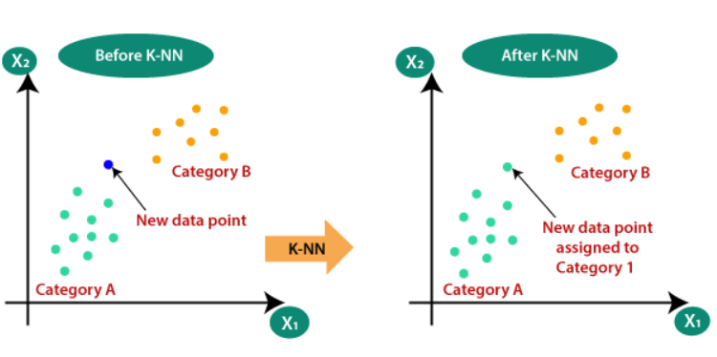
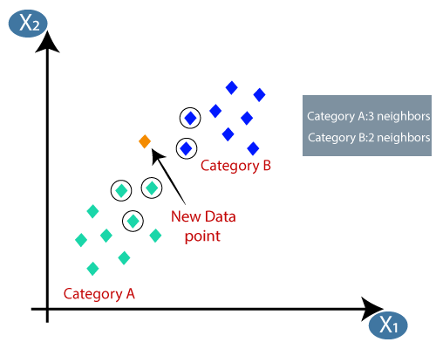
KNN Algorithm
The K-NN working can be explained on the basis of the below algorithm:
Step-1: Select the number K of the neighbors.
Step-2: Calculate the Euclidean distance of K number of neighbors.
Step-3: Take the K nearest neighbors as per the calculated Euclidean distance.
Step-4: Among these k neighbors, count the number of the data points in each category.
Step-5: Assign the new data points to that category for which the number of the neighbor is maximum.
Step-6: Our model is ready.

Slide 13
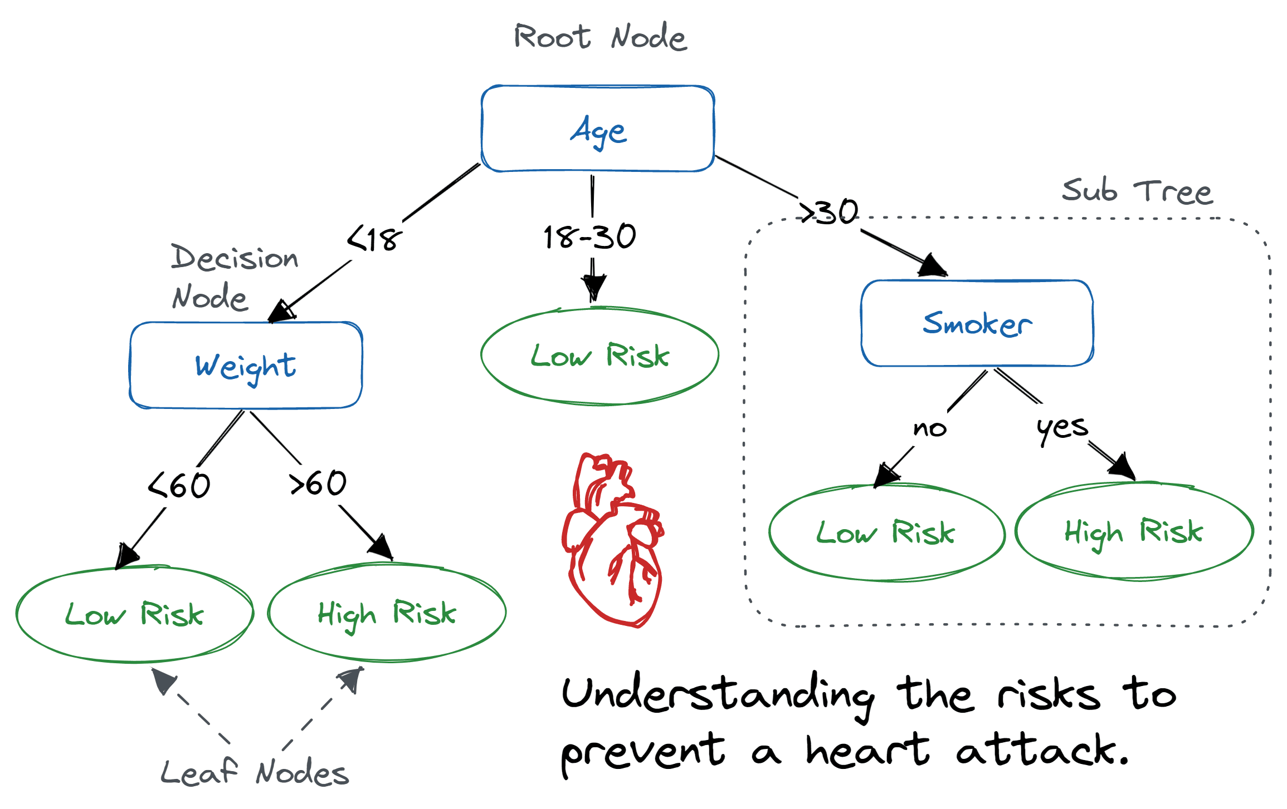
DT Algorithm
The logic behind the decision tree can be easily understood because it shows a tree-like structure .
Step-1: Begin the tree with the root node, says Age it contain complete dataset.
Step-2: Find the best attribute in the dataset using Attribute Selection Measure.
Step-3: Divide the Age into subsets that contains possible values
for the best attributes.
Step-4: Generate the decision tree node, which contains the best attribute.
Step-5: Recursively make new decision trees using the subsets
of the dataset created in step -3.
Continue this process until a stage is reached where you cannot
further classify the nodes and called the final node as a leaf node.

Slide 14
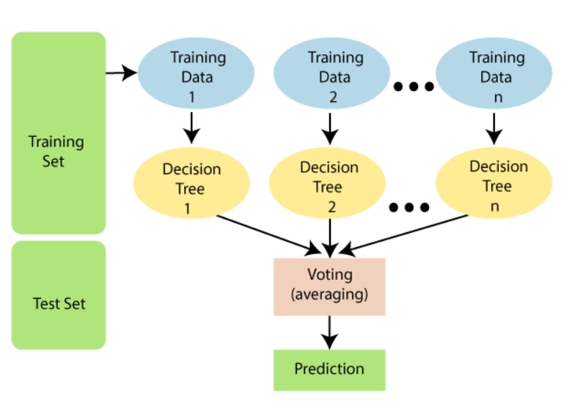
RF Algorithm
Step-1: Select random K data points from the training set
Step-2: Build the decision trees associated with the selected data points (Subsets).
Step-3: Choose the number N for decision trees that you want to build.
Step-4: Repeat Step 1 & 2.
Step-5: For new data points, find the predictions of each decision tree, and assign the new data points to the category that wins the majority votes.

Slide 15
Requirements
Software Requirements
Hardware Requirements
Software: Any preferred IDE, Jupyter, Google Collab.
Programming Language: Python
Operating System: Windows, Linux, MacOS.
Hard Disk Drive: 512 GB
Processor: i5 and above
RAM: 4 GB (8 GB preferred)

Slide 16
Modules
Data Collection
Feature Extraction
Prediction
Data Preprocessing
Classification

Slide 17
Modules Description
Data Collection:This part collects important information from different places about patients, like their health records, personal details, and test results such as blood pressure and cholesterol levels, to understand their overall heart health.
Data Preprocessing: This file contains all the pre-processing functions needed to process all input documents and texts. First we read the train, test and validation data files then performed some preprocessing. There are some exploratory data analysis is performed like response variable distribution and data quality checks like null or missing values etc.
Feature Extraction: Extracts relevant features from data sources, such as heart rate variability (HRV) from ECG signals.
Classification: We tried different ways to predict heart disease and picking the best ones. Then, we adjusted these methods to predict heart disease and checked which features were most important. Finally, we looked at how well the models worked with different types of data.
Prediction: It takes as input from user then model is used for final classification output that is shown to user along with probability of accuracy.

Slide 18
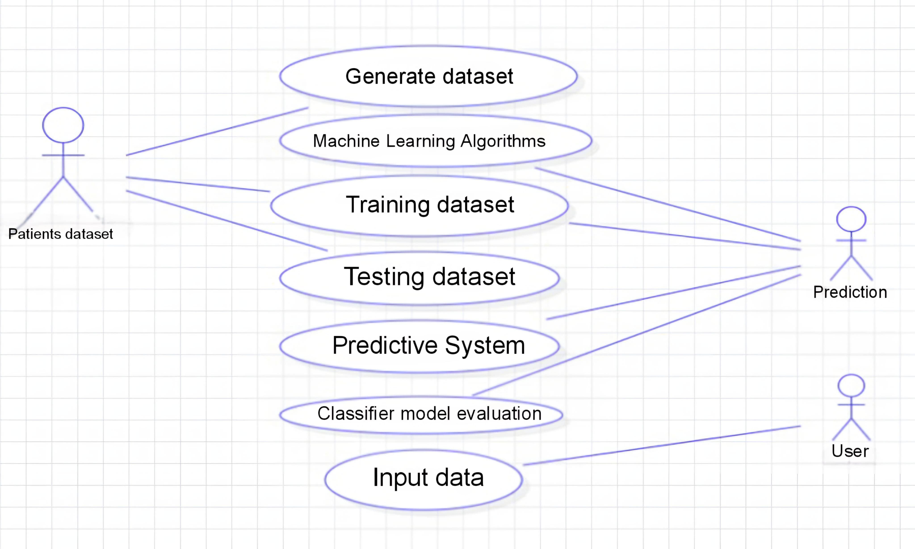
System Design

Slide 19
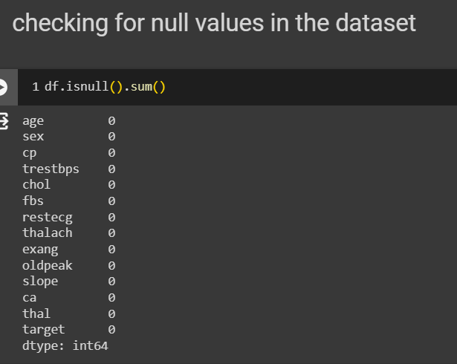
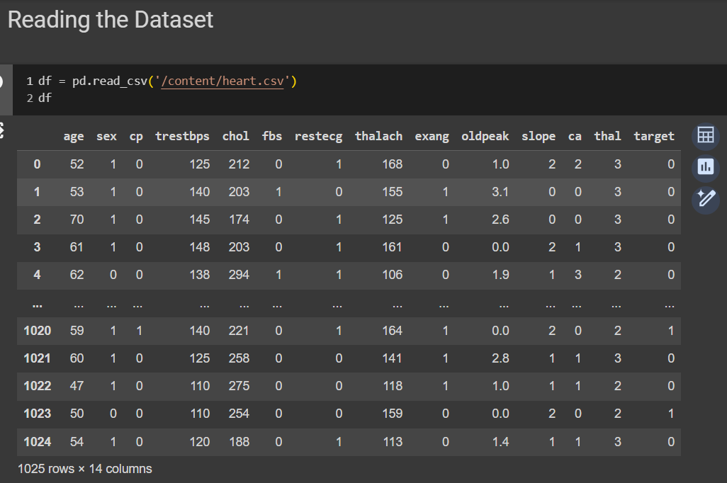
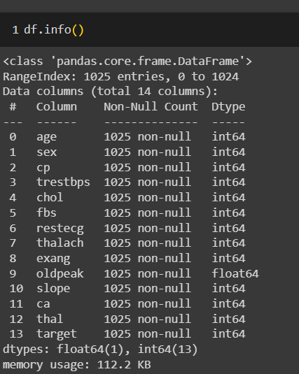
Implementation

Slide 20
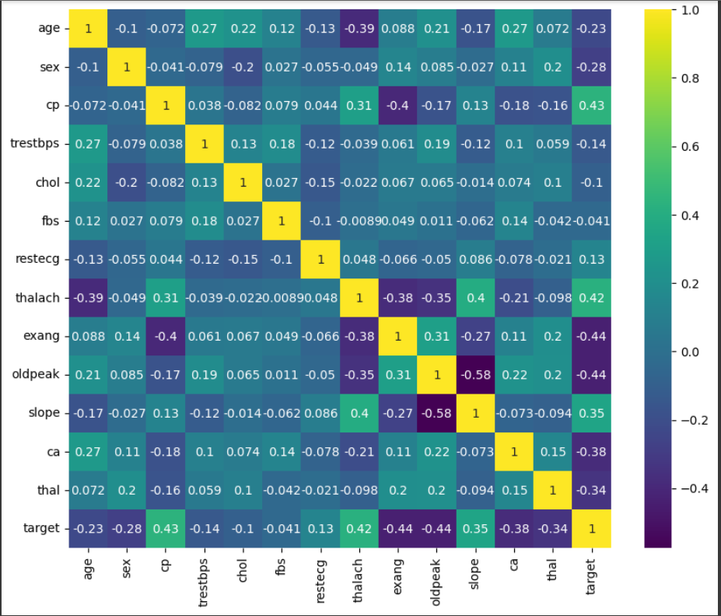
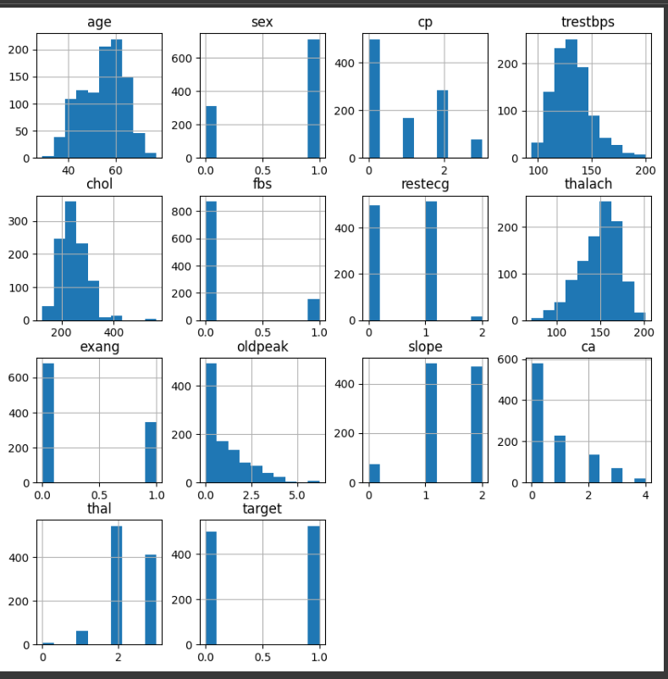
Fig: Future Selection using Seaborn Fig: Data Visualization plot

Slide 21
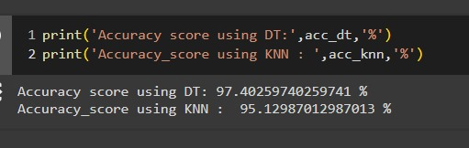
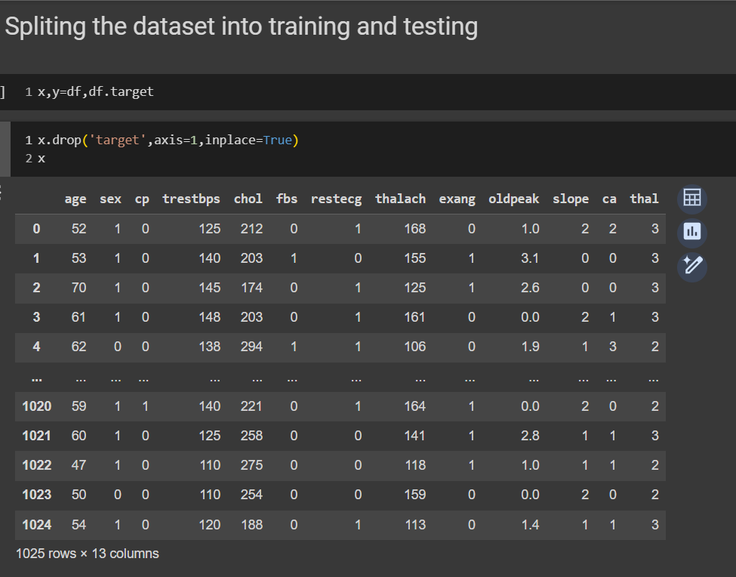
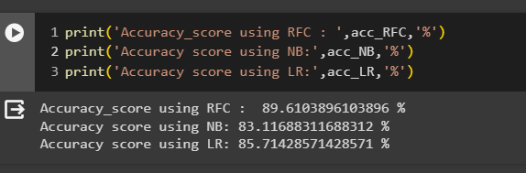
Fig: Accuracy Result

Slide 22
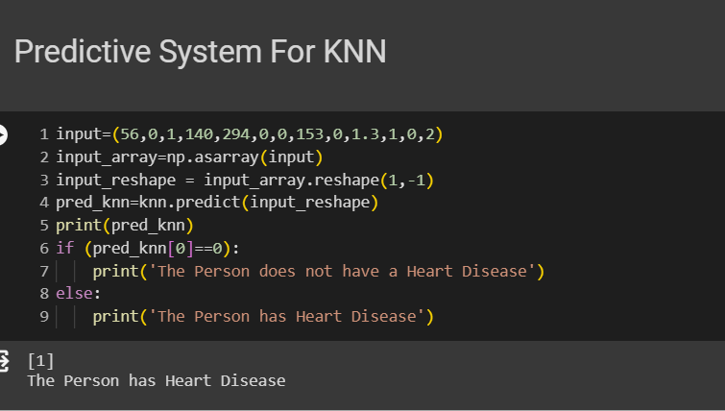
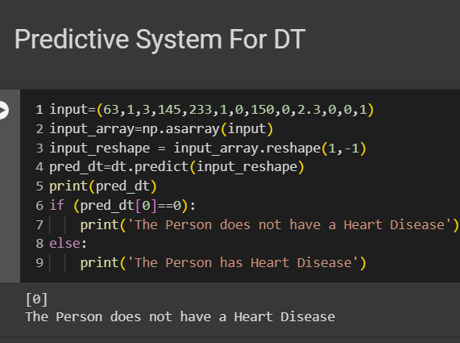

Slide 23
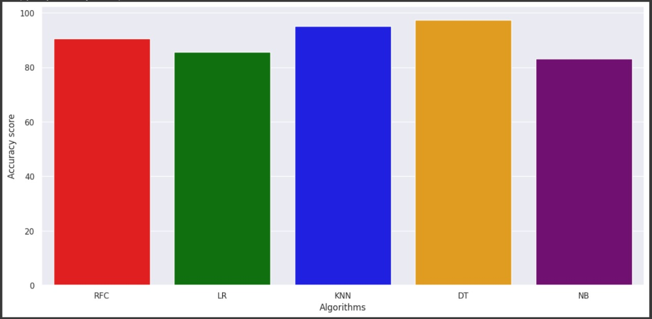
Result

Slide 24
Conclusion
Our project used five algorithms to predict heart disease. After refining them, Decision Tree had the best accuracy at 97%, better than before. This improvement shows Decision Tree is promising for early detection. Even though the base paper had 98% for Decision Tree, our refined model reached 97%. we also incorporated a larger dataset, enhancing the study's robustness. This suggests promising potential for early heart disease detection with further refinements possible.

Slide 25
References
A. Srivastava and A. k. Singh, "Heart disease prediction using machine learning", Proc. 2nd Int. Conf. Advance Compute. Innov. Technol. Eng. (ICACITE), pp. 2633-2635, Apr. 2022.
Katarya, Rahul, and Polipireddy Srinivas. "Predicting heart disease at early stages using machine learning: a survey." 2020 International Conference on Electronics and Sustainable Communication Systems (ICESC). IEEE, 2020.
Fahd Saleh Alotaibi, "Implementation of Machine Learning Model to predict Heart Failure Disease," International Journal of Advanced Computer Science and Applications (IJACSA), vol. 10, no.6, pp.261- 268, 2019.
(Sep. 2022). Aortic Stenosis Overview. [Online].Available: https://www heart.org/en/health-topics/heart-valve-problems-and-disease/heart-valve- problems-and-causes/problem-aortic-valve-stenosis

Slide 26
Thank You

Slide 27
