Slide 1
GROCERY DELIVERY WEBSITE
SOFTWARE REQUIREMENT SPECIFICATION DOCUMENT
Notes:
1

Slide 2
PURPOSE:
It enables the customer to browse the firm’s range of products and services.
Document conventions: This document is created for , 1.store IT personnel 2.customer 3.store personnel 4.software development team

Slide 3
Scope:
Our designed online shopping system provides a 24×7 service, that is customers can surf the website, place orders anytime they wish to. Also, the delivery system works 24×7 hours a week. Some of the features that can be modified and added to this system in the future involve its implementation by local shopkeepers, where shops will be providing an online interface to customers for shopping and placing orders.
Then some delivery persons can perform their work. This will be adding on benefit for the customers as it will save their time, plus it adds on for the shopkeepers also, as people will continue to shop from local shops rather than preferring to supermarkets every time.
Also, since the deliveries from these local vendors will not be as time-consuming as these days Flipkart, Amazon, etc. take but rather will be

Slide 4
Functional description:
This section provides requirement overview of the system. Various functional modules that can be implemented by the system will be
1. Registration 2. Login
3.Changes to Cart 4.Payment
5.Logout 6.Report Generation

Slide 5
Non Functional description:
(i) Secure access to consumer’s confidential data.
(ii) 24X7 availability.
(iii) Better component design to get better performance at peak time. Various other Non-Functional Requirements are:
→ Security →Reliability →Maintainability
→Portability → Extensibility → Reusability
→Compatibility → Resource → Utilization

Slide 6
Performance requirements
In order to maintain an acceptable speed at maximum number of uploads allowed from a particular customer as any number of users can access to the system at any time. Also the connections to the servers will be based on the attributes of the user like his location and server will be working 24X7 times.

Slide 7
Technical issues:
This system will work on client-server architecture. It will require an internet server and which will be able to run PHP application. The system should support some commonly used browser such as IE, mozzila firefox,chrome etc

Slide 8
Interface requirements:
1). Login Page
2). Registration Form
3). There will be a screen displaying information about product that the shop having.
4). If the customers select the buy button then another screen of shopping cart will be opened.
5). After ordering for the product,the system will sent one copyof the bill to the customer’s Emailaddress.

Slide 9
Software and hardware interface:
Software interfaces:
1.Operating System:Windows7 Ultimate which supports networking.
2.JAVA development toolkit.
Hardware Interface:
Processor:Dual Core RAM:2 GB
Hard Disk:320 GB NIC:For each party
Communication Interfaces:
The two parties should be connected by LAN or WAN for the communication purpose. SENDER Communication channel

Slide 10
System design specification:
Architecture Design:
It is a way of representing system requirements in graphical form;this led to modular design.A DFD describes a data flow(logical) rather than how they are processed.So they do not depend upon software,hardware,data structure or file organization.It is also known as ‘bubble sort’. A DFD is a structured analysis and a design tool that can be used for flowcharting in place of ,or in association with ,information-oriented and processoriented system flowcharts. A DFD is considered as an abstract of the logic of information-oriented or process-oriented system flowchart.

Slide 11
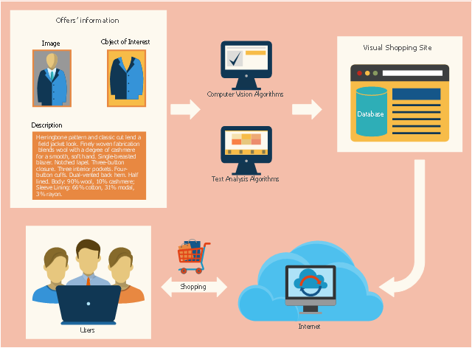
flowchart
Grocery delivery
website:

Slide 12
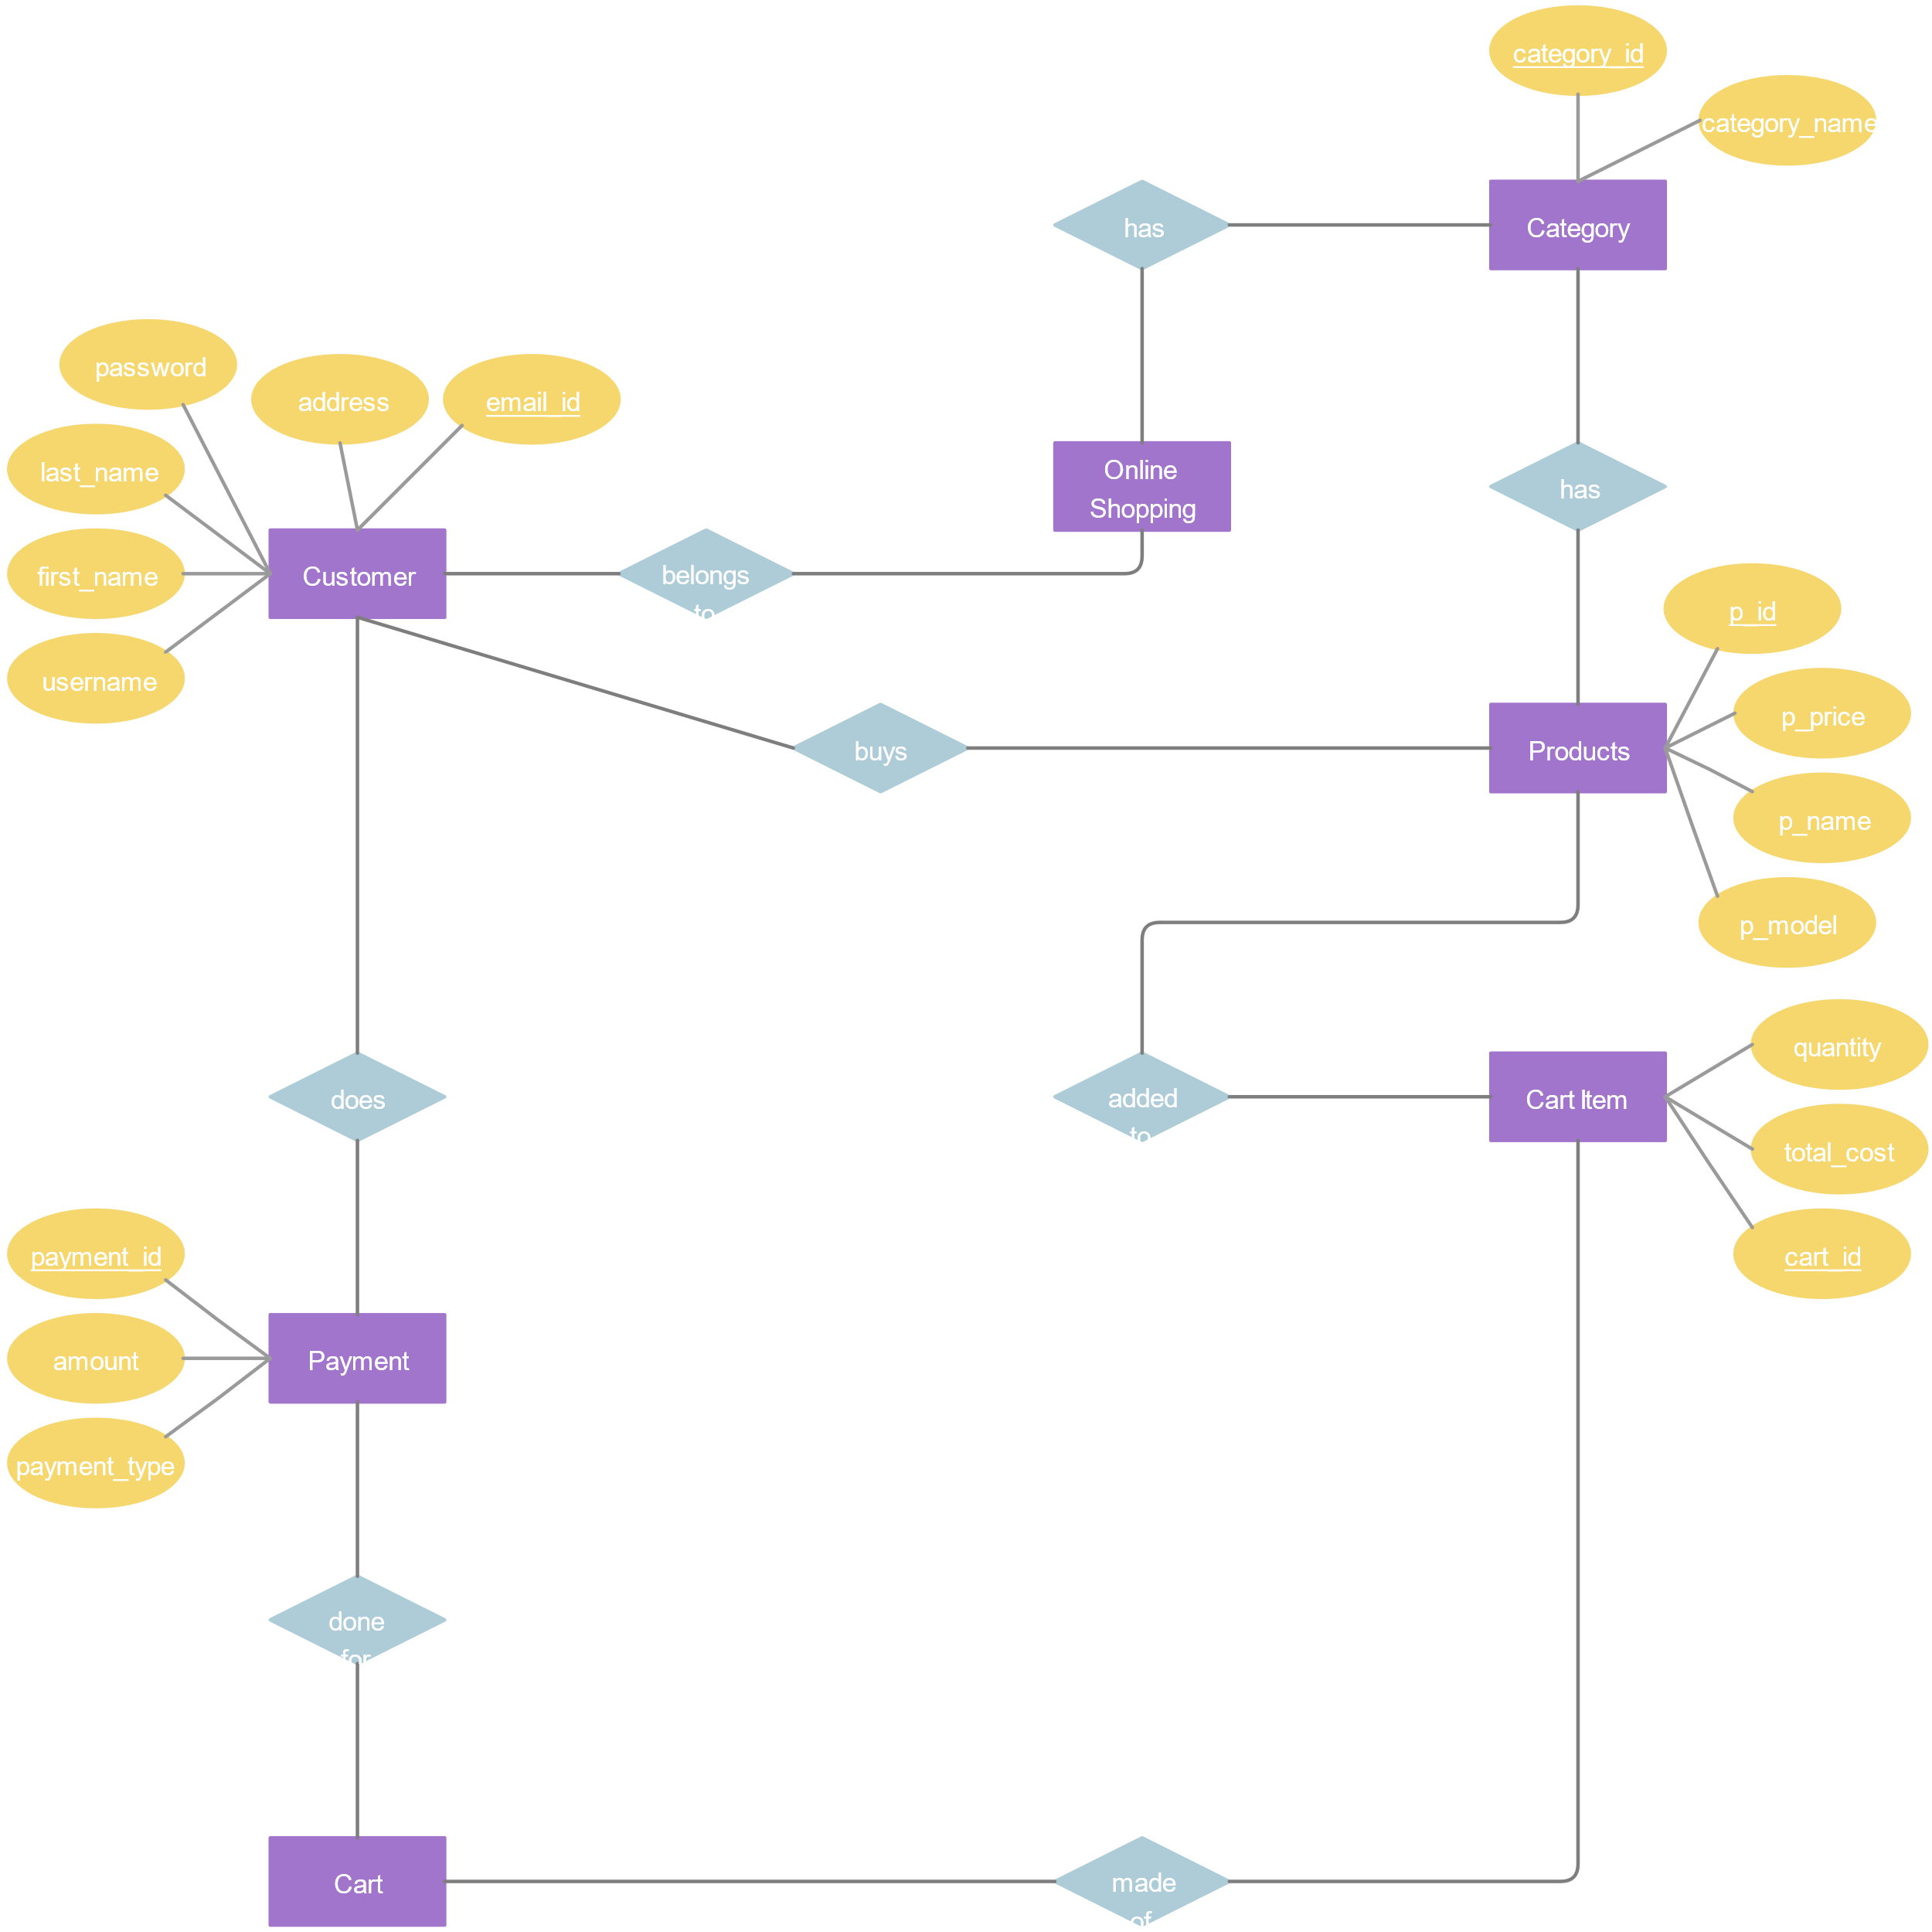
Entity relationship diagram
Grocery delivery
website

Slide 13
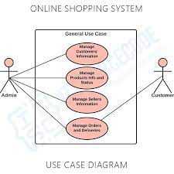
Use case diagram :
Actors: Use case:
Customer order
Shop keeper cancel
Delivery person login
payment

Slide 14
Git hub link:

Slide 15
thankyou!!!
End of the slide

