Slide 1


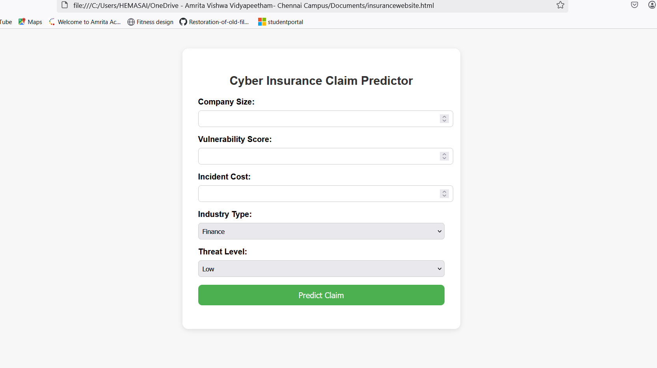

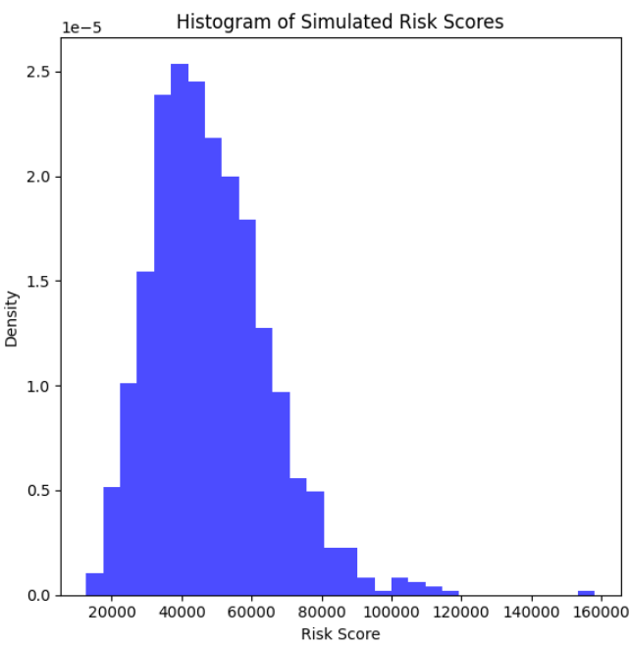
RiskSense: Comprehensive Cyber Insurance Platform
Ravikumar Hemakiran
Introduction
Cyber insurance policies are designed to mitigate the financial impact of cyber incidents, providing organizations with coverage for costs related to data breaches, business interruptions, legal liabilities, and more.
Motivation
The increasing sophistication of cyberattacks makes it challenging for insurers to accurately assess risks, leading to potential underpricing or overpricing of policies.
Problem Statement
Cyber threats evolve rapidly, making static risk assessment models ineffective in accurately predicting potential financial and operational impacts.
Objective
Develop a tool that automates the assessment of cyber risks for organizations, enhancing accuracy and efficiency in cyber insurance underwriting.
Methodology
Risks are quantified using probabilistic models, and Monte Carlo simulations are employed to forecast potential cyber losses.
Results
Histogram
Amrita Vishwa Vidyapeetham,Chennai,601103 Department of CYS

