Slide 1
CIRCUVENT TECHNOLOGIES
Architecture & operations
How it fits together, how it ships, and what to check when it does not
Generated 15 August 2026 · 999e5fe
Generated 15 August 2026 from the repository at 999e5fe · Docs/ is the source of truth

Slide 2
WHAT THIS DECK IS FOR
The other KT deck is the map; this is the machine room
● Read the handover deck first if you are new. It answers what the four deployables are and which documents to open.
● This one assumes you know that, and covers the parts you need when you are changing infrastructure or when something is down.
● Every fact here is derived from the repository at build time — topic names out of the firmware, limits out of mosquitto.conf, required secrets out of the schema that validates them.
● Where a fact could not be derived, the file that owns it is named. Go and check it rather than trusting the slide.
Circuvent Technologies · circuvent.com · contact@circuvent.com · +91 765 999 333 1
1
Notes:
Say plainly that this deck goes stale the moment somebody edits infrastructure by hand instead of in the repo, and that is the point: it is generated, so regenerate it rather than patching a slide.

Slide 3
THE SHAPE OF IT
Four deployables, one broker, two databases
WHAT PEOPLE TOUCH
Website · shop · console
Mobile app
Admin
src/ · Next.js 16 on Vercel
mobile/ · Expo · Play Store
src/app/admin · same deployment
WHAT HOLDS STATE
Neon Postgres
Control plane
Postgres 16
shop · orders · customers
platform/ · Express · api.circuvent.com
devices · telemetry · automations
Mosquitto broker
1883 private · 8883 TLS
WHAT PHYSICALLY HAPPENS
ESP32 boards
Cameras
Local bus
firmware/ · in customers' homes
binary frames over MQTT
ESP-NOW, board to board
The broker is the only path between the top two bands and the bottom one. The dashed edge is the local bus — the one connection that never leaves the building.
Circuvent Technologies · circuvent.com · contact@circuvent.com · +91 765 999 333 1
2
Notes:
Draw attention to the broker being a single hinge, and to the dashed edge: everything else on this diagram stops working when the internet does.

Slide 4
THE FOUR DEPLOYABLES
Where each one lives and what it owns
What | Lives in | Runs on | Owns
Website, shop, console, admin | src/ | Vercel → circuvent.com | Marketing, storefront, orders, customer accounts, the /smarthome console and /admin.
Control plane | platform/ | One VM, Docker Compose → api.circuvent.com | Devices, telemetry, commands, automations, scenes, rooms, households, voice assistants.
Mobile app | mobile/ | Play Store · com.circuvent.app | The console, on a phone.
Device firmware | firmware/ | ESP32 hardware in customers' homes | Sensing and actuation, and the local behaviour that must survive losing the network.
Circuvent Technologies · circuvent.com · contact@circuvent.com · +91 765 999 333 1
3

Slide 5
THE COMMAND PATH
What happens between a tap and a relay
Browser / app
Control plane
Broker
Device
cv/<id>/state
›
›
›
›
optimistic pin applied
auth, ownership, projection
cv/<id>/cmd, QoS 1
acts, then publishes
retained, fans back out
● The optimistic pin is why the UI feels instant — and why projectCommand has to predict exactly what the device will report. Predict a field the firmware computes for itself and the control waits forever for a confirmation that cannot arrive.
● The device is the only authority on its own state. Everything upstream is displaying a belief until the retained state message replaces it.
● Boards in one home can now short-circuit this entirely over the local bus — see the local-bus slide.
Circuvent Technologies · circuvent.com · contact@circuvent.com · +91 765 999 333 1
4

Slide 6
MQTT
The topic contract, which four codebases depend on
cv/<device-id>/
state
device → cloud
retained
everything it currently reports
telemetry
device → cloud
not retained
readings worth keeping history for
cmd
cloud → device
QoS 1
the only topic a device subscribes to
status
broker publishes
last will
how the fleet learns a device died
Rename a leaf in the sketch and the console, the app and the bridge all go quiet without a single error anywhere. These names are an interface, not an implementation detail.
Circuvent Technologies · circuvent.com · contact@circuvent.com · +91 765 999 333 1
5
Notes:
The retained/not-retained split is the part people get wrong. State is retained so a new subscriber learns reality immediately; telemetry must not be, or every reconnect replays an old reading as if it had just happened.

Slide 7
MQTT
Why each topic behaves the way it does
Topic | Direction | Delivery | Why it is that way
cv/<id>/state | device → cloud | retained | The whole reported state. Retained, so anything that connects learns the current state immediately instead of waiting for the next heartbeat.
cv/<id>/telemetry | device → cloud | not retained | Readings worth keeping history for. Never retained — a stored reading would be replayed to every new subscriber as though it had just happened.
cv/<id>/cmd | cloud → device | QoS 1 | The only topic a device subscribes to. QoS 1 because a dropped 'switch off' is not an inconvenience, it is a heater left running.
cv/<id>/status | device → cloud | last will | Set as the MQTT will, so the broker publishes it if the device stops answering. A device cannot announce its own unexpected death.
Circuvent Technologies · circuvent.com · contact@circuvent.com · +91 765 999 333 1
6

Slide 8
THE BROKER
Self-hosted, and deliberately so
 | How it is set up
Broker | eclipse-mosquitto:2, in Docker Compose on the control-plane VM
Listeners | 1883, 8883 — 1883 private to the Docker network, 8883 public TLS
Anonymous | allow_anonymous false
Auth | Dynamic Security plugin. The control plane creates a per-device client the moment the app provisions it, so a new device needs no server step.
ACL | Each device is scoped to cv/<its own id>/# — one compromised device cannot read or drive another.
Latency | set_tcp_nodelay true — without it Nagle buffers small control packets for ~40ms, which is felt on a light switch.
Limits | max_connections 2000, max_inflight 40, message_size_limit 262144 bytes
Circuvent Technologies · circuvent.com · contact@circuvent.com · +91 765 999 333 1
7
Notes:
Worth stressing: per-device credentials are minted automatically at provisioning by the control plane, so nobody touches the broker to add a device. The ACL is what keeps one compromised device from reading or driving the rest of the fleet.

Slide 9
CERTIFICATES
Three chains, and only one of them is ours
circuvent.com
api.circuvent.com
mqtt :8883
Leaf
Leaf
Leaf
Let's Encrypt R-series
Let's Encrypt R-series
Circuvent CA
ISRG Root X1
ISRG Root X1
embedded in firmware
Vercel renews it
Caddy renews it
Nobody renews it but us
Replace this and every device must take an OTA first, in that order, or the fleet cannot reconnect.
Circuvent Technologies · circuvent.com · contact@circuvent.com · +91 765 999 333 1
8
Notes:
Everybody reads 'Let's Encrypt' twice and stops paying attention before reaching the third column. That third one is the one whose expiry takes the whole fleet offline, and no ACME client is watching it.

Slide 10
CERTIFICATES
What each one means for you
Where | Issued by | Renewal | What that means for you
circuvent.com | Let's Encrypt, via Vercel | Automatic | Renewed by Vercel. Nothing to do, and nothing that can be done by hand.
api.circuvent.com | Let's Encrypt, via Caddy | Automatic | Caddy handles ACME in the compose stack. Port 80 must stay reachable or renewal fails silently until the certificate simply expires.
mqtt :8883 | Circuvent's own CA | Ours to renew | platform/scripts/gen-certs.sh. The firmware embeds ca.crt (CIRCUVENT_DEFAULT_CA), so replacing this CA means an OTA to every device before the swap, in that order, or the fleet cannot reconnect.
OTA downloads | Let's Encrypt roots, pinned in firmware | Pinned | ISRG Root X1 and X2 are compiled into the sketch so a device will only fetch firmware from a host chaining to them.
Circuvent Technologies · circuvent.com · contact@circuvent.com · +91 765 999 333 1
9

Slide 11
THE PINNING SCARE
A worked example of the house rule
● The firmware pins ISRG Root X1 and X2. Reading the live chain for the site showed it terminating at a root with a different name, which looks exactly like a fleet that is about to fail every OTA.
● Pushing an update on that reading would have been the wrong call in both directions — abandoning a working pipeline, or worse, removing the pin.
● Running the actual handshake settled it in a minute: the chain served is cross-signed and terminates at X1, which is precisely what the device validates against. Nothing was wrong.
● The lesson is the house rule, in its most expensive form: reading a certificate's subject names is not the same as completing a handshake.
Verify by running it, not by reading it.
Circuvent Technologies · circuvent.com · contact@circuvent.com · +91 765 999 333 1
10

Slide 12
SECRETS
Where each one lives — named here, never valued
Class | Lives in | The part that catches people
Website / console | Vercel project environment variables | Per-environment, and preview variables are branch-scoped — pulling them without naming the branch quietly gives you production's.
Control plane | platform/.env on the VM, read by Docker Compose | Never in the repo. config.ts validates it at boot so a missing one is a refusal to start rather than a runtime surprise at 3am.
Broker | Dynamic Security store in the mosquitto data volume | Per-device credentials, minted by the control plane at provisioning.
Device | NVS on the ESP32, written during provisioning | Identity and key never leave the device; a factory reset clears them.
Signing key (Android) | mobile/credentials/, gitignored | play-upload-key.json names the active keystore. Two keystores with no named winner is a refusal to build, not a guess.
Home link key | NVS, pushed as {action:"homekey"} | No key means no local bus — never an unauthenticated one.
Circuvent Technologies · circuvent.com · contact@circuvent.com · +91 765 999 333 1
11
Notes:
The branch-scoping of Vercel preview variables is a real trap: pulling env without naming the branch gives you production's values under a preview name.

Slide 13
CONTROL PLANE: WHAT IT REFUSES TO START WITHOUT
3 variables with no default, from config.ts
● DATABASE_URL — required — the API refuses to start without it
● MQTT_PASSWORD — required — the API refuses to start without it
● JWT_SECRET — required — the API refuses to start without it
Validated by a schema at boot, so a missing one is a refusal to start rather than a surprise at 3am.
Circuvent Technologies · circuvent.com · contact@circuvent.com · +91 765 999 333 1
12

Slide 14
INTEGRATIONS
Everything this system talks to that is not ours
Integration | How | What to know
Google Home | Smart Home intents + HomeGraph | onOff() decides what is exposed. A type missing from it is simply absent, with no error.
Amazon Alexa | Smart Home skill + event gateway | Display category is a physical-consequence decision: a pump typed as a switch is caught by 'turn everything off' at bedtime.
Siri | Derived on-device from DEVICE_META.toggle | No Swift change needed to add a device.
Shop ↔ console SSO | Shared FEDERATION_SECRET, HMAC + timestamp | Server-to-server only. Guarded by PROD_IDENTITY_HOSTS so a preview deployment cannot authenticate a production customer.
OTA | Signed pointer over MQTT → HTTPS fetch | public/fw/ on Vercel; the device pins the roots it will fetch from.
Incident routing | ICM + Teams webhooks | Durable escalation runs on the Vercel Workflow SDK.
Databases | Neon (shop) and Postgres 16 in Compose (fleet) | Two databases, deliberately. Different owners, different blast radius.
Circuvent Technologies · circuvent.com · contact@circuvent.com · +91 765 999 333 1
13
Notes:
The Alexa category point is the one to dwell on. It is not cosmetic: a water pump typed as a plain switch gets caught by 'turn everything off' at bedtime, which stops an irrigation cycle halfway.

Slide 15
DEPLOYMENT
Four things, four different mechanisms
Website · console
git push
Vercel build
circuvent.com
Control plane
ssh to VM
docker compose up -d --build
api.circuvent.com
Mobile
build-android.mjs
signing checked twice
Play / sideload
Firmware
platformio run
public/fw/*.bin
OTA over MQTT
A local build passing is not evidence the pushed tree builds — uncommitted files can satisfy an import. Diagnose with a worktree at the pushed commit.
Circuvent Technologies · circuvent.com · contact@circuvent.com · +91 765 999 333 1
14

Slide 16
DEPLOYMENT
The part of each that bites
What | How it ships | The part that bites
Website / console | git push → Vercel | main → circuvent.com, develop → dev.circuvent.com. Build failures surface as a stuck deployment, not a red X on the commit.
Control plane | docker compose up -d --build on the VM | Caddy terminates TLS; the API and broker sit behind it.
Mobile | node scripts/build-android.mjs --apk | --aab | Signing is checked before and after the build, so a rejected upload costs seconds instead of a seven-minute build plus a Play round trip.
Firmware | python -m platformio run, then OTA broadcast | The binary goes to public/fw/; the device is told where by MQTT.
Circuvent Technologies · circuvent.com · contact@circuvent.com · +91 765 999 333 1
15

Slide 17
A THREE-BEDROOM FLAT
The same switch, two ways to reach the light
Hall
Bedroom 1
Bedroom 2
Bedroom 3
Kitchen
board
lights · fans
board
lights · fans
board
lights · fans
board
lights · fans
board
lights · fans
ESP-NOW · stays in the building
Router
Internet
Broker
back down to the next room
the same tap, before the local bus
Two boards two metres apart, and the command left the country and came back. That path is still there and still authoritative — it is simply no longer the only one, and no longer what a light switch waits for.
Circuvent Technologies · circuvent.com · contact@circuvent.com · +91 765 999 333 1
16
Notes:
Point at the lower row: that is what a cross-room switch used to do every single time. Two boards two metres apart, and the command leaves the country and comes back. The dashed line is the same action after the local bus.

Slide 18
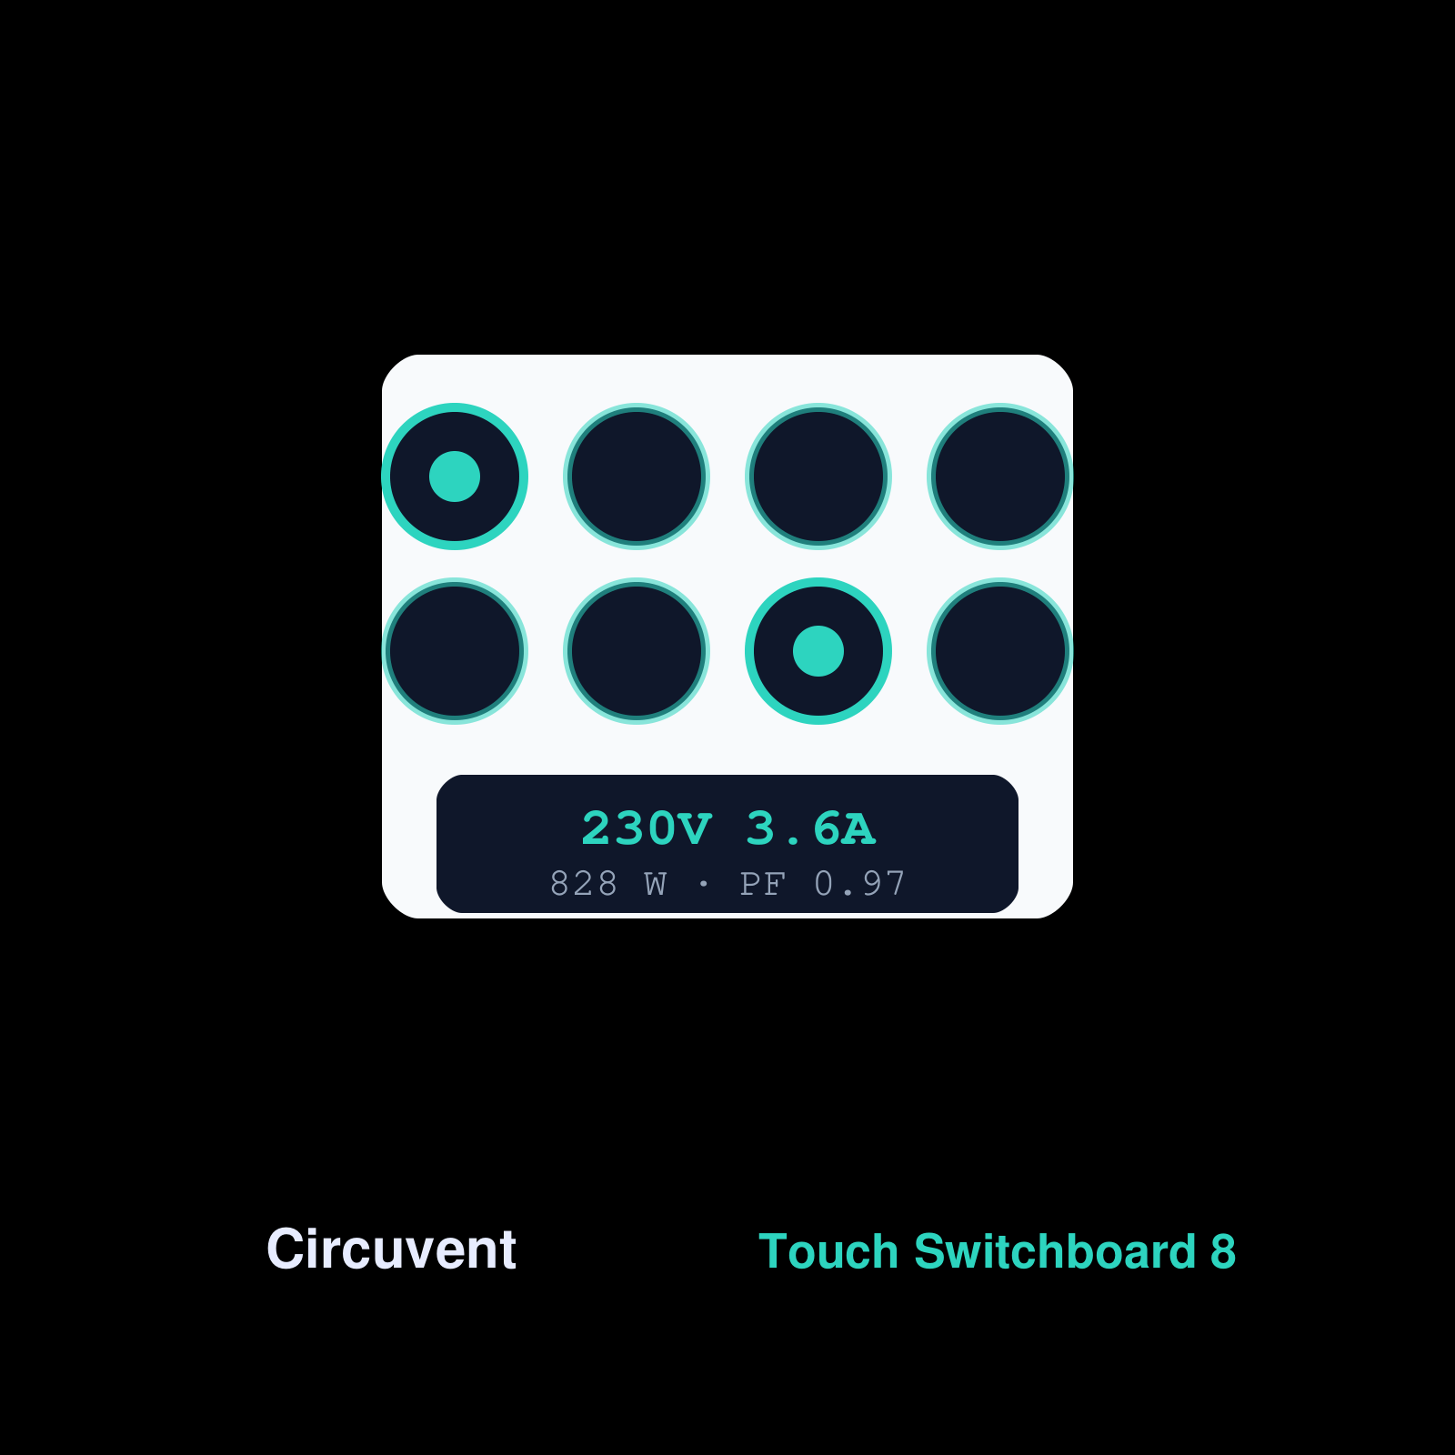
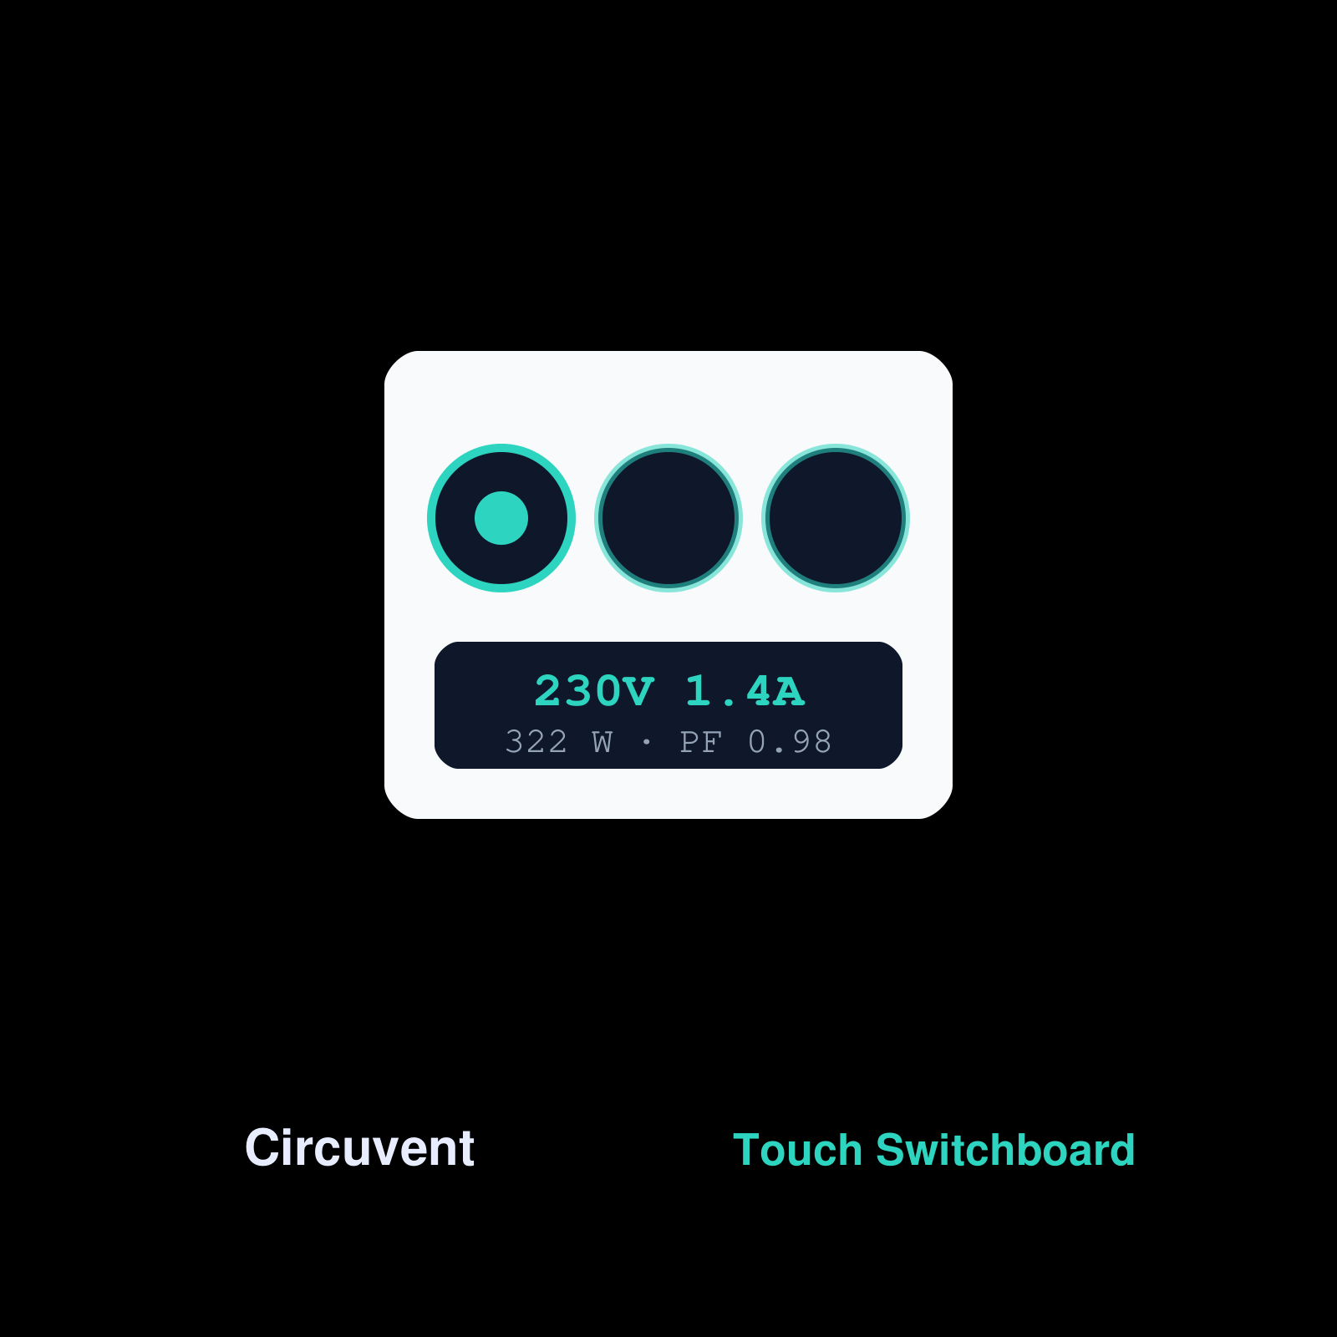
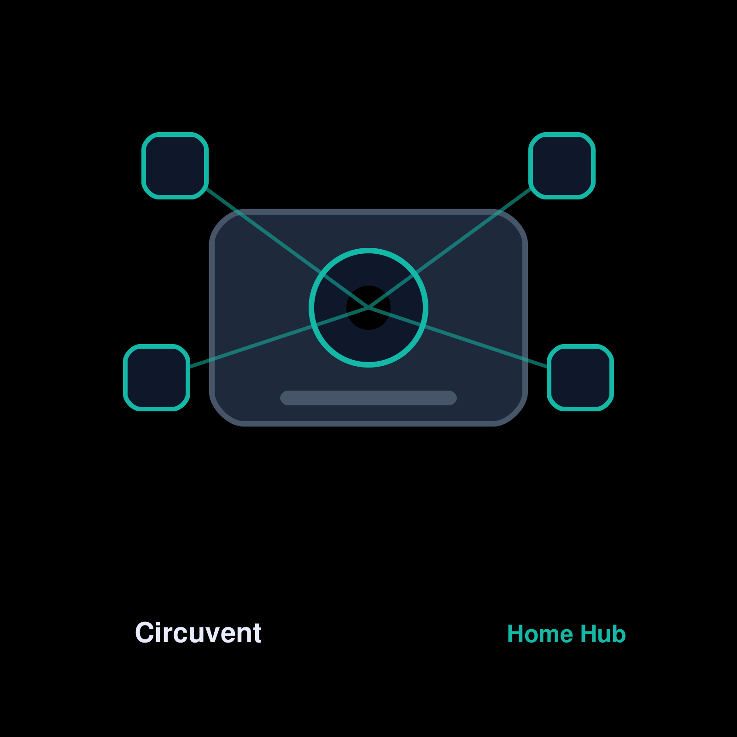
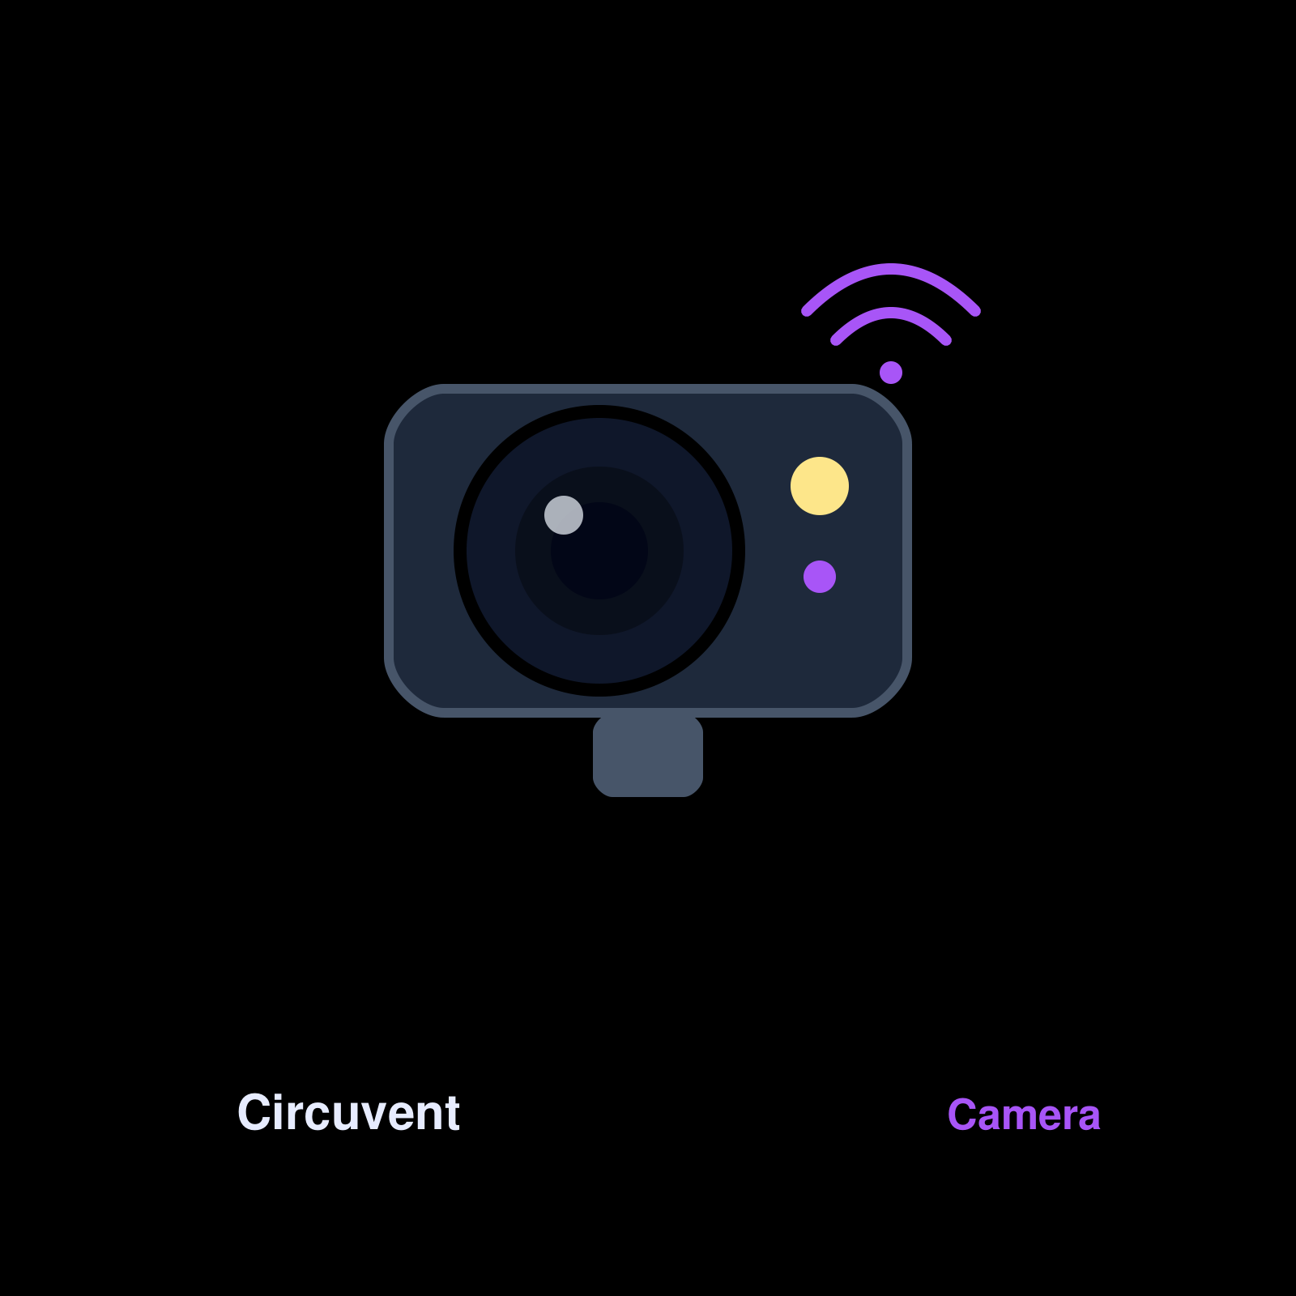
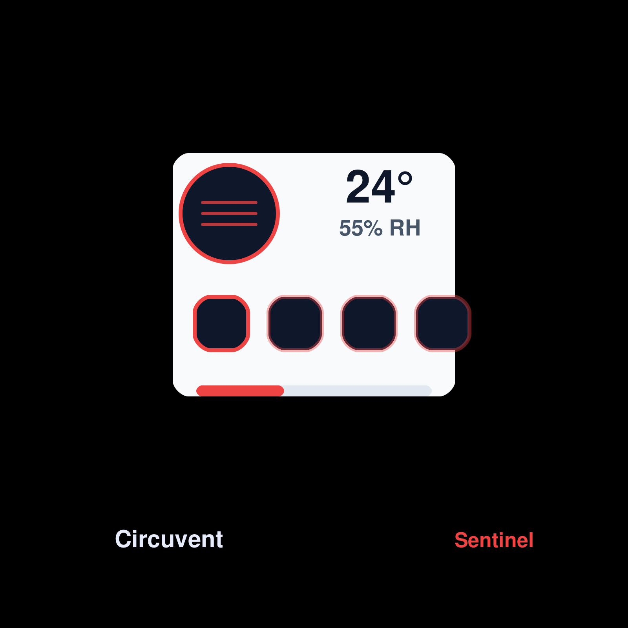
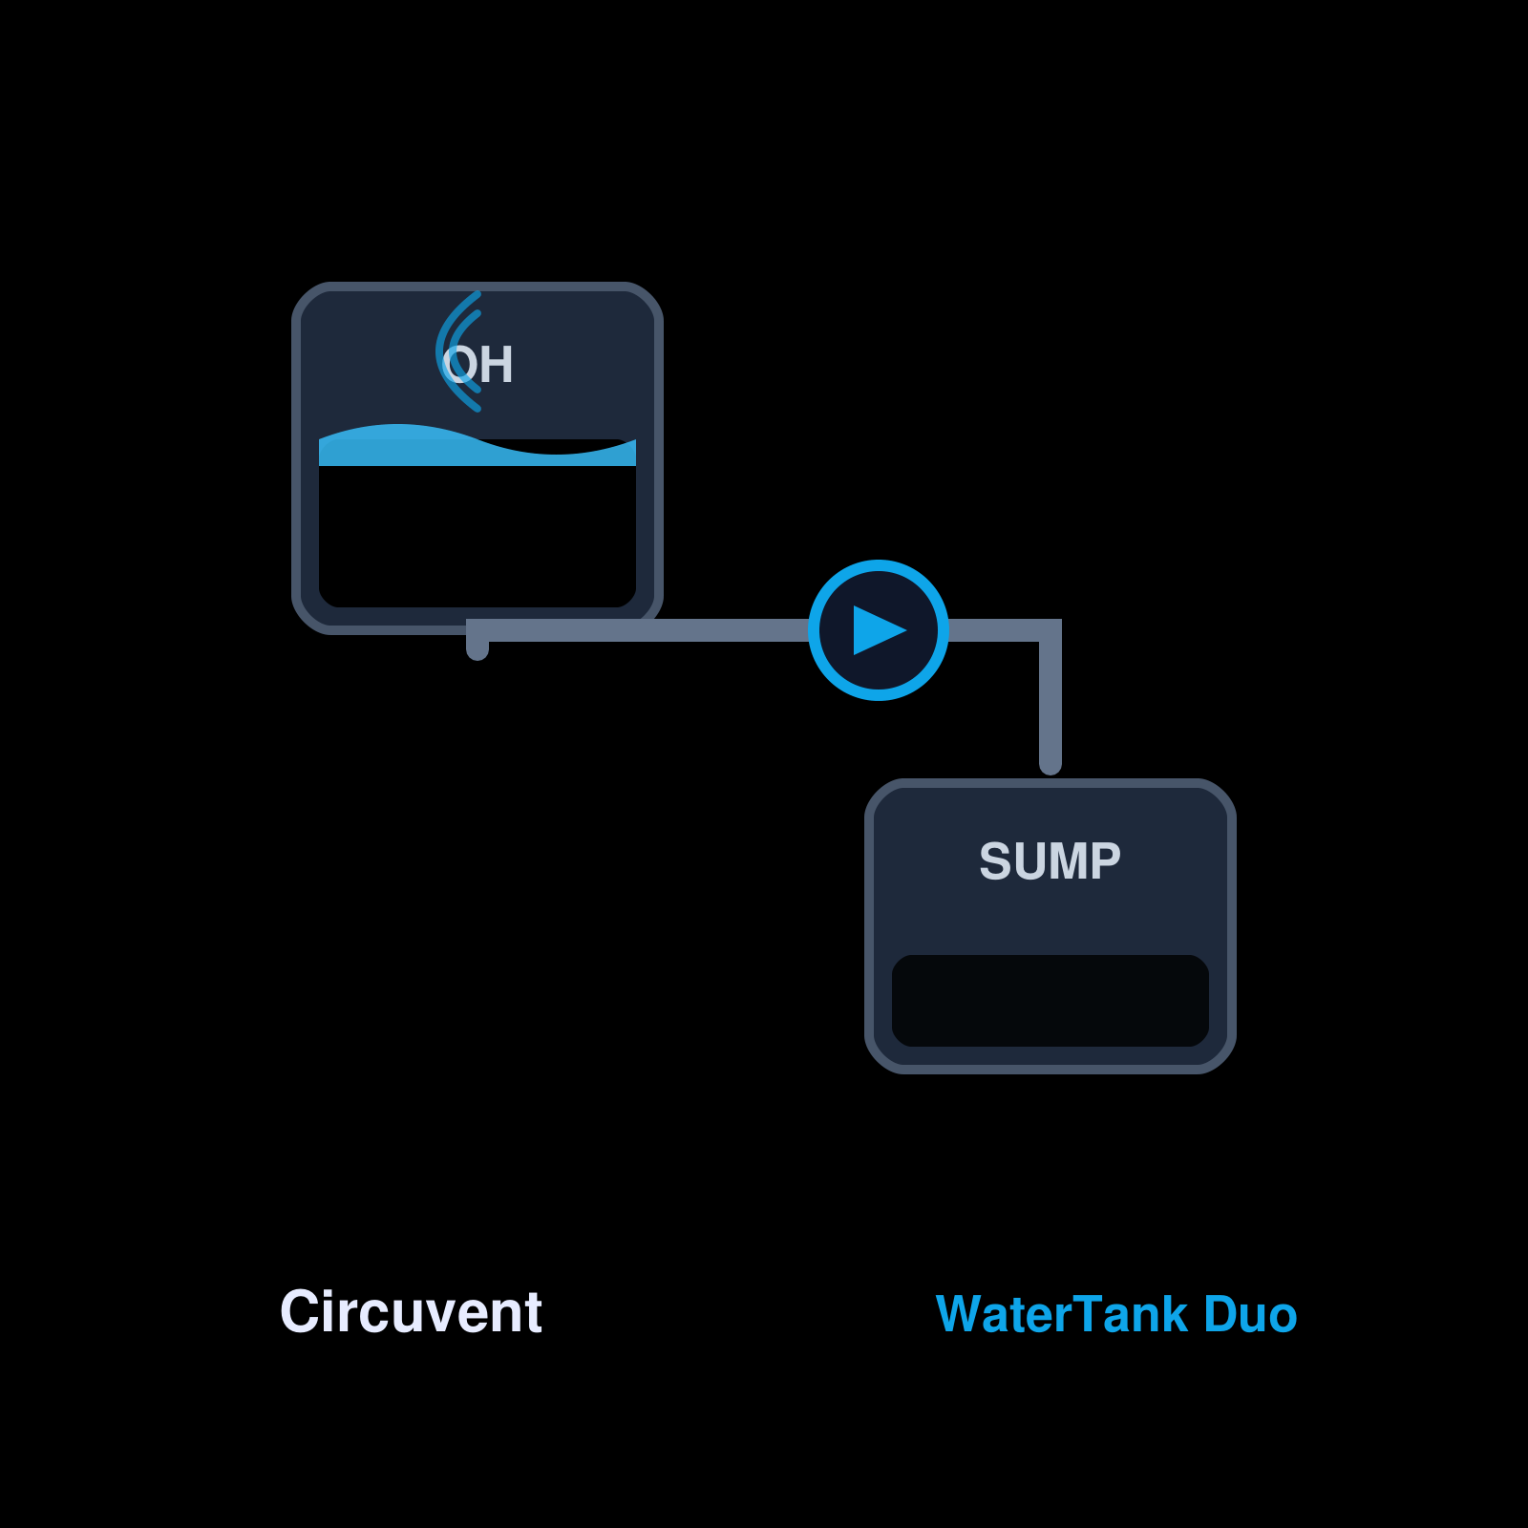
THE FLEET
24 device types ship from firmware/
Touch Board 8
Touch Board
Home Hub
Camera
Sentinel
WaterTank
Artwork is rasterised at build time from public/img, which scripts/gen-product-art.js owns. Nothing here is a screenshot that can go stale against the shop.
● Every one of these has a console control surface, a phone control surface and a command-map entry — tests/firmware-console-parity.test.ts fails the build if one is added without them.
● A device type touches roughly thirty files across four surfaces. Docs/07-adding-a-new-device.md is the checklist, and it names five failures that produce no error at all.
Circuvent Technologies · circuvent.com · contact@circuvent.com · +91 765 999 333 1
17

Slide 19
THE LOCAL BUS
Boards in one home talk directly
● ESP-NOW between boards: no router, no broker, single-digit milliseconds. A hall pad can switch a bedroom light with the broadband unplugged.
● Authenticated with a truncated HMAC-SHA512 keyed by a per-home secret, plus a per-sender rolling sequence. An ESP-NOW frame is broadcast into a building containing other people's flats.
● No home key means no local bus — never an unauthenticated one.
The hard part is the channel, not the radio
An ESP32 has one radio, and ESP-NOW transmits on whatever channel Wi-Fi is parked on. When the router dies each board starts scanning independently and they scatter across the band — so the local bus disintegrates during the outage it exists for. Boards now park on a fixed channel after 20s down, and all converge.
Circuvent Technologies · circuvent.com · contact@circuvent.com · +91 765 999 333 1
18

Slide 20
HOW THIS SYSTEM FAILS
Quietly, and while looking healthy
● A slider that cannot ask for what the hardware does — Camera fps capped at 15 in the app and 30 in the console while the firmware did 60. The device silently clamps, so nothing contradicts it.
● A field published and never read — otaStatus and wifiStatus were both broadcast for years. A camera mid-update rendered as a hardware fault telling somebody to reseat a ribbon cable.
● A control that reaches only part of what it claims — The view-density setting moved three padding steps out of six, so 46 sections ignored it.
● A job that fails closed and says nothing — Four crons returned 403 forever without CRON_SECRET and recorded nothing either way.
● A device that cannot be told anything — A gang in firmware with no entry in the console's field list is a switch on the wall that the app does not know exists.
Circuvent Technologies · circuvent.com · contact@circuvent.com · +91 765 999 333 1
19
Notes:
Every one of these shipped. None threw, none logged. This is why the codebase is full of parity tests between two files that must agree: they are the only thing that catches this class at all.

Slide 21
RECENT WORK
From the log, not from memory
Commit | What it did
999e5fe | Add an architecture and operations KT deck, generated from the tree
74ecb95 | Let the boards in a home talk to each other, and stop sending people to the wall
162d3ec | Add the 8-gang touch board, wired through every surface that has to know
9bf5ffb | Release 1.12.0 (22), and stop the console halving the camera's frame rate
811bbca | Fix cramped section headings by making all six padding steps density-aware
8aa7d0c | Ship the working tree: view settings, ICM durability, broker cert, PCBs
ab3e56c | Generate the engineering handover pack
ba3a4ef | The unattended sweep could never have run as documented
2081f26 | Set up the Vercel Workflow SDK, and exclude it from the proxy
7b7a7b1 | Unbreak the build: I committed somebody else's work in progress
d7df311 | The AI routes are deployed; the doc still said they 404
55fbe8a | Make it possible to find out whether the scheduled jobs run
Circuvent Technologies · circuvent.com · contact@circuvent.com · +91 765 999 333 1
20

Slide 22
If you change one thing here
● Regenerate this deck rather than editing a slide — it is built from the repository.
● Add a parity test whenever two files have to agree. That is what catches the silent class.
● Prove it by running it. A guard that has never failed is not a guard yet.
Generated 15 August 2026 from the repository at 999e5fe

