Slide 1
CLASSIFICATION OF: CIRRHOSIS LIVER DISEASE
HEMAKSHI JAIN
2023UCP1669
THIRD YEAR
MNIT JAIPUR

Slide 2
OBJECTIVE
Use various AI and ML techniques to classify the the images of cirrhosis liver into class 1,2 and 3 that is mild,moderate and severe.

Slide 3
DATASET
Original Dataset:
CirrMRI600+ dataset comprises 628 abdominal MRI scans (310 T1-weighted (T1W) and 318 T2-weighted (T2W)) volumetric scans along with corresponding segmentation masks annotated by physicians.
CirrMRI600+ is a single-center, multivendor, and multisequence dataset.
Dataset Used In The Study:
Used only T2 scan for the study
Arranged all the images in folders according to the labels given in the metadata.
Did not include the information of patient whose label was missing.
Link of dataset → https://arxiv.org/abs/2502.18225

Slide 4
DATASET:PATIENT WISE
LABEL | NUMBER OF PATIENTS
1 | 128
2 | 113
3 | 72
DATASET | LABEL | PATIENT NUMBER
TRAINING DATASET | 1 | 99
 | 2 | 98
 | 3 | 54
VALIDATION DATASET | 1 | 13
 | 2 | 9
 | 3 | 9
TESTING DATASET | 1 | 16
 | 2 | 6
 | 3 | 9

Slide 5
What Have We Done Till Now?
USED various state of art models such as googlenet,vggnet,resnet,etc ;used attention mechanism and transformer to improve accuracy

Slide 6
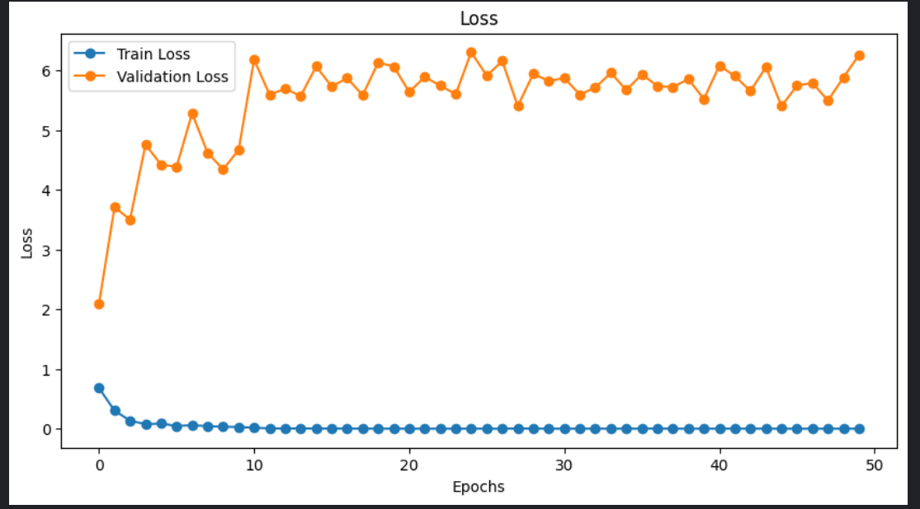
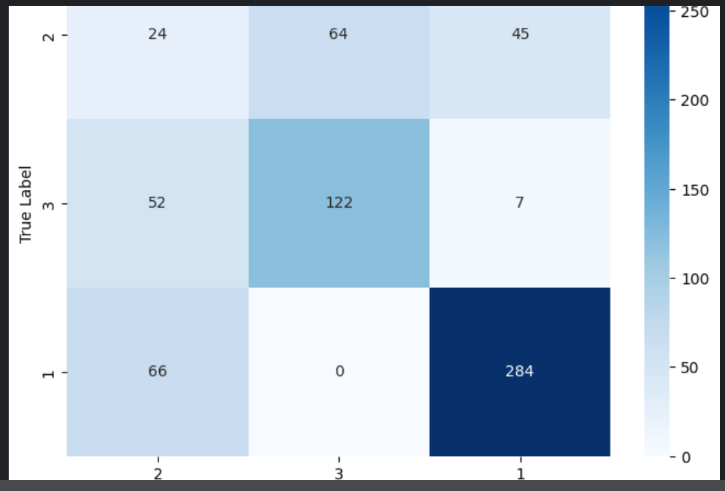
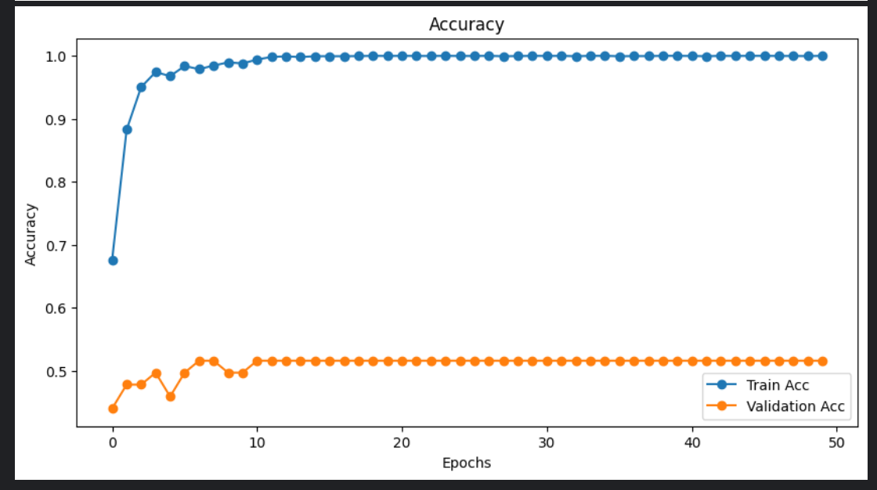
RESULTS
REPORT
The highest accuracy 64.76% was achieved using Densenet121 and spatial attention.

Slide 7
PROBLEM
The main issue is with images of class 2 resemble a lot with the images of class 3.

Slide 8
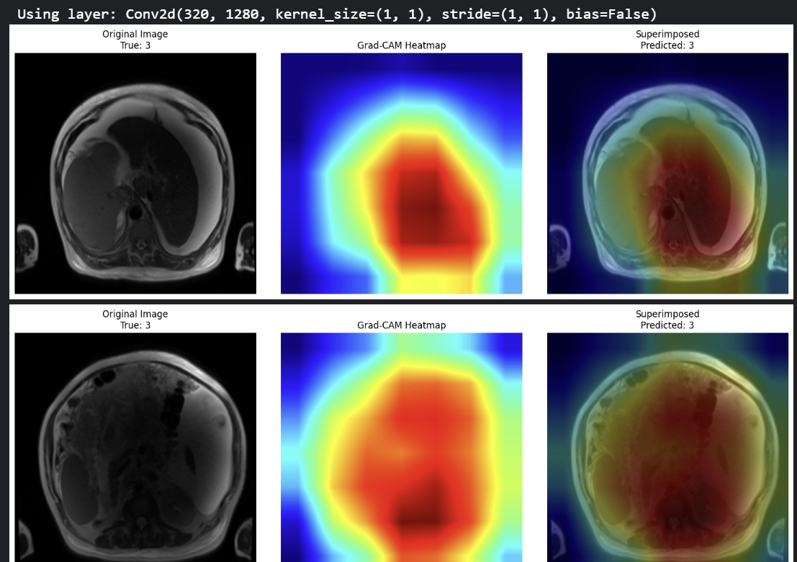
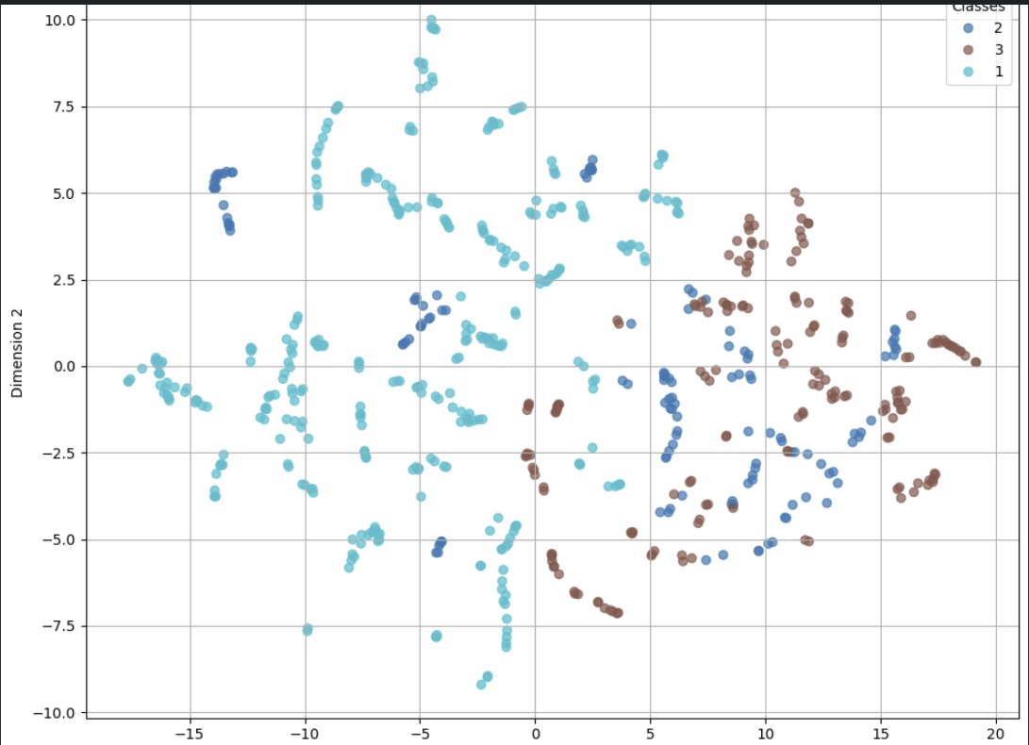
RESULTS WITH MOBILENETV2
Images produced by grad cam
T-sne

Slide 9
END

